Slide 1

GPGPU-Accelerated Construction of
High-Resolution Generalized Voronoi Diagrams and Navigation Meshes
Rudi Bonfiglioli
Textkernel
Wouter van Toll
Utrecht University
Roland Geraerts
Utrecht University
Motion in Games 2014

Slide 2
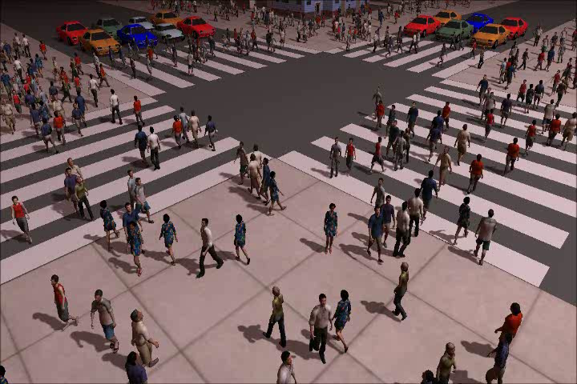
Motivation
Crowd simulation

Slide 3
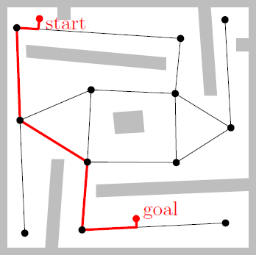
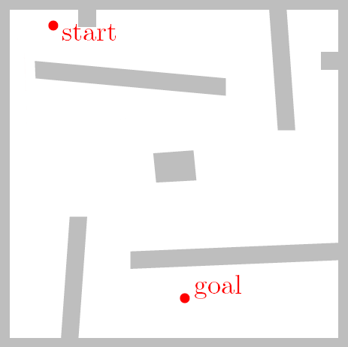
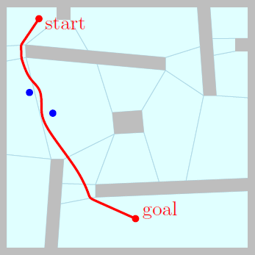
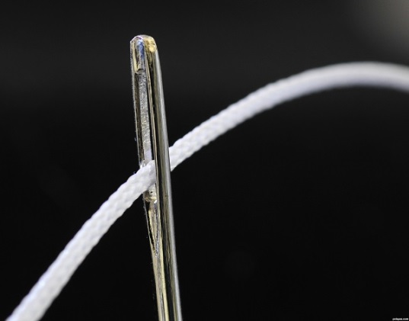
Motivation
Path planning for 1 agent
Navigation graph
  Not flexible enough for crowds
Navigation mesh
  Global path: sequence of polygons
  Local planning during movement
  Common in modern games / simulations
Large, complex environments
  High precision is required
  High speed is preferred
  In this paper, we improve both

Slide 4
Overview
Our navigation mesh: ECM
  Based on the Generalized Voronoi Diagram
GPGPU-enhanced GVD/ECM construction
  Original algorithm
  Improvements
  Multi-tiled extension
Results
Conclusions / Discussion

Slide 5
Our navigation mesh

Slide 6
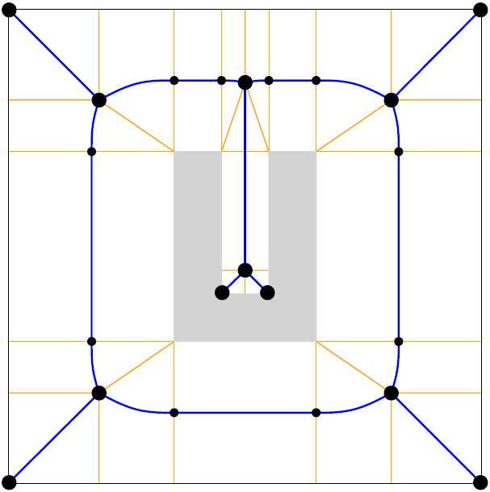
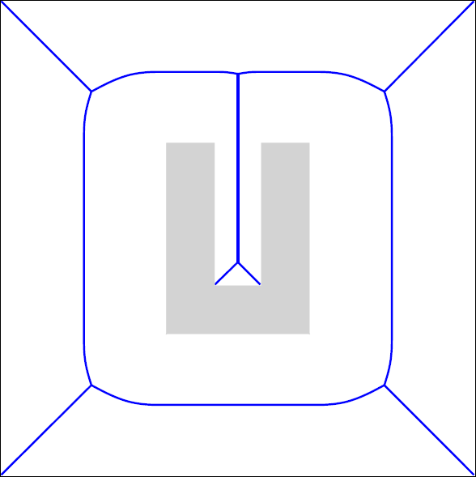

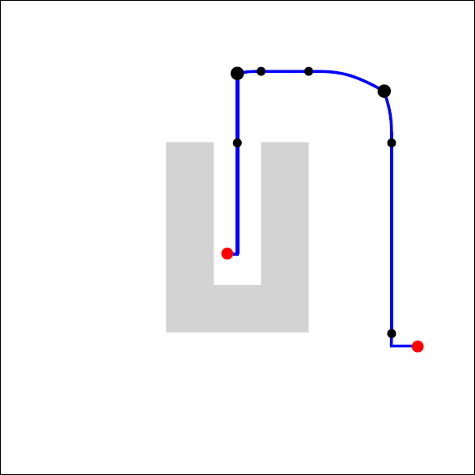
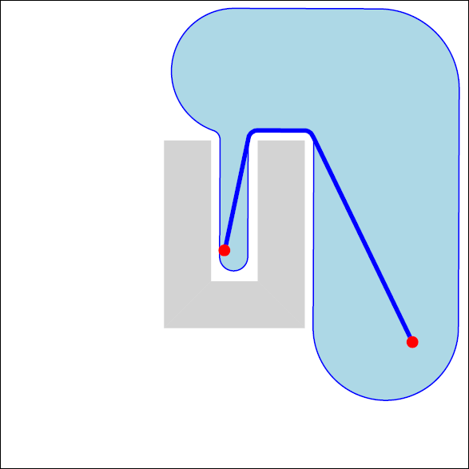
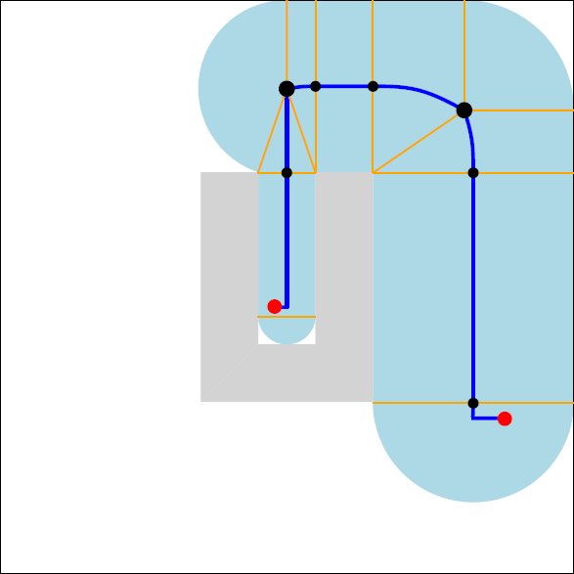


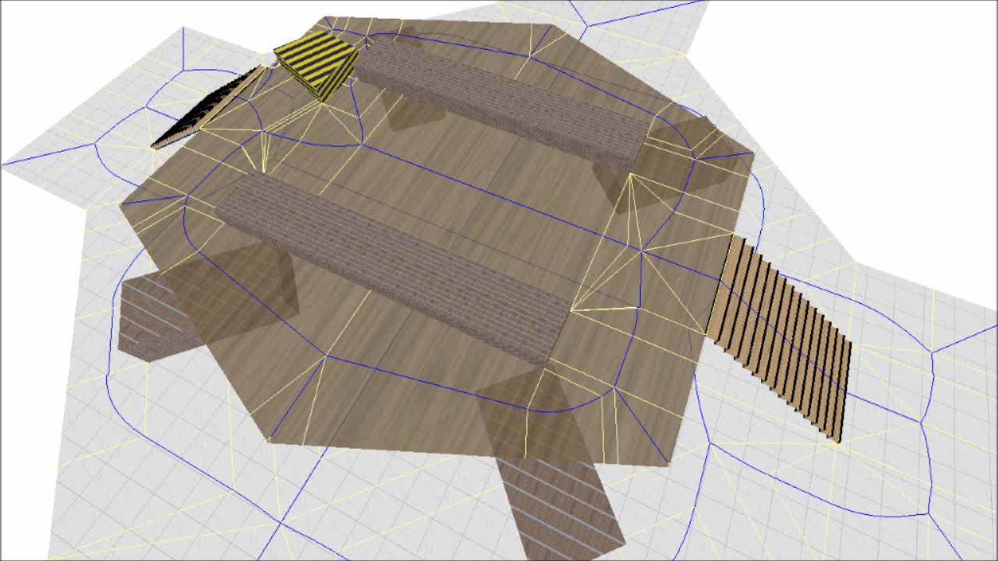
Explicit Corridor Map
An exact and flexible navigation mesh
  Medial axis (pruned GVD)
  Closest-obstacle annotations
  Clearance is known everywhere
  → supports all character sizes
  A* → path + corridor
  Short paths with clearance
  Collision avoidance
  Multi-layered environments
  Dynamic updates

Slide 7
GPGPU-Enhanced GVD

Slide 8

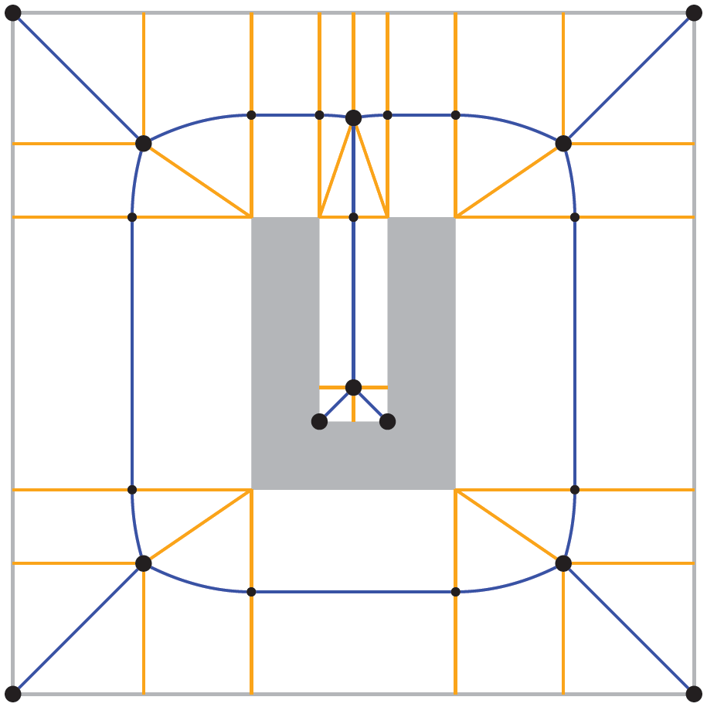
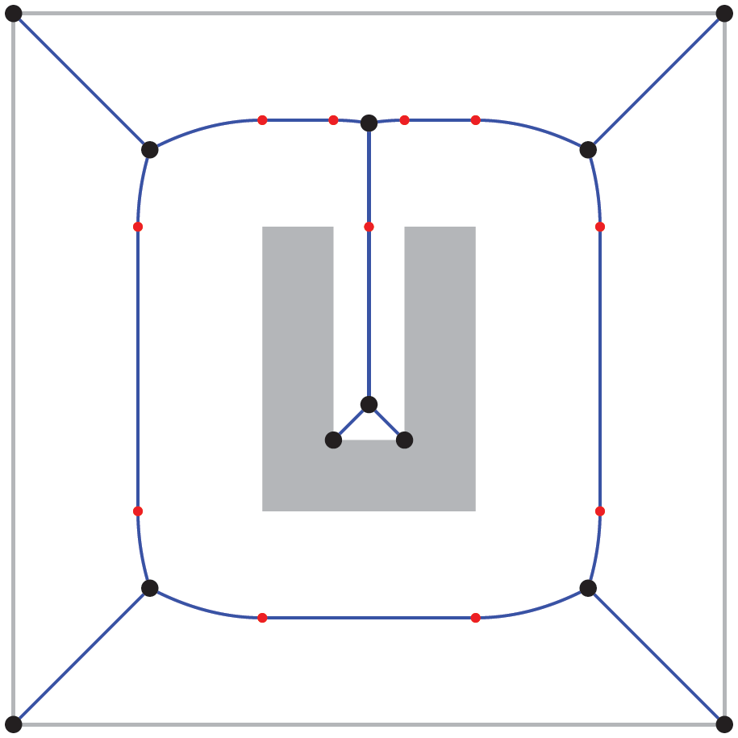
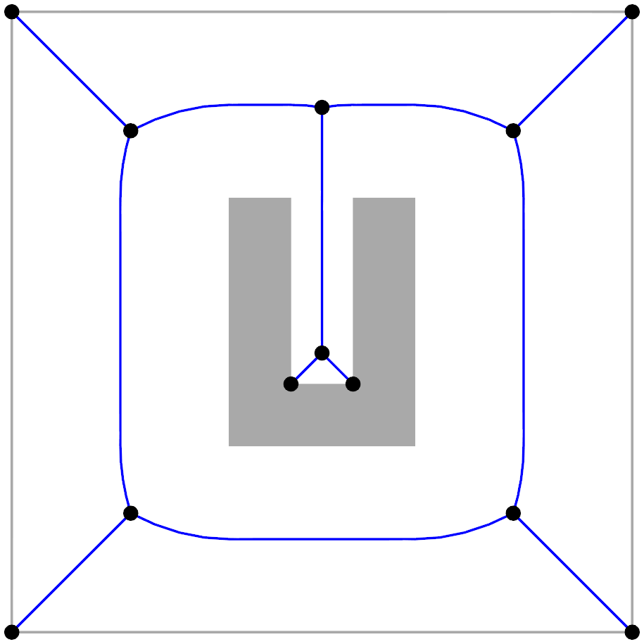

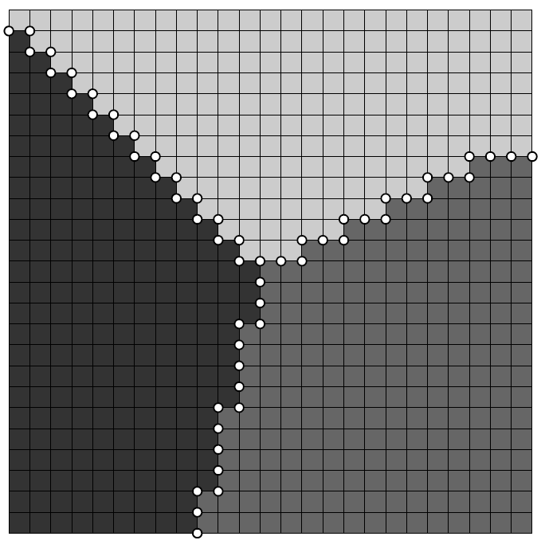
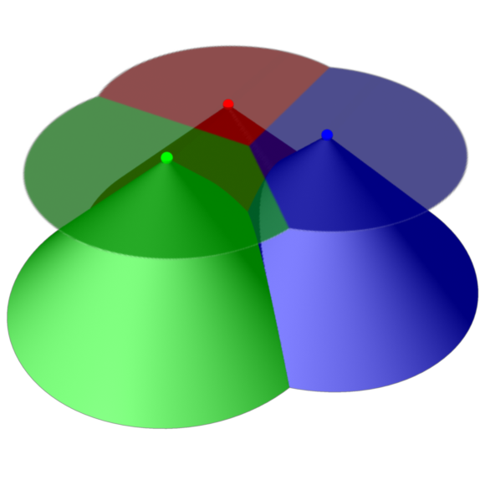
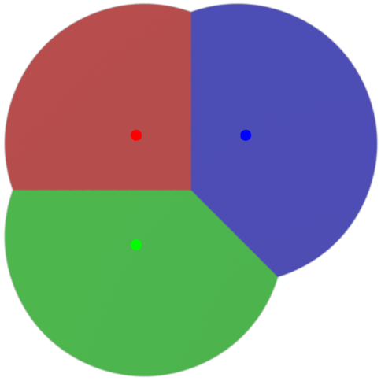
GVD / ECM by rendering
Based on Hoff et al. (1999)
GPU
CPU
color buffer data
Render
distance meshes
Find relevant
pixels
GVD
Compute
normals
Assign normals
to pixels
Find
event points
Compute CPs
ECM

Slide 9
Move work to the GPU
  Less copying
  More parallel computations
GPU
CPU
color buffer data
Render
distance meshes
partial color buffer data
Find relevant
pixels
GVD
Find relevant
pixels
Compute
normals
Assign normals
to pixels
Compute
normals
Assign normals
to pixels
Find
event points
Compute CPs
Compute CPs
ECM

Slide 10
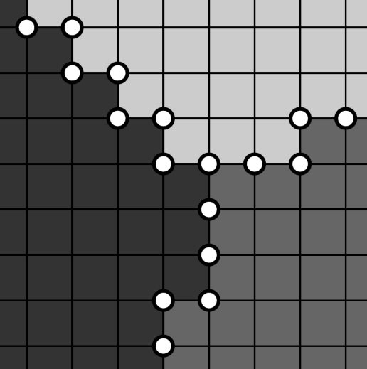
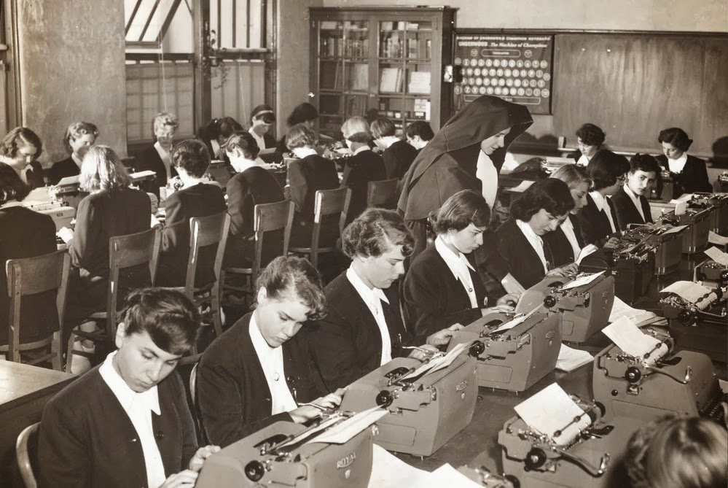
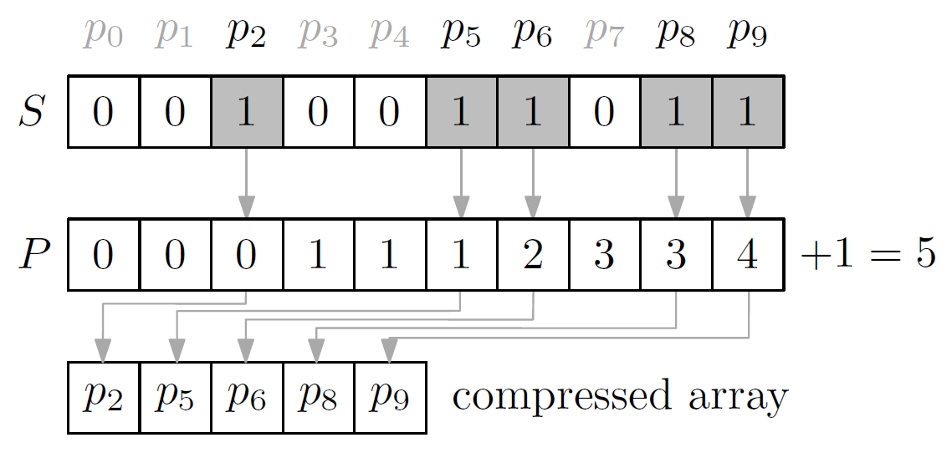
Some details
GPU is good at SIMT
  Single instruction, multiple threads
  “Doing a simple thing massively parallel”
Find relevant pixels
  2 colors = potential edge point
  3,4 colors = potential vertex
  Marker buffers: 000011110100111001000
  Compression: prefix sum
Closest points & normals
  For all relevant pixels,
  check all 2/3/4 nearest obstacles
  Some redundant work, but faster
  than checking if it’s needed

Slide 11
Multi-tiled extension

Slide 12
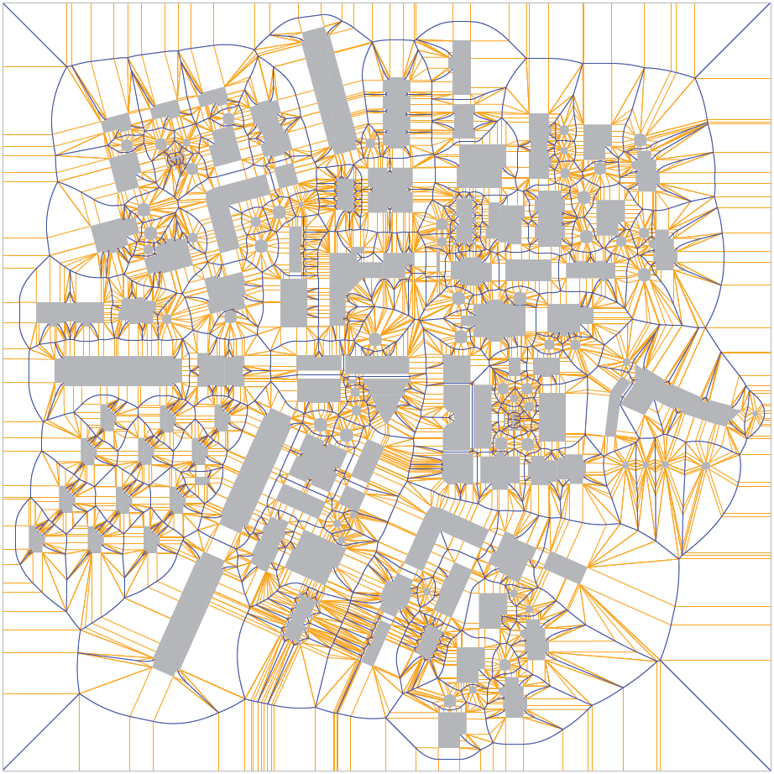
Multi-tiled extension
Large environments need high resolutions
  Split into tiles; size = framebuffer size

Slide 13
Multi-tiled: old style
GPU
color buffer data
CPU
Render
distance meshes
Find relevant
pixels
limited
Per tile
Compute
normals
Assign normals
to pixels
Find
event points
Compute CPs
ECM

Slide 14
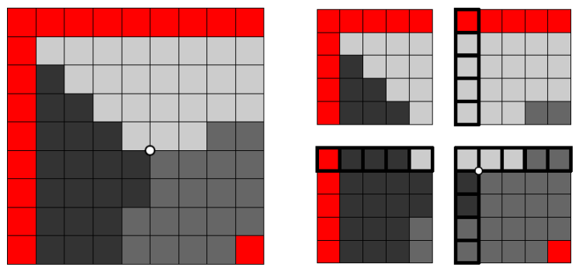
Multi-tiled: new style
GPU
CPU
Render
distance meshes
Find
event points
Find relevant
pixels
Partial ECM
Per tile
Compute
normals
Assign normals
to pixels
Compute CPs
ECM

Slide 15
Results

Slide 16
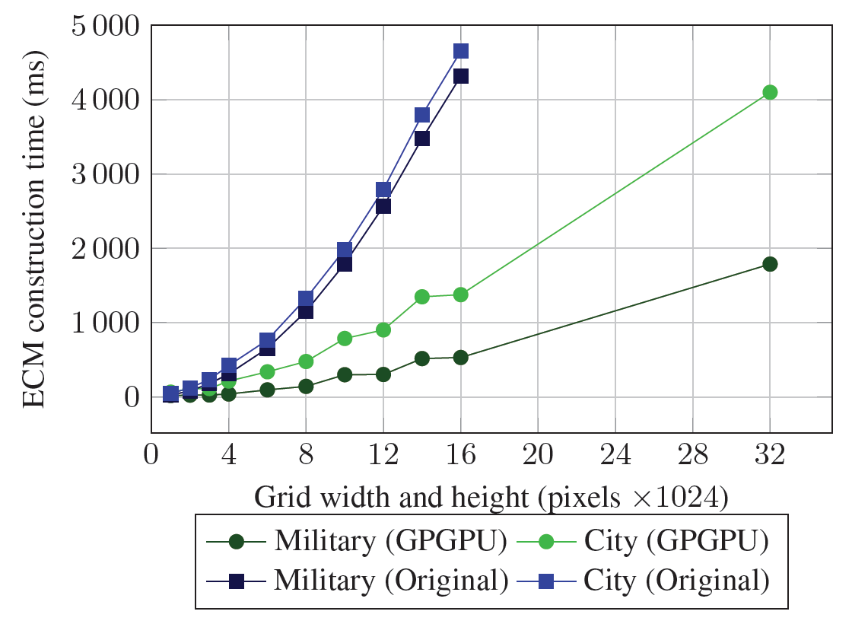
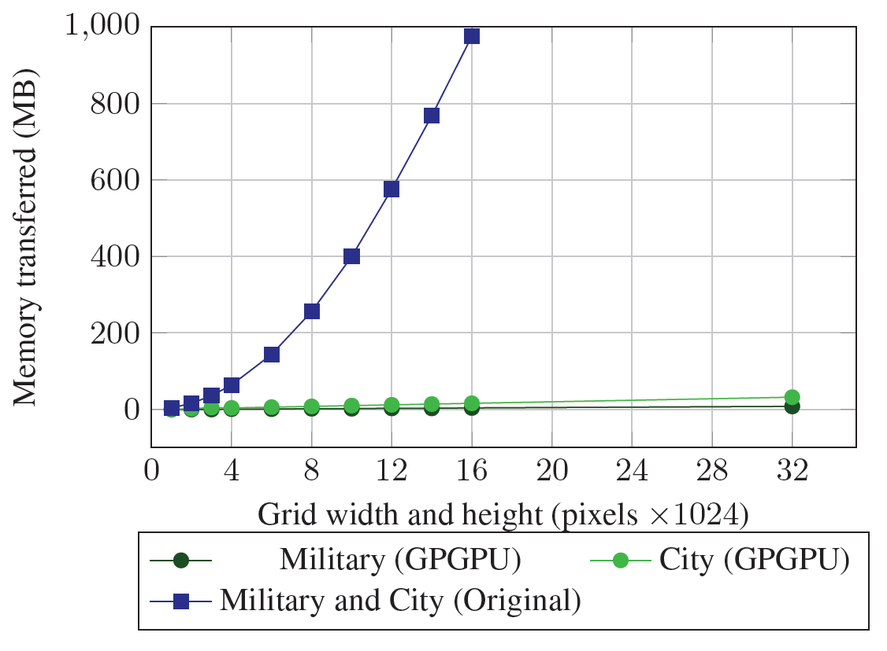
Improvements
  Faster construction of ECMs
  Less memory transferred
  Resolutions that used to be impossible

Slide 17
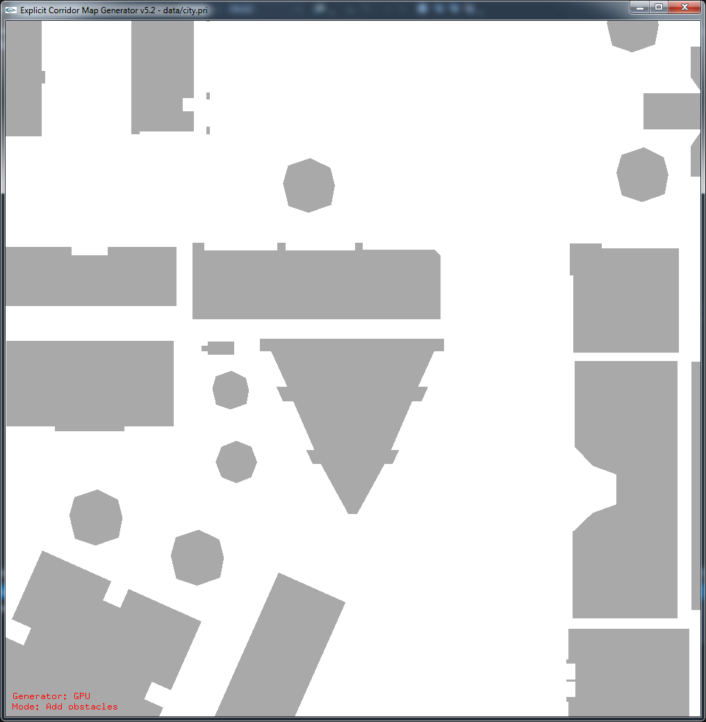
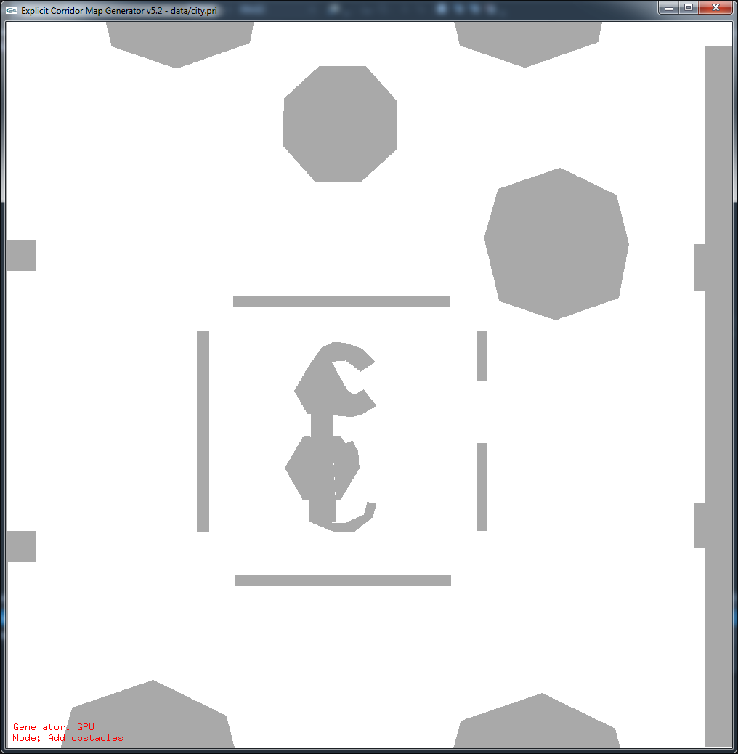
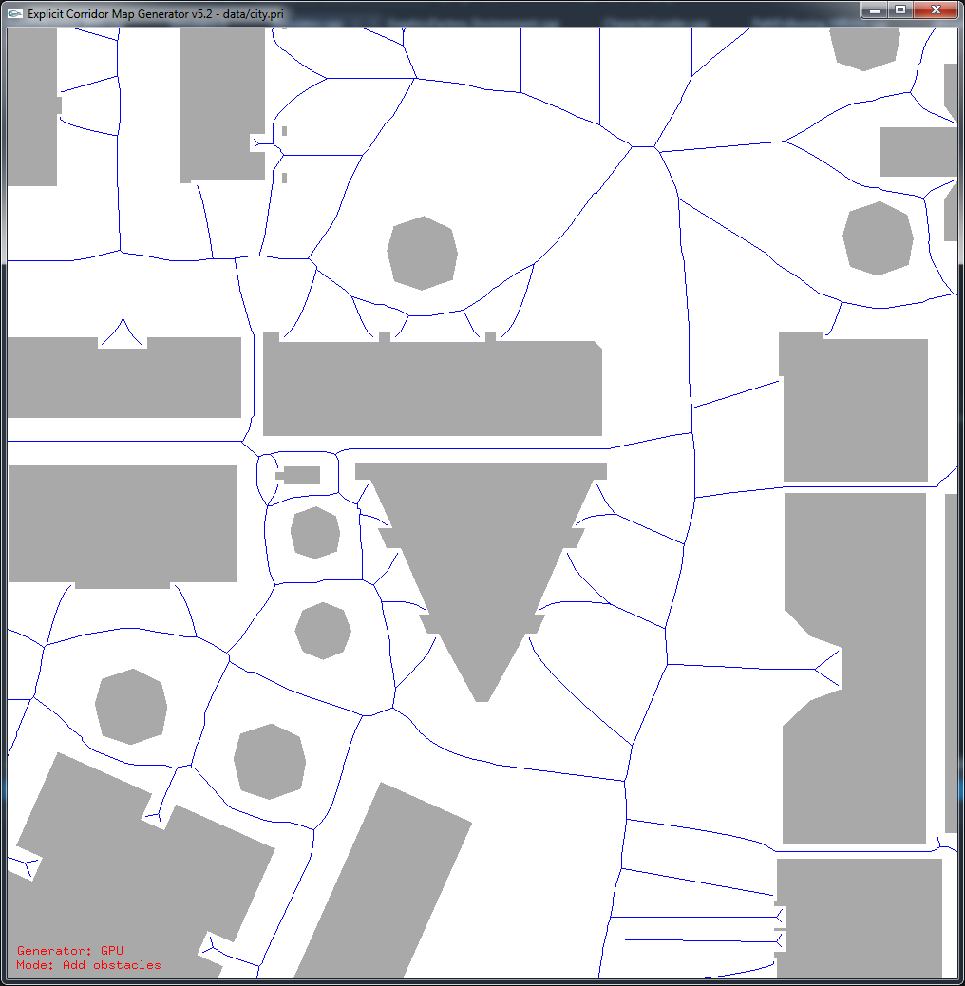



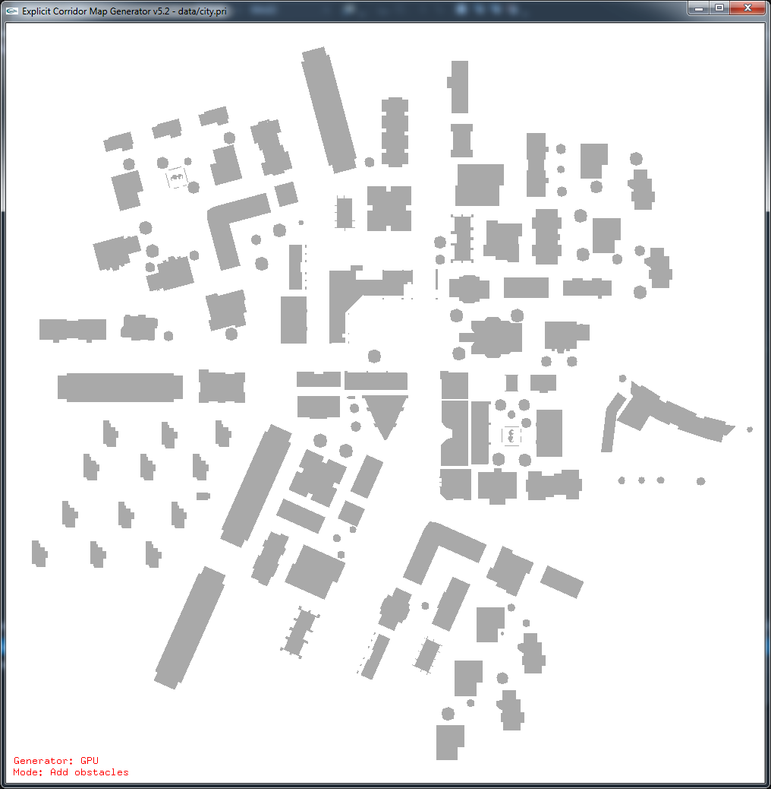
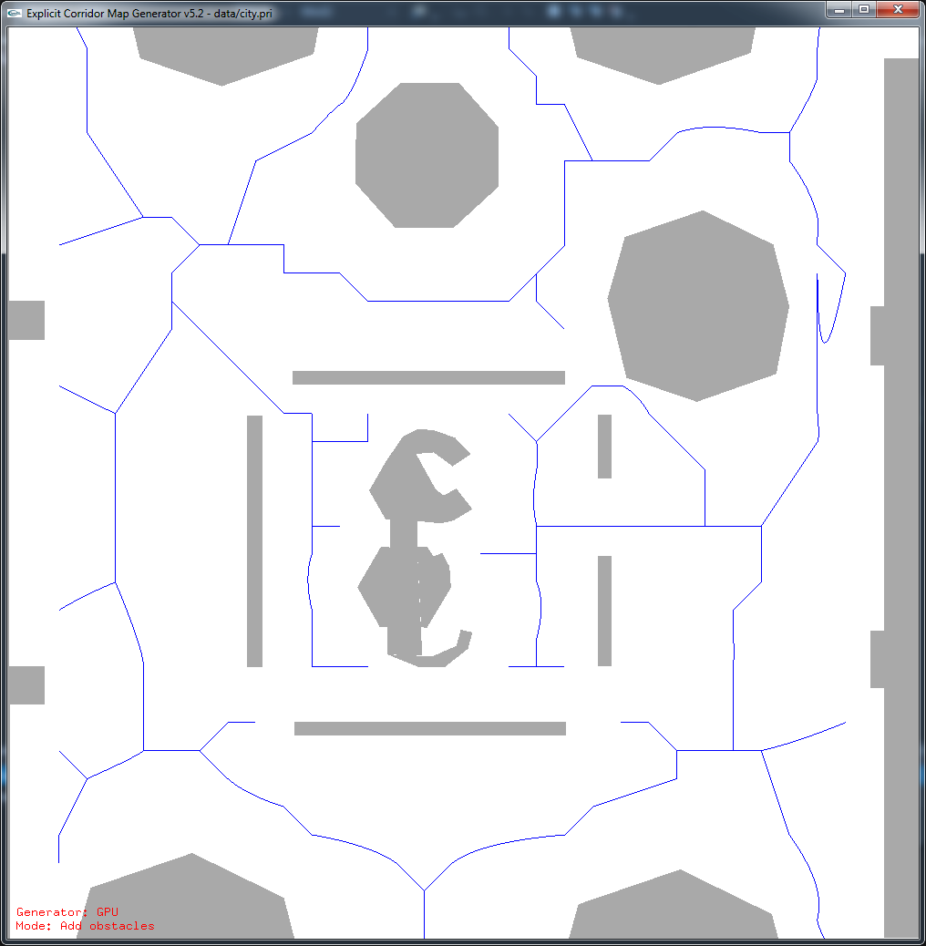
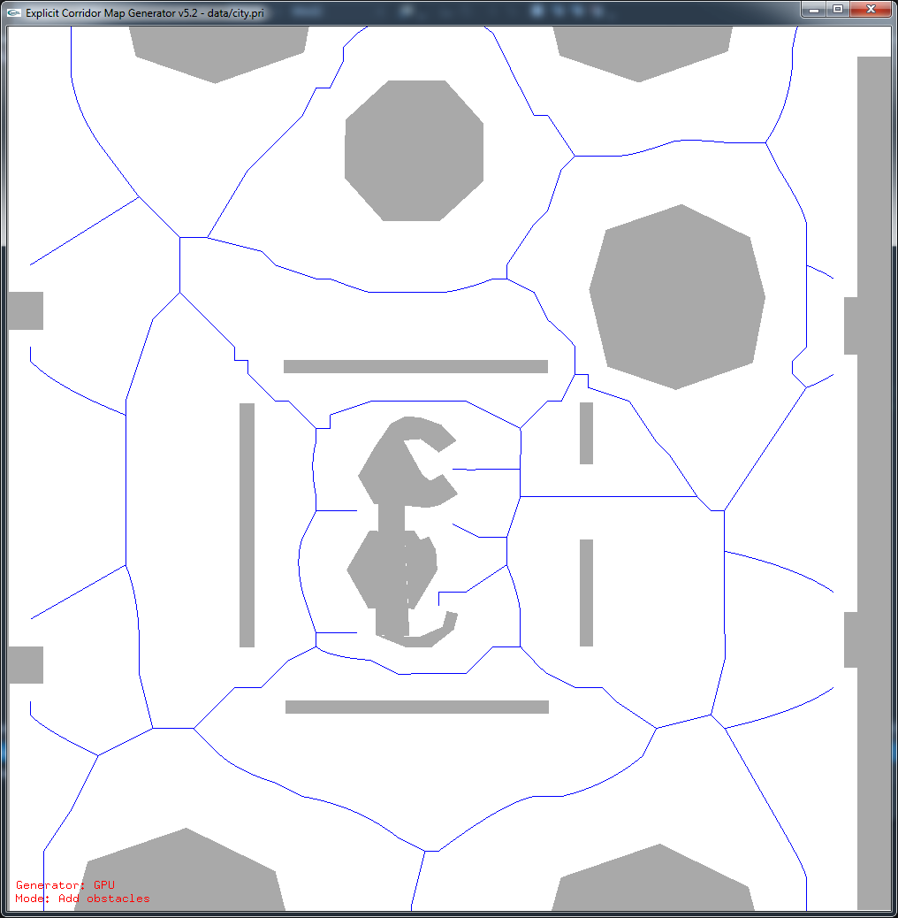


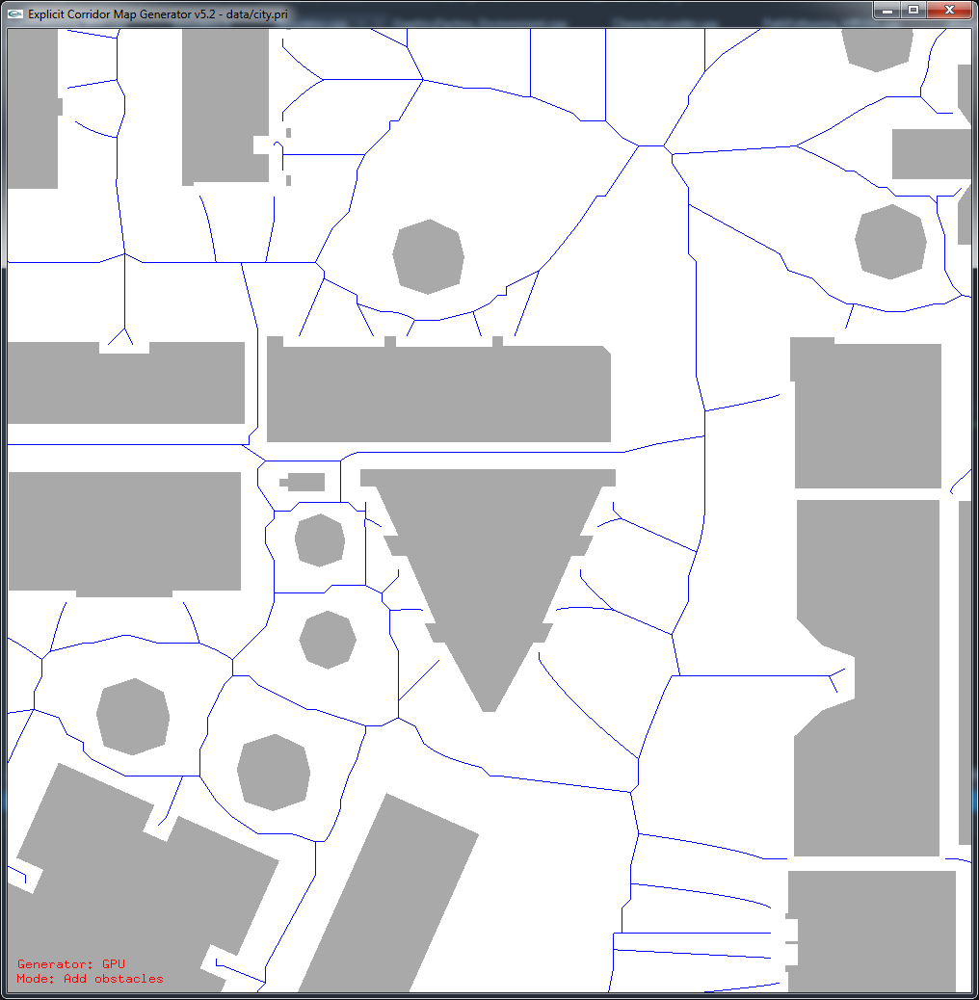

High resolutions reduce errors
10000x10000
3000x3000
1500x1500
5000x5000
500x500

Slide 18
Conclusions

Slide 19
Conclusions
ECM: flexible navigation mesh
  Based on the medial axis / GVD
  Can be computed using rendering
GPGPU enhancements
  Highly parallel computing
  Less memory transferred
  Much higher resolutions

Slide 20
Discussion / Future work
More technical improvements?
“Perfect resolution” is unknown
Exact methods are getting better, too
  VRONI
  Boost
  CGAL?

Slide 21


Thank you
Contact info
  W.G.vanToll@uu.nl
  http://www.uu.nl/staff/WGvanToll/

