Slide 1




A Comparative Study of Navigation Meshes
.
Motion in Games 2016
Wouter van Toll¹
Roy Triesscheijn¹
Marcelo Kallmann²
Ramon Oliva³
Nuria Pelechano³
Julien Pettré⁴
Roland Geraerts¹
1
2
3
4

Slide 2
Introduction
Motivation for a comparative study

Slide 3
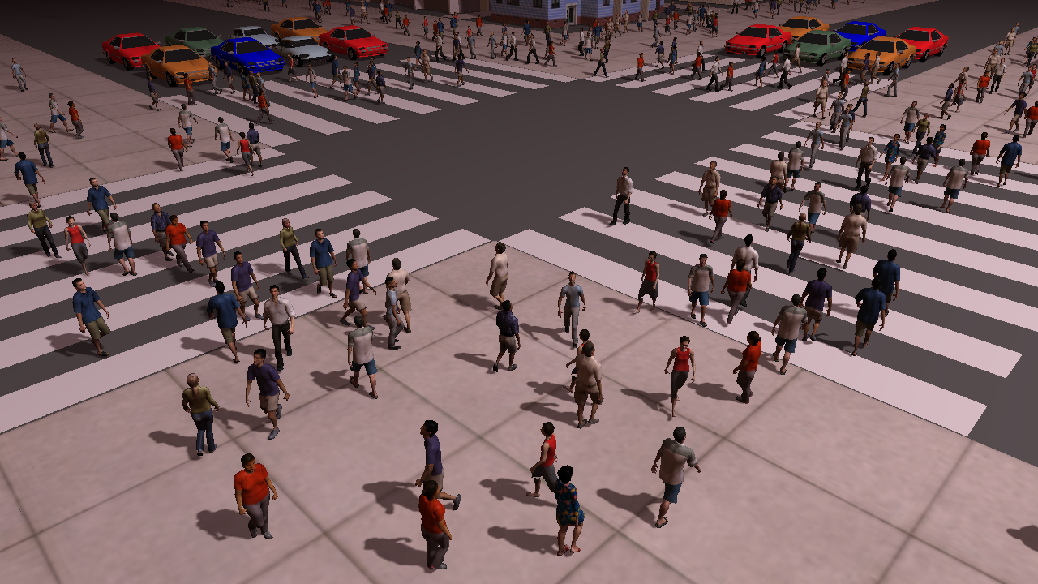
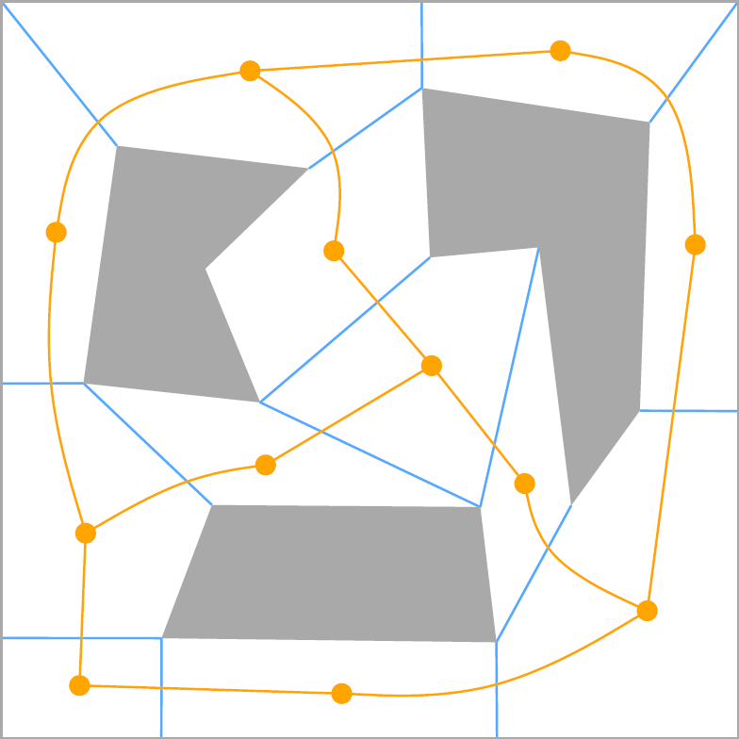
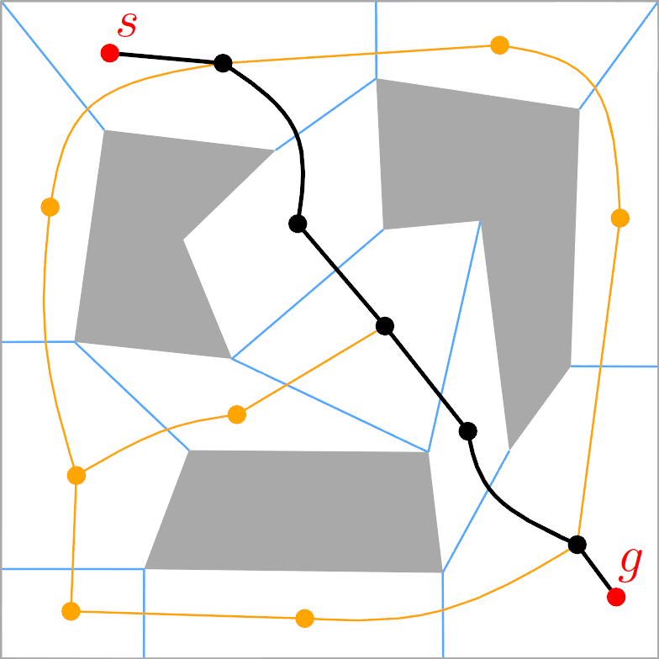
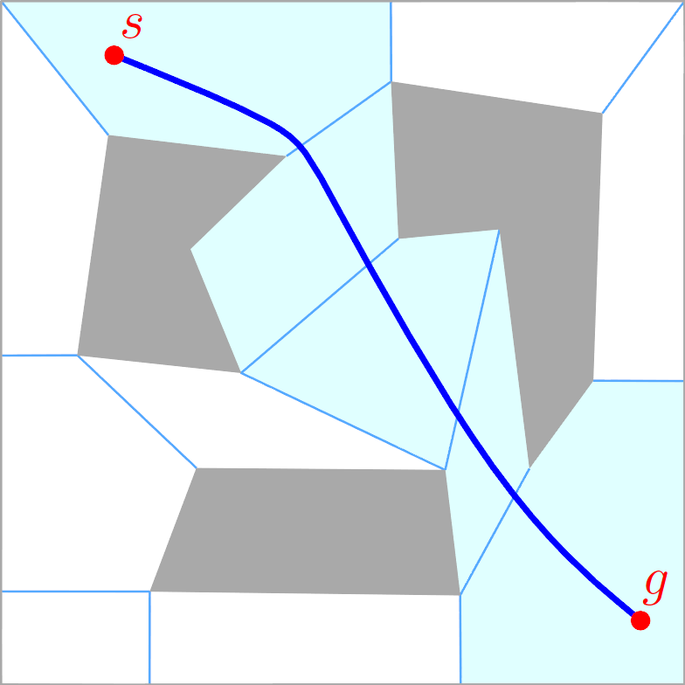
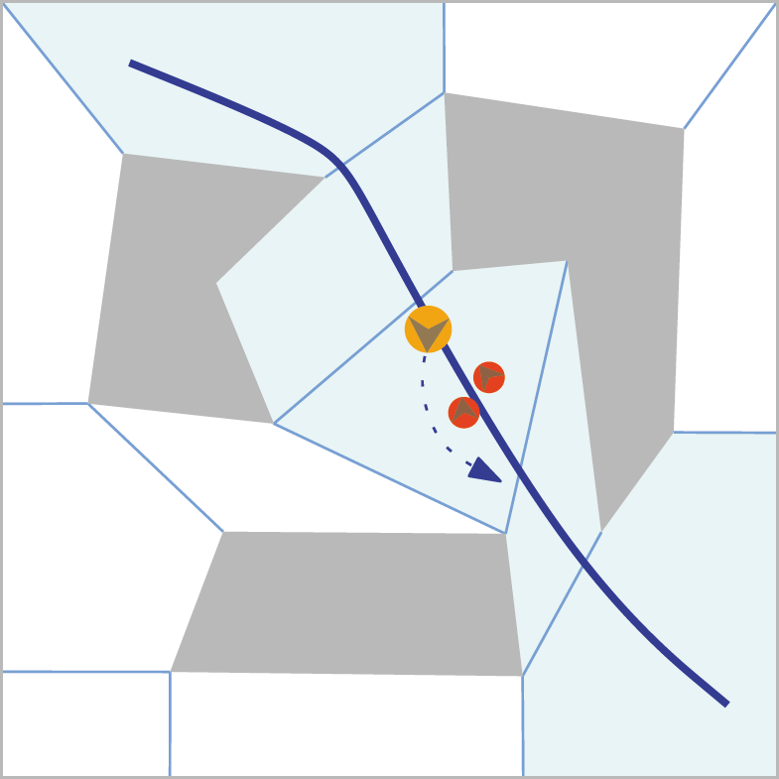
Navigation Meshes 101
Path planning for characters in virtual environments
  Many characters: crowd simulation
Games: real-time performance
  → Requires efficient data structures
Navigation mesh
  Environment representation
  for path planning purposes
  Geometric regions
  Path planning in (dual) graph
  Path → indicative route
  Flexibility for local movement

Slide 4
State of the Art
Many navigation meshes have been developed
  Automatic construction for 2D/3D environments
Different papers...
  ...use different assumptions about the input
  ...may have different applications in mind
  ...use different environments, hardware, settings, etc.
How “good” is a navigation mesh?
Where should research go next?

Slide 5
Comparative Study
Successful benchmarking in related areas
  Grid-based path planning [Sturtevant 2012]
  Collision avoidance [Singh et al. 2009]
Time to do it for navmeshes as well
  Set a standard for evaluation / comparison
  Gain insight in (dis)advantages of each method
  Steer future research

Slide 6
Definitions
Environments and navigation meshes

Slide 7
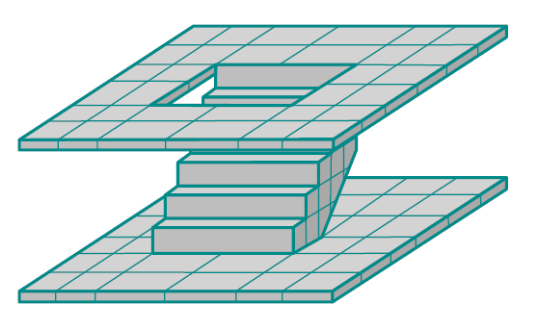
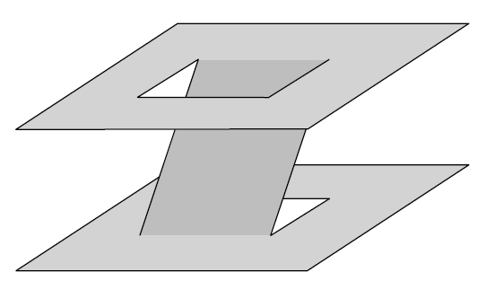
Environments (1/2)
3D environment (3DE)
  Raw collection of polygons: floors, walls, staircases, ...
  Assuming a common gravity direction / ground plane P
Walkable environment (WE)
  Polygons in 3D on which characters can walk
  Free space E_{free} of a 3DE based on parameters
    Character height, maximum slope w.r.t. P, ...

Slide 8
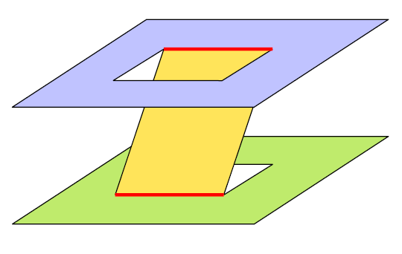
Environments (2/2)
Multi-layered environment (MLE)
  Subdivision of a WE into layers {L₀, L₁, ...}
  Each L_{i} can be projected onto P without overlap
2D environment (2DE)
  Polygons in 2D on which characters can walk
  2DE embedded in 3D == MLE with one layer
Next presentation

Slide 9
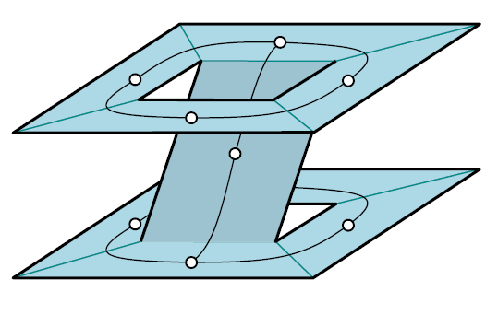
Navigation Mesh
Navigation mesh
  R = {R₀, R₁, ...} = regions in 3D that represent E_{free}
  G = (V,E) = graph that describes how to move between regions
  Often, G is the dual graph of R
Two types of construction algorithms
Voxel-based
Exact

Slide 10
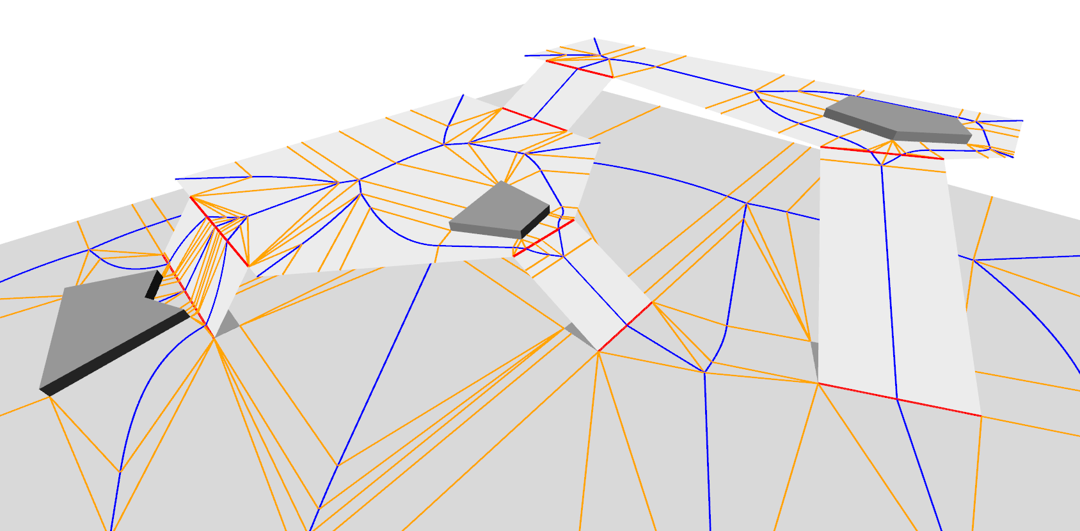
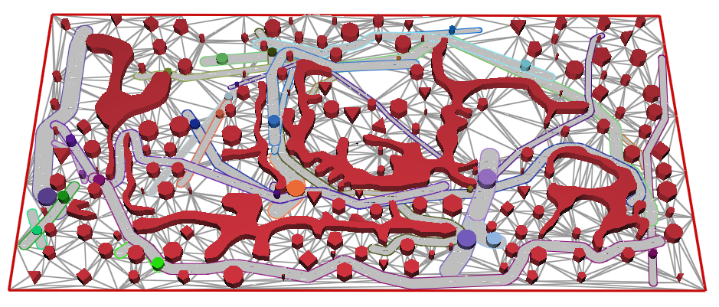
Featured Navigation Meshes (1/2)
Exact
  Local Clearance Triangulation (LCT) [Kallmann 2014]
  Explicit Corridor Map (ECM) [van Toll et al. 2011]
The Explicit Corridor Map: Using the Medial Axis for Real-Time Path Planning and Crowd Simulation
W. van Toll, A.F. Cook IV, M.J. van Kreveld, R. Geraerts
Computational Geometry Multimedia Exposition 2016
Dynamic and Robust Local Clearance Triangulations
M. Kallmann
ACM ToG, 2014

Slide 11
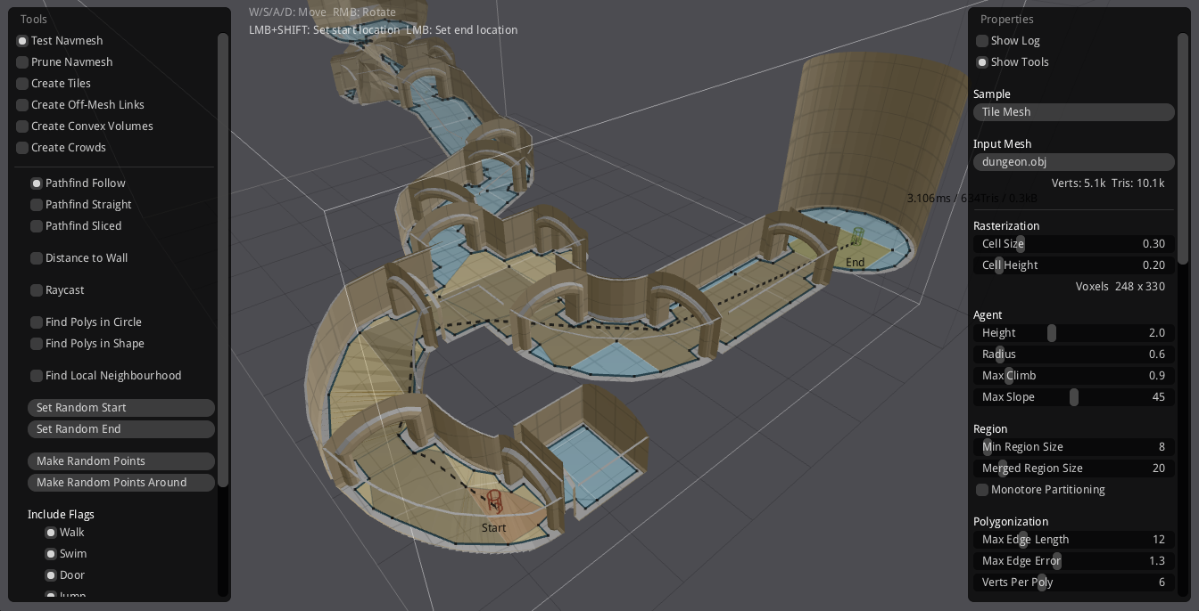
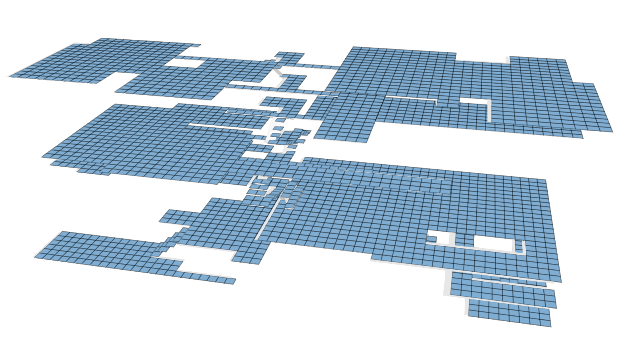
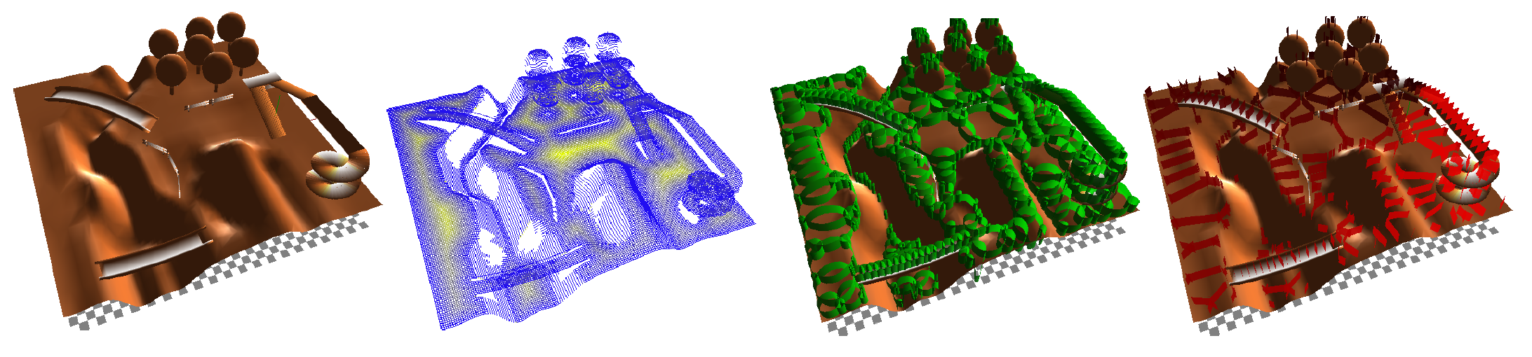
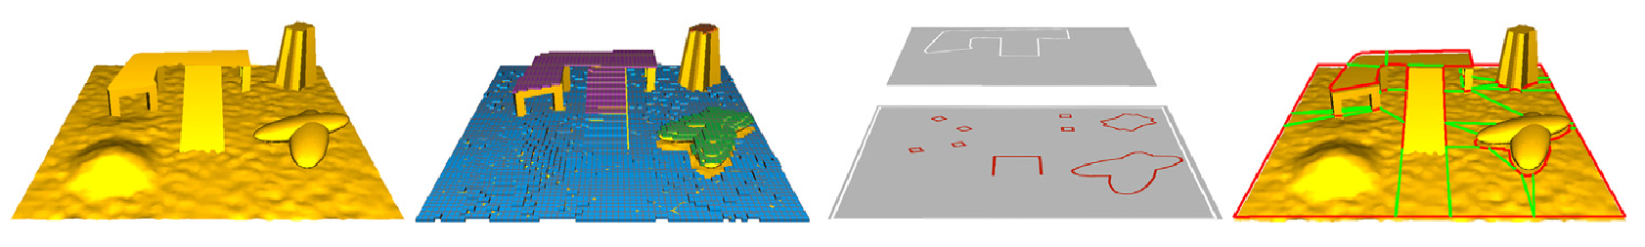
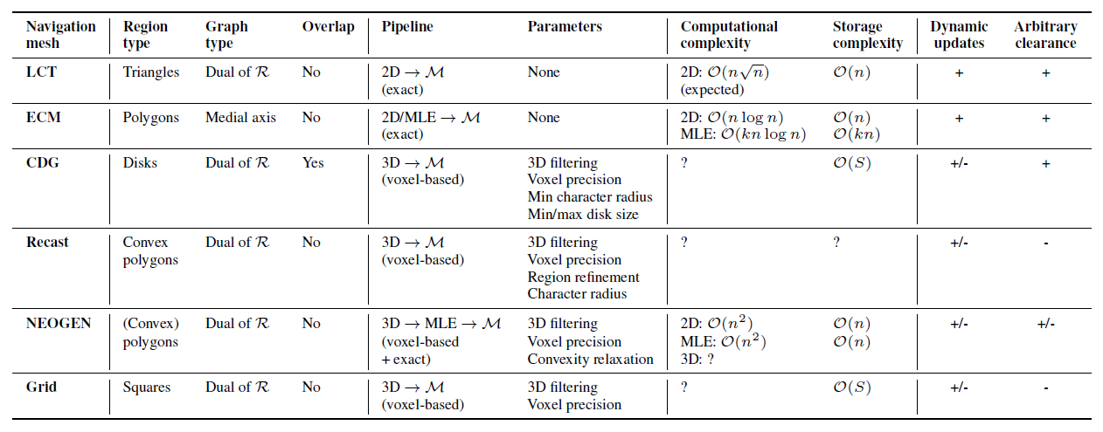
Featured Navigation Meshes (2/2)
Voxel-based
  Clearance Disk Graph (CDG) [Pettré et al. 2005]
  Recast Navigation [Mononen ~2011-now]
  NEOGEN [Oliva and Pelechano 2013]
  Grid
Theoretical comparison: see paper
https://github.com/recastnavigation/recastnavigation
NEOGEN: Near optimal generator of navigation meshes for 3D multi-layered environments
R. Oliva, N. Pelechano
Computers & Graphics, 2013
A navigation graph for real-time crowd animation on multilayered and uneven terrain
J. Pettré, J.-P. Laumond, D. Thalmann
1st International Workshop on Crowd Simulation, 2005

Slide 12
Quality Metrics
Implementation + Environment = Numbers

Slide 13
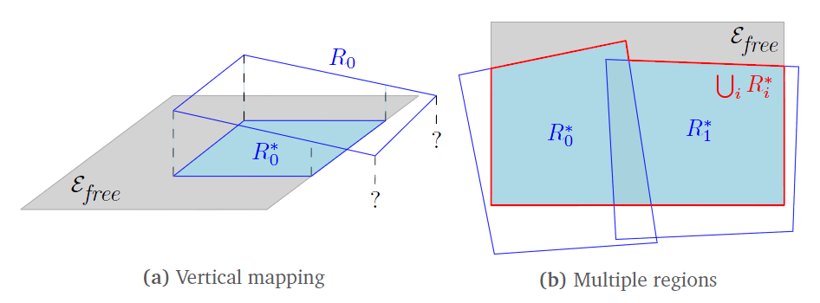
Coverage Metrics (1/2)
How accurately do the navmesh regions cover E_{free}?
  (Only interesting for voxel-based methods)
2D: compute unions/differences in the plane
3D: more difficult
  Vertically map each region R_{i} onto E_{free} → R*_{i}
  Compute unions/differences of mapped regions
  Compute projected areas (ignoring height differences)

Slide 14
Coverage Metrics (2/2)
Free space covered
  Total area of E_{free} that is covered by some region
Incorrect area
  Total area of the regions that does not map to E_{free}
Overlap
  Area of E_{free} that is covered more than once

Slide 15
Other Metrics
Connectivity
  #Connected components in G
  #Boundaries of R according to G
Complexity
  #Vertices and edges in G
  #Regions in R
  Region complexity: average, SD, total
Performance
  Construction time (avg/SD over 10 runs)
  Memory usage (avg/SD over 10 runs)
Application-dependent importance
Should match E_{free}
Lower = better,
but difficult to minimize all of them
Lower = better

Slide 16
Experiments and Results
Putting it into practice

Slide 17
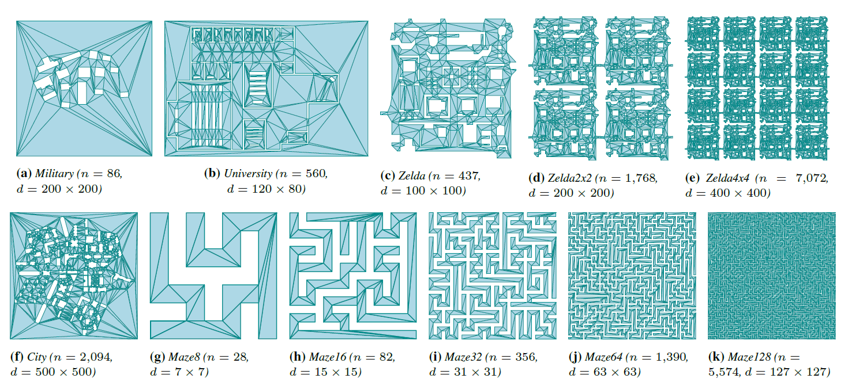
Environments: 2D

Slide 18
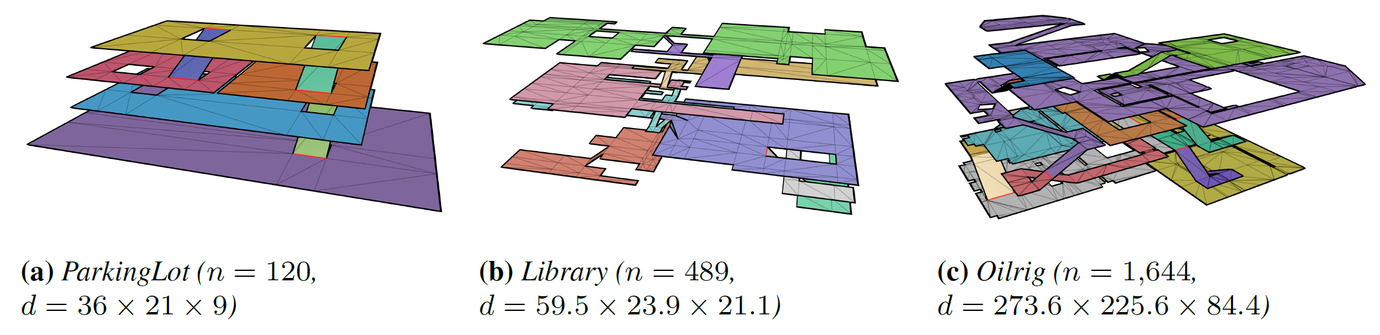
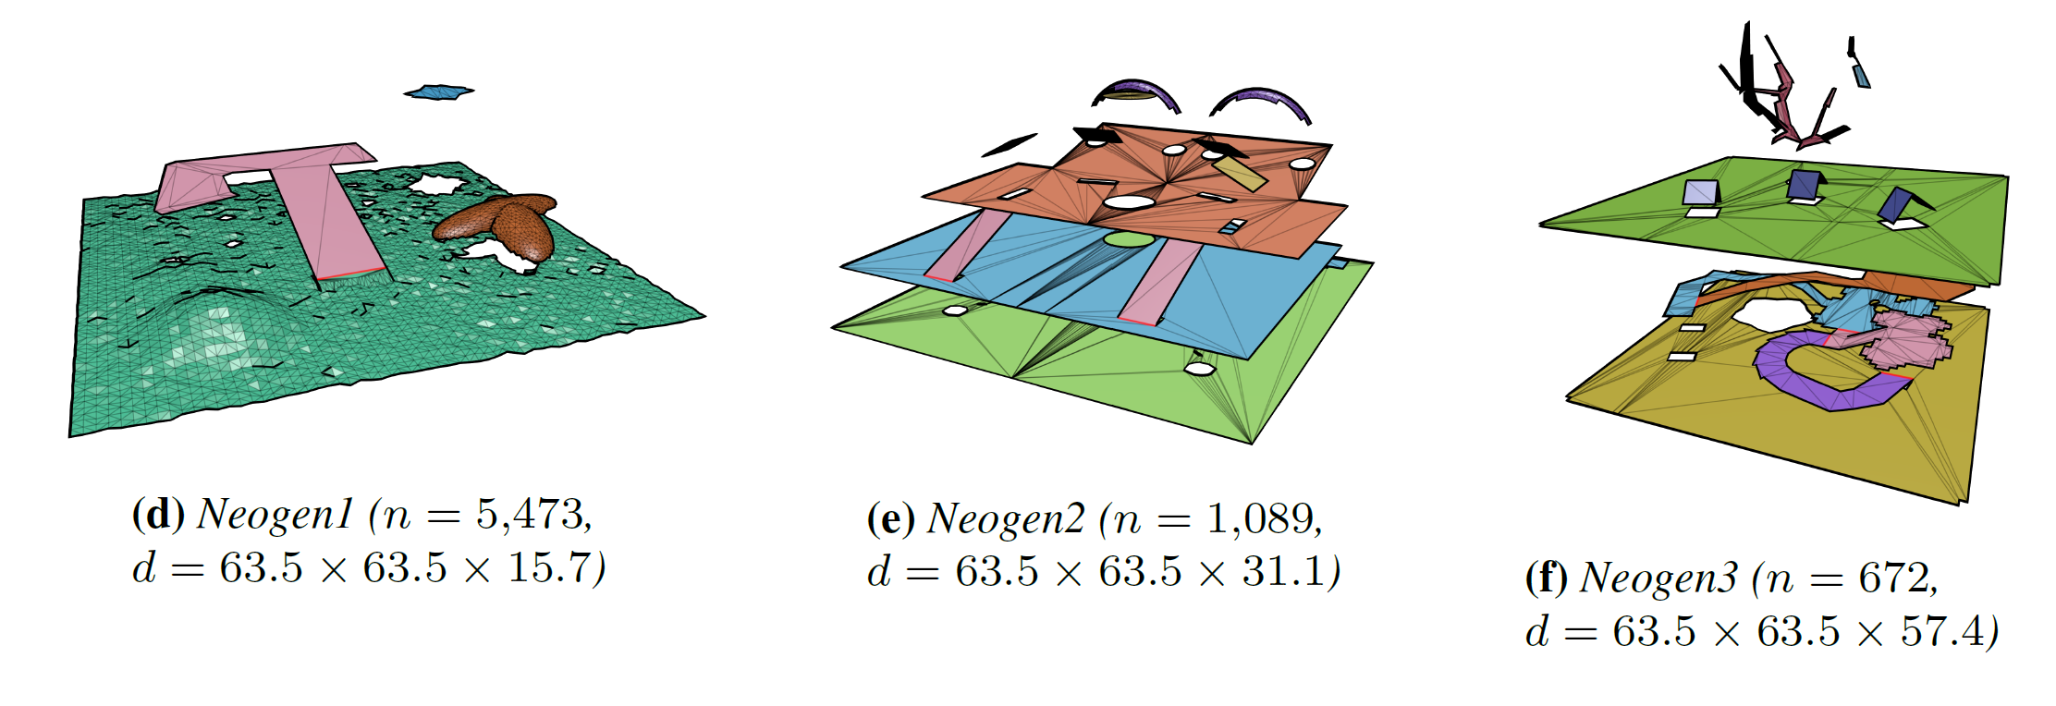
Environments: MLEs (1/2)

Slide 19
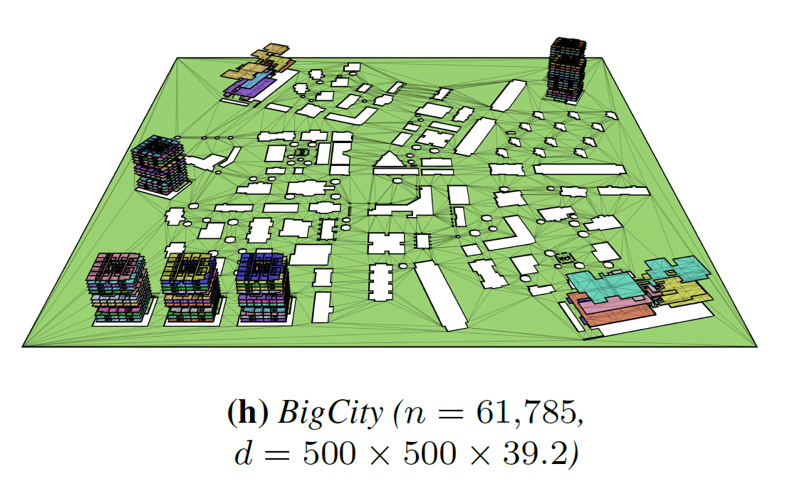
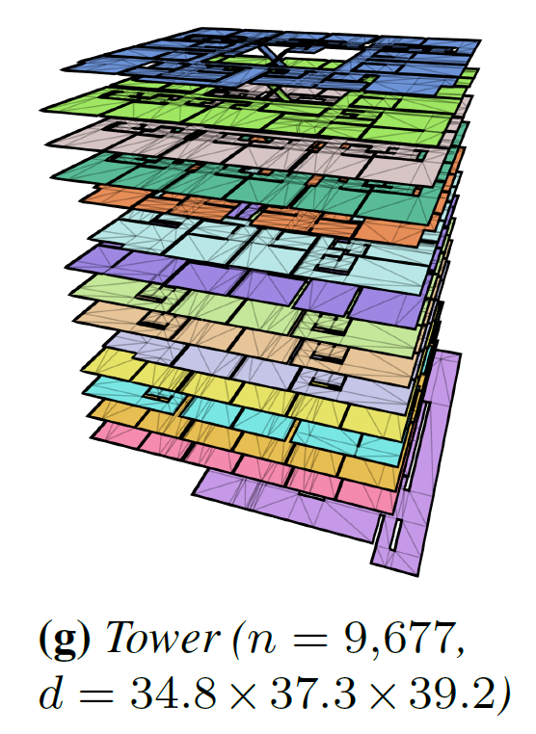
Environments: MLEs (2/2)

Slide 20

Results: Example
Ground truth

Slide 21
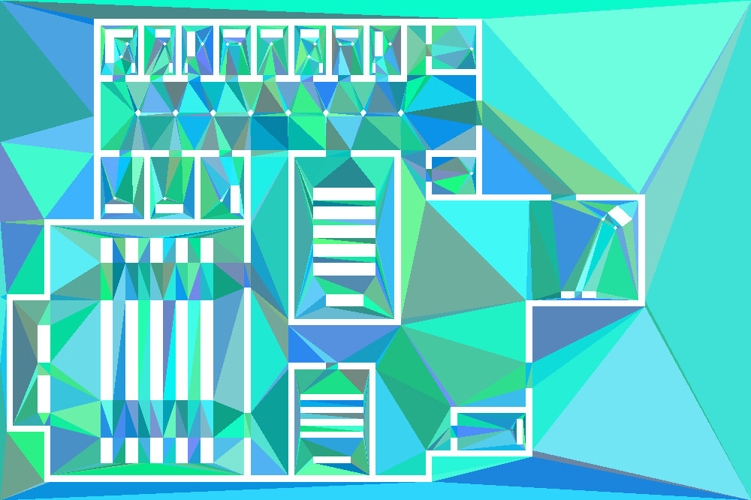
Results: Example
LCT

Slide 22
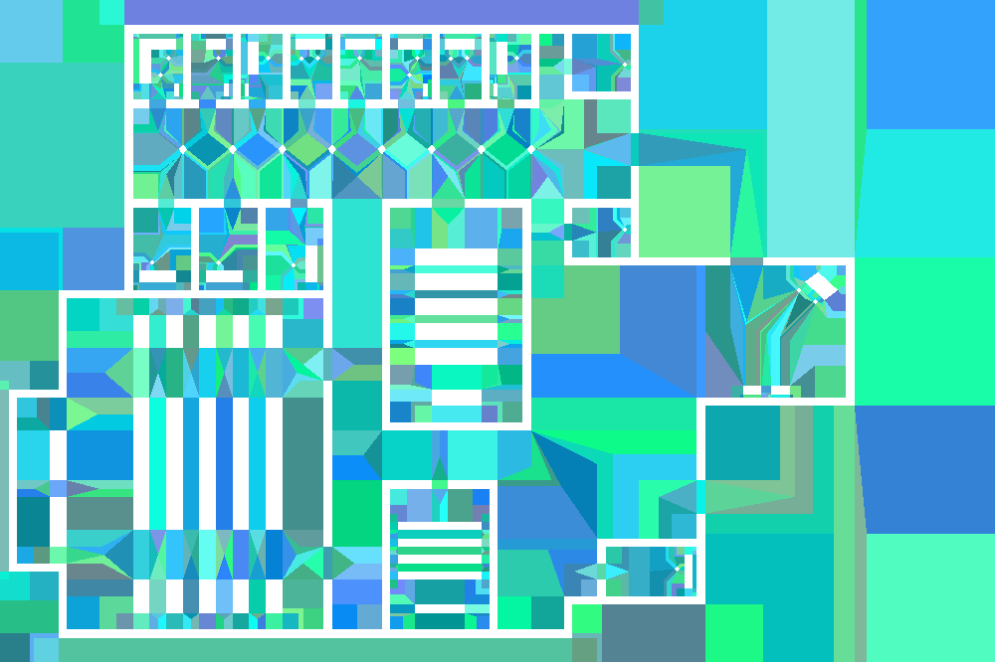
Results: Example
ECM

Slide 23
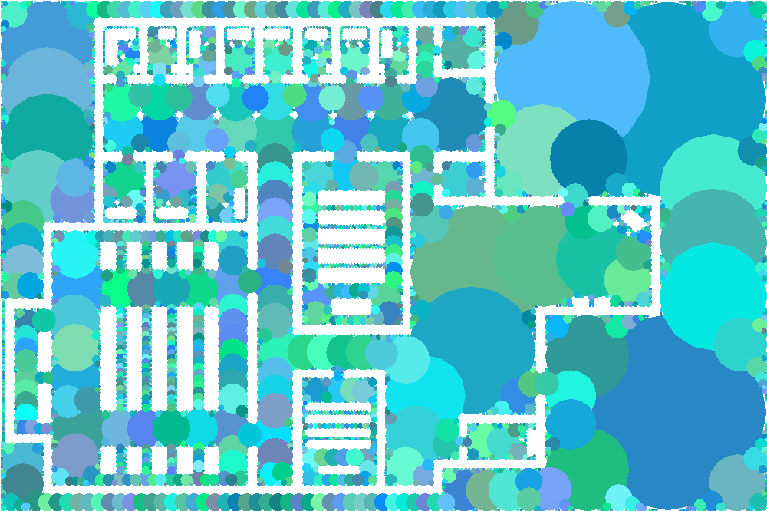
Results: Example
CDG

Slide 24
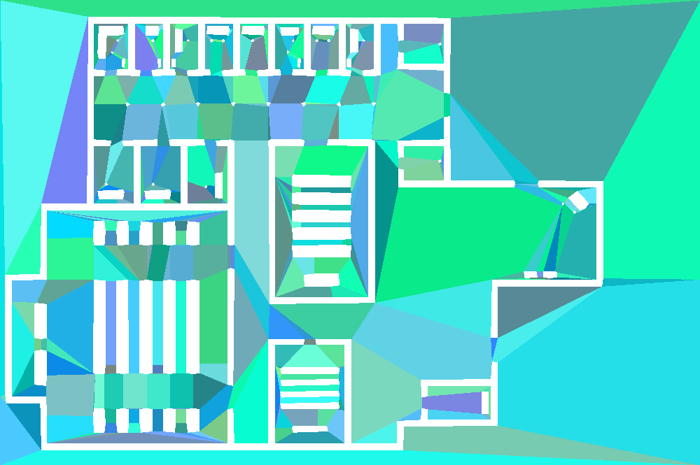
Results: Example
Recast

Slide 25
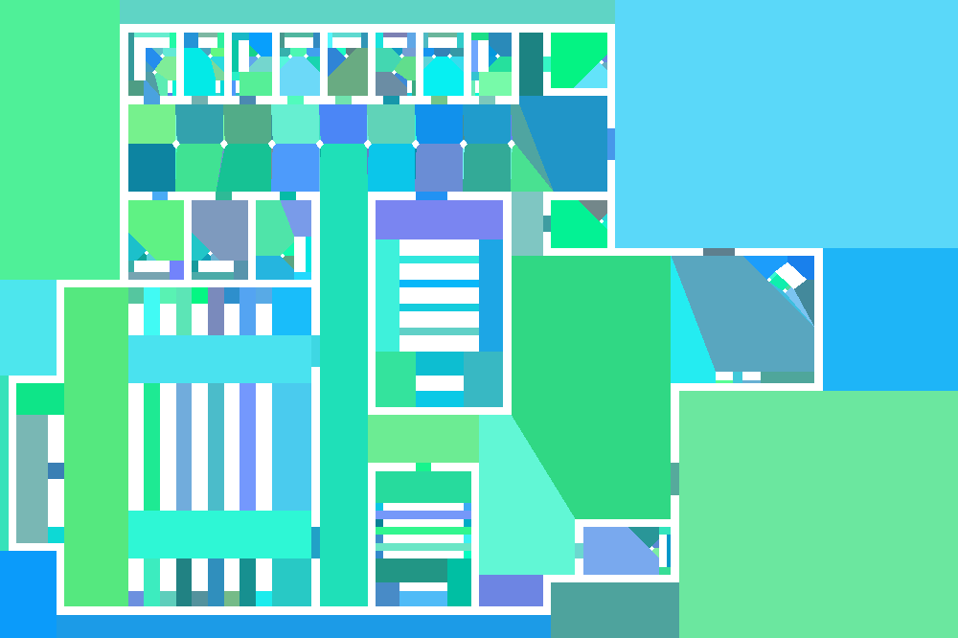
Results: Example
NEOGEN

Slide 26
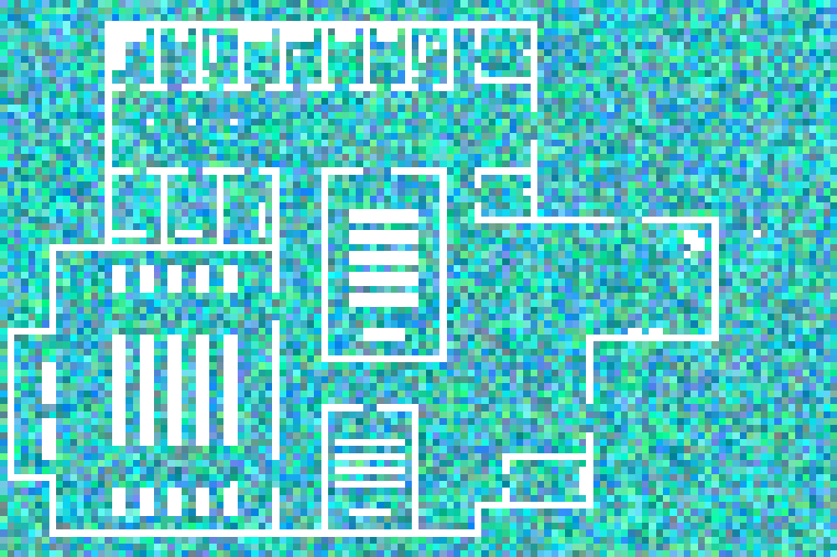
Results: Example
Grid

Slide 27
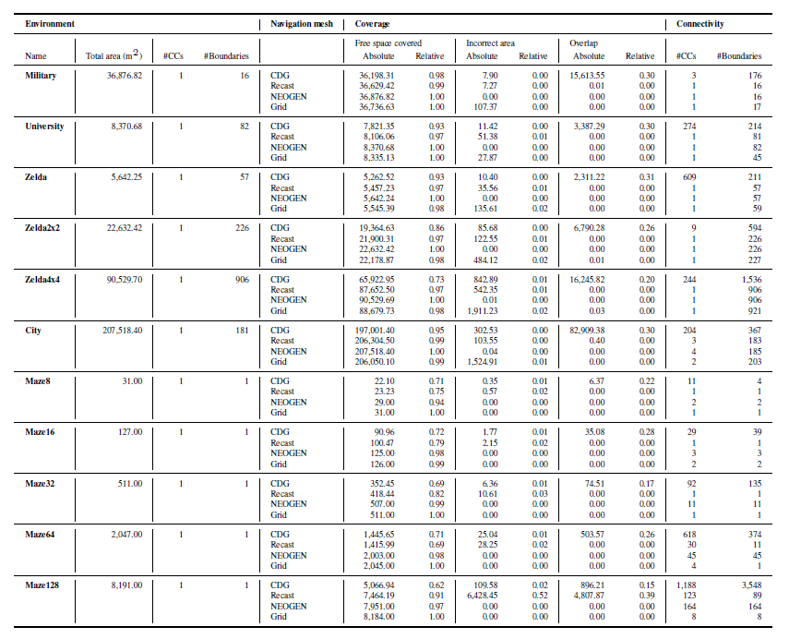
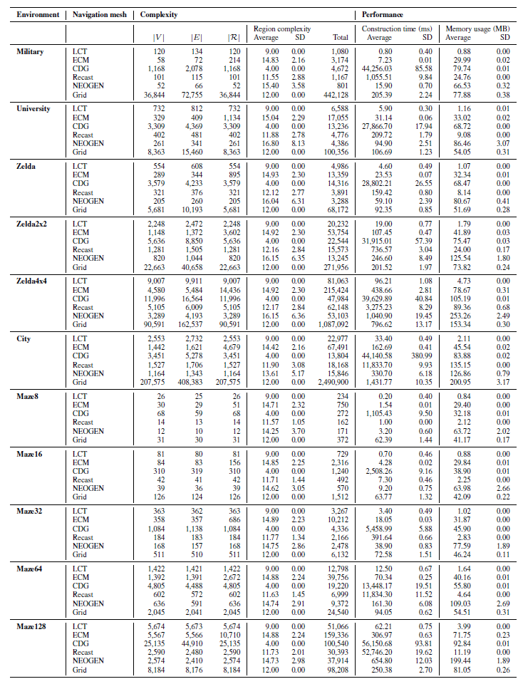
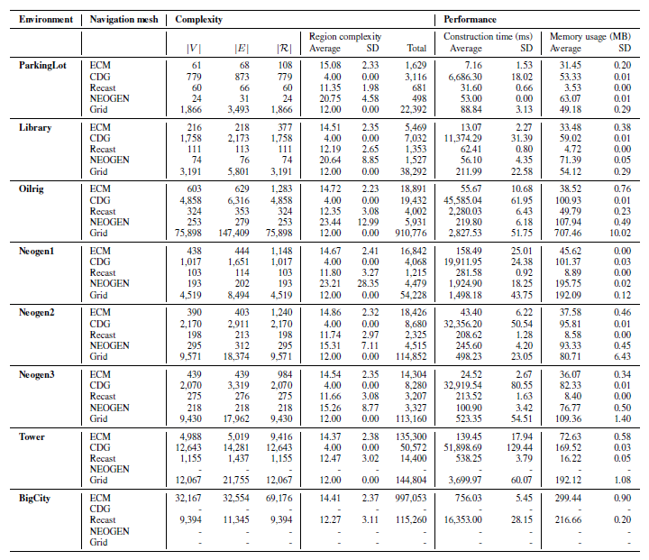
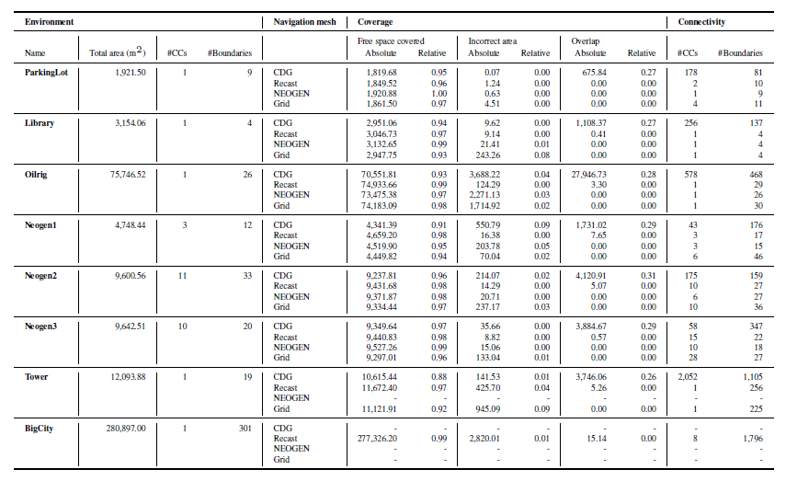
Results: Metrics

Slide 28
Results: Selected Observations
Coverage/connectivity
  Voxels often imperfect, even in mazes (Recast/CDG)
  Higher resolutions could help (but...)
  Numbers match visual inspection
Complexity
  NEOGEN/ECM: Smaller graph, higher region complexity
  Recast: in-between, thanks to imperfections
  Grids are inefficient (but...)
Performance
  LCT: fastest overall
  NEOGEN: usually fastest voxel-based method
  Voxels: time/memory doesn’t scale well to large environments
  Voxels vs. exact: difficult to judge

Slide 29
Conclusions and Discussion
and what to do next

Slide 30
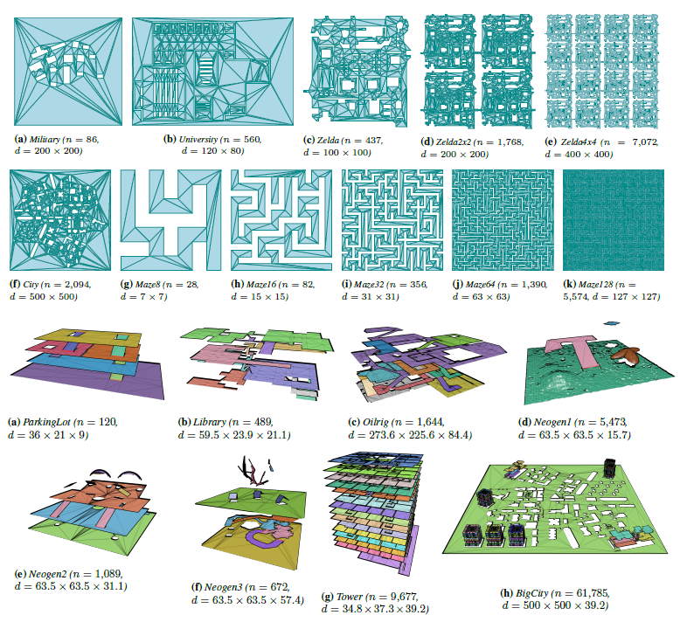
Summary
Comparative study of navigation meshes
  Unified definitions
  Theoretical properties for classification
  Quality metrics
    3D coverage
  Experimental comparison
    5 state-of-the-art navmeshes
    1 baseline grid
    Unified settings / environments
Main goals:
  Set a standard for evaluating/comparing navmeshes
  Gain insight in (dis)advantages of each method
  Steer future research

Slide 31
Current Limitations
Metrics
  How quickly can we compute paths in G?
  How short are the resulting routes through R?
  How realistic are these routes? (What is realistic?)
Environments
  Add examples from more papers
  Add real-world locations
  Add actual game levels (if allowed)
Settings
  Some methods have many parameters
  Many possible combinations; we only used 1
  Automatically deduce the best settings?

Slide 32
Future Work
Work on limitations
  Add more environments
  Try a range of settings
  Develop new metrics: planning time, path quality, realism
Make our ingredients publicly available
  (Environment OBJs are in the supplementary file)
  Website with environments, like [Sturtevant 2012]
  Donwloadable benchmark tool, like [Singh et al. 2009]
Develop exact algorithms for 3DE → WE → MLE
  Or hybrid techniques?

Slide 33

The final slide
Join the comparison?
W.G.vanToll@uu.nl

