Slide 1

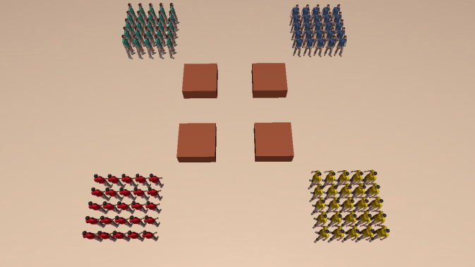
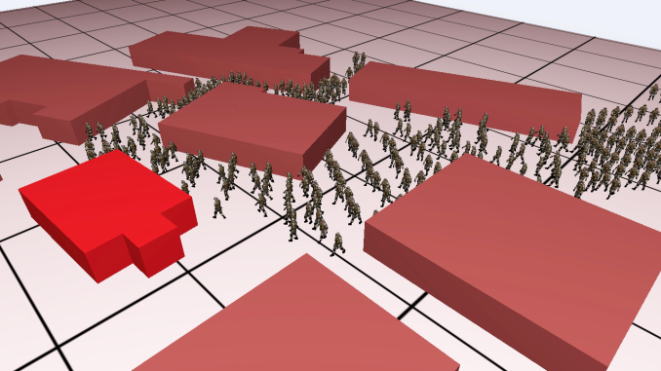
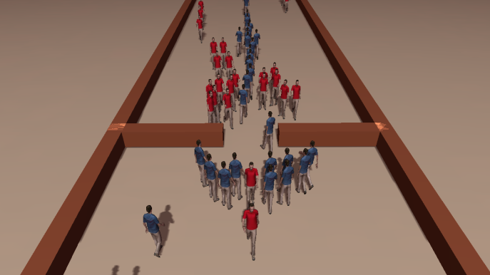
Space-time Group Motion Planning
Ioannis Karamouzas, Roland Geraerts and A. Frank van der Stappen
Notes:
1

Slide 2


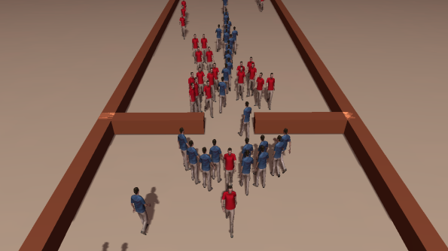
Space-time Group Motion Planning
A. Frank van der Stappen
Joint work with:
  Ioannis Karamouzas
  Roland Geraerts

Slide 3
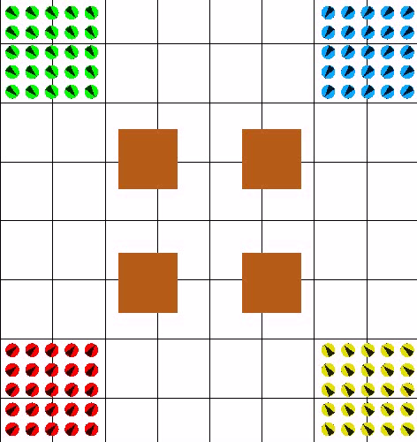
Introduction
Multi-group planning and navigation problem
Notes:
- In this work, we address the problem of planning the paths and directing the motions of agents/robots in an environment containing static obstacles. The agents are organized
into groups having similar characteristics and intentions. Each group has its own start and goal position, and each group member will traverse its own path. The main objective is to steer the group members towards their destinations as quickly as possible and without collisions with obstacles or other agents in the environment. (The multi-group problem can be considered an extension of the basic multi-agent navigation and planning problem, where agents belong to groups.)
This task would have been simple, if the paths of the agents were independent of each other. However, due to space restrictions, congestions may appear and waiting or finding alternative paths may be more efficient for some agents. Furthermore, the time dimension introduces additional complexity into the planning process; congestions only appear at certain moments in time, while at other moments the agents can move without delay.
As an example, consider the following scenario: Four groups are placed in the corners of an environment and have to move to their diagonally opposite corners. In the middle of the environment, four squared-like obstacles form narrow passages. A typical way to solve this problem would be to decouple global planning from local collision avoidance, where a graph directs the global motions of the members and a local planner is used to resolve collisions (play movie). However, since all these local methods are separated from the global planner, they are susceptible to local-minima problems. In densely packed environments, this normally leads to deadlock situations. In addition, such a decoupled solution is not optimal. (Alternatively, you can only describe the scenario in this slide, and the movie along with the cons of the typical solution can be explained in the next slide).
- To resolve the aforementioned problems, we present a novel algorithm for planning and directing group motions that is based on techniques from linear programming.

Slide 4
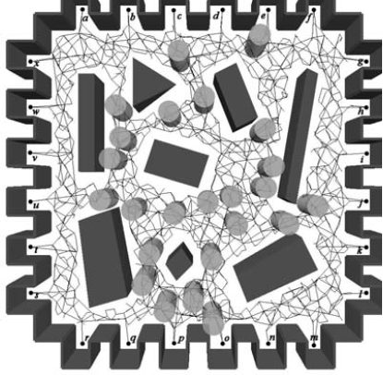
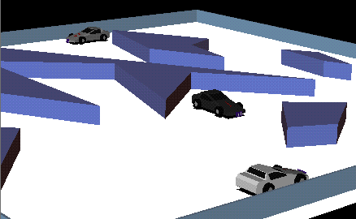
Related Work
Multi-agent planning and navigation
  Roadmap-based planner + local collision avoidance [van den Berg et. al, ‘08]
  Centralized planners [Švestka and Overmars, ‘98], [Sánchez and Latombe, ‘02]
  Decoupled planners [LaValle and Hutchinson, ‘98], [Simeon et. al, ‘02]
  Prioritized planning approaches [Sung et. al, ‘05], [van den Berg and Overmars, ‘05]
Svestka and Overmars, ‘98
van den Berg and Overmars, ‘05
Notes:
Let me first highlight prior work related to the aforementioned problem. For more details, please see our paper:
Let me first highlight some of the most relevant work in this area. For more details, please see our paper:
As discussed previously, two-level planning approaches have been widely used in the graphics and animation community for multi-agent navigation and crowd simulation due to their low computation times. However, such approaches, due to the fact that local collision avoidance is separated from the global planning, are susceptible to local-minima problems. In addition, such decoupled solutions are not optimal.
A centralized planner computes a path in the composite configuration space, which is formed by the Cartesian product of the configuration spaces of the individual robots.
Decoupled approaches compute a path for each robot independently, and a coordination diagram is used to plan a collision-free trajectory for each robot along its path. However, both centralized and decoupled planners are computationally demanding, which makes them unsuitable for real-time applications. Note also that decoupled approaches may not be able to guarantee completeness.
Prioritized planning approaches have also been proposed that plan paths sequentially for each robot according to a certain priority scheme. Here lower priority robots consider higher-priority robots whose motions have already being planned as dynamic obstacles with known trajectories. This reduces the multi-agent planning problem to the problem of computing a collision-free trajectory for a single agent in a known dynamic environment, which can be addressed by planning in the state-time space (see, e.g. the roadmap-based approach of van den Berg and Overmars). However, even though prioritized techniques guarantee inter-robot collision avoidance, the growing complexity of the planning space limits the number of robots that can be simulated.

Slide 5
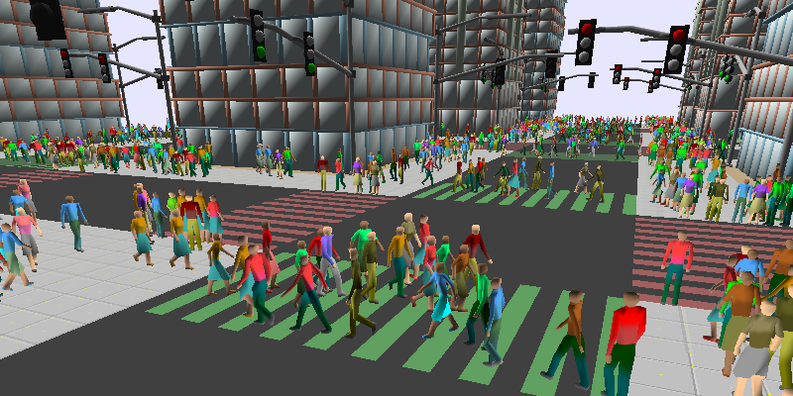
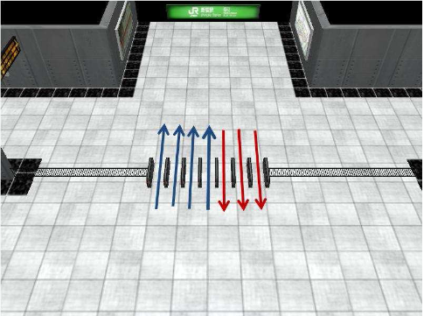
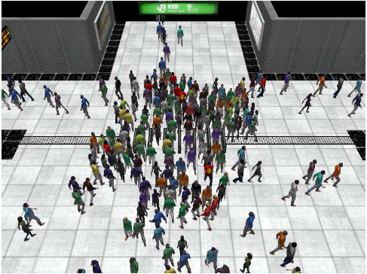
Related Work
Multi-group planning and navigation
  Continuum dynamics [Treuille et al, 2006]
  Navigation fields [Patil et. al, 2011]
  Dynamic multi-commodity flows [van den Akker et. al, 2010]
    Homogeneous groups of units
    Capacitated graph
    Integer Linear Programming (ILP)
Treuille et al, 2006
Patil et al, 2011
Notes:
Treuille et al has proposed a novel approach to simulate large homogeneous groups of human agents by dynamically constructing density-dependent velocity fields that the agents follow to reach their goals. This approach unifies global planning and local collision avoidance into a single framework and can become expensive when simulating a large number of groups.
An alternative approach was recently proposed by Patil et al to steer and interactively control groups of heterogeneous agents using goal-directed navigation fields. Their approach takes as an input user-specified guidance fields, such as the ones shown in the figure (agent interactions at the turnstiles of a subway station). Based on these inputs, a smooth, singularity-free vector field is computed that avoids collisions with the obstacles in the environment and steers the agents to their goals. A local method for collision avoidance is also used to ensure collision-free navigation for the agents. Although, this combined approach can handle challenging scenarios and successfully resolve congestion, it requires the user input to guide the agent flows, as compared to our model that automatically accounts for congestion and time-consuming situations.
Finally, a different solution to the group path planning problem has emerged from the operations research community. Van den Akker et al. translated this problem into a dynamic multi-commodity flow problem. Their approach takes as input a graph resembling the free space of the environment and several homogeneous groups of units, each having its own start and goal position. A capacity is associated with each arc on the graph representing the maximum number of units that can traverse this arc per unit time. The objective is to find paths that minimize the average arrival times of all units and respect the capacity constraints. Since this problem is known to be NP-hard, a new heuristic was proposed based on an integer linear programming formulation.
Our model is inspired by the aforementioned work, since we use a similar linear program to coordinate the global motions of the groups. However, we extend their formulation to allow the simulation of groups of heterogeneous agents. We also take into account capacity constraints on the nodes of the graph, which provides a more accurate solution to the problem and inhibits the oscillations we observed when multiple agents have to wait on a certain node. Finally, van den Akker et. al only presented a theoretical framework and do not discuss simulation, as compared to our solution. (There are also other differences, see page 4 in the paper, e.g. In van der Akker the graph is directed).

Slide 6




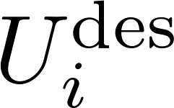


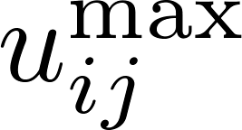
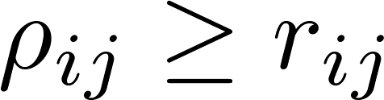
Problem Formulation
  We are given a geometric description of the virtual environment, in which k groups of agents must move.
  Each group has its own start and goal positions and consists of agents.
  A desired speed is also assigned to each group .
  Each member belonging to is modeled as a disc with radius and is subject to speed.
  We further assume that maintains a circular personal space of radius that others should not invade.
  The task is then to compute collision-free trajectories for the group members such that their average arrival time is minimized.
Notes:
- Each group C_i has its own start s_i and goal g_i position and consists of d_i agents that need to navigate from a specified start to a specified goal area defined around the group’s origin and destination point
respectively. Furthermore, each group is assigned a desired speed indicating the speed at which its members prefer to move.
For simplicity, we assume that each group member A_{ij} is modeled as a disc and its actual motion is subject to a maximum speed.
-We further assume that each agent keeps a certain psychophysical distance \rho_{ij} from other agents and static obstacles in order to feel comfortable. This distance defines the personal space of the agent and is modeled as a disc centered at A_{ij} and having radius \rho_{ij}.
- The task is then to steer the group members toward their corresponding goal areas as quickly as possible and without collisions with the environment and with each other, that is to determine collision-free trajectories for the agents such that their average arrival time or equivalently the sum of the travel times of the agents is minimized.

Slide 7
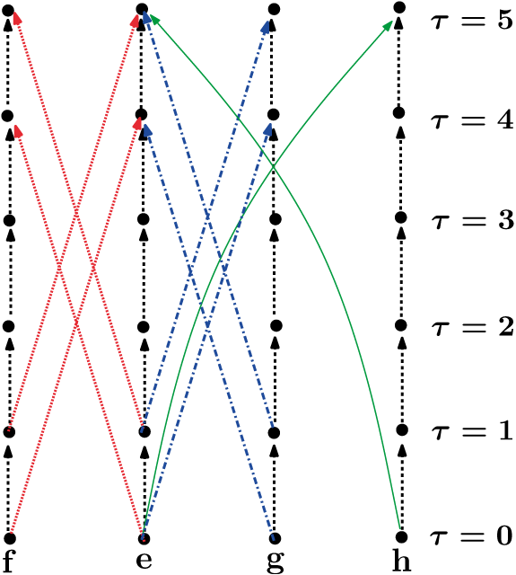
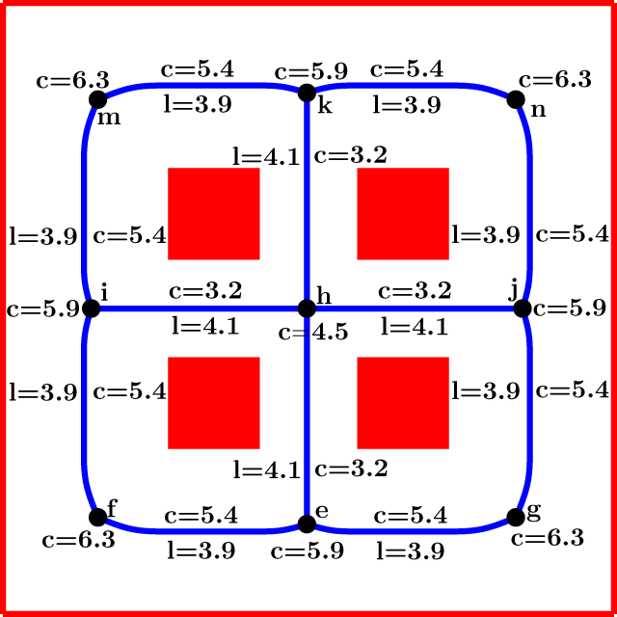
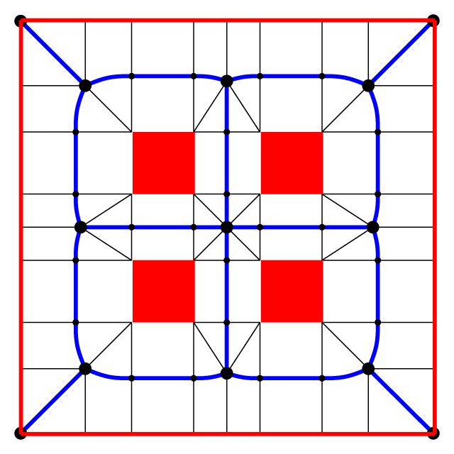
Overall Solution
Environment description
Groups
Origin
Destination
ILP Planner
min {Avg. Travel Time of Agents}
Group Size
Time-expanded graph
Capacitated graph
Medial axis graph
Space-time paths
Notes:
We propose a two-level framework to solve the aforementioned planning problem. In the first phase, we formulate the group planning problem as a dynamic multi-commodity flow problem and employ an Integer Linear Programming (ILP) approach to solve it. The ILP plans in both time and space by taking into account capacity constraints on the edges and the nodes of a graph that is based on the medial axis (MA) of the environment. (Such a graph is called a capacitated graph or network). The variables in the ILP represent the number of agents using a certain path. Such a path is described by the graph nodes that the agent should visit along with the times at which these nodes should be reached. Furthermore, waiting behavior can be encoded in the path.

Slide 8
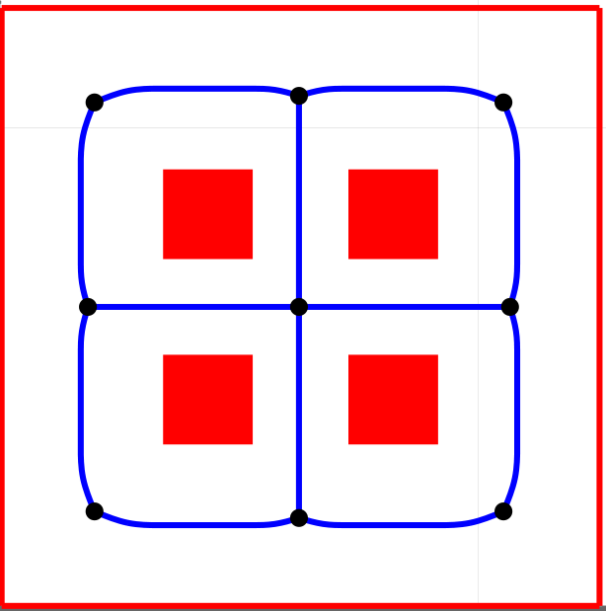
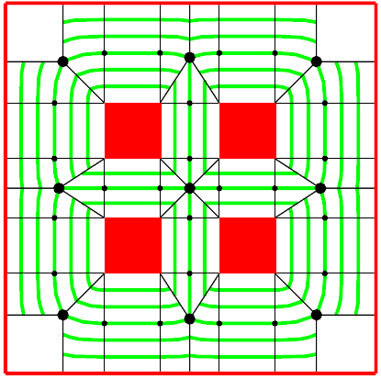
Overall Solution
c
t = 10
b
t = 5
a
Capacitated graph
Lanes
Notes:
- Let us assume that a group of three members has to move from a to b. Let us also assume that according to the paths returned by the ILP, all three members should be at node b at time t=5 and at node c at time t=10. This means that there is enough space for the members to walk simultaneously along the corresponding MA edges. Of course simply following these edges would result in collisions. To resolve this, in the second phase of our framework, we first create a number of lanes across the MA edges based on the capacity information of the graph. Such lanes allow the members to spread over the environment. An agent-based steering method is then used to guide the members along the lanes and ensure collision-free trajectories that respect the space-time plan provided by the ILP.

Slide 9
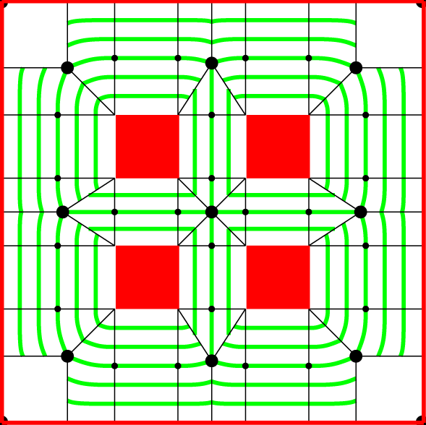
Overall Solution
Environment description
Groups
Origin
Destination
ILP Planner
min {Avg. Travel Time of Agents}
Group Size
Time-expanded graph
Capacitated graph
Medial axis graph
Space-time paths
Agent-based steering algorithm
Computes for each agent, a collision-free trajectory that respects the space-time plan of the ILP.
Lanes
Notes:
We propose a two-level framework to solve the aforementioned planning problem:
a) In the first phase, we formulate the group planning problem as a dynamic multi-commodity flow problem and employ an Integer Linear Programming (ILP) approach to solve it. The ILP plans in both time and space by taking into account capacity constraints on the edges and the nodes of a graph that is based on the medial axis (MA) of the environment. (Such a graph is called a capacitated graph or network). The variables in the ILP represent the number of agents using a certain path. Such a path is described by the graph nodes that the agent should visit along with the times at which these nodes should be reached. Furthermore, waiting behavior can be encoded in the path.
b) In the second phase of our framework, the paths computed by the ILP are given as input to an agent-based steering method in order to generate the final motions of the agents (group members). Given the capacity information of the graph, we first create a number of lanes across the MA edges of the environment. We then compute for each agent a collision-free trajectory along these lanes that respects the space-time plan provided by the ILP.

Slide 10

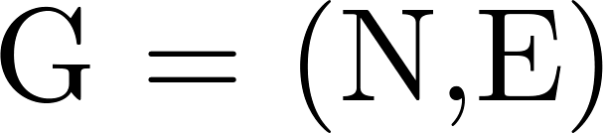






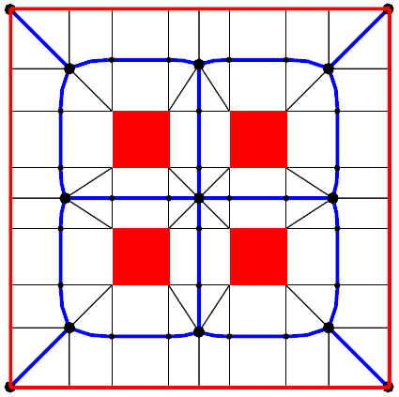
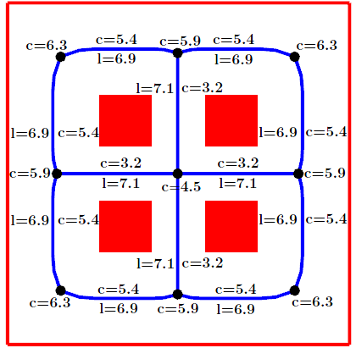
Planning for groups
Creating a capacitated graph
  Compute a medial axis graph [Geraerts, ‘10]
  Compute a capacitated graph based on
    Remove dead end vertices and edges from
    Define the time that an agent requires to traverse each edge in
    Assign a capacity to each edge in by determining the max number of agents that can traverse it while walking next to each other
    Assign a capacity to each node in indicating the maximum number of agents that can simultaneously be on the node.
Medial axis graph MG enhanced with proximity information to nearest obstacles
The corresponding capacitated graph G
Notes:
We now describe the first phase of our framework that formulates the multi-group planning problem as a dynamic multi-commodity flow problem:
To solve this problem, we first need a graph that resembles the free space of the environment. We base this graph on the edges and vertices of the medial axis (MA), as such a graph provides maximum clearance from the obstacles and includes all cycles present in the environment. For efficiency reason, we use the approach recently proposed by Geraerts to construct such a graph by determining the minimum number of sample points along each MA edge that are required to described such an edge. (Alternative: A MA edge is the locus of points that are equidistant to two obstacles and is formed by a concatenation of curves, i.e. line segments and parabolic arcs. For efficiency reasons, we use the approach recently proposed by Geraerts to construct such a graph by determining the minimum number of curves that describe each MA edge. In other words, we determine sample points along each edge where a curve must end and another one must start.) Also, for each sample point, we store its minimum clearance to the obstacles along with its corresponding nearest obstacle points. The image in the bottom left shows an example of such a MA graph. Note that the graph is undirected. The blue curves are MA edges. The large black discs denote MA vertices, while the small discs denote sample points along each MA edge.
Based on the MA graph, we compute a capacitated graph G = (N,E) by first copying all vertices and edges from MG to G. We then remove all nodes of degree 1 in the graph and their corresponding edges as can be seen in the bottom right image. For each remaining edge, we define its traversal time as the time that an agent requires to traverse this edge and compute it as the edge length divided by the maximum speed among all groups’ desired speeds. We note that this traversal time is a lower bound and it may take longer for a group to traverse the edge. We resolve this issue while solving our ILP, as explained in our paper. A capacity is also assigned to each edge denoting the maximum number of agents that can traverse the edge at the same time while walking next to each other. The capacity is computed as the minimum clearance along the edge divided by the maximum personal space among all agents. Similarly, a capacity is associated with each node n in the graph indicating the maximum number of agents that can simultaneously be on the node, that is on the maximum disc centered on the node that does not intersect with the environment.

Slide 11





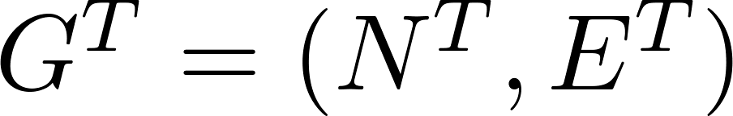



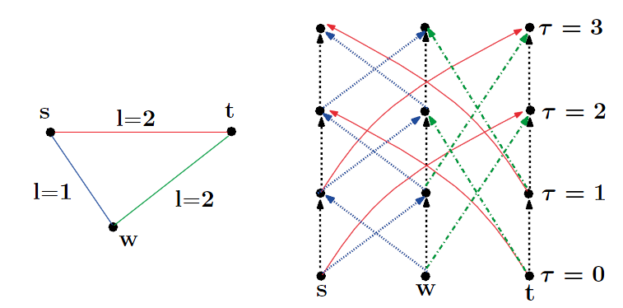
Planning for groups
Creating a time-expanded graph
  Use a condensed-like approach [Fleischer and Skutella, ‘07]
    Choose a time-step for the graph.
    Define the discrete traversal time for each edge in as
    Define the discrete capacity of each edge as and of each node as
  Compute the time expanded graph of
    T defines the total number of discrete time steps
    Create a copy of for each time step based on
    Add waiting arcs
Discrete capacitated graph
Time-expanded graph
Notes:
The capacitated graph captures different paths that the agents can follow in order to reach their destinations. Nevertheless, to properly avoid congestions, we must not only know which nodes are visited but also at which times these nodes should be reached. In addition, waiting at certain nodes may be more efficient for some of the agents. For that reason a time-expanded graph is created that adds the time dimension to G. In our implementation a condensed time-expanded graph is used as proposed by Fleischer and Skutella (to reduce the size of the graph). The basic idea here is to round up the traversal time of each edge in G to the nearest multiple of an appropriately chosen time step Dt. The capacity of the edge is also multiplied by Dt in order to define the maximum number of agents that can traverse the edge in one time unit. In a similar manner is determined the discrete capacity of each node in G.
Let G^T denote the time-expanded graph of the capacitated graph G. T defines the time horizon, that is the total number of discrete time steps. An upper bound is used for T, but I will not elaborate on it (such an upper bound is defined by assuming that the groups move in turns). G^T is directed and is constructed from G based on its discrete capacities and traversal times. As an example consider the discrete capacitated graph in the bottom left image, where for clarity we omit the capacity information. Its corresponding time-expanded graph is shown in the right image for a time horizon T=4. First we create a copy of each node s,w,t for each discrete time step \tau = [0,3]. (Such a copy has the same discrete capacity as its corresponding static node.) In addition for every edge in the static graph, two arcs are created in the time-expanded graph. For example for the edge {s,t} an arc at \tau=0 is created from s to t two time steps later (red arrow) and another one from t to s two time steps later. Similar arcs are created for \tau=1. For the other two time steps no arcs are created as the time horizon does not permit it. Finally, waiting arcs are also added from each node to the same node one time-step later (black arrows). Such an arc allows an agent to stay at a node for one time-step period (having the same capacity with the discrete capacity of its corresponding static node.) Note that we do not explicitly construct the time-expanded graph, but we lazily construct time-expanded graphs and nodes whenever it is required.

Slide 12
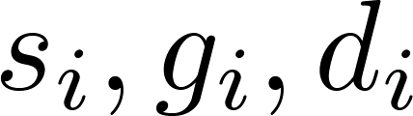

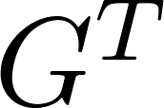




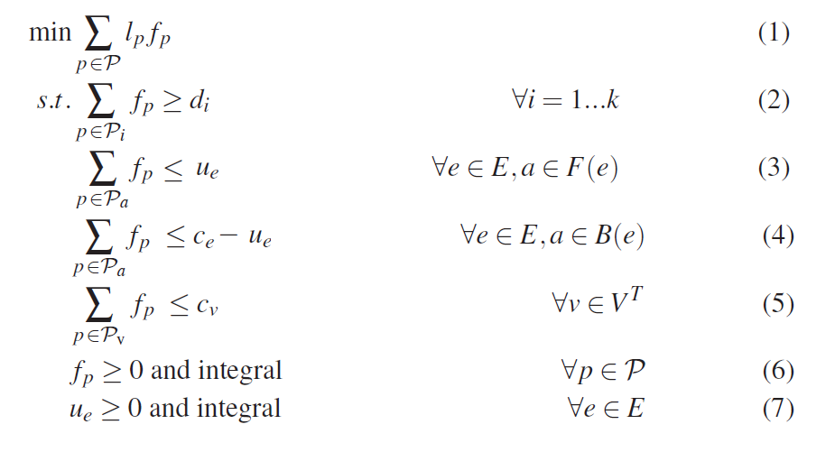
Planning for groups
Integer Linear Programming formulation
  For each group , we are given its .
  Let be the set of all valid paths in . For each path , let denote its length and the number of agents using . Then:
  Solve the LP-relaxation using the column generation technique [Ford and Fulkerson, ‘58].
Notes:
- In our problem formulation, we are given the origin s_i, destination t_i and the size d_i of each group. Let us assume that we know all valid paths in the time-expanded graph corresponding to each origin-destination pair. A path is valid, if it starts at the origin of a group at time step \tau=0 and ends at the destination of the same group at some time step \tau smaller than the time horizon T. Let P denote the set of all these valid paths in G^T . For every path, we introduce a decision variable f_p which denotes the number of agents using the path p. We also use l_p to denote the cost (length) of the path, that is the time that is required for an agent to reach the end of the path. Then, we can model our path planning problem as an Integer Linear Programming problem:
a) As can be seen in Eq (1), our objective function minimizes the sum of the travel times of all agents, that is the average arrival times of all agents. We also formulate demand constraints to guarantee that the number of generated paths is at least equal to the number of agents (group members) present in the simulation.
b) Restrictions are also needed to ensure that the capacity constraints on the arcs of the tare obeyed. In our problem setting, the static capacitated graph G is undirected. Consequently, an edge can be traversed in both directions at the same point in time. To avoid having to add an enormous number of constraints, we introduce a non negative variable u_e for each edge in G. Then, the discrete capacity c_e of the edge is divided between the two directions of the edge. We do not fix the capacity distribution beforehand, but we make it time-independent by putting the capacity of the forward time-expanded arcs emerging from the edge equal to u_e (equation (3)) and the capacity of the backward arcs equal to c_e −u_e (equation 4). (You can skip the last sentence)
c) Finally, to account for the throughput limitation of each node v in the time-expanded graph, additional constraints are added to the ILP.
- Obviously, we do not know the entire set of paths P and enumerating it would be impractical, since there are infinite paths in the time-expanded graph. Therefore, we will make a selection of paths that we consider of ‘possibly useful value’, that is, paths that might improve the value of our objective function, and we will solve the ILP for this subset. We determine these paths by considering the LP-relaxation of the ILP, which is obtained by
removing the integrality constraints from Eq. 6 and 7. We solve the LP-relaxation through the technique of column generation, which was first described by Ford and Fulkerson for the static multi-commodity flow problem.
Column generation is a method to efficiently solve linear programs with a huge number of variables. (The basic idea is to solve the LP problem for a restricted set of variables and then add variables that may improve the objective value. If there are no such variables, it is guaranteed that the current solution is optimal for the whole problem.) Since the approach is too technical, we refer to our paper for a detailed explanation of the column generation algorithm. I should only note that, using the column generation, our linear program can be solved in polynomial time (I will include this in the thesis).
Frank, note that I’ve also skipped section 4.4 from the paper.

Slide 13

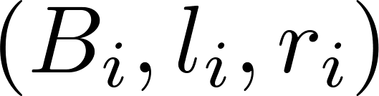

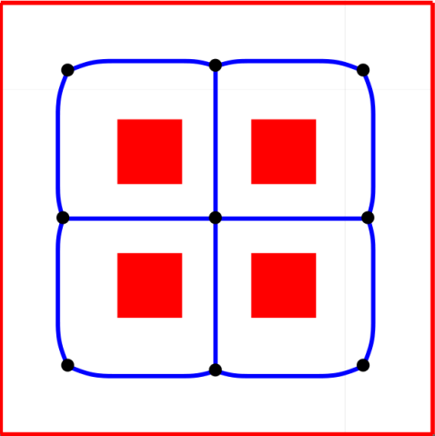
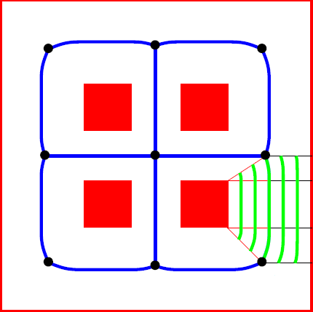
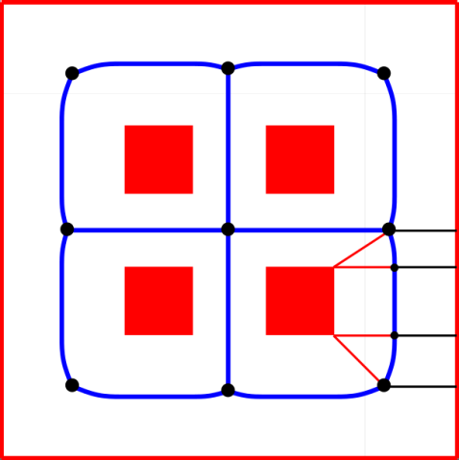
Planning for group members
  The ILP returns a path in for each agent .
  Agents may share the same arcs and nodes in . To resolve this
    The environment is discretized into lanes.
    A steering algorithm guides the agents through the lanes without collisions.
Constructing lanes
  An edge in can be expressed as a sequence of portals
  lanes are created along by placing waypoints on the portals.
B₃
m
m
r₃
l₂, l₃
r₂
B₂
l₀, l₁
B₁
r₁
n
r₀
n
B₀
A medial axis edge e = {n, m}
The edge consists of 4 portals
Creating lanes along the edge
Notes:
- At the end of the first phase of our framework, a path has been computed for each agent (group member) by the ILP. Such a path is defined in the time-expanded graph G^T and can be described by a sequence of waiting arcs and traversal arcs, that is arcs that run along the medial axis edges of the capacitated graph G. Therefore, a straightforward approach for generating the final trajectory of a group member A_{ij} would be to let the agent follow the MA edges, while adjusting its speed in order to adhere to the time constraints of its ILP path. However, as mentioned before, multiple agents may have the same path in G^T or share the same edge or node at the same time. Since all paths produced by the ILP satisfy the capacity constraints, this means that there is enough clearance for these agents to walk or stand next to each other. Based on this observation, we utilize the maximum capacity of each edge and create a number of lanes that the group members can follow. An agent-based steering method is also used to guide the agents through the lanes and generate a collision-free trajectory that respects the space-time plan provided by the ILP.
(Alternatively, you can explain all this using the figures in the 8th slide, which means that the 7th and 8th slides, i.e. the overall solution, will be replaced by slide no 9).
Let e denote a MA edge in the capacitated graph as shown in the bottom-left image. Let us also define a pseudo-orientation for the edge from n to m. As discussed previously, the edge consists of a number of sample points, B_0 to B_3 in our example (click for animation). For each sample point B_i, its left l_i and right r_i closest obstacle points are also defined. Then, the edge can be expressed as a sequence of portals, where each portal is described by the normals between the left and right obstacle points to their corresponding sample point. Lanes can be easily constructed along the edge by placing waypoints on the portals. For example, let us assume that the integral capacity of the edge in the capacitated graph is 5. This capacity defines the maximum number of agents that can simultaneously traverse the edge and hence, 5 lanes will be created. For each lane, a waypoint is generated on each of the 4 portals of the edge using simple linear interpolation. Since each edge can also be traversed in the opposite direction, for each lane its reverse one is also computed using a similar procedure.

Slide 14
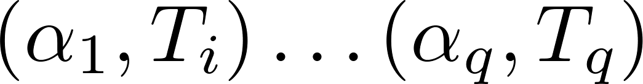
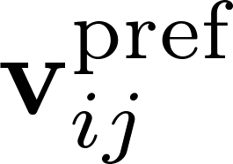
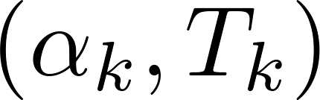

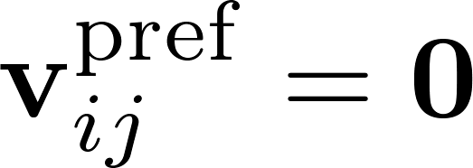
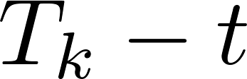







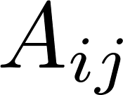
Planning for group members
Trajectory synthesis for an agent
  Express the path of as a sequence of tuples .
  Let be the preferred velocity and the next tuple.
  If is a waiting arc, we set for the next seconds.
  If is a traversal arc, we retrieve its edge in and the edge’s lanes . selects and traverses one of the lanes, as follows:
    Determine all lanes in that are free and retain that is closest to .
    If , for each in , assign cost(L_{k}) = c_{D}D(L_{k}) + c_{E}E(L_{k}) and retain the lane with the lowest cost. E(L_{k}) is defined as in [Guy et. al, ‘10].
    traverses by selecting an attraction point along the lane [Karamouzas et. al, ‘09] and estimating its given the time that has at its disposal.
  serves as an input to a local collision avoidance method to compute a collision-free velocity for and update its position.
Notes:
Given all the lanes in the graph and the ILP path corresponding to a group member A_{ij} , I will now describe how we can compute the final trajectory for this agent:
We first express the ILP path as a sequence of tuples, where the first element in the tuple denotes an arc in the time-expanded graph and the second element denotes the time instant at which the task of the arc (waiting or traversing a lane) should be completed.
The agent processes the tuples sequentially while adjusting its preferred velocity v^pref in order to complete its tasks at the specified times. Let (a_k ,T_k) denote the next tuple to be processed.
If a_k is a waiting arc, we set the preferred velocity to zero for the next Tk −t seconds, where t is the current time of the simulation.
In case a_k is a traversal arc, we determine its corresponding edge in the capacitated graph along with the lanes of the edge having the same orientation as our given arc. The agent needs to select one of these lanes and traverse it within the provided time. For that reason:
a) We first determine all lanes that are free. A lane is considered as free, if no other agent has entered it at the current time t and if its reverse lane is unoccupied. Among the free lanes, we select the one that is closest to
the agent.
b) An agent, due to interactions with other agents, may deviate from the time plan provided by the ILP and arrive at its next arc later than the expected time. Thus, there may be no free lanes to follow. In this case, (However, a more relaxed time-plan can be provided for each agent by including a fixed additional time the expected completion time of every arc. In case, there are still no free lanes available)
a heuristic approach is employed that dynamically assigns with each lane a cost depending on two terms: the distance between the agent and the lane, and the biomechanical energy that the agent needs to spend in order to traverse this lane. Among all the lanes, the agent retains the lane with the lowest cost.
c) It then uses the selected lane as an indicative route in order to traverse its current arc. More precisely, an attraction point moves along the lane and attracts the agent forward using the technique described in [Karamouzas et al ‘09]. Given the attraction point and the distance that that the agent still has to traverse within the time that has at its disposal, the preferred velocity of A_{ij} can then be estimated.
- At each simulation time-step, the preferred velocity is given as an input to a local collision avoidance method in order to compute a collision-free velocity for the agent and update its position. Note that simply using the preferred velocity may not be sufficient for a collision-free motion; the agent may still need to resolve collisions with its neighboring agents and the environment while advancing along its selected lane or waiting at a specific location. However, the use of lanes significantly reduces the interactions among the agents and, in most cases, each agent has only to resolve collisions when waiting at a certain node or upon entering a new lane. In our implementation, we used a model based on social forces for local collision avoidance.

Slide 15
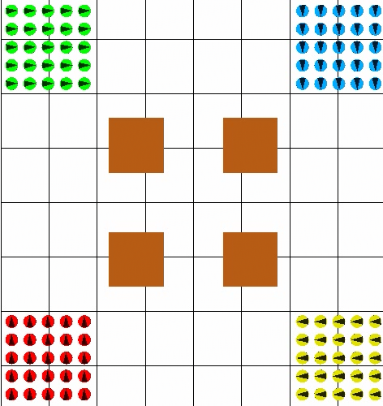
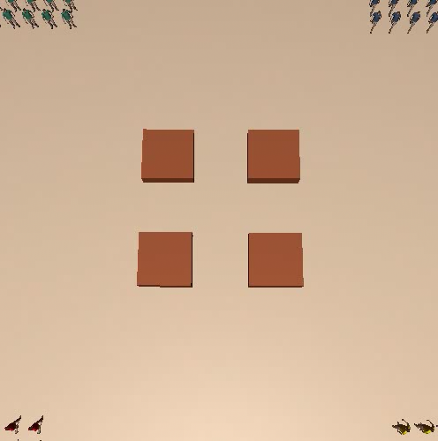
Results
Scenario:
Four groups, of 25 agents each, are placed in the 4 corners of the environment and have to move to their opposite corner.
Notes:
- We implemented our approach in order to evaluate it and test its applicability in real-time applications:
a) In the 4-blocks scenario, as you can see, the agents anticipate that a congestion will occur at the center of the environment and avoid it by moving around the obstacles. (If you have time you can also say that depending on the input parameters, e.g. capacity information, different macroscopic behaviours can be generated and play the corresponding video).
b) Two opposing groups need to exchange positions while passing through a narrow bottleneck. Our method is able to prevent deadlock situations from occurring by regulating the starting times of the agents, incorporating explicit waiting behaviour and dealing with opposing flows of agents through the use of lanes. In the next movie, I will show you how a typical collision avoidance method combined with a global planner handles this scenario. As can be observed, as the bottleneck becomes crowded, the agents start to exhibit undesirable behaviours and eventually they get stuck in the congested area. In this example, we used the rvo method for collision avoidance. However, no matter what local collision avoidance method is employed, due to the nature of the problem, congestion conditions evolve near the bottleneck and the agents are susceptible to local minima problems. For example, we also used the ORCA formulation, as proposed by the reviewers, with similar results.
Note also that approaches like coordination graphs are specifically designed to resolve this type of scenarios. However, they are not generic enough to handle a wide range of complex planning problems.

Slide 16
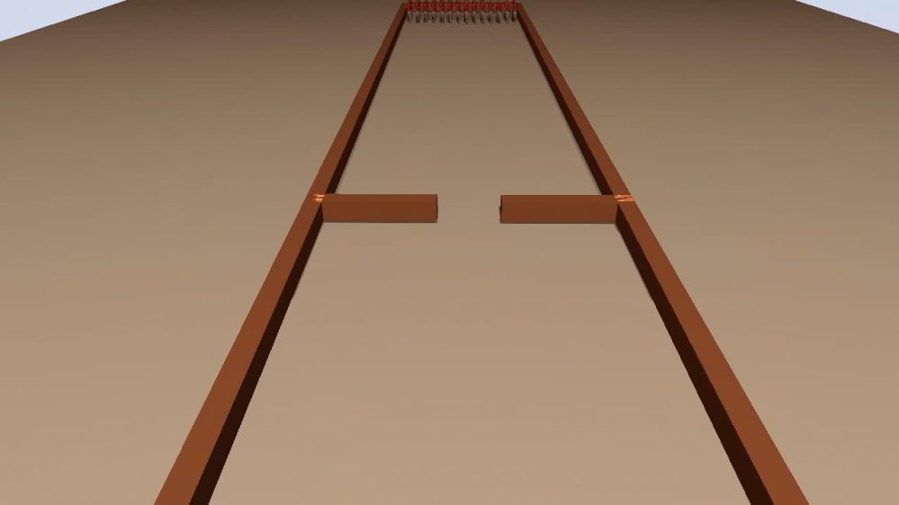
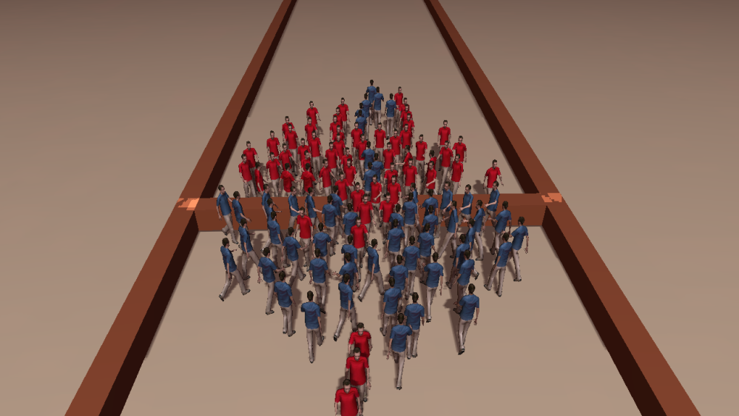
Results
Scenario:
Two opposing groups, of 50 agents each, exchange positions while passing through a narrow bottleneck.
Notes:
b) Two opposing groups need to exchange positions while passing through a narrow bottleneck. Our method is able to prevent deadlock situations from occurring by regulating the starting times of the agents, incorporating explicit waiting behavior and dealing with opposing flows of agents through the use of lanes. In the next movie, I will show you how a typical collision avoidance method combined with a global planner handles this scenario. As can be observed, as the bottleneck becomes crowded, the agents start to exhibit undesirable behaviours and eventually they get stuck in the congested area. In this example, we used the RVO method for collision avoidance. However, no matter what local collision avoidance method is employed, due to the nature of the problem, congestion conditions evolve near the bottleneck and the agents are susceptible to local minima problems. For example, we also used the ORCA formulation, as proposed by the reviewers, with similar results.
Note also that approaches like coordination graphs are specifically designed to resolve this type of scenarios. However, they are not generic enough to handle a wide range of complex planning problems.

Slide 17
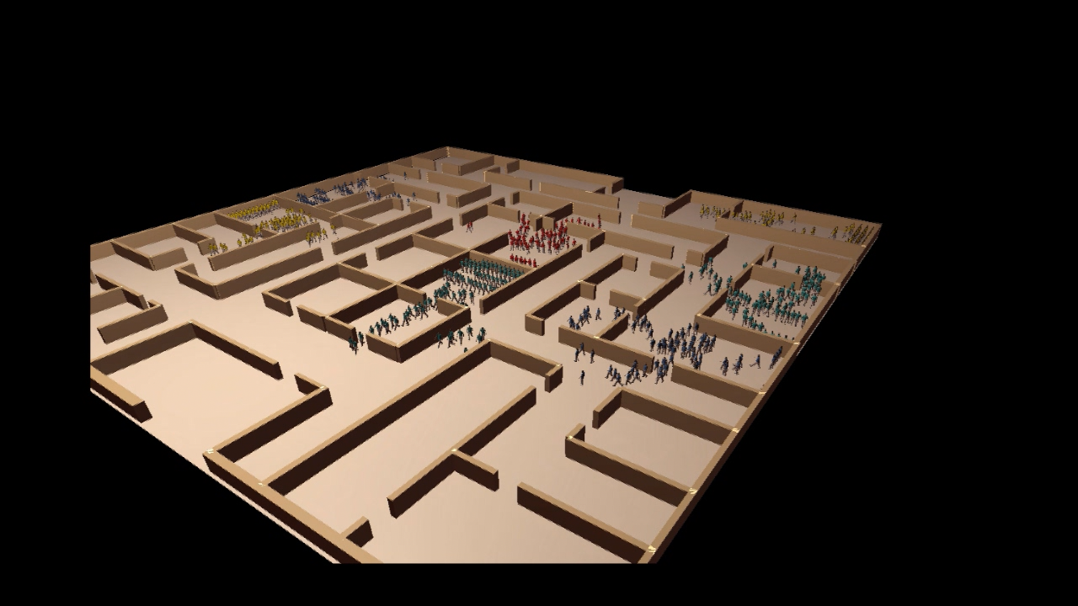
Results
Scenario:
Seven groups of 100 agents each have to evacuate an office building floor through two main exits.
Notes:
c) In this scenario, 7 groups of 100 agents are positioned randomly across an office building floor. The agents have to evacuate the building through two main exits.
As can be observed, our approach directs the group flows over alternative paths in both time and space, allowing the agents to quickly escape through the two exits. By controlling the starting and waiting times of the agents, no oscillatory behavior is observed when the agents thread through the narrow doorways. (Alternatively you may load the Office2.avi)

Slide 18
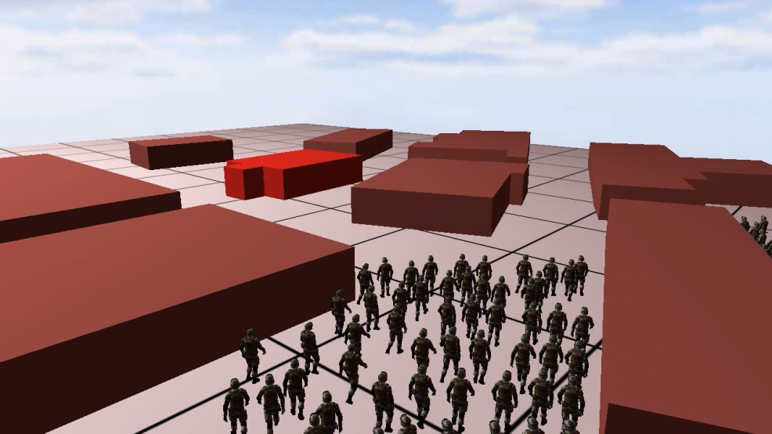
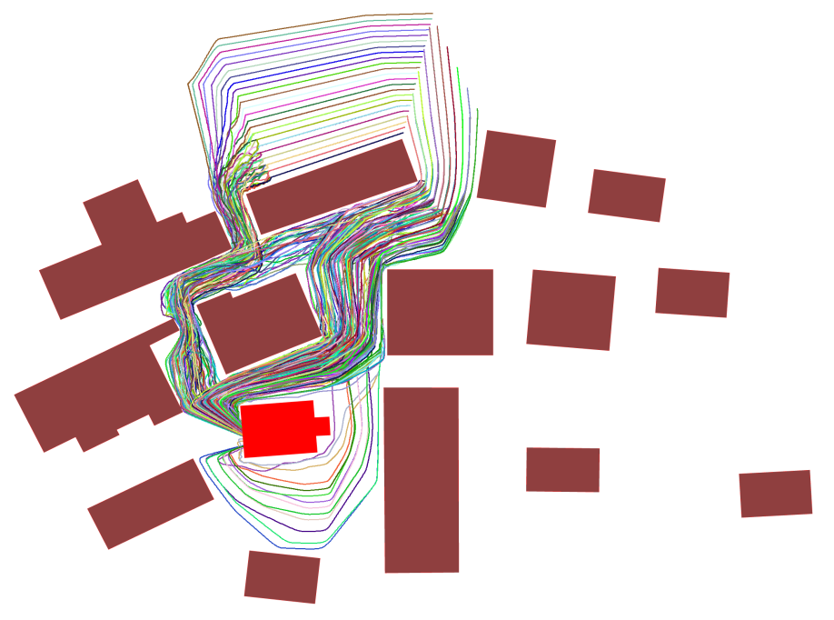
Results
Scenario:
An army of 400 soldiers needs to move to a designated goal area in a village-like environment.
Notes:
d) An army of 400 soldiers needs to move to a designated goal area in the village-like environment.
Our approach identifies areas with low capacity and divides the soldiers over different space-time paths allowing them to avoid congestions and quickly reach their target. Moreover, the agents exploit the
maximum capacity of the corridors and spread over the environment while moving toward their destinations, as can be seen in the figure above. Let me show you an example of a simulation generated by our approach.

Slide 19
Results
Quantitative evaluation
  Metrics
    Average travel time of the agents.
    Maximum travel time among the agents.
    Average percentage error between actual and expected (ILP) arrival times of the agents.
  Results
Scenes | Max travel time (s) | Avg. travel time (s) | Optimality error (%)
4-Blocks | 32.41 (52.59/47.19) | 30.01 (37.06/37.67) | 1.29
Bottleneck | 186.9 (219.4/203.8) | 129.75 (139.46/138.03) | 6.36
Office | 189.1 | 123.59 | 8.63
Military | 149.78 | 117.61 | 4.69
Notes:
Besides the visual inspection of the generated simulations, we are also interested in a quantitative evaluation of our model. We first measured for each scenario the average time that it takes for the agents to reach their goals, as well as the time that it takes for the last agent to arrive at its goal. In general, by planning in both time and space and exploiting the notion of lanes, interactions among agents are efficiently solved enabling fast traveling times. In the 4-blocks scenario, for example, using a global roadmap in combination with the RVO method led to an average traveling time of 37.06s, whereas the max arrival time was 52.59s (see parenthesis), as compared to our technique. Similarly, in the narrow bottleneck scenario, it took 219.4s for the last agent to arrive at its goal. (I will update these numbers using the ORCA method during the weekend, as proposed by the reviewers).
To adequately assess the quality of our approach, we also need to determine the efficiency of the steering algorithm used in the second phase of our framework. For that reason, we compared the actual time that an agent requires in order to reach its destination with its expected arrival time. The latter is simply the length of the agent’s time-expanded path computed by the ILP. The % error between the actual and the expected arrival time can then be used as a measure of the optimality of the agent’s trajectory. Since each agent needs to avoid collisions with other agents and is also subject to dynamic constraints, its actual traveling time is higher
than the expected one. However, as can be seen from the table, in all of our experiments, the optimality error is quite low, indicating that our approach generates near time-optimal trajectories.

Slide 20
Results
Performance
  Intel Core 2 Duo CPU (2.4 GHz) using a single core
  The size of the time step used in the time-expanded graph allows for a tradeoff between accuracy and speed.
Scenes | # Agents | Capacitated Graph (# vertices, # edges) | Group planning time (msec) | Avg. sim. time (msec/frame)
4-Blocks | 100 | (9, 12) | 15.6 | 0.28
Bottleneck | 112 | (4, 3) | 358.8 | 0.29
Office | 700 | (218, 235) | 1156.2 | 0.72
Military | 400 | (42, 56) | 514.8 | 0.37
Notes:
This table summarizes the performance of our approach on the four benchmark scenarios. All computations were run on a 2.4 GHz Core 2 Duo CPU (on a single core).
The fourth column of the table indicates the total running time of the first phase of our approach, that is solving the ILP and determining the space-time paths of the group members. The last column of the table indicates the average computation time of the second phase of our approach, that is the average time taken per simulation step to steer the agents and resolve collisions. As can be inferred, our steering algorithm combined with the underlying collision avoidance scheme is very efficient. This is expected, since most of the collisions are taken into account during the ILP planning. In addition, the use of lanes dramatically reduces the number of collisions that need to be resolved at every step of a simulation.
Regarding the total planning time of the first phase, the difficulty of the problem seems to have a high impact on the computational cost. See, for example, the difference in the running times between the 4-blocks and the narrow bottleneck scenarios. The difficulty of the problem is directly related to the arc and node capacities of the time-expanded graph and can be controlled by the size of the time step $\Delta t$ used for the discretization of the graph. Smaller time steps improve the accuracy of the graph at the expense of higher computational times. In our example scenarios, the time step was set to 1sec with the exception of the office scenario where we set \Delta t = 2sec. Please see our paper for more details (and the thesis).

Slide 21
Conclusions
Limitations
  During the ILP planning, we assume that members of the same group prefer to move with the same desired speed.
  Group members may split up in order to reach their goals as fast as possible.
  Waiting on certain nodes of the capacitated graph may lead to unconvincing simulations.
  The level of heterogeneity between the simulated groups may have a strong impact on the realism.
Notes:
Like any other model, our approach makes some simplifying assumptions.
a) Our system is specifically designed to model groups of agents. While in-group members can have different behaviour characteristics (e.g. size, personal space, maximum speed), during the ILP planning, we assume that they prefer to move with the same desired speed. This enables our method to account for dynamic congestion and other time-consuming situations. We think that this assumption is also justifiable in real-life, where people belonging to the same group tend to exhibit similar walking behaviours.
b) In our implementation, we do not require groups to stay coherent. Consequently group members may split up and take alternative paths trying to reach their targets as quickly as possible. Note that group coherence can be obtained either by modifying the ILP formulation or discarding any isolated path returned by the ILP.
c) Using our approach the agents can wait on the nodes of the capacitated graph. However, in certain scenarios, this may lead to unconvincing visual simulations. For example, in the Office scenario, as the graph is based on the medial axis of the environment, many nodes are placed in-between the doorways. Of course, waiting on these nodes would be unrealistic, as typically people prefer to wait inside the offices. If our goal is simply to coordinate the movements of robots so that they can quickly reach their destinations, then this is not a problem. However, if we strive for a realistic simulation, we should either manually annotate the graph nodes at which waiting is permitted, or use a different type of graph than the medial axis.
d) Finally, we must note that the level of heterogeneity between the simulated groups may have a strong impact on the realism of the resulting simulations. For example, even though we could simulate an army of soldiers interacting with a group of tanks, the generated capacity graph would allow too little space for the soldiers to maneuver, since such a graph is constructed based on the maximum personal space among all entities present in the world.

Slide 22
Conclusions
Future Work
  Traffic simulation
  Logistics problems
  Multi-group planning in changeable and interactive environments
Project Website
  http://sites.google.com/site/ikaramouzas/ilp
  Motion planning for human crowds: from individuals to groups of virtual characters, PhD thesis.
Notes:
Despite the aforementioned limitations, we believe that, overall, our solution can be used to efficiently resolve complex planning situations involving one or multiple groups of agents.
Although our current work focuses on crowds of virtual agents, other virtual environment applications can benefit from it as well. An interesting extension, for example, would be to use our formulation for simulating traffic in streets of urban environments and in complex highway scenarios, where congestions and traffic jams are very likely to arise. In this case, refinements to the structure of our capacitated graph and its corresponding ILP will be necessary to account for the kinematic and dynamic constraints of the simulated vehicles and be able to incorporate different types of vehicle motions.
Another important direction for future work is to address changeable and interactive environments, as our current implementation assumes that the virtual world remains static and its dynamics are perfectly known a priori. Note that in such changeable environments, in which obstacles may appear, disappear and paths can become blocked or invalid due to the user interaction, the agents may not have the time to plan and re-plan optimal paths across the time-expanded graphs. To this end, we can trade-off optimality for performance gain by quitting the column generation algorithm as soon as a feasible solution has been found (before we have solved the LP-relaxation problem to optimality).
- Finally, you can find a detailed explanation of our method, including theorems, proofs and additional experiments in Ioannis’ PhD thesis, which will be available online start of July. Note that we have already addressed several of the comments of the reviewers in our paper and we will also provide a more updated version by the end of June. Due to space limitations, though, several of the comments are addressed in the aforementioned phd thesis.

Slide 23
Questions
Thank you !

