Slide 1

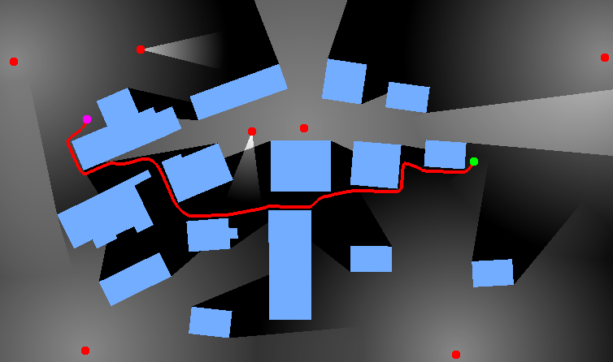
Stealth-Based Path Planning using Corridor Maps
Roland Geraerts and Erik Schager
CASA 2010

Slide 2
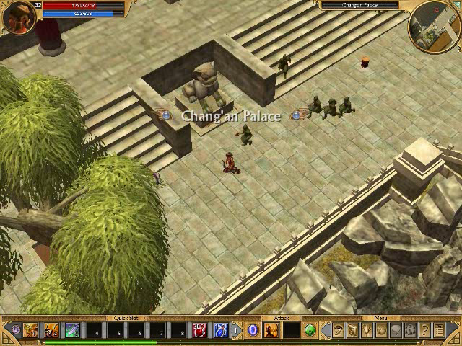
Requirements
Fast and flexible 2D path planner
Real-time planning for thousands of characters
Dealing with local hazards
Global path
Natural paths
Smooth
Short
Keeps some distance to obstacles
Avoids other characters
Minimize exposure to hostile observers
Titan Quest: Immortal throne

Slide 3
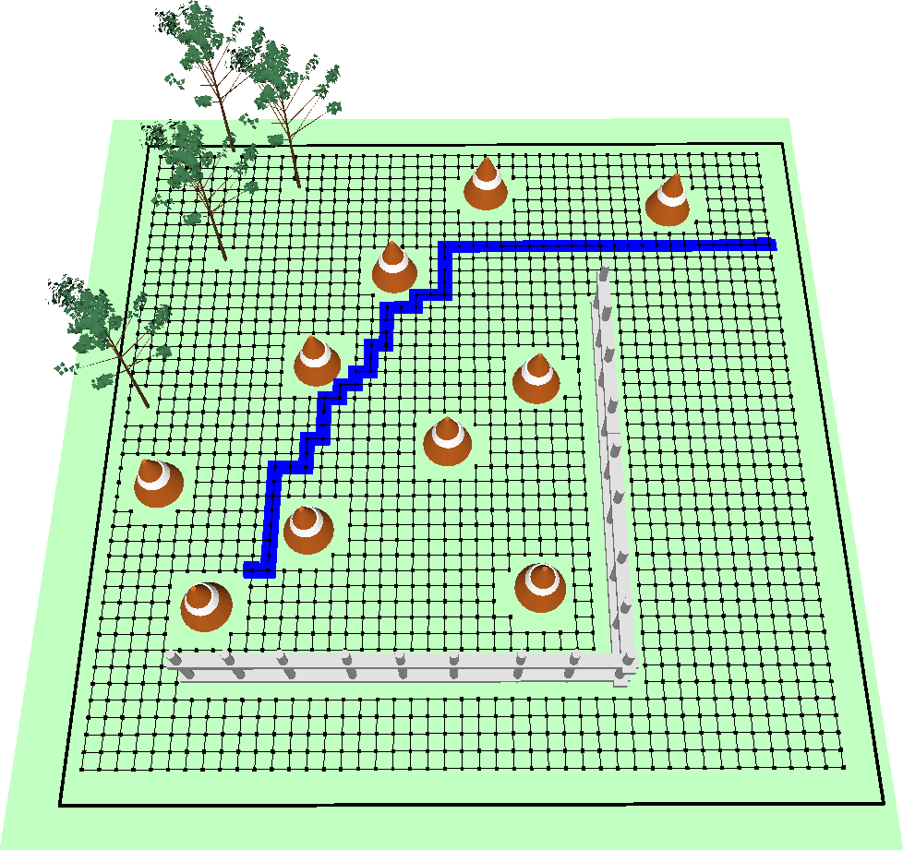
Representing the Free Space
Traditional approach
Run a shortest-path algorithm on a grid
Advantages
Simple
Disadvantages
May not run through narrow passages
Slow in large or maze-like environments
Ugly paths: little clearance, sharp turns
Other approaches
Sampling-based motion planning methods, visibility graphs, …
Fixed path is inflexible

Slide 4
Representing the Free Space
Explicit Corridor Map
Medial axis
Annotated with closest points on obstacles
CM-Plus graph
Extra edges provide short and additional paths
[Geraerts 2010]
Notes:
Now that we’ve found a representation of the free space (planar subdivision), we need to incorporate the observers.
Explicit Corridor Map: See http://www.cs.uu.nl/~roland/motion_planning/ecm.html
Complexity ECM (new version): O(n); n = nr of vertices on obstacles
Computer: Quad-core 2.4 GHz, 1 cpu, Nvidia GTX 8800
Resolution: 1000x1000 pixels
Graph: 56 vertices, 70 edges, 838 samples on edges

Slide 5
Creating a Visibility Map
Visibility map
Assigns a visibility value to each free cell
Visibility value
Denotes the number of observers that see the cell
Describes how well they see the cell
The lighter the cell, the more visible it is

Slide 6
Creating a Visibility Map
Computing the visibility for one observer
Construct visibility polygon by updating visibility cone
Notes:
Computation is done on the original ECM graph→ find cell: O(log n) time; visibility polygon: output sensitive

Slide 7
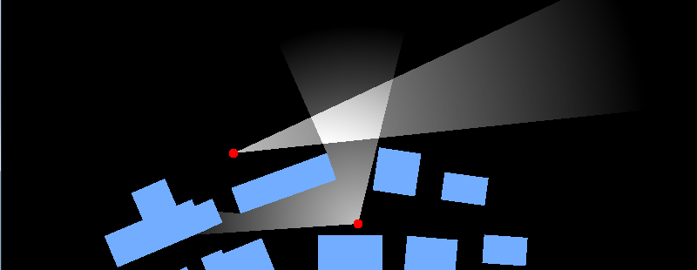
A More Realistic Vision Model
Incorporate limitations
Limit field of view
Limit the vision range
Limit the vision intensity
Implementation uses GPU for efficiency purposes
B
C
A

Slide 8
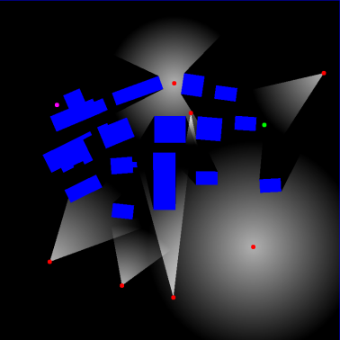
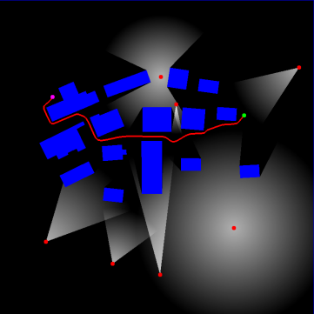
Finding a Stealthy Path
Costs of stealthy path
Combination of path length and its visibility
+
=
Edge costs: distance
Edge costs: visibility
Stealthy path

Slide 9
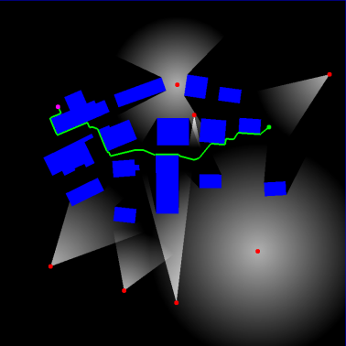


Finding a Stealthy Path
Algorithm
Connect start and goal to the Explicit Corridor Map
Find the shortest path in the graph (using A*)
Retract this path to the medial axis
Retrieve corresponding corridor
Provides global route and flexibility to deal with local hazards
Compute stealthy path using the Indicative Route Method
Uses shortest path and corridor

Slide 10
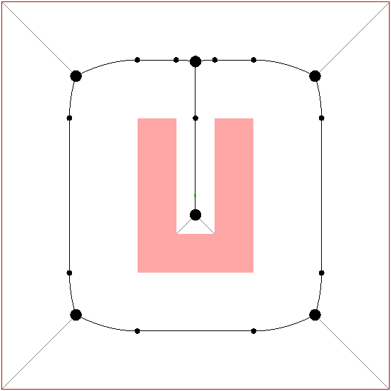
Finding a Stealthy Path
Indicative Route Method [Karamouzas, Geraerts, Overmars; 2009]
Compute an Indicative Route
Shortest path
Define the attraction force
Point moves along Indicative Route
Pulls the character toward the goal
Define the boundary force
Keeps the character inside the corridor
Define other forces
Leads to other behaviors, e.g. character avoidance
Time-integrate the forces
Yields a smooth (C1-continous) path

Slide 11
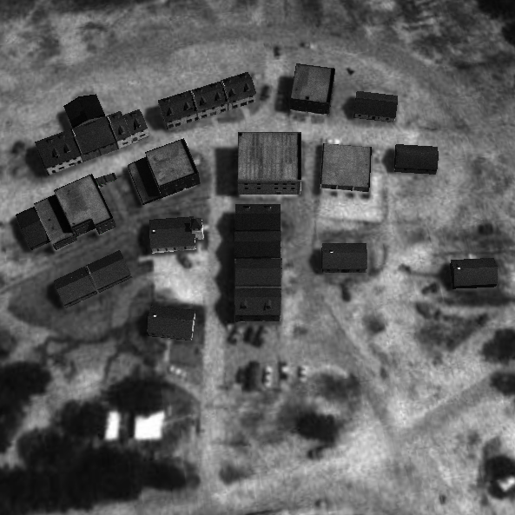
Experiments
Setup
GPU: NVIDIA GeForce 7600 GT graphics card
CPU: Intel Core2 Duo E6300 1.86 GHz, 1 CPU used
Environment: 200x200m, 23 polygons, 1000x1000 pixels
Results: CM-Plus graph
Environment + footprint
Running time: 13ms
Running time: 15ms

Slide 12
Experiments
Setup
GPU: NVIDIA GeForce 7600 GT graphics card
CPU: Intel Core2 Duo E6300 1.86 GHz, 1 CPU used
Environment: 200x200m, 23 polygons, 1000x1000 pixels
Results: visibility
Average running time of 100 random queries
running time (ms)
resolution
Notes:
One random location and visibility area, random visibility range

Slide 13
Experiments
Setup
GPU: NVIDIA GeForce 7600 GT graphics card
CPU: Intel Core2 Duo E6300 1.86 GHz, 1 CPU used
Environment: 200x200m, 23 polygons, 1000x1000 pixels
Results: stealthy paths
Average running time of 1000 random paths, 3 observers
CPU-load (%)
resolution

Slide 14
Conclusions and Future Work
The Corridor Map data structure facilitates
Computing visibility polygons
Minimum-exposure paths
Path quality
Similarly stealthy as traditional approach, but
Short, smooth, guaranteed amount of clearance, …
Implementation
The algorithms are simple and fast
Future work
Handle many observers efficiently
Handle dynamic observers efficiently

Slide 15
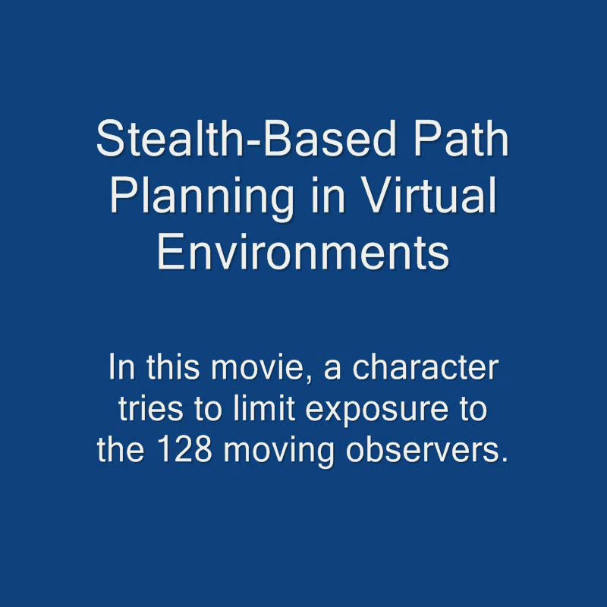
Questions
Contact
Roland Geraerts (roland@cs.uu.nl)
Home page: www.cs.uu.nl/~roland
Conference: www.motioningames.org
128 dynamic observers: CPU-load=8%

