Slide 1

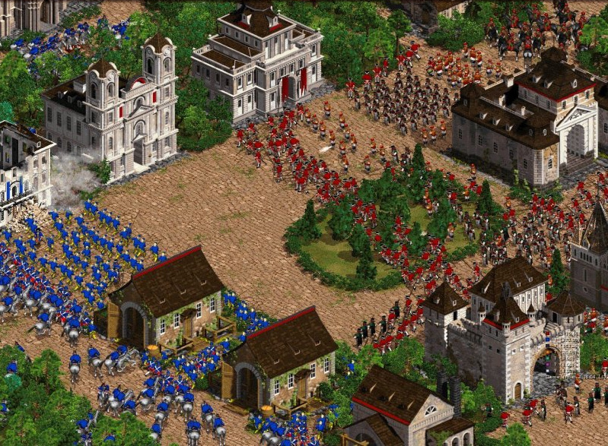
Path Planning for Groups using Column Generation
Roland Geraerts Han Hoogeveen Marjan van den Akker Corien Prins
Motion in Games 2010
Notes:
Cossacks: back to war [2002]

Slide 2
What are we going to solve?
Problem
Find paths for one or more groups of units
Minimize average arrival times of all units
Each group has its own start/goal area
Each unit will traverse its own path
Assumptions
The units in a group have equal size and speed
Environment is static
Our focus is on global path planning

Slide 3
Pathfinding challenges with groups
Movie: Path finding challenges with large groups

Slide 4
Pathfinding challenges with groups
Non-optimal distribution of paths
Long traversal times
Getting stuck near narrow passages
Many re-planning actions
Simplifications
Primitive local planner
No dynamic updates taken into account
Primitive collision avoidance
Notes:
4

Slide 5
Related work
Games and AI: fast, but greedy
A* on a grid [Hart 1968]
Boids model [Reynolds 1987]
Roadmap techniques [Bayazit et al 2002]
Corridors [Kamphuis & Overmars 2004]
Robotics: slow, but good solutions
Centralized methods [Sánchez & Latombe 2002]
Decoupled methods [Siméon et al 2002]

Slide 6
Our solution
Solution
We propose a global method based on linear programming
Set of compatible paths
From this set paths can be chosen for the units
External collision-avoidance algorithm can be plugged in
Units walk these paths in a natural way

Slide 7
Our solution
First step: creating a graph
Each arc gets a traversal time and a capacity
Two-dimensional representation of the free space
ECM graph
Explicit Corridor Map
Corridor
Demo

Slide 8
Dynamic multi-commodity flow
Related problem: dynamic multi-commodity flow
Commodity i corresponds to the i’th group of units
Commodity i must flow from origin i to destination i
The size of the commodity is equal to the size of the group
The goal is to minimize the average arrival time
An earliest arrival flow (maximum throughput at each time point) would be perfect

Slide 9
Known results for this problem
One origin, one destination
Ford-Fulkerson (1958) maximize throughput
Wilkinson (1971) finds earliest arrival flow
Fully exchangeable units
Hoppe and Tardos (2000): polynomial, but not practical
Baumann and Skutella (2009): earliest arrival flow for multiple source, one sink case
General problem (throughput)
NP-hard (Hall, Hippler, Skutella, 2007)
Nice survey by Skutella (2008)

Slide 10
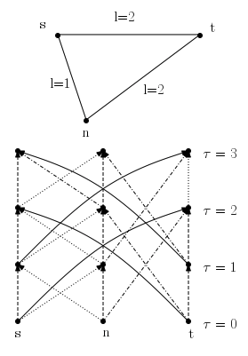
Useful: Time-expanded graph
Create this graph as follows
Nodes: one copy per time unit
Arcs connecting vertices at the right time
Waiting arcs of length 1

Slide 11
Integer Linear Programming formulation (1)
Formulation
We use an ILP-formulation based on paths in the time-expanded graph
A path fully specifies when you arrive/leave a vertex
Each path connects an Origin-Destination pair
The cost of path s is equal to the time it arrives in the destination
For each path s we introduce a decision variable x_{s} denoting the number of units following this path

Slide 12
Integer Linear Programming formulation (2)
Objective: minimize average travel time of units subject to the constraints
All units must arrive at their destinations
All variables are ≥ 0 and integral
All capacity constraints are obeyed at all times
Easy for an arc
Hard for an edge (which can be traversed in both ways)

Slide 13
Capacity division for edges
Division of capacity per edge
Edges can be traversed in both directions
You need many constraints to enforce the capacity constraint at time t
We use a constant division of the capacity u_{e} over time
u₁(e) ≥ 0 for one direction
u(e) − u₁ (e) ≥ 0 for the other direction
u₁(e) is a decision variable.
If necessary, we can let u₁(e) vary over time

Slide 14
Inconveniences of the model
Two drawbacks
An ILP is computationally demanding to solve to optimality
but do we really need an optimum?
There are very many paths possible in the time-indexed graph for each Origin-Destination pair; we do not want to (and cannot) enumerate them all

Slide 15
LP-relaxation finds an approximate solution
LP-relaxation
Relax ILP to LP: drop the requirement that the variable x_{s} has to be integral → we allow that a fractional number of units follows path s
Solve the LP-relaxation using column generation:
Start with a subset of variables (paths) that allow a solution
Repeat the following until an optimal solution has been found:
Solve LP for the current set of variables
Find new variables (paths) that improve the solution

Slide 16
Pricing problem (1)
Pricing problem
LP-theory: a variable can improve the current solution only if it has negative reduced cost
Find path with minimum reduced cost (pricing problem)
Add this path, together with the paths that are obtained by shifting the time by which the origin is left

Slide 17
Pricing problem (2)
Reduced cost
The reduced cost of a path is equal to its original cost (the time it arrives at the destination) with corrections for its compatibility with other paths (using saturated arcs increases its cost)
These saturation costs (dual variables) are known per arc
The pricing problem boils down to finding a shortest path problem in the time-expanded graph with lengths adjusted with dual variables for each origin-destination pair separately

Slide 18
Back to an integer solution
Possible approach
Solve the ILP formulation for the set of paths discovered when solving the LP-relaxation
Add additional paths if necessary
Not very satisfactory: we will come back to this

Slide 19
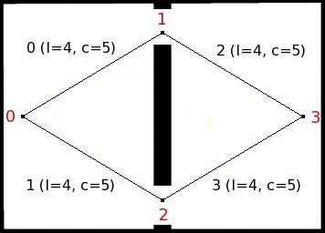
Units in opposite direction (1)
We have
Two groups
Two routes
Equal length
Equal capacity
40 units from 0 to 3
200 units from 3 to 0

Slide 20
Units in opposite direction: solution
Solving the LP requires 150 ms; scales up nicely

Slide 21
Specific challenges in game environments
Challenges
It must run in real time
We do not want to use paths that lead to isolated units in a war game
The environment may change
There can be different types of units (different speed, width)
Integration with a local rule for collision avoidance

Slide 22
Real time computation
Solving the ILP takes too long
Require more units per origin-destination pair
Add new paths until you run out of time (the resulting solution may not be optimal, but it is feasible)
Round down the LP-relaxation
If there are redundant paths, then select the best set in post-processing
If you run out of time: compute some paths quickly, let the first units follow these, and compute additional paths for the remaining units

Slide 23
Avoid having isolated units
Isolated units may get slaughtered in a war game
Generate more than enough paths for all units
Select the right number of paths from this set (each choice is feasible!)
You can use all kinds of criteria for this choice, like speed and safety

Slide 24
Recomputation after a change
If the environment changes …
then we must come up with a new plan quickly
Translate the environmental changes into changes in constraints
Remove paths that are no longer valid
Do not solve the problem from scratch; start with the current, presumably infeasible solution
LP is known to possess very convenient possibilities to deal with changes in parameters
Possibly: Use insight in the game to anticipate changes

Slide 25
Different types of units
Tanks versus humans
A different width is no problem; split up the group into subgroups according to width
Different speed is a problem
Reserving space for overtaking slower units requires many additional constraints
Work-around: sequential solution with divided capacity

Slide 26
Collision avoidance
Integration with collision avoidance
We have generated a set of compatible paths
Collision avoidance may lead to additional constraints
Not too many units in a vertex (for example a room)
Avoidance varies the speed of units a little
A limited space for units per vertex can be easily modeled through an additional constraint
A small variation in speed is no problem; this only occurs in case of big groups of units
Methods
Predictive model [Karamouzas et al 2009]
Reciprocal velocity obstacles [van den Berg et al 2008]

Slide 27



Questions
Contact
Roland Geraerts
roland@cs.uu.nl
www.cs.uu.nl/staff/roland.html
Han Hoogeveen
slam@cs.uu.nl
www.cs.uu.nl/staff/slam.html

