Slide 1
The FoCal Detector Project
Physics motivation
  The structure of a proton
  A new state of matter: the color glass condensate
  The signal: direct photons
A new photon detector
  Introduction to electromagnetic calorimeters
  A high granularity calorimeter

Slide 2
Proton Structure
Scattering experiments of electrons on protons reveal the constituents of the proton
Dominantly a proton consists of 3 “valence” quarks (up, up, down)
  More detailed view:
  Other quarks and gluons can also be found inside the proton.
  Characterized by probability distributions as a function of
  x = p_{L}(quark)/p_{L}(proton)

Slide 3
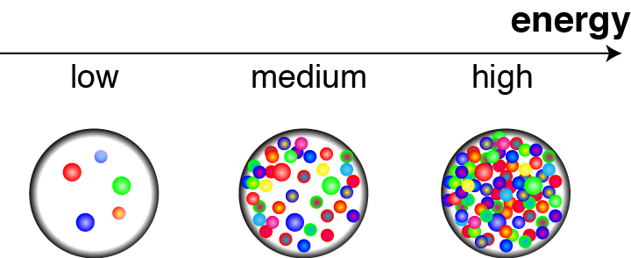
Proton Structure
Number of quarks and gluons (= partons) that are “visible” depends on the energy of the scattering.
  More precisely: higher momentum transfer Q
Higher scattering energy = better resolution, more partons
  Few partons with high momentum split up into many partons with low momentum

Slide 4
Proton Structure
  Prediction of traditional theory of strong interactions:
  Parton distributions functions (PDFs) at small momentum fraction x increase for large momentum transfer Q2.
  “DGLAP-evolution”

Slide 5
Gluon Saturation
DGLAP-evolution is due to parton splittings:
g → g+g, …
For very high parton density, reverse processes become important, i.e. gluon fusion:
g+g → g, …
The balance between both processes leads to a dynamic equilibrium: gluon saturation.
  At high Q² and small x the gluon density saturates at a very high value.

Slide 6
A New State of Matter
Theoretical description of the saturated state of gluons:
  High density: a condensate
  Slowly varying on typical time scales: glass-like
  Consists of colour charges
Colour glass condensate
Behaves like the classical field limit of the strong interaction.
Defines the state of protons when seen in high energy scatterings.
  Important for the understanding of collisions at very high energy.

Slide 7
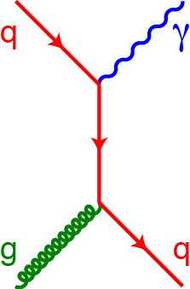
Direct Photons as a Signal
To observe this state need to measure the gluon distributions at low x.
Production of “direct photons”
is sensitive to gluon density
Need to measure production from gluons at small x:
  Small angles relative to the beam (large “rapidity”)
  At small angles particle density is high.
Need detector for high energy photons, which can separate also very close-by particles: new technology!

Slide 8
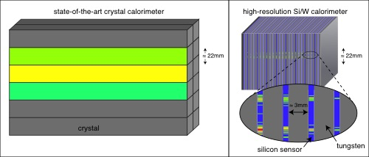
A High Granularity Calorimeter
Conventional calorimeter has limited granularity.
New sandwich-structure from W and silicon allows very high granularity: superior measurement properties.

Slide 9
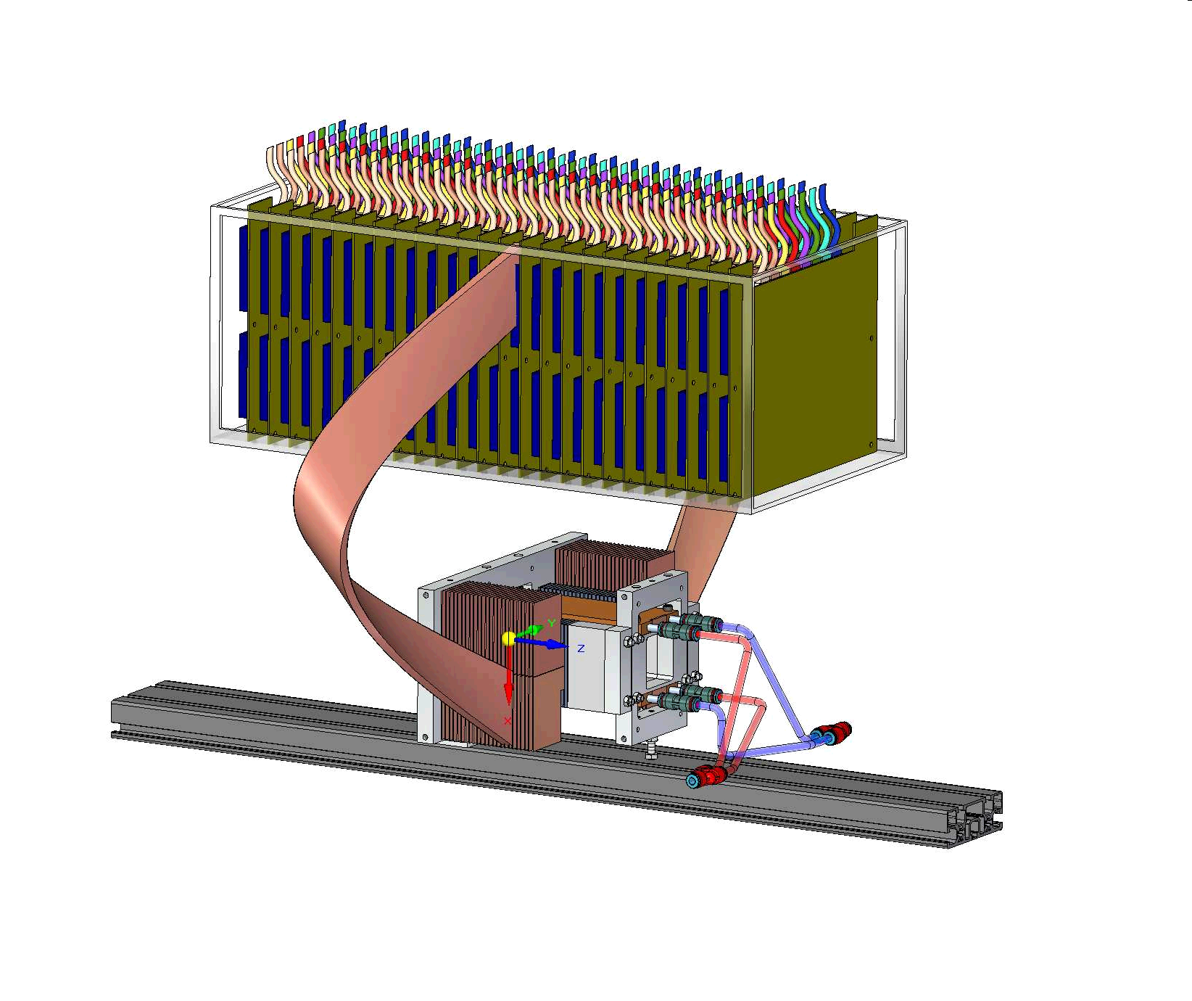
The FoCal Project
  First detector prototype:
  39 Million silicon pixels in a 4cm x 4cm x 10cm large device
  Allows extremely precise measurement of high energy photons

Slide 10
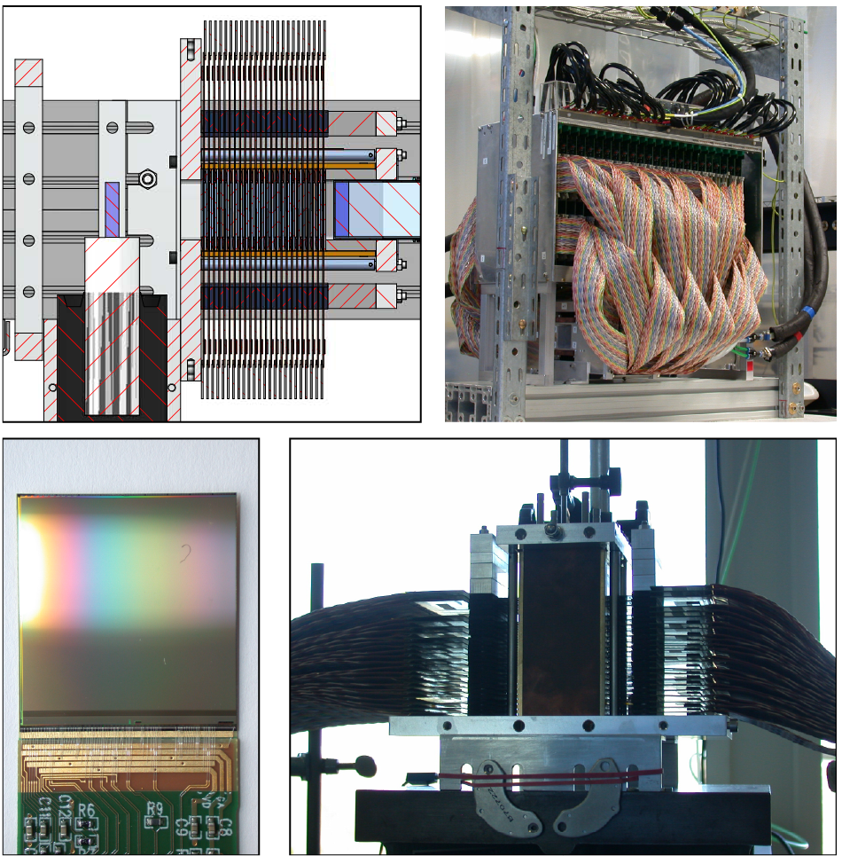
The FoCal Project

