Slide 1
Graphs and Algorithms (2MMD30)
Lecture 5
Introduction to Exponential Time:
Clever Enumeration

Slide 2
Overview of Today
Introduction
CNF-Sat
3-coloring
Vertex Cover + Definition of FPT
Cluster Editing
Feedback Vertex Set
Subset Sum

Slide 3
Exponential time
Many problems NP-complete
How fast can solve in worst-case?
sometimes all else fails
Exponential time isn’t too bad sometimes (FPT)
interesting algorithmics.

Slide 4
CNF-Sat
Recall the definition of CNF-formula
literal $l_{i}$: expression of the type $v_{i}$ or $¬v_{i}$.
clause $C_{i}$: disjunction of literals (e.g. $v_{i}∨¬v_{j}$)
CNF-formula: conjunction of clauses (e.g. $C_{i}∧C_{j}$)
k-CNF-formula: all clauses of size at most k
Examples:
$v_{1}∧\left(¬v_{2}∨v_{3}∨v_{4}\right)$
$\left(v_{2}∨v_{1}\right)∧\left(v_{2}∨¬v_{3}\right)∧\left(¬v_{3}∨v_{5}\right)$
(k-)CNF-SAT: is the given (k-)CNF-formula satisfiable?
n denotes #vars, m denotes #clauses

Slide 5
CNF-Sat
Easy $O{(2}^{n}nm)$ time algorithm:
Footnote*: nothing substantially better is known!
(the `Strong Exponential Time Hypothesis’ even states O(1.99^{n}(n+m)^{c}) is not possible).
*footnotes will not be examinated

Slide 6
3-coloring in O(2^{n}(n+m)) time
k-coloring of G=(V,E): map $c:V→\{1,…,k\}$ s.t. $c\left(u\right)≠c\left(v\right)$, for every $\left(u,v\right)∈E$.
Not 2-colorable

Slide 7
3-coloring in O(2^{n}(n+m)) time
k-coloring of G=(V,E): map $c:V→\{1,…,k\}$ s.t. $c\left(u\right)≠c\left(v\right)$, for every $\left(u,v\right)∈E$.
2-colorable

Slide 8
3-coloring in O(2^{n}(n+m)) time
k-coloring of G=(V,E): map $c:V→\{1,…,k\}$ s.t. $c\left(u\right)≠c\left(v\right)$, for every $\left(u,v\right)∈E$.
2-colorable

Slide 9
3-coloring in O(2^{n}(n+m)) time
k-coloring of G=(V,E): map $c:V→\{1,…,k\}$ s.t. $c\left(u\right)≠c\left(v\right)$, for every $\left(u,v\right)∈E$.
2-colorable

Slide 10
Vertex Cover
A vertex cover of G=(V,E) is a subset $X⊆V$ such that for every edge $\left(u,v\right)∈E$, $u∈X$ or $v∈X$.
Can you find a vertex cover of size 7 in the graph below?

Slide 11
Vertex Cover
A vertex cover of G=(V,E) is a subset $X⊆V$ such that for every edge $\left(u,v\right)∈E$, $u∈X$ or $v∈X$.
Can you find a vertex cover of size 7 in the graph below?

Slide 12
First algorithm for vertex cover

Slide 13
…
v
w
6
v
w
…
7
…
6
v
w
…

Slide 14
Time Bound and Branching tree
We spend at most O(n+m) time per recursive call
Recursion depth is at most k
Thus, the number of recursive calls is at most k*#non-rec. calls.
Let $T\left(k\right)$ be #non-rec calls
$T\left(0\right)=1$
$T\left(k\right)≤T\left(k−1\right)+T(k−1)$
$T\left(k\right)≤2^{k}$
Running time: $O(\left(n+m\right)k2^{k})$
Depth at most k
Number of leaves at most 2^{k}

Slide 15
Parameterized Complexity
As long as k is constant, $O\left(\left(n+m\right)k2^{k}\right)$ is linear time.
In our example n=27, k=7,
$2^{27}=\text{134217728}$, $2^{7}=128$
In general, we can often isolate the exponential dependency of the RT in a parameter that is often small.
A parameterized problem is a language $L⊆\{0,1\}^{∗}×ℕ$. For an instance $\left(x,k\right)∈\{0,1\}^{∗},$ $x$ is called the input, and $k$ is called the parameter.
A parameterized problem is called Fixed Parameter Tractable (FPT) if there exists an algorithm for it that runs in time $f\left(k\right){\left|x,k\right|}^{c}$, for some constant $c$ and function $f(⋅)$.
So, vertex cover parameterized by k is FPT

Slide 16
Second algorithm for vertex cover

Slide 17
…
6
v
…
7
…
2
…

Slide 18
Time Bound and Branching tree
We spend at most O(n+m) time per recursive call
Recursion depth is at most k
Thus, the number of recursive calls is at most k*#non-rec. calls.
Let $T\left(k\right)$ be #non-rec calls
$T(0)=1$
$T\left(k\right)≤\max_{d≥2}{T\left(k−1\right)+T(k−d)}$
$T\left(k\right)≤{1.62}^{k}$
Running time: $O(\left(n+m\right)k2^{k})$

Slide 19
Time Bound and Branching tree
We spend at most O(n+m) time per recursive call
Recursion depth is at most k
Thus, the number of recursive calls is at most k*#non-rec. calls.
Let $T\left(k\right)$ be #non-rec calls
$T(0)=1$
$T\left(k\right)≤\max_{d≥2}{T\left(k−1\right)+T(k−d)}$
$T\left(k\right)≤{1.62}^{k}$
Running time: $O(\left(n+m\right)k2^{k})$
How to guess $T\left(k\right)≤{1.62}^{k}$?
Since it’s a linear recurrence, $T\left(k\right)=c^{k}$
$T(k)≤{\max_{d≥2} c}^{k−1}+c^{k−d}$ $≤c^{k−1}+c^{k−2}≤c^{k},$
Dividing both sides by $c^{k}$ gives $c^{−1}+c^{−2}≤1$
So for any $c$ satisfying this, $T\left(k\right)≤c^{k}$.
Use educated guess or a numerical method for guessing some $c$ (there is no easy formula).
(want)

Slide 20
Cluster Editing
Given graph G=(V,E), a cluster editing of size k is a set of k `modifications’ to G, such that each connected component is a clique (cluster graph),
modification: addition of deletion of an edge.
Models biological questions: partition species in families, where available data contains mistakes
NP-complete.
Example with k=4:

Slide 21
Cluster Editing via induced P₃’s
G is a cluster graph if and only it does not contain an induced $P_{3}$
If cluster graph, clearly no induced $P_{3}$
If not cluster graph, there are non-adjacent u and x. Let $u,v_{1},…,x$ be a shortest path from u to x. Then $u,v_{1},v_{2}$ is an induced $P_{3}$.
u
v
w

Slide 22
Cluster Editing via induced P₃’s
G is a cluster graph if and only it does not contain an induced $P_{3}$
G has cluster editing of size at most k if and only if at least one of the graphs $\left(V,E∖uv \right),\left(V ,E∖vw\right),\left(V,E∪uw\right)$ has a cluster editing of size at most k-1.
u
v
w
Runs in $O(3^{k}n^{3})$ time.
Usually we focus on f(k): $O^{∗}(3^{k})$ time.
$O^{∗}()$ suppresses factors poly in input size

Slide 23
Feedback Vertex Set via Iterative Compression
A feedback vertex set (FVS) of an undirected graph $G=(V,E)$ is a subset $X⊆V$such that $G\left[V∖X\right]$ is a forest.
In operating systems, feedback vertex sets play a prominent role in the study of deadlock recovery. In the wait-for graph of an operating system, each directed cycle corresponds to a deadlock situation. In order to resolve all deadlocks, some blocked processes have to be aborted.

Slide 24
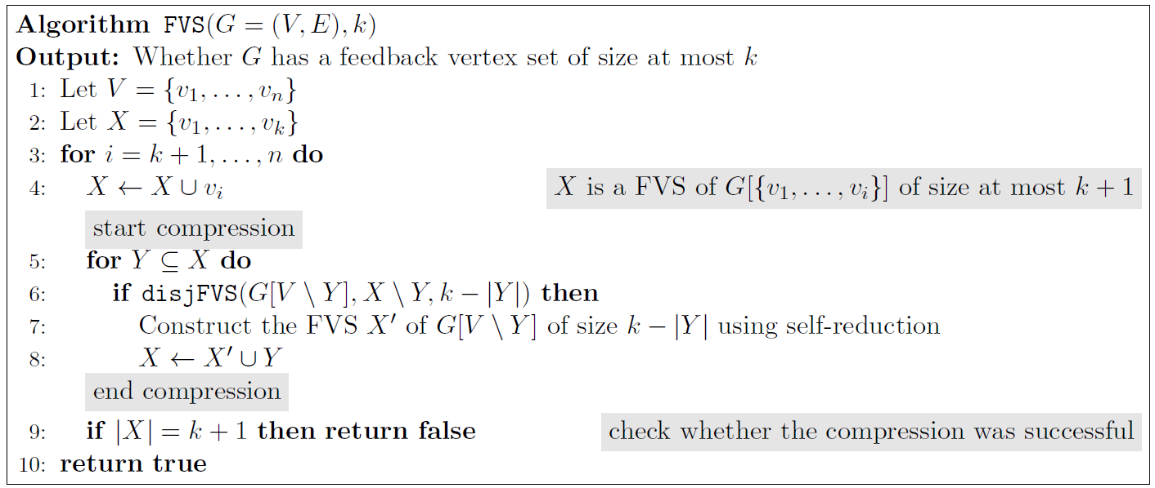
Iterative compression?
Crux: it helps if we are given a FVS of size k+1
Iterative compression allows us to assume this
Use X to find the minimum FVS of $G[\{v_{1},…,v_{i}\}]$. Write the found FVS to X again

Slide 25
Iterative compression?
Crux: it helps if we are given a FVS of size k+1
Iterative compression allows us to assume this
Use X to find the minimum FVS of $G[\{v_{1},…,v_{i}\}]$. Write the found FVS to X again
$$v_{1}$$
$$v_{2}$$
$$v_{3}$$
$$v_{4}$$
$$v_{5}$$
$$v_{6}$$
$$v_{7}$$
$$v_{n}$$

Slide 26
Iterative compression?
Crux: it helps if we are given a FVS of size k+1
Iterative compression allows us to assume this
Use X to find the minimum FVS of $G[\{v_{1},…,v_{i}\}]$. Write the found FVS to X again
$$v_{1}$$
$$v_{1}$$
$$v_{2}$$
$$v_{3}$$
$$v_{4}$$
$$v_{5}$$
$$v_{6}$$
$$v_{7}$$
$$v_{n}$$

Slide 27
Iterative compression?
Crux: it helps if we are given a FVS of size k+1
Iterative compression allows us to assume this
Use X to find the minimum FVS of $G[\{v_{1},…,v_{i}\}]$. Write the found FVS to X again
$$v_{1}$$
$$v_{2}$$
$$v_{3}$$
$$v_{3}$$
$$v_{4}$$
$$v_{5}$$
$$v_{6}$$
$$v_{7}$$
$$v_{n}$$

Slide 28
Iterative compression?
Crux: it helps if we are given a FVS of size k+1
Iterative compression allows us to assume this
Use X to find the minimum FVS of $G[\{v_{1},…,v_{i}\}]$. Write the found FVS to X again
$$v_{1}$$
$$v_{2}$$
$$v_{3}$$
$$v_{4}$$
$$v_{4}$$
$$v_{5}$$
$$v_{6}$$
$$v_{7}$$
$$v_{n}$$

Slide 29
Iterative compression?
Crux: it helps if we are given a FVS of size k+1
Iterative compression allows us to assume this
Use X to find the minimum FVS of $G[\{v_{1},…,v_{i}\}]$. Write the found FVS to X again
determines there exists a FVS of G disjoint from X of size at most k.
$$v_{1}$$
$$v_{2}$$
$$v_{3}$$
$$v_{4}$$
$$v_{5}$$
$$v_{6}$$
$$v_{7}$$
$$v_{n}$$

Slide 30
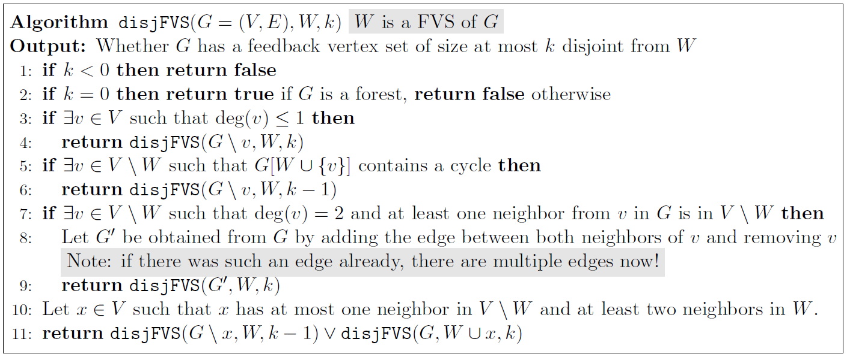
L3: $v$ is not on any cycle so not relevant
L5: the only way to hit the cycle is to pick $v$
L7: if $N\left(v\right)=\{u,w\}$, all cycles including $v$ also include$u$ and$w$.
In any FVS$v$ can be replaced with $u,w$
Thus we may discard including $v$
Delete $v$, account for the connections via $v$ by adding $uw$.
W= X\Y
forest
w
u
v
v
v

Slide 31
Let $x$ be leaf in forest with $≥2$nbs in $V∖W$
if $x$ has no such neighbor, L3 applies
if x has 1 such neighbor, L7 applies.
Now decide whether $x$ is in or not.
if it is, simply remove it
If it is not, discard by adding to $W$
Finishes correctness
W= X\Y
forest
w
u
v

Slide 32
Running time:
Does not decrease k every time.
But surely instance should get easier?!
$μ\left(G,W,k\right)=k+\#cc(G[W])$does decrease
$k$ decreases in first branch
$\#cc\left(G\left[W\right]\right)$ in second
So as in previous analyses, algo runs in
$O^{∗}\left(2^{k+\#cc\left(G\left[W\right]\right)}\right)={O^{∗}(4}^{k})$
Total running time: $O^{∗}(8^{k})$.
W= X\Y
forest
w
u
v

Slide 33
Subset Sum
Given integers $w_{1},…,w_{n},t$ find $X⊆\{1,…,n\}$ such that $\sum_{i∈X }{w_{i}}=t$
{1 2 3 4 5 6 7 8 9 10 11 12}, t= 50
We’ll see ${O^{∗}(2}^{n/2})$ time algorithm here.
2SUM: given $a_{1},…,a_{m},b_{1},…,b_{m},t$ find $i,j$ such that $a_{i}+b_{j}=t$.
We’ll see: 2SUM in $O(m lg m )$ time.
{1 2 3 4 5 6 7 8 9 10 11 12}, t= 50

Slide 34
Subset Sum via 2SUM
Use as follows; suppose $n$ even.
Create an int $a_{i}=\sum_{e∈X}{w_{e}}$ for all $X⊆\{1,…,n/2\}$
Create an int $b_{i}=\sum_{e∈Y}{w_{e}}$ for all $Y⊆\{n/2+1,…,n\}$
There exist $i,j$ with $a_{i}+b_{j}=t$ iff there exists $X⊆\{1,…,n/2\}$, $Y⊆\{n/2+1,…,n\}$ such that $\sum_{e∈X}{w_{e}}+\sum_{e∈Y}{w_{e}=t}$ ($X∪Y$ is a solution)
2SUM in $O\left(m\lg{m}\right)$ time, $m=2^{n/2}$.

Slide 35
Linear Time for 2SUM
j
$$l_{1},l_{2},…,l_{m−1},l_{m}$$
$$r_{1},r_{2},…,r_{m−1},r_{m}$$
If $l_{i}+r_{j}<t$ -> increase i,
If $l_{i}+r_{j}>t$ -> decrease j,
If $l_{i}+r_{j}=t$ -> solution
Declare NO if i or j out of range
Linear
Search
i

Slide 36
Linear Time for 2SUM
Clearly correct if it returns true
If there exists $x,y$ such that $l_{x}+r_{y}=t$,
consider the first moment where $i=x$or$j=y$
say it is $i=x$, since $y<j$, $j$ will be lowered until $l_{x}+r_{j}=t$. Case $j=y$ is similar
Clearly run in $O(m\lg{m})$ time.

Slide 37
Subset Sum in $O\left(2^{n/2}\right)$ time and $O\left(2^{n/4}\right)$ space
4SUM: given $a_{1},…,a_{m}, b_{1},…,b_{m},c_{1},…,c_{m},$ $d_{1},…,d_{m},t$ find $i,j,k,l$ s.t. $a_{i}+b_{j}+c_{k}+d_{l}=t$.
We’ll see: $O\left(m^{2}\lg{m}\right)$ time, $O(m\lg{m})$ space
How to use? Excercise 5.3

Slide 38
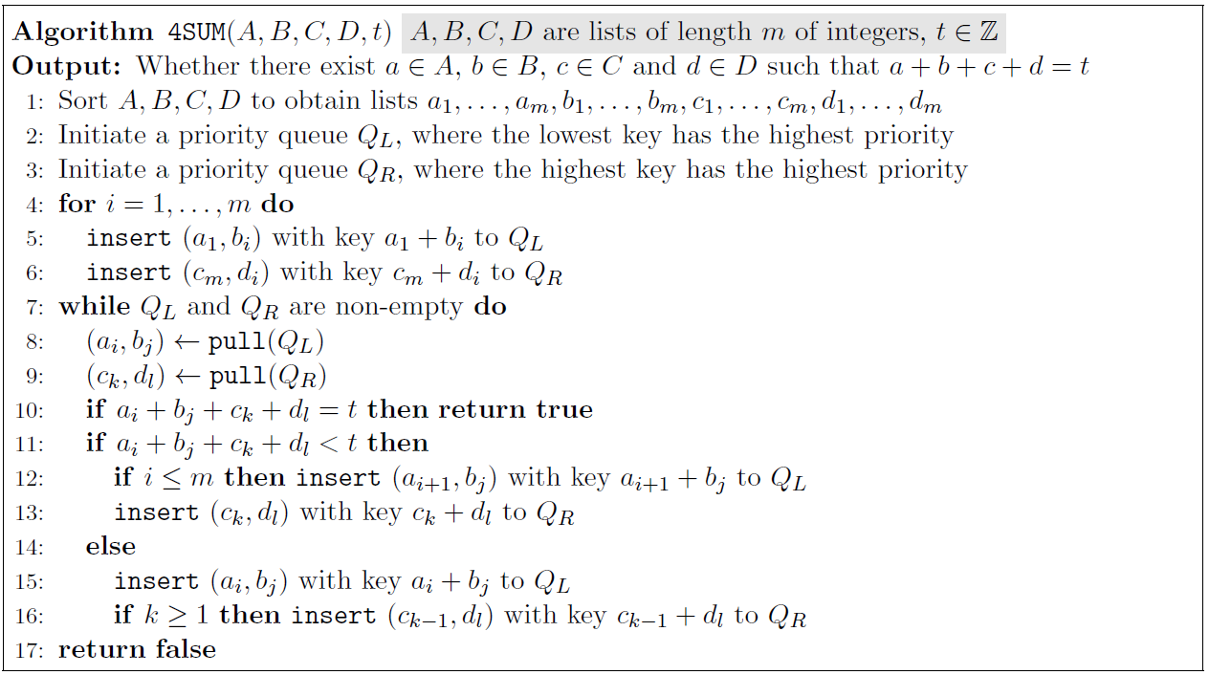
The contents of this algorithm will not be examinated
Mimicks 2-SUM with L = A+B, R=C+D in space efficient way
Always has a solution at l10
If exists w,x,y,z s.t. $a_{w}+b_{x}+c_{y}+d_{z}=t$, reaches $w,x$ or $y,z$ at some point,
in the other queue we move to the correct indices.

