Slide 1
Subset Sum (and related problems)
Jesper Nederlof (Eindhoven University)
Based on
[Part 1]
Bansal, Garg, N, Vyas Faster Space-Efficient Algorithms for Subset Sum, k-Sum, and Related Problems [STOC’17, SICOMP’18]
[Part 2]
Austrin, Kaski, Koivisto, N Subset Sum in the Absence of Concentration [STACS 2015]
Austrin, Kaski, Koivisto, N Dense Subset Sum May Be the Hardest [STACS 2016]

Slide 2

Subset Sum
010011110010000010100001100001101010010
Given integers $w_{1},…,w_{n},t$ find $X⊆\left[n\right]$ with $\sum_{i∈X}{w_{i}=t}$
$O(nt)$ time by DP
$O^{∗}\left(t\right)$ time, poly space [LN, STOC’10]
$\tilde{O}\left(n+t\right)$ time, or $\tilde{O}(nt)$ time poly space [B SODA’17]
not in $O^{∗}(t^{1−ε})$ time under SETH [ABHS, SODA’19]
${O^{∗}(2}^{n})$ time, poly space ($O^{∗}$omits poly factors in input)
${O^{∗}(2}^{n/2})$ time, $O^{∗}(2^{n/2})$ space [HS, JACM’72]
${O^{∗}(2}^{n/2})$ time, $O^{∗}(2^{n/4})$ space [SS, SICOMP81]
Algo
i’th bit?
$poly(n)$ time
0/1
Theorem: There is a Monte Carlo algorithm for Subset Sum using $O^{∗}(2^{0.86n})$ time and poly space, assuming random read-only access to random bits

Slide 3
List Disjointness
Given two lists $x,y∈{\left[m\right]}^{n}$, $m≤poly(n)$
Asked do they share a common value?
$x=\text{(}\text{1, 9, 2, 4, 9, 4, 6, }\text{5}\text{, 2)}$ $y=(\text{7, 8, }\text{5}\text{, 0, 3, 7, 3, 0, 8})$
Define $p\left(x\right)=\sum_{v∈[m]}{{|x}^{−1}\left(v\right){\left.​\right|}^{2}};$ i.e p$\left(y\right)=1+4⋅2^{2}$ $p\left(x,y\right)=p\left(x\right)+p\left(y\right)$ Counts number of pseudo-solutions
Theorem: There is an $\tilde{O}\left(n\sqrt{p}\right)$ time, $O(\log{n})$ space algorithm for List Disjointness, if given $p\left(x,y\right)≤p$
assuming random read-only access to random bits

Slide 4
Floyd’s Cycle Finding
Define $f\left(i\right):=\left\{\begin{aligned}x_{i}, i≤n \\ &y_{n−i}, i>n\end{aligned}\right.$
We are interested* in distinct $i,j$ with $f\left(i\right)=f(j)$
View $f$ as digraph (with arcs $(i,f(i))$)
s

Slide 5
Floyd’s Cycle Finding
Define $f\left(i\right):=\left\{\begin{aligned}x_{i}, i≤n \\ &y_{n−i}, i>n\end{aligned}\right.$
We are interested* in distinct $i,j$ with $f\left(i\right)=f(j)$
View $f$ as digraph (with arcs $(i,f(i))$)
i
s
j

Slide 6
Meet in the Middle [HS JACM 72]
Ints $w_{1},…, w_{n},t$. Denote w$\left(X\right)≔ \sum_{i∈X}{w_{i}}$
Reduce SSS on $n$ integers to List Disjointness on lists of length $2^{n/2};$run the sorting algo
$$L$$
$$R$$
$w_{1},…,w_{n/2}$, $w_{n/2+1},…,w_{n}$
$$x={\left(w\left(X\right)\right)}_{X⊆L}$$
$$y={\left(t−w\left(X\right)\right)}_{X⊆R}$$
LD instance solved in $O(2^{n/2}\operatorname{polylog}{(2^{n/2})})$ time, which is $O^{∗}(2^{n/2})$. Also uses $2^{n/2}$ space

Slide 7
Meet in the Middle [HS JACM 72]
Ints $w_{1},…, w_{n},t$. Denote w$\left(X\right)≔ \sum_{i∈X}{w_{i}}$
Reduce SSS on $n$ integers to List Disjointness on lists of length $2^{n/2};$run the sorting algo.
new
$$L$$
$$R$$
$w_{1},…,w_{n/2}$, $w_{n/2+1},…,w_{n}$
$$x={\left(w\left(X\right)\right)}_{X⊆L}$$
$$y={\left(t−w\left(X\right)\right)}_{X⊆R}$$
$O^{∗}\left(1\right)$ space, $O^{∗}(2^{n/2}\sqrt{p(x,y)})$ time
$p\left(x\right)=\left|\{X,Y⊆L:w\left(X\right)=w\left(Y\right)\}\right|≤2^{n}$
If $w_{i}=0$, $p\left(x\right),p\left(y\right)=2^{n}$ -> $2^{n}$ time ☹
How do instances with $p\left(x\right)≥2^{0.99n}$ look?

Slide 8
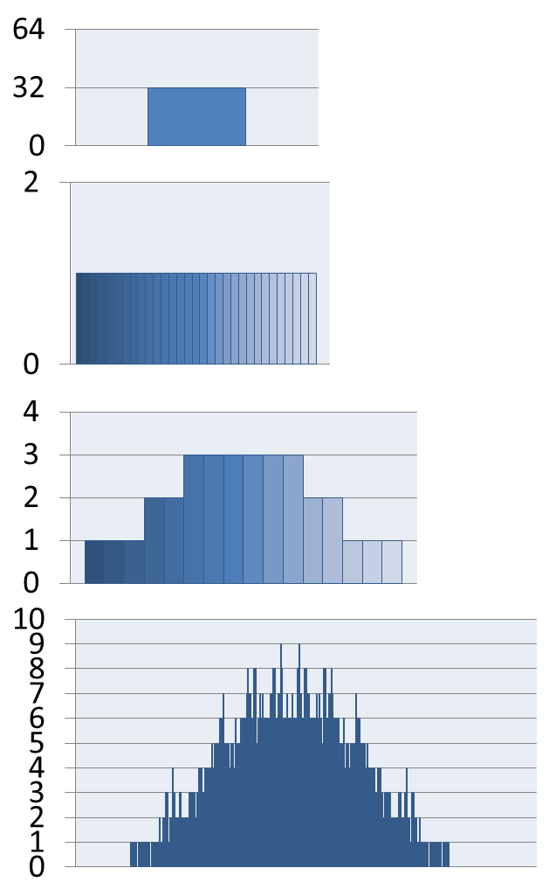
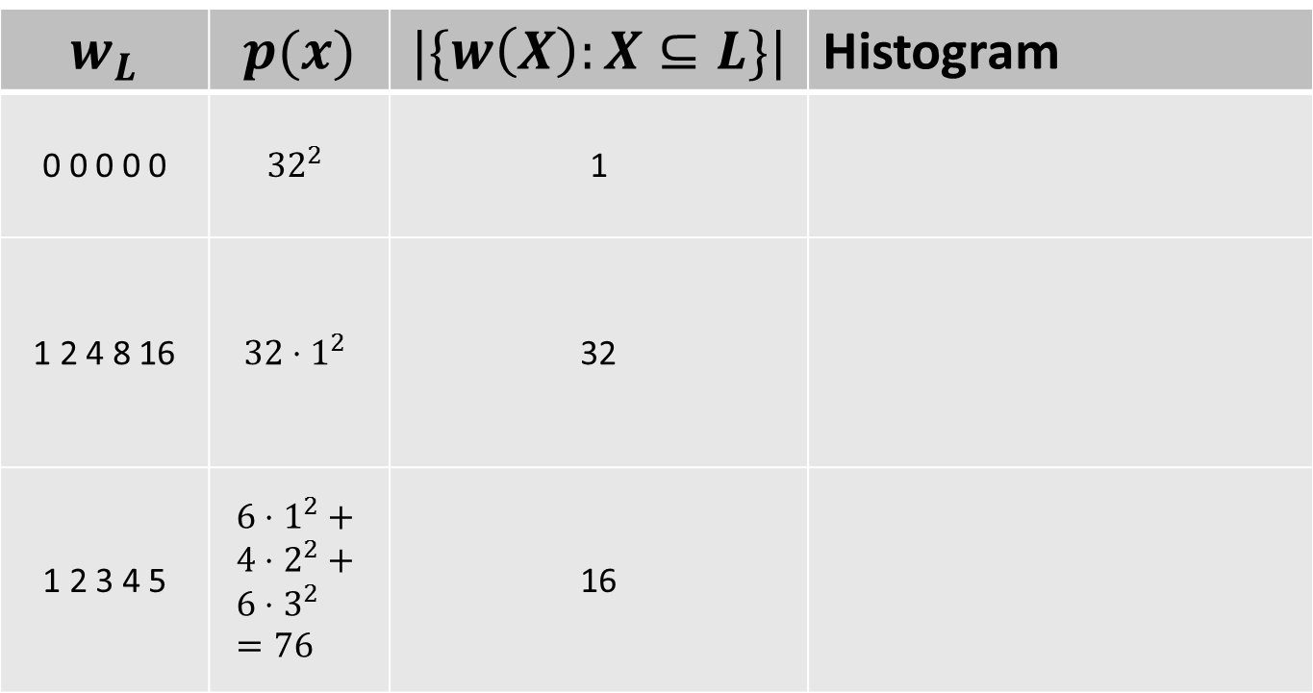
Smoothness Subset Sums [AKKN, STACS’16]
Lemma: $p\left(x\right)⋅|\{w\left(X\right):X⊆L\}|≤6^{n/2}$
$$w_{L}$$ | $$p(x)$$ | $$|\{w\left(X\right):X⊆L\}|$$ | Histogram
0 0 0 0 0 | $${32}^{2}$$ | 1
1 2 4 8 16 | $$32⋅1^{2}$$ | 32
1 2 3 4 5 | $$6⋅1^{2}+ \\ 4⋅2^{2}+ \\ 6⋅3^{2}=76$$ | 16

Slide 9
Smoothness Subset Sums [AKKN, STACS’16]
Lemma: $p\left(x\right)⋅|\{w\left(X\right):X⊆L\}|≤6^{n/2}$
If $p\left(x\right)>{1.99}^{n}$ or $p\left(y\right)>{1.99}^{n}$, then either
$|\{w\left(X\right):X⊆L\}|≤{1.99}^{n/2}$ or
$|\{w\left(Y\right):Y⊆R\}|≤{1.99}^{n/2}$.
But then $\left|\left\{w\left(X\right):X⊆\left[n\right]\right\}\right|≤{2^{\frac{n}{2}}1.99}^{\frac{n}{2}}≤{1.999}^{n}$
Lemma: Can solve instance $w_{1},…,w_{n},t$ in time $O^{∗}(\left|\left\{w\left(X\right):X⊆\left[n\right]\right\}\right|$) and poly space.
Hash numbers mod a prime of $O\left(\left|\left\{w\left(X\right):X⊆\left[n\right]\right\}\right|\right)$
Run $O^{∗}\left(t\right)$ time $O^{∗}(1)$ space DFT algo [LN, STOC’10]

Slide 10
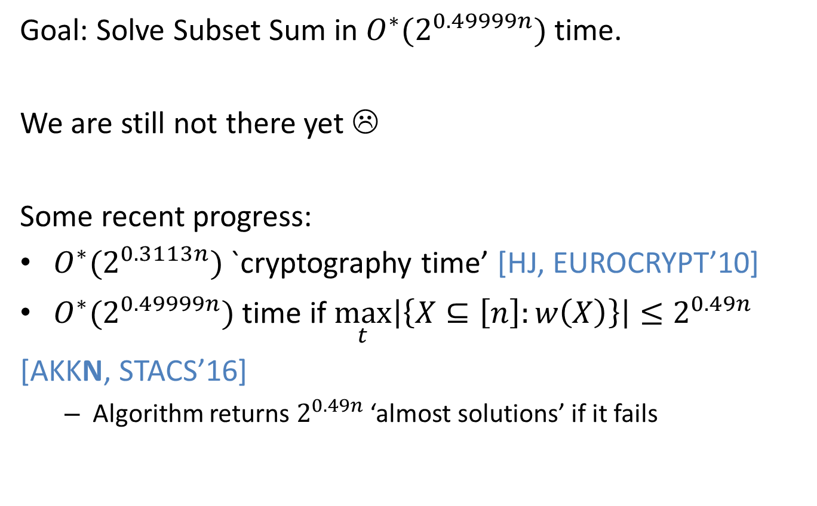
Part 2 [AKKN, STACS’15,16]
Goal: Solve Subset Sum in ${O^{∗}(2}^{0.49999n})$ time.
We are still not there yet ☹
Some recent progress:
${O^{∗}(2}^{0.3113n})$ `cryptography time’ [HJ, EUROCRYPT’10]
$O^{∗}(2^{0.49999n})$ time if $\max_{t}\left|\left\{X⊆\left[n\right]:w\left(X\right)\right\}\right|≤2^{0.49n}$
[AKKN, STACS’16]
Algorithm returns $2^{0.49n}$ ‘almost solutions’ if it fails

Slide 11
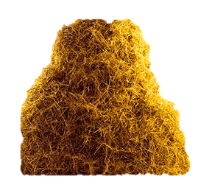
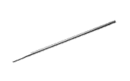
Representation Method [HJ’10]
Seek for a set in $𝒮⊆ \left({[n] \atop s}\right)$ as follows:
List $\left({[n] \atop s/2}\right)$, check if $A∪B∈𝒮$ for all pairs $A,B$ listed
$S∈𝒮$ gives rise to $\left({[n] \atop s/2}\right)≈2^{s}$ pairs (representatives)
Thus we can restrict our search to ${1/2}^{s}$ fraction of pairs
Only consider
needle

Slide 12
Representation Method [HJ’10]
Seek for a set in $𝒮⊆ \left({[n] \atop s}\right)$ as follows:
List $\left({[n] \atop s/2}\right)$, check if $A∪B∈𝒮$ for all pairs $A,B$ listed
$S∈𝒮$ gives rise to $\left({[n] \atop s/2}\right)≈2^{s}$ pairs (representatives)
Thus we can restrict our search to ${1/2}^{s}$ fraction of pairs
Seems bad idea: ${\left({n \atop s/2}\right)}^{2}/2^{s}≥\left({n \atop s}\right)$
for Subset Sum
restrict search space to only $\left({n \atop s/2}\right)/2^{s}$ candidates for $A$
for fixed $A$ quickly enumerate and check candidates for $B$
Specifically, pick $p≈2^{s}$, $t_{L}∈_{R}ℤ_{p}$
Check all $A$,$B$ with $w\left(A\right)≡_{p}t$, $w\left(B\right)≡_{p}t−t_{L}$

Slide 13
Concluding Remarks
Crypto people have many cool algorithmic ideas
Cycle finding is a great tool low space algo’s
Representation method gives unchampioned run times
Also used to solve $n$-element Set Cover in ${O^{∗}(2}^{\left(1−ε^{5}\right)n})$ time, if the target Set Cover is of size $εn$
Win/win approach for many/few distinct sums based on smoothness subset sum distribution
To improve over $O^{∗}(2^{n/2})$ time for Subset Sum it remains to `win’ in the case of few sums
Thanks for listening!

