Slide 1
Space and Time Efficient Structural Improvements of Dynamic Programming Algorithms
Jesper Nederlof
Dissertation for the degree of Philosophiae Doctor (PhD)
University of Bergen
December 2011

Slide 2
Outline
Dynamic Programming Ch2
Subset Sum Ch5
Steiner Tree Ch3
Steiner Tree on graphs of small treewidth Ch7
Hardness of Set Cover Ch8
Further remarks and conclusion

Slide 3
1
Dynamic programming (Chapter 2)

Slide 4
Dynamic Programming (DP)
Initiated in 1950's by Bellman in his book "Bottleneck Problems and Dynamic Programming".
Nowadays one of most prominent algorithmic techniques in designing algorithms.
Discussed in any basic course or text book on algorithms.

Slide 5
Dynamic Programming (DP)
The method works with a big table of data that has to be stored in the (preferably working) memory.
A relatively easy procedure computes new table entries using already computed table entries.
This easy procedure is often so easy that we just write it down as a single formula, obtaining a recurrence.

Slide 6
Dynamic Programming (DP)
Some problems for which DP is the best
approach (in theory):
“Easy problems” (we know how to solve them fast)
Weighted shortest path (Bellman-Ford algorithm).
Weighted longest path in directed acyclic graphs.
Matrix multiplication,
Sequence alignment.
“Hard problems” ( -hard problems)
Subset Sum, Knapsack, Steiner Tree, Set Cover,
Traveling Salesman Problem.
Problems on graphs of small treewidth.

Slide 7
Dynamic Programming (DP)
Some problems for which DP is the best
approach (in theory):
“Easy problems” (we know how to solve them fast)
Weighted shortest path (Bellman-Ford algorithm).
Weighted longest path in directed acyclic graphs.
Matrix multiplication,
Sequence alignment.
“Hard problems” ( -hard problems)
Subset Sum, Knapsack, Steiner Tree, Set Cover,
Traveling Salesman Problem.
Problems on graphs of small treewidth.

Slide 8
Dynamic Programming (DP)
Some problems for which DP is the best
approach (in theory):
“Easy problems” (we know how to solve them fast)
Weighted shortest path (Bellman-Ford algorithm).
Weighted longest path in directed acyclic graphs.
Matrix multiplication.
Sequence alignment.
“Hard problems" ( -hard problems)
Subset Sum, Knapsack, Steiner Tree, Set Cover,
Traveling Salesman Problem.
Problems on graphs of small treewidth.
Almost as fast, but using a lot less space.

Slide 9
Dynamic Programming (DP)
Some problems for which DP is the best
approach (in theory):
“Easy problems“ (we know how to solve them fast)
Weighted shortest path (Bellman-Ford algorithm).
Weighted longest path in directed acyclic graphs.
Matrix multiplication.
Sequence alignment.
“Hard problems" ( -hard problems)
Subset Sum, Knapsack, Steiner Tree, Set Cover,
Traveling Salesman Problem.
Problems on graphs of small treewidth.
Can be solved faster.

Slide 10
Dynamic Programming (DP)
Some problems for which DP is the best
approach (in theory):
“Easy problems“ (we know how to solve them fast)
Weighted shortest path (Bellman-Ford algorithm).
Weighted longest path in directed acyclic graphs.
Matrix multiplication.
Sequence alignment.
“Hard problems" ( -hard problems)
Subset Sum, Knapsack, Steiner Tree, Set Cover,
Traveling Salesman Problem.
Problems on graphs of small treewidth.
If counting version is solved faster, then a big open question is solved.

Slide 11
2
Subset Sum (Chapter 5)

Slide 12
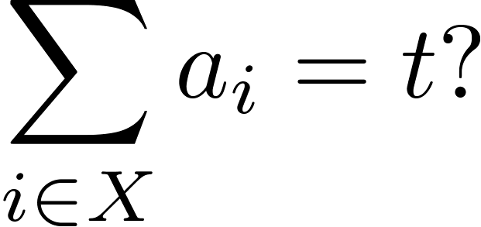
Subset Sum
Given: integers and integer
Asked: is there such that

Slide 13
Subset Sum
Given: integers and integer
Asked: is there such that
Example
{1 2 3 4 5 6 7 8 9 10 11 12}, = 50

Slide 14
Subset Sum
Given: integers and integer
Asked: is there such that
Example
{1 2 3 4 5 6 7 8 9 10 11 12}, = 50

Slide 15
Subset Sum
Integers:
Target:
Oef....
3 20 58 90 267 493 869 961
1000 1153 1246 1598 1766 1922

Slide 16
Subset Sum
Integers:
Target:
Oef....
3 20 58 90 267 493 869 961
1000 1153 1246 1598 1766 1922

Slide 17
Subset Sum
Integers:
Target:
Oef....
In fact, I even know there
are 5 solutions!
3 20 58 90 267 493 869 961
1000 1153 1246 1598 1766 1922

Slide 18
Subset Sum
Integers:
Target:
Oef....
In fact, I even know there
are 5 solutions!
How did I find I out?
3 20 58 90 267 493 869 961
1000 1153 1246 1598 1766 1922

Slide 19
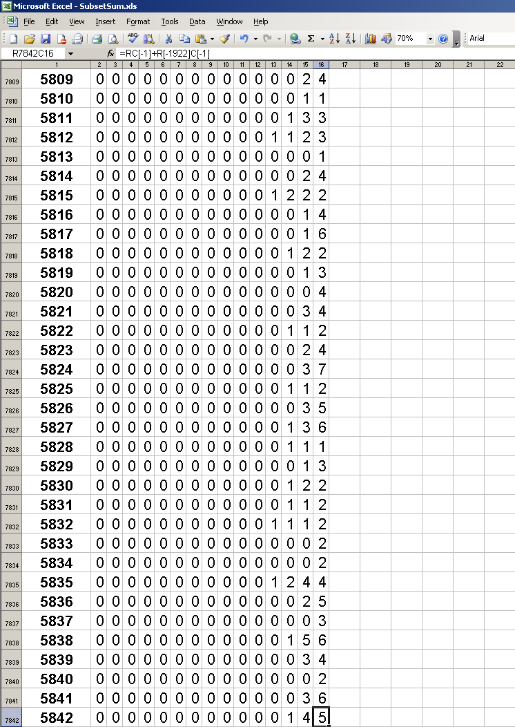
Subset Sum
Integers:
Target:
Oef....
In fact, I even know there
are 5 solutions!
How did I find I out?
3 20 58 90 267 493 869 961
1000 1153 1246 1598 1766 1922

Slide 20
Subset Sum
Integers:
Target:
Oef....
In fact, I even know there
are 5 solutions!
How did I find I out?
3 20 58 90 267 493 869 961
1000 1153 1246 1598 1766 1922

Slide 21
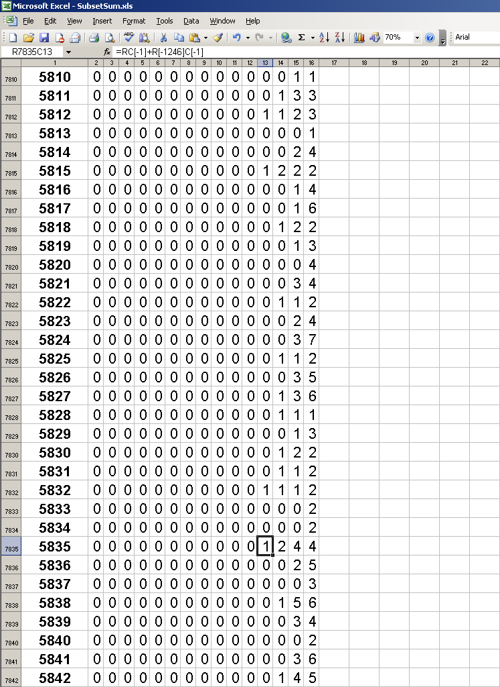
Subset Sum
Integers:
Target:
Oef....
In fact, I even know there
are 5 solutions!
How did I find I out?
3 20 58 90 267 493 869 961
1000 1153 1246 1598 1766 1922

Slide 22
 | 1 | 2 | ... | 14
0
1
2
3
4
5
6
7
8
9
10
...
5842 |  |  |  | ?

Slide 23
 | 1 | 2 | ... | 14
0
1
2
3
4
5
6
7
8
9
10
...
5842 |  |  |  | ?

Slide 24
 | 1 | 2 | ... | 14
0
1
2
3
4
5
6
7
8
9
10
...
5842 |  |  |  | ?

Slide 25
 | 1 | 2 | ... | 14
0
1
2
3
4
5
6
7
8
9
10
...
5842 |  |  |  | ?

Slide 26
 | 1 | 2 | ... | 14
0
1
2
3
4
5
6
7
8
9
10
...
5842 |  |  |  | ?

Slide 27
 | 1 | 2 | ... | 14
0
1
2
3
4
5
6
7
8
9
10
...
5842 |  |  |  | ?

Slide 28
 | 1 | 2 | ... | 14
0
1
2
3
4
5
6
7
8
9
10
...
5842 |  |  |  | ?

Slide 29
 | 1 | 2 | ... | 14
0
1
2
3
4
5
6
7
8
9
10
...
5842 |  |  |  | ?

Slide 30
 | 1 | 2 | ... | 14
0
1
2
3
4
5
6
7
8
9
10
...
5842 |  |  |  | ?

Slide 31
 | 1 | 2 | ... | 14
0
1
2
3
4
5
6
7
8
9
10
...
5842 |  |  |  | ?

Slide 32
 | 1 | 2 | ... | 14
0
1
2
3
4
5
6
7
8
9
10
...
5842 |  |  |  | ?

Slide 33
 | 1 | 2 | ... | 14
0
1
2
3
4
5
6
7
8
9
10
...
5842 |  |  |  | ?

Slide 34
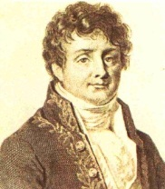
 | 1 | 2 | ... | 14
0
1
2
3
4
5
6
7
8
9
10
...
5842 |  |  |  | ?
 | 1 | 2 | ... | 14
0
1
2
3
4
5
6
7
8
9
10
...
5842
Apply

Slide 35
 | 1 | 2 | ... | 14
0
1
2
3
4
5
6
7
8
9
10
...
5842 |  |  |  | ?
 | 1 | 2 | ... | 14
0
1
2
3
4
5
6
7
8
9
10
...
5842
Apply

Slide 36
 | 1 | 2 | ... | 14
0
1
2
3
4
5
6
7
8
9
10
...
5842 |  |  |  | ?
 | 1 | 2 | ... | 14
0
1
2
3
4
5
6
7
8
9
10
...
5842
Apply
Apply
-1

Slide 37
 | 1 | 2 | ... | 14
0
1
2
3
4
5
6
7
8
9
10
...
5842 |  |  |  | ?
 | 1 | 2 | ... | 14
0
1
2
3
4
5
6
7
8
9
10
...
5842
Apply
Apply
-1

Slide 38
 | 1 | 2 | ... | 14
0
1
2
3
4
5
6
7
8
9
10
...
5842 |  |  |  | ?
 | 1 | 2 | ... | 14
0
1
2
3
4
5
6
7
8
9
10
...
5842
Apply
Apply
-1

Slide 39
 | 1 | 2 | ... | 14
0
1
2
3
4
5
6
7
8
9
10
...
5842 |  |  |  | ?
 | 1 | 2 | ... | 14
0
1
2
3
4
5
6
7
8
9
10
...
5842
Apply
Apply
-1

Slide 40
 | 1 | 2 | ... | 14
0
1
2
3
4
5
6
7
8
9
10
...
5842 |  |  |  | ?
 | 1 | 2 | ... | 14
0
1
2
3
4
5
6
7
8
9
10
...
5842
Apply
Apply
-1

Slide 41
 | 1 | 2 | ... | 14
0
1
2
3
4
5
6
7
8
9
10
...
5842 |  |  |  | ?
 | 1 | 2 | ... | 14
0
1
2
3
4
5
6
7
8
9
10
...
5842
Apply
Apply
-1

Slide 42
 | 1 | 2 | ... | 14
0
1
2
3
4
5
6
7
8
9
10
...
5842 |  |  |  | ?
 | 1 | 2 | ... | 14
0
1
2
3
4
5
6
7
8
9
10
...
5842
Apply
Apply
-1

Slide 43
 | 1 | 2 | ... | 14
0
1
2
3
4
5
6
7
8
9
10
...
5842 |  |  |  | ?
 | 1 | 2 | ... | 14
0
1
2
3
4
5
6
7
8
9
10
...
5842
Apply
Apply
-1

Slide 44
 | 1 | 2 | ... | 14
0
1
2
3
4
5
6
7
8
9
10
...
5842 |  |  |  | ?
 | 1 | 2 | ... | 14
0
1
2
3
4
5
6
7
8
9
10
...
5842
Apply
Apply
-1

Slide 45
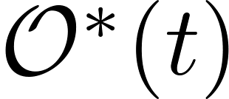
Subset Sum
Bellman(1950’s): Can be solved in time and space.
In the thesis: Can be solved in time and space.

Slide 46
3
Steiner Tree (Chapter 3)

Slide 47
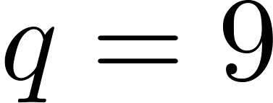
Steiner Tree
Given: Graph , terminal vertices and integer .
Asked: Is there such that ,
and connected?
.

Slide 48
Steiner Tree
Given: Graph , terminal vertices and integer .
Asked: Is there such that ,
and connected?
.

Slide 49
Steiner Tree
Resembles many network design problems.
Often, the original network (the graph ) is huge, but there a relatively few terminals. So can we give algorithms exploiting this?

Slide 50
Steiner Tree
Resembles many network design problems.
Often, the original network (the graph ) is huge, but there a relatively few terminals. So can we give algorithms exploiting this?
Dreyfus & Wagner (1972): can be solved in time and space.
Björklund et al. (2006): can be solved in time and space.
Fuchs et al. (2007): time and space for the (orginal) weighted variant.
Fomin et al. (2008): time and space.

Slide 51
Steiner Tree
Resembles many network design problems.
Often, the original network (the graph ) is huge, but there a relatively few terminals. So can we give algorithms exploiting this?
Dreyfus & Wagner (1972): can be solved in time and space.
Björklund et al. (2006): can be solved in time and space.
Fuchs et al. (2007): time and space for the (orginal) weighted variant.
Fomin et al. (2008): time and space.
This thesis: time and space.

Slide 52
 | 1 | 2 | ... | |V|
0000
0001
0010
0011
0100
0101
0110
0111
1000
1001
1010
...
1111 |  |  |  | ?

Slide 53
 | 1 | 2 | ... | |V|
0000
0001
0010
0011
0100
0101
0110
0111
1000
1001
1010
...
1111

Slide 54
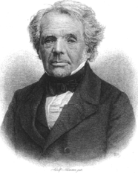
 | 1 | 2 | ... | |V|
0000
0001
0010
0011
0100
0101
0110
0111
1000
1001
1010
...
1111 |  |  |  | ?
 | 1 | 2 | ... | |V|
0000
0001
0010
0011
0100
0101
0110
0111
1000
1001
1010
...
1111
Apply
Apply
-1

Slide 55
 | 1 | 2 | ... | |V|
0000
0001
0010
0011
0100
0101
0110
0111
1000
1001
1010
...
1111 |  |  |  | ?
 | 1 | 2 | ... | |V|
0000
0001
0010
0011
0100
0101
0110
0111
1000
1001
1010
...
1111
Apply
Apply
-1

Slide 56
Steiner Tree
In the thesis a combinatorial interpretation of the space efficient algorithm is also given by introducing the notion of branching walks.

Slide 57
Steiner Tree
In the thesis a combinatorial interpretation of the space efficient algorithm is also given by introducing the notion of branching walks.
d
h
d
k
g
i
a
b
e
j
c
f
l

Slide 58
Steiner Tree
In the thesis a combinatorial interpretation of the space efficient algorithm is also given by introducing the notion of branching walks.
d
h
d
k
a
g
h
g
i
a
b
e
j
c
f
l

Slide 59
Steiner Tree
In the thesis a combinatorial interpretation of the space efficient algorithm is also given by introducing the notion of branching walks.
d
h
d
k
a
g
h
g
i
a
b
i
e
d
j
j
c
f
l

Slide 60
Steiner Tree
In the thesis a combinatorial interpretation of the space efficient algorithm is also given by introducing the notion of branching walks.
d
h
d
k
a
g
h
g
i
a
b
i
e
d
j
j
c
f
l
f
l
f

Slide 61
 | 1 | 2 | ... | |V|
0000
0001
0010
0011
0100
0101
0110
0111
1000
1001
1010
...
1111
 | 1 | 2 | ... | |V|
0000
0001
0010
0011
0100
0101
0110
0111
1000
1001
1010
...
1111
Apply
Count the number of branching walks in the graph obtained by removing a certain subset of the terminals.
Apply
-1

Slide 62
4
Steiner Tree on graphs of small treewidth (Chapter 7)

Slide 63
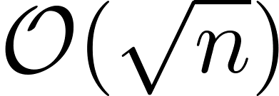
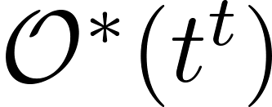
Graphs of small treewidth
Means the graph is decomposable in small pieces of size at most treewidth.
Important concept, for example all planar graphs have small treewidth ( ).
An efficient decomposition can be used to solve many graph problems quickly using dynamic programming.
For connectivity problems like
the best known algorithm used time
where is the treewidth by DP.

Slide 64
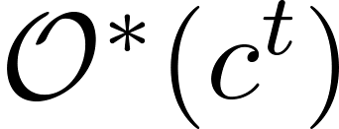
Graphs of small treewidth
Means the graph is decomposable in small pieces of size at most treewidth.
Important concept, for example all planar graphs have small treewidth ( ).
An efficient decomposition can be used to solve many graph problems quickly using dynamic programming.
For connectivity problems like
the best known algorithm used time
where is the treewidth by DP.
We show that this can be improved to for some constant .

Slide 65
graphs
A simplification of graphs of treewidth ~ .
Definition
Graph on vertices ordered in rows and columns
Only edges between vertices in adjacent columns.

Slide 66
graphs
A simplification of graphs of treewidth ~ .
Definition
Graph on vertices ordered in rows and columns
Only edges between vertices in adjacent columns.
Example (with and ):

Slide 67
graphs
A simplification of graphs of treewidth ~ .
Definition
Graph on vertices ordered in rows and columns
Only edges between vertices in adjacent columns.
Example (with and ):

Slide 68
graphs
A simplification of graphs of treewidth ~ .
Definition
Graph on vertices ordered in rows and columns
Only edges between vertices in adjacent columns.
Example (with and ):

Slide 69
graphs
A simplification of graphs of treewidth ~ .
Definition
Graph on vertices ordered in rows and columns
Only edges between vertices in adjacent columns.
Example (with and ):

Slide 70
Steiner Tree on graphs
An example with

Slide 71
Steiner Tree on graphs
An example with

Slide 72
Steiner Tree on graphs
We introduce the notion of cut object: a pair of a subset X of vertices and a blue-white coloring of X such that:
The top-left terminal is colored blue
If both endpoints of an edge are in X they must have the same color.

Slide 73
Steiner Tree on graphs
We introduce the notion of cut object: a pair of a subset X of vertices and a blue-white coloring of X such that:
The top-left terminal is colored blue
If both endpoints of an edge are in X they must have the same color.
An example with

Slide 74
Steiner Tree on graphs
We introduce the notion of cut object: a pair of a subset X of vertices and a blue-white coloring of X such that:
The top-left terminal is colored blue
If both endpoints of an edge are in X they must have the same color.
A cut object.

Slide 75
Steiner Tree on graphs
Then we transform the Steiner problem to counting the number of cut objects.
This is possible since the number of cut objects is equal to the number of Steiner tree solutions modulo 2.
Counting cut objects can be done quick with standard techniques (in fact, dynamic programming again!).
A cut object.

Slide 76
Steiner Tree on graphs
Then we transform the Steiner problem to counting the number of cut objects.
This is possible since the number of cut objects is equal to the number of Steiner tree solutions modulo 2.
Counting cut objects can be done quick with standard techniques (in fact, dynamic programming again!).
A cut object.

Slide 77
5
Hardness of Set Cover (Chapter 8)

Slide 78
Set Cover
Given: A bipartite graphs
Asked: Find of minimum size such that
every has a neighbor in .

Slide 79
Set Cover
Given: A bipartite graphs
Asked: Find of minimum size such that
every has a neighbor in .

Slide 80
Set Cover
Given: A bipartite graphs
Asked: Find of minimum size such that
every has a neighbor in .

Slide 81
Set Cover
Given: A bipartite graphs
Asked: Find of minimum size such that
every has a neighbor in .
Can be solved in by brute force
Can be solved in by DP
No improvements known.
Using a (fairly) famous hypothesis we prove
the brute force can not be improved.

Slide 82
Set Cover
Given: A bipartite graphs
Asked: Is the number of such that every
has a neighbor, in even?
Can be solved in by brute force
Can be solved in by DP
No improvements known.
Using a (fairly) famous hypothesis we prove
the brute force can not be improved.

Slide 83
Set Cover
Given: A bipartite graphs
Asked: Is the number of such that every
has a neighbor in , even?
Can be solved in by brute force
Can be solved in by DP
No improvements known.
Using a (fairly) famous hypothesis we prove
the brute force and DP can not be improved.

Slide 84
Set Cover
Given: A bipartite graphs
Asked: Is the number of such that every
has a neighbor in , even?
“The Flip”:

Slide 85
Set Cover
Given: A bipartite graphs
Asked: Is the number of such that every
has a neighbor in , even?
“The Flip”:
It does not matter!!

Slide 86
6
Further remarks and conclusion

Slide 87
Further remarks
Chapter 6 studies transformations for the case when the table is sparse that is, contains lots of zeros.
In several cases, improvement is possible even when only the last `segment’ is guaranteed to be sparse
Work in progress.

Slide 88
Conclusion
Conventional DP algorithms that evaluate a (cleverly constructed) recurrence in a naive way, can often be significantly improved using transformations.

Slide 89
Conclusion
Conventional DP algorithms that evaluate a (cleverly constructed) recurrence in a naive way, can often be significantly improved using transformations.
(!)

Slide 90
Conclusion
Conventional DP algorithms that evaluate a (cleverly constructed) recurrence in a naive way, can often be significantly improved using transformations.
(!)
Many interesting open problems
The project will be continued from February
Be welcome to join!

Slide 91
End of presentation

