Slide 1
Bipartite TSP in $O({1.9999}^{n})$ Time, Assuming Quadratic Time Matrix Multiplication
HIM, Bonn
November ’21
Jesper Nederlof
(Utrecht University)

Slide 2
Traveling Salesman Problem
Given vertices $\left\{1,…,n\right\}$, distance $d\left(i,j\right)∈\{1,…,W,∞\}$ for each $i,j≤n$
Asked shortest roundtrip visiting all vertices once
Clean formulation and applicability make it favorite in TCS
Focus on the exact worst case complexity
Problem is NP-complete: Expect `wall’ for improvements
Much recent interest in similar study for related problems
Strong Exponential Time Hypothesis, fine-grained lower bounds within $P$
3
2
2
1
4
2
1
5
3
4
2
1
3
2
2
6
But where: $n^{\log{n}}$, $2^{\sqrt{n}}$, $2^{n/\log{n}}$, $2^{0.99n}, 2^{n}, n!$ ?

Slide 3
Traveling Salesman Problem
Given vertices $\left\{1,…,n\right\}$, distance $d\left(i,j\right)∈\{1,…,W,∞\}$ for each $i,j≤n$
Asked shortest roundtrip visiting all vertices once
Clean formulation and applicability make it favorite in TCS
Focus on the exact worst case complexity
3
2
2
1
4
2
1
5
3
4
2
1
3
‘30 (Menger) | $O(n!)$ | time, can do faster?
2
2
6

Slide 4
Traveling Salesman Problem
Given vertices $\left\{1,…,n\right\}$, distance $d\left(i,j\right)∈\{1,…,W,∞\}$ for each $i,j≤n$
Asked shortest roundtrip visiting all vertices once
Clean formulation and applicability make it favorite in TCS
Focus on the exact worst case complexity
3
2
2
1
4
2
1
5
3
4
2
1
3
‘30 (Menger) | $O(n!)$ | time, can do faster?
’62 (Bellman;Held&Karp) | ${O(2}^{n}n^{2})$ | with DP
2
2
6
Pick $s∈V$ arbitrarily
t’
$P_{t}\left[X\right]:=$ min length ($s$-$t$)-path visiting $X$ in between
$$P_{t}\left[X\right]=\left\{\begin{aligned}d\left(s,t\right), \text{if} X=∅, \\ &\min_{t^{′}∈X} P_{t^{′}}\left[X∖t′\right]+ d(t′,t), \text{otherwise}.\end{aligned}\right.$$
t’
s
t
t’

Slide 5
Traveling Salesman Problem
Given vertices $\left\{1,…,n\right\}$, distance $d\left(i,j\right)∈\{1,…,W,∞\}$ for each $i,j≤n$
Asked shortest roundtrip visiting all vertices once
Clean formulation and applicability make it favorite in TCS
Focus on the exact worst case complexity
3
2
2
1
4
2
1
5
3
4
2
1
3
‘30 (Menger) | $O(n!)$ | time, can do faster?
’62 (Bellman;Held&Karp) | ${O(2}^{n}n^{2})$ | with DP
2
2
6
Pick $s∈V$ arbitrarily
$P_{t}\left[X\right]:=$ min length ($s$-$t$)-path visiting $X$ in between
$$P_{t}\left[X\right]=\left\{\begin{aligned}d\left(s,t\right), \text{if} X=∅, \\ &\min_{t^{′}∈X} P_{t^{′}}\left[X∖t′\right]+ d(t′,t), \text{otherwise}.\end{aligned}\right.$$
Output $\min_{t} P_{t}\left[V∖\left\{s,t\right\}\right]+d(t,s)$
s
t
t’

Slide 6
Traveling Salesman Problem
Given vertices $\left\{1,…,n\right\}$, distance $d\left(i,j\right)∈\{1,…,W,∞\}$ for each $i,j≤n$
Asked shortest roundtrip visiting all vertices once
Clean formulation and applicability make it favorite in TCS
Focus on the exact worst case complexity
3
2
2
1
4
2
1
5
3
4
2
1
3
‘30 (Menger) | $O(n!)$ | time, can do faster?
’62 (Bellman;Held&Karp) | ${O(2}^{n}n^{2})$ | with DP
’82 (Karp) | $${O(2}^{n}n^{2} W)$$ | $O(W)$ space, with inclusion-exclusion
2
2
6
Fix $s∈V$ arbitrarily
For $X⊆G$, denote $G[X]$ for subgraph induced on $X$
Denote $A_{G}$ for the adjacency matrix of $G$
$$\#HC\left(G\right)=\sum_{s∈X⊆V }{{\left(−1\right)}^{n−\left|X\right|} A_{G\left[X\right]}^{n}\left[s,s\right]}$$

Slide 7
Traveling Salesman Problem
Given vertices $\left\{1,…,n\right\}$, distance $d\left(i,j\right)∈\{1,…,W,∞\}$ for each $i,j≤n$
Asked shortest roundtrip visiting all vertices once
Clean formulation and applicability make it favorite in TCS
Focus on the exact worst case complexity
3
2
2
1
4
2
1
5
3
4
2
1
3
‘30 (Menger) | $O(n!)$ | time, can do faster?
’62 (Bellman;Held&Karp) | ${O(2}^{n}n^{2})$ | with DP
’82 (Karp) | $${O(2}^{n}n^{2} W)$$ | $O(W)$ space, with inclusion-exclusion
’10 (Björklund) | ${O(1.66}^{n} W)$ | if symmetric ($d\left(i,j\right)=d(j,i)$)
 | $O({1.41}^{n} W)$ | if symmetric and bipartite
2
2
6
Determinants + cancellations modulo 2 (too long to fit on slide)

Slide 8
Traveling Salesman Problem
Given vertices $\left\{1,…,n\right\}$, distance $d\left(i,j\right)∈\{1,…,W,∞\}$ for each $i,j≤n$
Asked shortest roundtrip visiting all vertices once
Clean formulation and applicability make it favorite in TCS
Focus on the exact worst case complexity
3
2
2
1
4
2
1
5
3
4
2
1
3
‘30 (Menger) | $O(n!)$ | time, can do faster?
’62 (Bellman;Held&Karp) | ${O(2}^{n}n^{2})$ | with DP
’82 (Karp) | $${O(2}^{n}n^{2} W)$$ | $O(W)$ space, with inclusion-exclusion
’10 (Björklund) | ${O(1.66}^{n} W)$ | if symmetric ($d\left(i,j\right)=d(j,i)$)
 | $O({1.41}^{n} W)$ | if symmetric and bipartite
’13 (Cygan, Kratsch, N) | ${ O(1.89}^{n} W)$ | if bipartite
2
2
6

Slide 9
Traveling Salesman Problem
Given vertices $\left\{1,…,n\right\}$, distance $d\left(i,j\right)∈\{1,…,W,∞\}$ for each $i,j≤n$
Asked shortest roundtrip visiting all vertices once
Clean formulation and applicability make it favorite in TCS
Focus on the exact worst case complexity
3
2
2
1
4
2
1
5
3
4
2
1
3
‘30 (Menger) | $O(n!)$ | time, can do faster?
’62 (Bellman;Held&Karp) | ${O(2}^{n}n^{2})$ | with DP
’82 (Karp) | $${O(2}^{n}n^{2} W)$$ | $O(W)$ space, with inclusion-exclusion
’10 (Björklund) | ${O(1.66}^{n} W)$ | if symmetric ($d\left(i,j\right)=d(j,i)$)
 | $O({1.41}^{n} W)$ | if symmetric and bipartite
’13 (Cygan, Kratsch, N) | ${ O(1.89}^{n} W)$ | if bipartite
’17 (Björklund, Kaski, Koutis) | $$O({1.74}^{n} W)$$ | if bipartite
2
2
6

Slide 10
Traveling Salesman Problem
Given vertices $\left\{1,…,n\right\}$, distance $d\left(i,j\right)∈\{1,…,W,∞\}$ for each $i,j≤n$
Asked shortest roundtrip visiting all vertices once
Clean formulation and applicability make it favorite in TCS
Focus on the exact worst case complexity
3
2
2
1
4
2
1
5
3
4
2
1
3
‘30 (Menger) | $O(n!)$ | time, can do faster?
’62 (Bellman;Held&Karp) | ${O(2}^{n}n^{2})$ | with DP
’82 (Karp) | ${O(2}^{n}n^{2} W)$ | $O(W)$ space, with inclusion-exclusion
’10 (Björklund) | ${O(1.66}^{n} W)$ | if symmetric ($d\left(i,j\right)=d(j,i)$)
 | $O({1.41}^{n} W)$ | if symmetric and bipartite
’13 (Cygan, Kratsch, N) | ${ O(1.89}^{n} W)$ | if bipartite
’17 (Björklund, Kaski, Koutis) | $O({1.74}^{n} W)$ | if bipartite
 | $$O(({2−f(ε))}^{n} )$$ | if unweighted and at most $1/ε^{n}$ HC’s
2
2
6

Slide 11
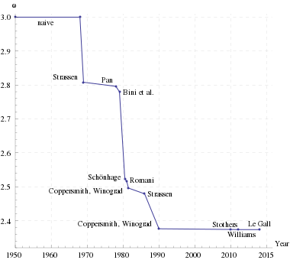
New Contribution
Theorem Symmetric bipartite TSP in $O({1.9999}^{n})$ time, assuming $ω=2$
Symmetric
Harder for general graphs: need to detect Ham. cycles in directed graphs in
$O({1.9999}^{n})$ time
Bipartite
Good stepping stone towards
solving the general case?!
$ω=2$
Sometimes
conjectured, but
not clear at all!
$ω≔$ smallest constant s.t. $(s×s)$ matrix multiplication in $s^{ω+o(1)}$ time

Slide 12
Our Approach
Step 0: Assume $n$ even
Need pm’s $A,B$ that form an HC and minimize $d\left(A\right)+d(B)$
( $d\left(M\right)≔\sum_{\left\{i,j\right\}∈M}{d\left(i,j\right)}$ )
3
2
2
1
4
2
1
5
3
4
2
1
3
2
2
6

Slide 13
Our Approach
Step 0: Assume $n$ even
Need pm’s $A,B$ that form an HC and minimize $d\left(A\right)+d(B)$
( $d\left(M\right)≔\sum_{\left\{i,j\right\}∈M}{d\left(i,j\right)}$ )
9
1
2
3
4
5
6
3
2
2
8
1
2
3
4
5
6
4
1
2
1
5
5
1
2
3
4
5
6
3
4
2
6
1
2
3
4
5
6
1
3
6
1
2
3
4
5
6
2
2
6

Slide 14
Our Approach
Step 0: Assume $n$ even
Need pm’s $A,B$ that form an HC and minimize $d\left(A\right)+d(B)$
( $d\left(M\right)≔\sum_{\left\{i,j\right\}∈M}{d\left(i,j\right)}$ )
9
1
2
3
4
5
6
3
2
2
8
1
2
3
4
5
6
4
1
2
1
5
5
1
2
3
4
5
6
Step 1: Find set $𝒜$ of ${O(2}^{n/2})$ pm’s that is representative for all pm’s in ${1.9999}^{n}$ time, assuming $ω=2$
3
4
6
2
6
1
3
1
2
2
3
4
5
6
1
6
2
6
1
2
6
1
2
2
3
4
5
6

Slide 15
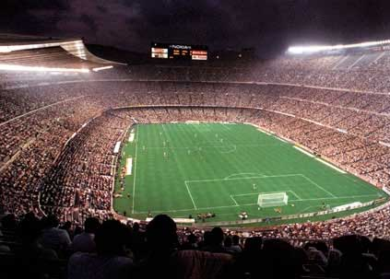
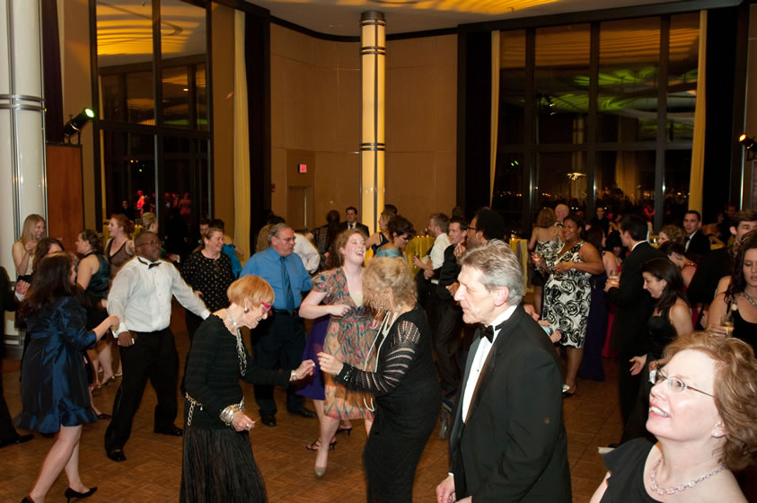
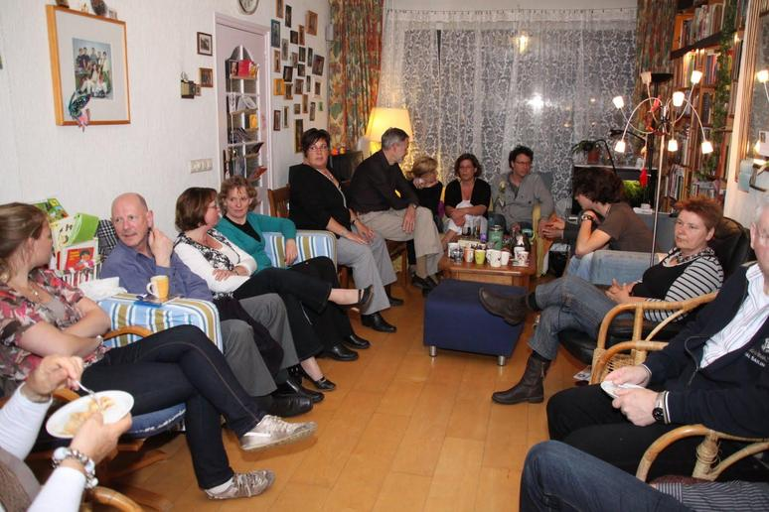
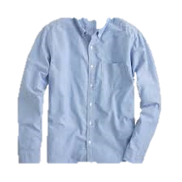
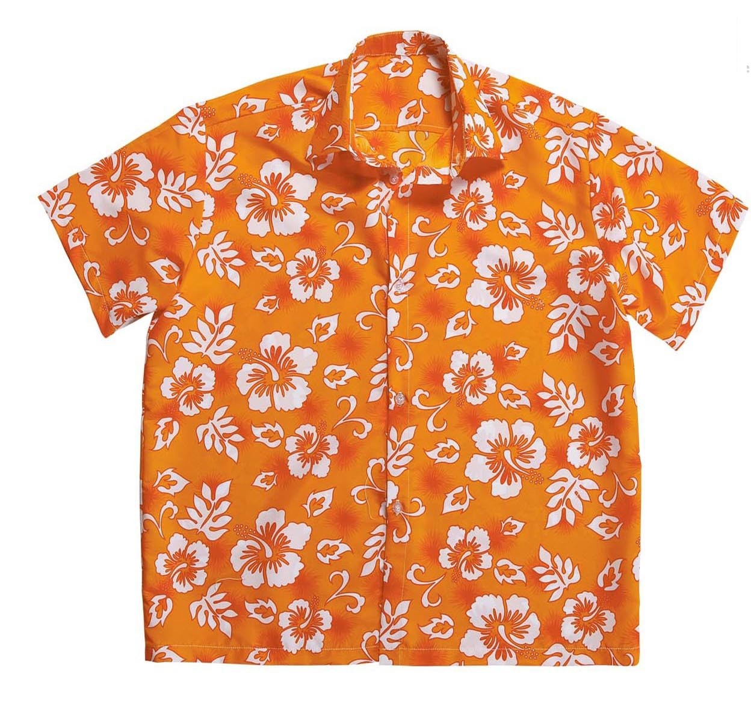
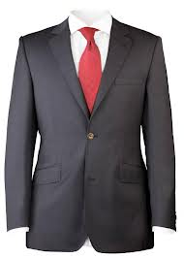
Representative Sets (unweighted)
1 | 0 | 0 | 1 | 0
0 | 0 | 1 | 1 | 0
1 | 1 | 0 | 0 | 1
0 | 1 | 1 | 0 | 1

Slide 16
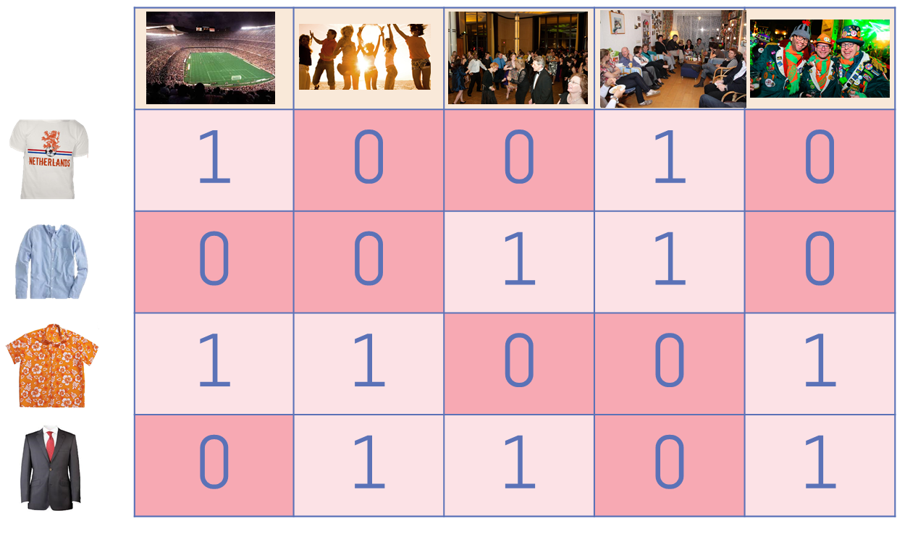
Representative Sets (unweighted)
Let $ℱ⊆2^{U}$ be a set system, with incidence matrix $A$
$$U$$
$$ℱ$$
OBS
Any row basis $ℬ⊆ℱ$ of $A$ is a set cover!
Formally, $∪_{S∈ℬ}S=∪_{S∈ℱ}S$
Works for any field (but we’ll use $𝔽_{2}$ )

Slide 17
Our Approach
Step 0: Assume $n$ even
Need pm’s $A,B$ that form an HC and minimize $d\left(A\right)+d(B)$
( $d\left(M\right)≔\sum_{\left\{i,j\right\}∈M}{d\left(i,j\right)}$ )
9
1
2
3
4
5
6
3
2
2
8
1
2
3
4
5
6
4
1
2
1
5
5
1
2
3
4
5
6
Step 1: Find set $𝒜$ of ${O(2}^{n/2})$ pm’s that is representative for all pm’s in ${1.9999}^{n}$ time, assuming $ω=2$
3
4
6
2
6
1
3
1
2
2
3
4
5
6
1
6
2
6
1
2
6
1
2
2
3
4
5
6
Definition Let $𝒜⊆𝒜′$ be families of pm’s.
Say $𝒜$ is representative for $𝒜′$ if for each pm $B$ of $K_{n}$:
$$\min_{\begin{aligned}A∈𝒜 \\ A∪B is HC\end{aligned}} d\left(A\right)=\min_{\begin{aligned}A^{′}∈𝒜^{′} \\ A^{′}∪B is HC\end{aligned}} d(A′)$$

Slide 18
Representative Sets (weighted)
1 | 0 | 0 | 1 | 0
0 | 0 | 1 | 1 | 0
1 | 1 | 0 | 0 | 1
0 | 1 | 1 | 0 | 1

Slide 19
Our Approach
Step 0: Assume $n$ even
Need pm’s $A,B$ that form an HC and minimize $d\left(A\right)+d(B)$
( $d\left(M\right)≔\sum_{\left\{i,j\right\}∈M}{d\left(i,j\right)}$ )
9
1
2
3
4
5
6
3
2
2
8
1
2
3
4
5
6
4
1
2
1
5
5
1
2
3
4
5
6
Step 1: Find set $𝒜$ of ${O(2}^{n/2})$ pm’s that is representative for all pm’s in ${1.9999}^{n}$ time, assuming $ω=2$
3
4
6
2
6
1
3
1
2
2
3
4
5
6
1
6
2
6
1
2
6
1
2
2
3
4
5
6
Step 2: Find $A,B∈𝒜$ that form an HC and minimize $d\left(A\right)+d(B)$ in $O\left(\left|𝒜\right|2^{0.3n}+3^{n/2}\right)$ time

Slide 20
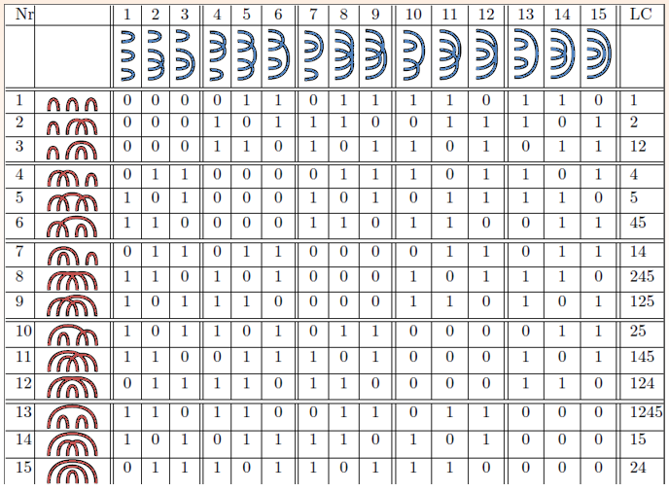
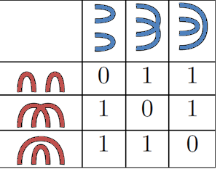
Matchings Connectivity Matrix
Definition For even $n≥2$ and perfect matchings $A,B$ of $K_{n}$
$$H_{n}\left[A,B\right]:=\left\{\begin{aligned}1, \text{if} A∪B \text{is} \text{an} \text{HC} \\ &0, \text{otherwise} \end{aligned}\right.$$
9
1
2
3
4
5
6
3
2
2
8
1
2
3
4
5
6
4
1
2
1
5
5
1
2
3
4
5
6
3
4
2
6
1
2
3
4
5
6
1
3
6
1
2
3
4
5
6
2
2
6
$$H_{4}$$
$$H_{6}$$

Slide 21
Matchings Connectivity Matrix Step 1
Definition For even $n≥2$ and perfect matchings $A,B$ of $K_{n}$
$$H_{n}\left[A,B\right]:=\left\{\begin{aligned}1, \text{if} A∪B \text{is} \text{an} \text{HC} \\ &0, \text{otherwise} \end{aligned}\right.$$
9
1
2
3
4
5
6
3
2
2
8
1
2
3
4
5
6
4
1
2
1
5
5
1
2
3
4
5
6
$$∞$$
$$\text{6}$$
$$∞$$
$$∞$$
$$∞$$
$$∞$$
$$∞$$
$$∞$$
9
$$∞$$
$$∞$$
8
5
6
$$∞$$
3
4
2
6
1
2
3
4
5
6
1
3
6
1
2
3
4
5
6
2
2
6
9
8
$$∞$$
$$H_{4}$$
5
$$∞$$
6
$$∞$$
$$∞$$
6
$$∞$$
$$∞$$
$$∞$$
$$∞$$
$$H_{6}$$
$$∞$$
$$∞$$

Slide 22
Matchings Connectivity Matrix Step 1
Definition For even $n≥2$ and perfect matchings $A,B$ of $K_{n}$
$$H_{n}\left[A,B\right]:=\left\{\begin{aligned}1, \text{if} A∪B \text{is} \text{an} \text{HC} \\ &0, \text{otherwise} \end{aligned}\right.$$
9
1
2
3
4
5
6
3
2
2
8
1
2
3
4
5
6
4
1
2
1
5
5
1
2
3
4
5
6
Matchings Factorization* [CKN’13]
3
4
6
2
$H_{n}≡_{2}H_{n}\left[⋅,𝒫_{n}\right]⋅{(H}_{n}{\left[⋅,𝒫_{n}\right])}^{T}$, where $𝒫_{n}$ is the set of PM’s of
1
2
3
4
5
6
1
3
9
6
2
2
8
1
2
3
4
5
6
6
n-2
$$∞$$
2
4
6
5
1
n
$$∞$$
3
5
7
n-1
6
$$∞$$
$\left|𝒫_{n}\right|=2^{n/2−1}$ rank $2^{n/2−1}$
$$∞$$
6
Min weight row basis of $H_{n}\left[𝒜,𝒫_{N}\right]$ is representative set for $𝒜$ [BCKN’13]
Not quite fast enough for us, exploit bipartiteness (see paper)
$$∞$$
$$∞$$
$$∞$$
$$∞$$
$$∞$$
$$∞$$
$$H_{6}[⋅,𝒫_{6}]$$

Slide 23
Our Approach
Step 0: Assume $n$ even
Need pm’s $A,B$ that form an HC and minimize $d\left(A\right)+d(B)$
( $d\left(M\right)≔\sum_{\left\{i,j\right\}∈M}{d\left(i,j\right)}$ )
9
1
2
3
4
5
6
3
2
2
8
1
2
3
4
5
6
4
1
2
1
5
5
1
2
3
4
5
6
Step 1: Find set $𝒜$ of ${O(2}^{n/2})$ pm’s that is representative for all pm’s in ${1.9999}^{n}$ time, assuming $ω=2$
3
4
6
2
6
1
3
1
2
2
3
4
5
6
1
6
2
6
1
2
6
1
2
2
3
4
5
6
Step 2: Find $A,B∈𝒜$ that form an HC and minimize $d\left(A\right)+d(B)$ in $O\left(\left|𝒜\right|2^{0.3n}+3^{n/2}\right)$ time
Step 2A: Reduce weighted to unweighted variant (simple trick)
Step 2B: Solve unweighted variant

Slide 24
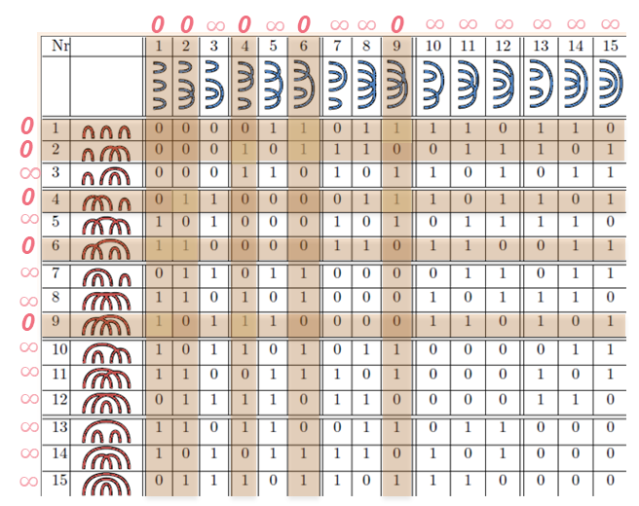
Our Approach Step 2b
Theorem Given set $𝒜$ of PM’s of $K_{n}$, can detect $A,B∈𝒜$
such that $A∪B$ is an HC in time $O(\left|𝒜\right|2^{n/2})$
Lemma [F’79] If $M≠LR$, and $x$, $y$ random, then $Pr\left[y^{T}Mx=(y^{T}L)\left(Rx\right)\right]≤3/4$
Need to check $H_{n}\left[𝒜,𝒜\right]=0$
Sample $x$,$y$; compute ${y^{T}H}_{n}\left[𝒜,𝒜\right]x=$
${(y^{T}H}_{n}\left[𝒜,𝒫_{n}\right])⋅{((H}_{n}{\left[𝒜,𝒫_{n}\right])}^{T}x)$
$(y^{T}C_{n}\left[𝒜,𝒞_{n}\right])⋅{((C}_{n}{\left[ℬ,𝒞_{n}\right])}^{T}x)$
Can be computed in $O(\left|𝒜\right|2^{3n/10})$ time
apply random permutation to matchings
delete matchings with $≥2^{3n/10}$ ones
enumerate ones cleverly)
Output YES iff output is non-zero
Run time follows since $\left|𝒫_{n}\right|=2^{n/2}$

Slide 25
Matchings Connectivity Matrix Step 2b
Definition For even $n≥2$ and perfect matchings $A,B$ of $K_{n}$
$$H_{n}\left[A,B\right]:=\left\{\begin{aligned}1, \text{if} A∪B \text{is} \text{an} \text{HC} \\ &0, \text{otherwise} \end{aligned}\right.$$
Matchings Factorization* [CKN’13]
Cut Factorization [CNPPvRW’11, BCKN’13]
$H_{n}≡_{2}H_{n}\left[⋅,𝒫_{n}\right]⋅{(H}_{n}{\left[⋅,𝒫_{n}\right])}^{T}$, where $𝒫_{n}$ is the set of PM’s of
$H_{n}≡_{2}C_{n}⋅C_{n}^{T}$, with for each $1∈X⊆\{1,…,n\}$:
$$C_{n}\left[A,X\right]≔ \left\{\begin{aligned}\text{1}, \\ \text{0},\end{aligned}\right.$$
if $X$ splits $A$
2
4
6
n-2
otherwise,
1
n
3
5
7
n-1
where `$X$ splits $A$’ if no edge in $A$ has one end in $X$
$\left|𝒫_{n}\right|=2^{n/2−1}$ rank $2^{n/2−1}$
1
2
3
4
5
6

Slide 26
Matchings Connectivity Matrix Step 2b
Definition For even $n≥2$ and perfect matchings $A,B$ of $K_{n}$
$$H_{n}\left[A,B\right]:=\left\{\begin{aligned}1, \text{if} A∪B \text{is} \text{an} \text{HC} \\ &0, \text{otherwise} \end{aligned}\right.$$
Matchings Factorization* [CKN’13]
Cut Factorization [CNPPvRW’11, BCKN’13]
$H_{n}≡_{2}H_{n}\left[⋅,𝒫_{n}\right]⋅{(H}_{n}{\left[⋅,𝒫_{n}\right])}^{T}$, where $𝒫_{n}$ is the set of PM’s of
$H_{n}≡_{2}C_{n}⋅C_{n}^{T}$, with for each $1∈X⊆\{1,…,n\}$:
$$C_{n}\left[A,X\right]≔ \left\{\begin{aligned}\text{1}, \\ \text{0},\end{aligned}\right.$$
if $X$ splits $A$
2
4
6
n-2
otherwise,
1
n
3
5
7
n-1
where `$X$ splits $A$’ if no edge in $A$ has one end in $X$
$\left|𝒫_{n}\right|=2^{n/2−1}$ rank $2^{n/2−1}$
1
2
3
4
5
6

Slide 27
Matchings Connectivity Matrix Step 2b
Definition For even $n≥2$ and perfect matchings $A,B$ of $K_{n}$
$$H_{n}\left[A,B\right]:=\left\{\begin{aligned}1, \text{if} A∪B \text{is} \text{an} \text{HC} \\ &0, \text{otherwise} \end{aligned}\right.$$
Matchings Factorization* [CKN’13]
Cut Factorization [CNPPvRW’11, BCKN’13]
$H_{n}≡_{2}H_{n}\left[⋅,𝒫_{n}\right]⋅{(H}_{n}{\left[⋅,𝒫_{n}\right])}^{T}$, where $𝒫_{n}$ is the set of PM’s of
$H_{n}≡_{2}C_{n}⋅C_{n}^{T}$, with for each $1∈X⊆\{1,…,n\}$:
$$C_{n}\left[A,X\right]≔ \left\{\begin{aligned}\text{1}, \\ \text{0},\end{aligned}\right.$$
if $X$ splits $A$
2
4
6
n-2
otherwise,
1
n
3
5
7
n-1
where `$X$ splits $A$’ if no edge in $A$ has one end in $X$
$\left|𝒫_{n}\right|=2^{n/2−1}$ rank $2^{n/2−1}$
rank $2^{n−1}$
dense: $Θ(n^{−1/2})$ fraction of ones
sparse: $C_{n}$has only $2^{n/2−1}$ ones per row

Slide 28
Matchings Connectivity Matrix Step 2b
Definition For even $n≥2$ and perfect matchings $A,B$ of $K_{n}$
$$H_{n}\left[A,B\right]:=\left\{\begin{aligned}1, \text{if} A∪B \text{is} \text{an} \text{HC} \\ &0, \text{otherwise} \end{aligned}\right.$$
Matchings Factorization* [CKN’13]
Cut Factorization [CNPPvRW’11, BCKN’13]
$H_{n}≡_{2}H_{n}\left[⋅,𝒫_{n}\right]⋅{(H}_{n}{\left[⋅,𝒫_{n}\right])}^{T}$, where $𝒫_{n}$ is the set of PM’s of
$H_{n}≡_{2}C_{n}⋅C_{n}^{T}$, with for each $1∈X⊆\{1,…,n\}$:
$$C_{n}\left[A,X\right]≔ \left\{\begin{aligned}\text{1}, \\ \text{0},\end{aligned}\right.$$
if $X$ splits $A$
2
4
6
n-2
otherwise,
1
n
3
5
7
n-1
where `$X$ splits $A$’ if no edge in $A$ has one end in $X$
$\left|𝒫_{n}\right|=2^{n/2−1}$ rank $2^{n/2−1}$
rank $2^{n−1}$
dense: $Θ(n^{−1/2})$ fraction of ones
sparse: $C_{n}$has only $2^{n/2−1}$ ones per row
Narrow Cut Factorization*
Let $𝒞_{n}$ be all cuts that split some matching in $𝒫_{n}$. Then $H_{n}≡_{2}C_{n}\left[⋅,𝒞_{n}\right]⋅C_{n}{\left[⋅,𝒞_{n}\right]}^{T}$
$\left|𝒞_{n}\right|=3^{n/2−1}$ rank $3^{n/2}$
$C_{n}\left[⋅,𝒞_{n}\right]$ has ${≤2}^{3n/10}$ ones per row on average

Slide 29
Our Approach Step 2b
Theorem Given set $𝒜$ of PM’s of $K_{n}$, can detect $A,B∈𝒜$
such that $A∪B$ is an HC in time $O(\left|𝒜\right|2^{n/2})$
Lemma [F’79] If $M≠LR$, and $x$, $y$ random, then $Pr\left[y^{T}Mx=(y^{T}L)\left(Rx\right)\right]≤3/4$
Need to check $H_{n}\left[𝒜,𝒜\right]=0$
Sample $x$,$y$; compute ${y^{T}H}_{n}\left[𝒜,𝒜\right]x=$
${(y^{T}H}_{n}\left[𝒜,𝒫_{n}\right])⋅{((H}_{n}{\left[𝒜,𝒫_{n}\right])}^{T}x)$
$(y^{T}C_{n}\left[𝒜,𝒞_{n}\right])⋅{((C}_{n}{\left[ℬ,𝒞_{n}\right])}^{T}x)$
Can be computed in $O(\left|𝒜\right|2^{3n/10})$ time
apply random permutation to matchings
delete matchings with $≥2^{3n/10}$ ones
enumerate ones cleverly)
Output YES iff output is non-zero
Run time follows since $\left|𝒫_{n}\right|=2^{n/2}$

Slide 30
Our Approach Step 2b
Theorem Given set $𝒜$ of PM’s of $K_{n}$, can detect $A,B∈𝒜$
such that $A∪B$ is an HC in time $O(\left|𝒜\right|2^{n/2})$ $O(\left|𝒜\right|2^{3n/10}+3^{n/2})$
Lemma [F’79] If $M≠LR$, and $x$, $y$ random, then $Pr\left[y^{T}Mx=(y^{T}L)\left(Rx\right)\right]≤3/4$
Need to check $H_{n}\left[𝒜,𝒜\right]=0$
Sample $x$,$y$; compute ${y^{T}H}_{n}\left[𝒜,𝒜\right]x=$
${(y^{T}H}_{n}\left[𝒜,𝒫_{n}\right])⋅{((H}_{n}{\left[𝒜,𝒫_{n}\right])}^{T}x)$
Can be computed in $O(\left|𝒜\right|2^{3n/10})$ time
apply random permutation to matchings
delete matchings with $≥2^{3n/10}$ ones
enumerate ones cleverly)
Output YES iff output is non-zero
Run time follows since $\left|𝒫_{n}\right|=2^{n/2}$

Slide 31
Our Approach Step 2b
Theorem Given set $𝒜$ of PM’s of $K_{n}$, can detect $A,B∈𝒜$
such that $A∪B$ is an HC in time $O(\left|𝒜\right|2^{n/2})$ $O(\left|𝒜\right|2^{3n/10}+3^{n/2})$
Lemma [F’79] If $M≠LR$, and $x$, $y$ random, then $Pr\left[y^{T}Mx=(y^{T}L)\left(Rx\right)\right]≤3/4$
Need to check $H_{n}\left[𝒜,𝒜\right]=0$
Sample $x$,$y$; compute ${y^{T}H}_{n}\left[𝒜,𝒜\right]x=$
${(y^{T}H}_{n}\left[𝒜,𝒫_{n}\right])⋅{((H}_{n}{\left[𝒜,𝒫_{n}\right])}^{T}x)$
$(y^{T}C_{n}\left[𝒜,𝒞_{n}\right])⋅{((C}_{n}{\left[𝒜,𝒞_{n}\right])}^{T}x)$
Can be computed in $O(\left|𝒜\right|2^{3n/10})$ time:
randomly order vertices
$𝒜^{′}≔$ matchings with $≤2^{3n/10}$ ones
enumerate ones in $C_{n}\left[𝒜′,𝒞_{n}\right]$ cleverly
Output YES iff output is non-zero
Run time follows since $\left|𝒫_{n}\right|=2^{n/2}$

Slide 32
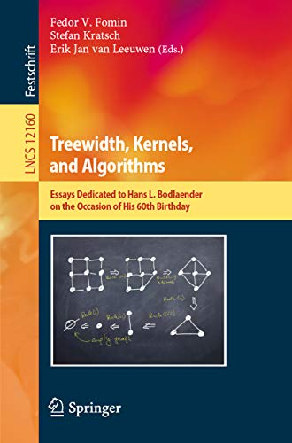
Conclusions
Actual algorithm for Bipartite TSP is a bit uglier
Dynamic programming along ‘pathwidth decomposition’
Rank upper bounds imply powerful algorithms
Also for weighted problems via Gaussian elimination!
Not only the rank is an important quality measure of a factorization
Sparsity of factorization may also be important
See my recent survey for more applications:
“Algorithms for NP-Hard Problems via Rank-Related Parameters of Matrices”, festschrift “Treewidth, Kernels, and Algorithms”

Slide 33
Further Research
Can we avoid Gaussian elimination in rep set computation?
(sort of) Set Cover in structured instances
Solve symmetric TSP in $O({1.9999}^{n})$ time
Asymmetric case is still far away….
For the symmetric case, we need to compute rep sets of $2^{0.79n}$ matchings
Can compute rep sets of ${1.999}^{n}$ matchings in ${1.999}^{n}$ time, assuming $ω=2$ (I think)
Remove assumption $ω=2$
Re-use computations in Gaussian elim. Step?
Other uses Narrow Cut Factorization?
Hamiltonicity in $O^{∗}({(2+3^{0.5})}^{tw})$ time?
Even better factorizations of $H_{n}$?

Slide 34
Bonus slide: Narrow Cut factorization
Narrow cut fact. relatively naturally gives ${O^{∗}(3}^{n/2})$ time for undirected Hamiltonicity
Let $I$ be the vector indexed by all pm’s that indicates whether a matching is in $G$
Then $I^{T}⋅H_{n}⋅I=\#HC^{′}s$ of $G$ (actually times 2)
Real Narrow Cut Factorization
Let $𝒞_{n}$ be all cuts that split some matching in $𝒫_{n}$. Then
$H_{n}≡_{2}C_{n}\left[⋅,𝒞_{n}\right]⋅{\left(\begin{matrix}0 & 1 & 1 \\ 1 & 0 & 1 \\ 1 & 1 & 0\end{matrix}\right)}^{⊗n/2−1}⋅C_{n}{\left[⋅,𝒞_{n}\right]}^{T}$
We can compute each entry of the vector ${I^{T}⋅C}_{n}\left[⋅,𝒞_{n}\right]$ modulo 2 in polynomial time
Matrix vector multiplication with middle matrix in near-linear time (Yates’ algorithm)

