Slide 1
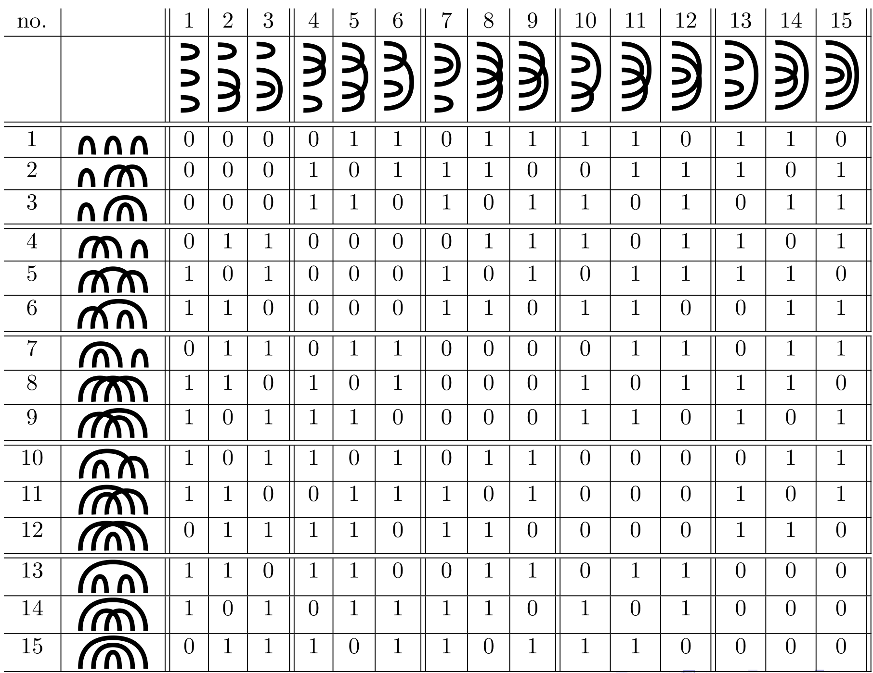
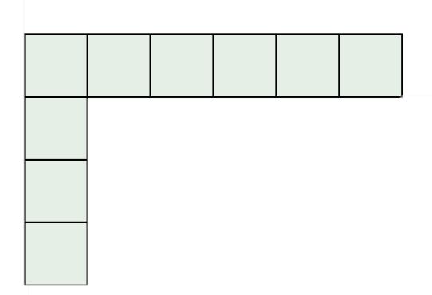
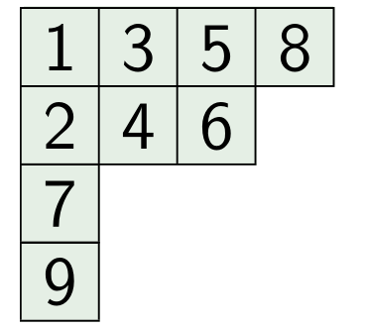
A Tight Lower Bound for Counting Hamiltonian Cycles via Matrix Rank
Radu Curticapean Hungarian Academy of Sciences
Nathan Lindzey University of Waterloo
Jesper Nederlof Technische Universiteit Eindhoven
Slides mostly by Radu
Notes:
https://www.youtube.com/watch?v=SolEjKrcg4E
33:00

Slide 2
Hamiltonicity
brute force
$$O(n!)$$
dynamic programming $O(2^{n}⋅n^{2})$
[Bellman, Held-Karp 62]
algebraic techniques
$O^{∗}\left({1.66}^{n}\right)$
directed, special graphs,
...
undirected
[Björklund 10]
$n$ vertices

Slide 3
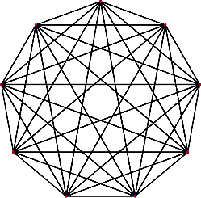
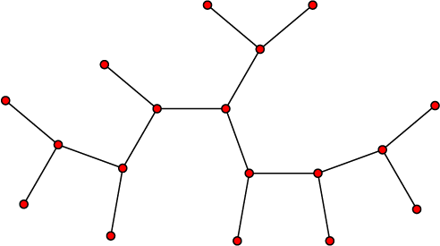
Hamiltonicity under treewidth
treewidth $tw\left(G\right)=k:$ hierarchy of $k$-sized separators
enables dynamic programming
tree
SPG
planar
deg-$3$
$$K_{n}$$
$$1$$
$$2$$
$$\sim \sqrt{n}$$
$$\sim n/6$$
$$n−1$$
$n$ vertices

Slide 4
Hamiltonicity under treewidth
treewidth $tw\left(G\right)=k:$ hierarchy of $k$-sized separators
enables dynamic programming
standard
$O^{∗}\left(tw!\right)$
refined
$$O^{∗}(c^{tw})$$
[Cygan et al. 13]
[Wlodarczyk 16]
decision
$c=2+\sqrt{2}$
optimal under SETH!
counting
$c=6$ (assuming $ω=2)$
optimal under SETH?
$n$ vertices

Slide 5
Standard DP
Any partial solution $A$ outside $S$ is a vertex-disjoint union of paths.
Each $v∉S$ has deg $2$ in $A$.
Each $v∈S$ has deg $∈\left\{0,1,2\right\}$ in $A$.
⇒ All path endpoints are in $S$.
$$S$$
essential information of $A$
fingerprint $f$ on $S$
$d :S→\left\{0,1,2\right\}$ stores degrees in $S$
perfect matching $M$ on $d^{−1}\left(1\right)$ stores connectivity of endpoints

Slide 6
Standard DP
Any partial solution $A$ outside $S$ is a vertex-disjoint union of paths.
Each $v∉S$ has deg $2$ in $A$.
Each $v∈S$ has deg $∈\left\{0,1,2\right\}$ in $A$.
⇒ All path endpoints are in $S$.
$$S$$
essential information of $A$
fingerprint $f$ on $S$
$d :S→\left\{0,1,2\right\}$ stores degrees in $S$
perfect matching $M$ on $d^{−1}\left(1\right)$ stores connectivity of endpoints

Slide 7
Standard DP
Traverse separator hierarchy .
For each separator $S$, fill table $T_{S}$ indexed by fingerprints $f$ on $S$:
.
$T_{S}\left(f\right)=$ # of partial solutions below $S$ with fingerprint $f$.
Total time: $\#fgpts⋅n^{O\left(1\right)}≤O^{∗}(k^{O(k)})$
fingerprint $f$ on $S$
$d :S→\left\{0,1,2\right\}$ stores degrees in $S$
perfect matching $M$ on $d^{−1}\left(1\right)$ stores connectivity of endpoints
# of fingerprints ${≤ k}^{O(k)}$

Slide 8
Refined DP
fingerprint matrix $H_{k}$
binary, over all fingerprints on $\left[k\right],$,
$H_{k}\left(f,f^{′}\right)=1$ iff $f,f^{′}$ combine
[Cygan et al. 13]
 | 0 | 0 | 0
 | 0 | 0 | 1
 | 0 | 1 | 0
$d+d′$ is all-$2$s
$M∪M′$ single cycle
$=Θ({(2+\sqrt{2})}^{k})$ over $ℤ_{2}$
rank$\left(H_{k}\right)$
$≪$ # of fingerprints
$≤O(6^{k})$ over $ℚ$
[Raz-Spieker 95]
fingerprint $f$ on $S$
$d :S→\left\{0,1,2\right\}$ stores degrees in $S$
perfect matching $M$ on $d^{−1}\left(1\right)$ stores connectivity of endpoints
# of fingerprints ${≤ k}^{O(k)}$

Slide 9
Refined DP
fingerprint matrix $H_{k}$
binary, over all fingerprints on $\left[k\right],$,
$H_{k}\left(f,f^{′}\right)=1$ iff $f,f^{′}$ combine
[Cygan et al. 13]
 | 0 | 0 | 0
 | 0 | 0 | 1
 | 0 | 1 | 0
$=Θ({(2+\sqrt{2})}^{k})$ over $ℤ_{2}$
rank$\left(H_{k}\right)$
$≤O(6^{k})$ over $ℚ$
[Raz-Spieker 95]
Pick set of basis row fingerprints
that induce full rank in $H_{k}$.
$⇒$ span „simulates“ all fingerprints.
# of basis fingerprints $=rank(H_{k})≤{ c}^{k}$
# of fingerprints ${≤ k}^{O(k)}$

Slide 10
Refined DP
Traverse separator hierarchy .
For each separator $S$, fill table $T_{S}$ indexed by basis fingerprints $f$on $S$:
.
$T_{S}\left(f\right)=$ # of partial solutions below $S$ with fingerprint $f$.
Total time: $rank(H_{k})⋅n^{O\left(1\right)}≤O^{∗}(c^{k})$
parity
$rank\left(H_{k}\right)≤{3.41}^{k}$
over $ℤ_{2}$
decision reduction to parity
counting
$rank\left(H_{k}\right)≤6^{k}$
over $ℚ$
# of basis fingerprints $=rank(H_{k})≤{ c}^{k}$
# of fingerprints ${≤ k}^{O(k)}$

Slide 11
[Cygan et al. 13]
parity
DP-wizardry
$O^{∗}({3.41}^{pw})$ time
$rank\left(H_{k}\right)=Θ^{∗}({3.41}^{k})$
over $ℤ_{2}$
$rank\left(H_{k}\right)≤{3.41}^{k}$
over $ℤ_{2}$
reduction
optimal base
under SETH
counting
[Wlodarczyk 16]
DP-wizardry
$O^{∗}(6^{tw})$ time
$rank\left(H_{k}\right)=Θ^{∗}(6^{k})$ ?
over $ℚ$
$rank\left(H_{k}\right)≤6^{k}$
over $ℚ$
optimal base
under SETH ?
reduction ?

Slide 12
1+2
Our results
1
2
Precise $ℚ$-rank of $H_{k}$ using representation theory of symmetric group
New reduction idea
turns rank lower bounds
into complexity lower bounds
counting
[Wlodarczyk 16]
DP-wizardry
$O^{∗}(6^{tw})$ time
$rank\left(H_{k}\right)=Θ^{∗}(6^{k})$
over $ℚ$
$rank\left(H_{k}\right)≤6^{k}$
over $ℚ$
optimal base
under SETH
reduction

Slide 13
1
Precise $ℚ$-rank of $H_{k}$ using representation theory of symmetric group
counting
[Wlodarczyk 16]
DP-wizardry
$O^{∗}(6^{tw})$ time
$rank\left(H_{k}\right)=Θ^{∗}(6^{k})$
over $ℚ$
$rank\left(H_{k}\right)≤6^{k}$
over $ℚ$
optimal base
under SETH
reduction

Slide 14
 | 0 | 0 | 0
 | 0 | 0 | 1
 | 0 | 1 | 0
fingerprint matrix $H_{k}$
over all fingerprints on $\left[k\right],$,
$H_{k}\left(f,f^{′}\right)=1$ iff $f,f^{′}$ combine
$rank\left(H_{k}\right)=Ω^{∗}({(2+4)}^{k})$
$H_{k}$ is direct sum of copies of $M_{1}…M_{l}$
We prove:
$rank\left(M_{b}\right)=Ω^{∗}(4^{b})$
 | 0 | 1 | 1
 | 1 | 0 | 1
 | 1 | 1 | 0
matchings connectivity matrix $M_{b}$
over all perfect matchings on $\left[b\right],$,
$M_{b}\left(N,N^{′}\right)=1$ iff ${N∪N}^{′}$ is cycle

Slide 15
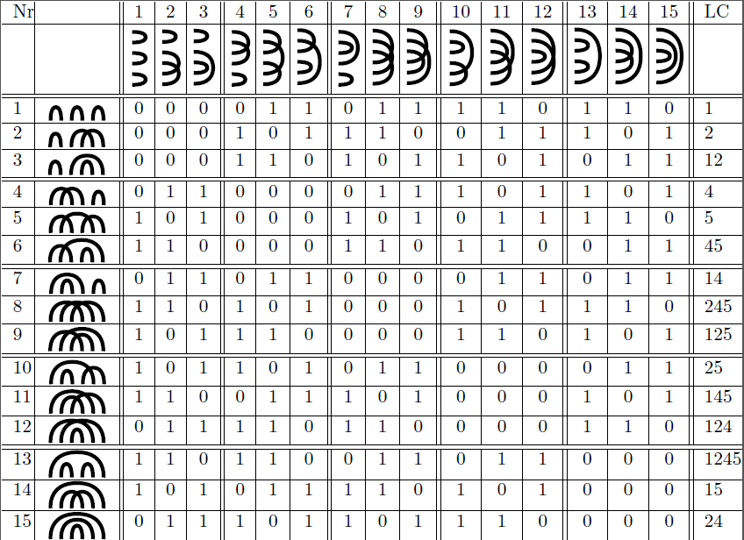
$$M_{6}$$

Slide 16
Basis of $M_{6}$ over $GF(2)$ (Cygan et al.)
We define a set of pm’s as follows:
Divide base set $[b]$ into groups:
1 | 2 3 | 4 5 | . . | . b-1 | b

Slide 17
Basis of $M_{6}$ over $GF(2)$ (Cygan et al.)
We define a set of pm’s as follows:
Divide base set $[b]$ into groups:
$X_{b}$ are all matchings using only edges between
consecutive groups.
1-1 correspondence with $(\frac{b}{2}−1)$-length bitstrings
1 | 2 3 | 4 5 | . . | . b-1 | b

Slide 18
Basis of $M_{6}$ over $GF(2)$ (Cygan et al.)
We define a set of pm’s as follows:
Divide base set $[b]$ into groups:
$X_{b}$ are all matchings using only edges between
consecutive groups.
1-1 correspondence with $(\frac{b}{2}−1)$-length bitstrings
1 | 2 3 | 4 5 | . . | . b-1 | b
1
1

Slide 19
Basis of $M_{6}$ over $GF(2)$ (Cygan et al.)
We define a set of pm’s as follows:
Divide base set $[b]$ into groups:
$X_{b}$ are all matchings using only edges between
consecutive groups.
1-1 correspondence with $(\frac{b}{2}−1)$-length bitstrings
1 | 2 3 | 4 5 | . . | . b-1 | b
0
1

Slide 20
Basis of $M_{6}$ over $GF(2)$ (Cygan et al.)
We define a set of pm’s as follows:
Divide base set $[b]$ into groups:
$X_{b}$ are all matchings using only edges between
consecutive groups.
1-1 correspondence with $(\frac{b}{2}−1)$-length bitstrings
Two matchings give HC if bitstrings complementary
1 | 2 3 | 4 5 | . . | . b-1 | b
0
1

Slide 21
Basis of $M_{6}$ over $GF(2)$ (Cygan et al.)

Slide 22
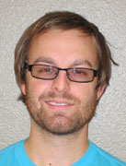
Representation theory
$6=5+1$
1
2
3
4
5
6
Integer partition $λ⊢n$
$6=4+1+1$
1
2
4
6
Standard Young tableau of $λ$
numbers $1…n$ in the boxes
ascending in each row, column
$f\left(λ\right) ≔$ # standard Young tableaux of $λ$
3
5
$6=3+3$
1
2
4
3
5
6
Non-bipartite setting:
Bipartite setting (RS):
$$rank M_{n}^{bip}=\sum_{\begin{aligned} \\ nice λ⊢n/2\end{aligned}}{f{\left(2λ\right)}^{}}$$
$$rank M_{n}^{bip}=\sum_{\begin{aligned} \\ hook λ⊢n/2\end{aligned}}{f{\left(λ\right)}^{2}}$$
$λ$ is hook if $⊆λ$
$$=Θ^{∗}(4^{n})$$
$λ$ is nice if $⊆λ$
$$=Θ^{∗}(2^{n})$$
[Raz-Spieker 95]

Slide 23
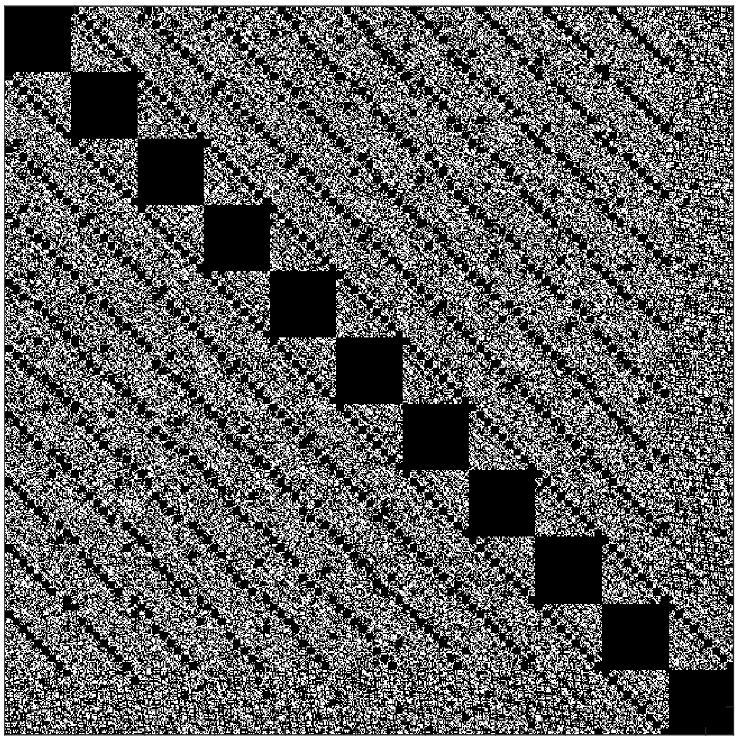
$$f\left(2 \frac{a}{b} \right)=462$$
$rank M_{12}=10395−462$
$=9933$
Non-bipartite setting:
$$rank M_{n}^{bip}=\sum_{\begin{aligned} \\ nice λ⊢n/2\end{aligned}}{f{\left(2λ\right)}^{}}$$
$$M_{12}$$
$$=Θ^{∗}(4^{n})$$
$$10395×10395$$

Slide 24
2
New reduction idea
turns rank lower bounds
into complexity lower bounds
counting
[Wlodarczyk 16]
DP-wizardry
$O^{∗}(6^{tw})$ time
$rank\left(H_{k}\right)=Θ^{∗}(6^{k})$
over $ℚ$
$rank\left(H_{k}\right)≤6^{k}$
over $ℚ$
optimal base
under SETH
reduction

Slide 25
Block propagation schemes
[Lokshtanov et al. 11]
$n$ variables
$cn$ treewidth
$m$ clauses
$poly(n,m)$ size
$$m$$
CNF-SAT
formula $φ$
$$≤$$
target problem graph $G$
$$cn$$
$⇒tw\left(G\right)≤cn$
running time
${(2^{1/c}−ε)}^{tw(G)}⋅{\left|G\right|}^{O(1)}$ refutes SETH

Slide 26
clauses
$$…$$
$$t$$
$$C_{1}$$
$$C_{2}$$
$$C_{m}$$
var.
$$x_{1}$$
$$l$$
$$r$$
$$x_{2}$$
$i$-th row
propagates assignment
to variable $x_{i}$
$$b$$
$$x_{3}$$
cell gadget at $(i,j)$
$$x_{4}$$
ensures
Same states on $l,r$.
State of $b$ is
$1$ if state of $l$ encodes ass. t$o x_{i}$ s$atisfying C_{j}$,
$\text{s}\text{tate} \text{of} t$ otherwise.
$j$-th column propagates at pos. $i$ whether variables $x_{1}…x_{i}$ satisfy $C_{j}$
$$…$$
$$x_{n}$$

Slide 27
clauses
$$…$$
$$t$$
blocks
of $γ$
$$C_{1}$$
$$C_{2}$$
$$C_{m}$$
var.
$$x_{1}$$
$$l$$
$$r$$
$$B_{1}$$
$$β$$
$$x_{2}$$
$i$-th row
propagates assignment
to block $B_{i}$
$i$-th row
propagates assignment
to variable $x_{i}$
$$b$$
$$x_{3}$$
$$B_{2}$$
cell gadget at $(i,j)$
$$x_{4}$$
ensures
Same states on $l,r$.
State of $b$ is
$1$ if state of $l$ encodes ass. t$o x_{i}$ s$atisfying C_{j}$,
$\text{s}\text{tate} \text{of} t$ otherwise.
$j$-th column propagates at pos. $i$ whether variables $x_{1}…x_{i}$ satisfy $C_{j}$
$j$-th column propagates at pos. $i$ whether blocks $B_{1}…B_{i}$ satisfy $C_{j}$
$$…$$
$$B_{q}$$
$$x_{n}$$

Slide 28
clauses
$$…$$
$$t$$
blocks
of $γ$
$$C_{1}$$
$$C_{2}$$
$$C_{m}$$
var.
$$r_{1}$$
$$l_{1}$$
$$x_{1}$$
$$l$$
$$⋮$$
$$⋮$$
$$r$$
$$B_{1}$$
$$β$$
$$l_{β}$$
$$r_{β}$$
$$x_{2}$$
$i$-th row
propagates assignment
to block $B_{i}$
$$b$$
$$x_{3}$$
$$B_{2}$$
cell gadget at $(i,j)$
$$x_{4}$$
ensures
Same states on $l,r$.
State of $b$ is
$1$ if state of $l$ encodes ass. t$o B_{i}$ s$atisfying C_{j}$,
$\text{s}\text{tate} \text{of} t$ otherwise.
$j$-th column propagates at pos. $i$ whether blocks $B_{1}…B_{i}$ satisfy $C_{j}$
$$…$$
$$B_{q}$$
$$x_{n}$$

Slide 29
fingerprint gadget $H$
interface $I=l∪r∪\left\{t\right\}∪\left\{b\right\},$
fixed set $𝒮$ of fingerprints on $I.$
Any partial solution $A$ inside $H$ has a fingerprint from $𝒮.$
$$t$$
$$l_{1}$$
$$r_{1}$$
$$l$$
$$⋮$$
$$⋮$$
$$r$$
$$l_{β}$$
$$r_{β}$$
$$b$$
Building cell gadget $(i,j)$ for decision:
cell gadget at $(i,j)$
$∃$ fingerprint set $𝒫_{β}$ s.t. $H_{β}[𝒫_{β},𝒫_{β}]$ is a permutation matrix.
Using fingerprint gadget,
ensure for all partial sol. $A$:
Same fingerprint $f$ on $l,r$.
Degree $\deg_{A}(b)$is
$2$ if assignment $π^{−1}(f)$ satisfies clause $C_{j}$,
$\deg_{A}(b)$otherwise.
ensures
Same states on $l,r$.
State of $b$ is
$1$ if state of $l$ encodes ass. t$o B_{i}$ s$atisfying C_{j}$,
$\text{s}\text{tate} \text{of} t$ otherwise.
$$\left|𝒫_{β}\right|={\left(2+\sqrt{2}\right)}^{β}$$
Injective encoding: ${π:\left\{0,1\right\}}^{γ}→𝒫_{β}$.

Slide 30
weighted fingerprint gadget $H$
interface $I=l∪r∪\left\{t\right\}∪\left\{b\right\},$
$w :$fingerprints on $I ↦ ℚ$
(Weighted) number of partial sol. with fingerprint $f$ inside $H$ is $w(f)$.
$$t$$
$$l_{1}$$
$$r_{1}$$
$$l$$
$$⋮$$
$$⋮$$
$$r$$
$$l_{β}$$
$$r_{β}$$
$$b$$
Building cell gadget $(i,j)$ for counting:
cell gadget at $(i,j)$
$∃$ fingerprint set $𝒫_{β}$ s.t. $F=H_{β}[𝒫_{β},𝒫_{β}]$ has full rank
Allow only ${f∈𝒫}_{β}$ inside $H$.
ensures
Same states on $l,r$.
State of $b$ is
$1$ if state of $l$ encodes ass. t$o B_{i}$ s$atisfying C_{j}$,
$\text{s}\text{tate} \text{of} t$ otherwise.
Let $v_{L}(f)$ / $v_{R}(f)$ count the part. sol. with fingerprint $f$ left/right of gadget.
$$\left|𝒫_{β}\right|=6^{β}$$
with gadget:
Total number
w/o gadget:
Injective encoding: ${π:\left\{0,1\right\}}^{γ}→𝒫_{β}$.
$$v_{L}^{T}(QF^{−1})Fv_{R}$$
$$v_{L}^{T}Fv_{R}$$
exists!
tests for satisfaction, etc.

Slide 31
HCs mod 2
$O^{∗}({3.41}^{tw})$ time
$rank\left(H_{k}\right)≈{3.41}^{k}$
over $ℤ_{2}$
optimal base
under SETH
„block propagation“ with permutation submatrix of $H_{k}$
HCs mod p$≠$2
$$?$$
$rank\left(H_{k}\right)≥{3.97}^{k}$
over $ℤ_{p}$
$Ω^{∗}({3.97}^{tw})$ time under SETH
Counting HCs
$O^{∗}(6^{tw})$ time
rank$\left(H_{k}\right)≈6^{k}$
over $ℚ$
optimal base
under SETH
„block propagation“ that works with any basis of $H_{k}$

Slide 32
Future work
HCs mod p$≠$2
$$?$$
$rank\left(H_{k}\right)≥{3.97}^{k}$
over $ℤ_{p}$
$Ω^{∗}({3.97}^{tw})$ time under SETH
General problems
$O^{∗}(c^{tw})$ time
$rank\left(A_{k}\right)≈c^{k}$
optimal base under SETH
What about counting connected subgraphs?
Rank bound and all needed machinery ready, some gadget is missing

Slide 33
Standard DP
fingerprint $f′$ on $S$:
$d^{′}:S→\left\{0,1,2\right\}$
perfect matching $M′$ on ${d′}^{−1}\left(1\right)$
$d+d′$ is all-$2$s
$M∪M′$ single cycle
combine
fingerprint $f$ on $S$
$d :S→\left\{0,1,2\right\}$ stores degrees in $S$
perfect matching $M$ on $d^{−1}\left(1\right)$ stores connectivity of endpoints
don‘t
combine

