Slide 1

Improved (exponential time) algorithms:
A case study for Subset Sum and Bin Packing
Contains material from
[1] Jesper Nederlof, Jakub Pawlewicz, Céline M. F. Swennenhuis, Karol Wegrzycki
A Faster Exponential Time Algorithm for Bin Packing With a Constant Number of Bins
via Additive Combinatorics. (SODA 2021)
[2] Jesper Nederlof, Karol Wegrzycki
Improving Schroeppel and Shamir's algorithm for subset sum via orthogonal vectors.
(STOC 2021)
[3] Nikhil Bansal, Shashwat Garg, Jesper Nederlof, Nikhil Vyas
Faster space-efficient algorithms for subset sum and k-sum. (STOC 2017)
[4] Per Austrin, Petteri Kaski, Mikko Koivisto, Jesper Nederlof
Dense Subset Sum May Be the Hardest. (STACS 2016)
Jesper Nederlof
(Utrecht University)

Slide 2
Wall of NP-completeness

Slide 3

Wall of NP-completeness
CNF-Sat
VC
FVS
3DM
Set-Cover
BILP
Max-Cut
Bin Packing
TSP
Bin Packing
Subset-Sum
Subset-Sum
$$2^{n}$$
Strong
ETH
Set Cover
Conjecture
ETH
P ≠ NP

Slide 4
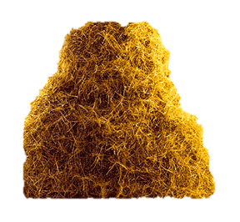
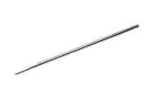
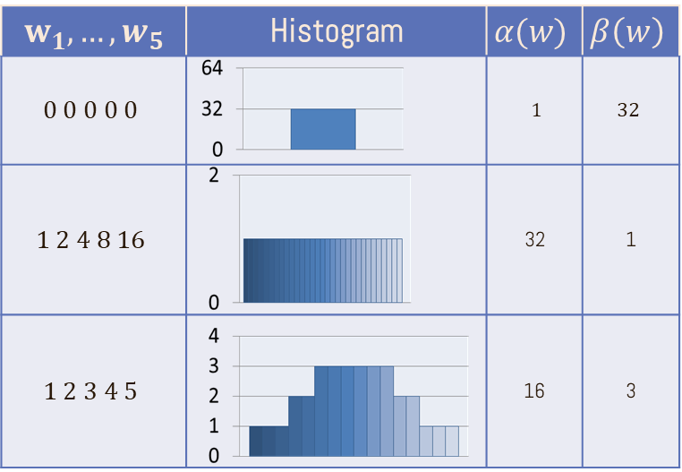

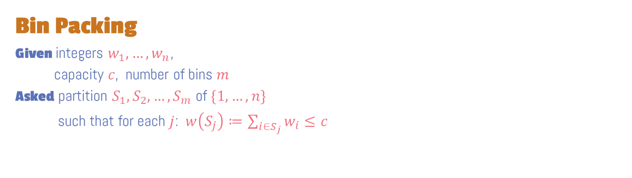
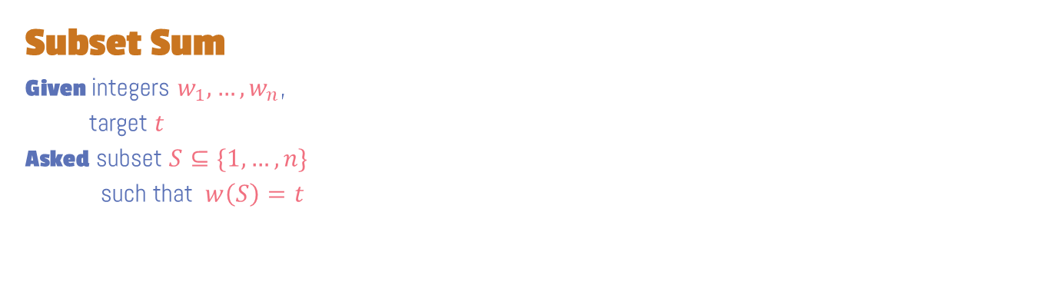
Bin Packing
Given integers $w_{1},…,w_{n}$,
capacity $c$, number of bins $m$
Asked partition $S_{1},S_{2},…,S_{m}$ of $\{1,…,n\}$
such that for each $j$: $w\left(S_{j}\right)≔\sum_{i∈S_{j}}{w_{i}}≤c$
Subset Sum
Given integers $w_{1},…,w_{n}$,
target $t$
Asked subset $S⊆\{1,…,n\}$
such that $w\left(S\right)=t$
needle
Representation Method
Additive combinatorics
(#Distinct Sums vs anti-concentration)

Slide 5
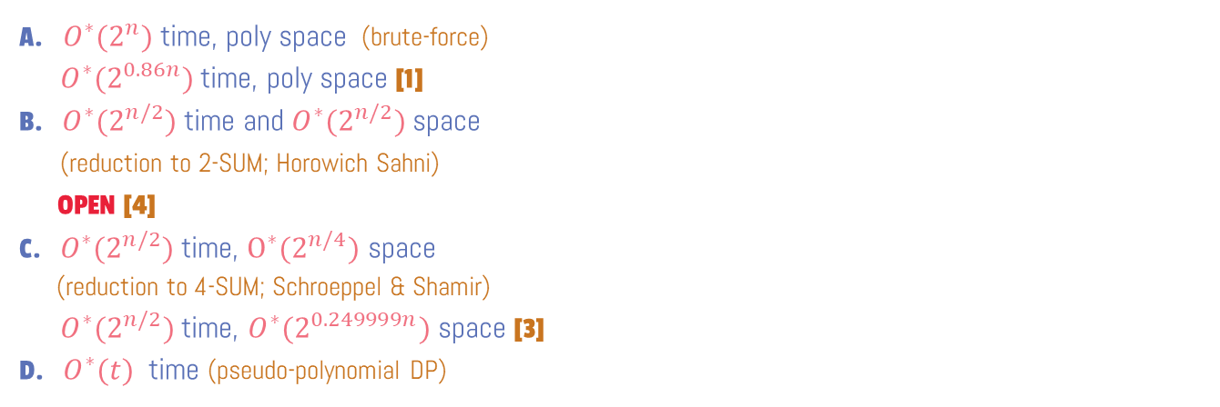
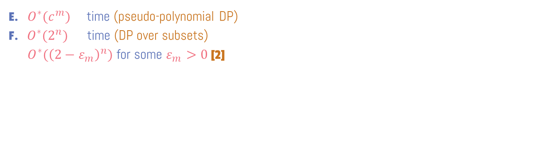
Bin Packing
Given integers $w_{1},…,w_{n}$,
capacity $c$, number of bins $m$
Asked partition $S_{1},S_{2},…,S_{m}$ of $\{1,…,n\}$
such that for each $j$: $w\left(S_{j}\right)≔\sum_{i∈S_{j}}{w_{i}}≤c$
Subset Sum
Given integers $w_{1},…,w_{n}$,
target $t$
Asked subset $S⊆\{1,…,n\}$
such that $w\left(S\right)=t$
E. $O^{∗}(c^{m}⁡)$ time (pseudo-polynomial DP)
F. ${O^{∗}(2}^{n})$ time (DP over subsets)
$O^{∗}({\left(2−ε_{m}\right)}^{n})$ for some $ε_{m}>0$ [2]
A. ${O^{∗}(2}^{n})$ time, poly space (brute-force)
$O^{∗}(2^{0.86n})$ time, poly space [1]
B. ${O^{∗}(2}^{n/2})$ time and ${O^{∗}(2}^{n/2})$ space
(reduction to 2-SUM; Horowich Sahni)
OPEN [4]
C. ${O^{∗}(2}^{n/2})$ time, $O^{∗}(2^{n/4})$ space
(reduction to 4-SUM; Schroeppel & Shamir)
${O^{∗}(2}^{n/2})$ time, $O^{∗}(2^{0.249999n})$ space [3]
D. $O^{∗}(t)$ time (pseudo-polynomial DP)

Slide 6
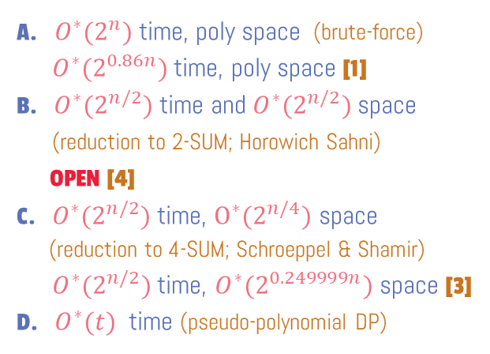

SSS in ${O^{∗}(2}^{n/2})$ time
Subset Sum
Given integers $w_{1},…,w_{n}$,
target $t$
Asked subset $S⊆\{1,…,n\}$
such that $w\left(S\right)=t$
k-SUM
Given $A_{1},…,A_{k}⊆ℕ$, such that $\left|A_{i}\right|=N$
integer $t$
Asked elements $x_{1}∈A_{1},…,x_{k}∈A_{k}$ summing to $t$
2-SUM in $O(N\log{N})$ time:
Sort $A_{1}$ and $A_{2}$
Keep pointers $l=min⁡(A_{1})$, $r=max⁡(A_{2})$
Compare $A_{1}\left[l\right]+A_{2}[r]$ with $t$, move pointer accordingly
Given SSS instance $w_{1},…,w_{n}$, and $t$ define
$A_{1}≔\left\{w\left(X\right):X⊆\{1,…,\frac{n}{2}\}\right\}$
$A_{2}≔\left\{w\left(X\right):X⊆\frac{\{n}{2}+1,…,\frac{n}{2}\}\right\}$
A. ${O^{∗}(2}^{n})$ time, poly space (brute-force)
$O^{∗}(2^{0.86n})$ time, poly space [1]
B. ${O^{∗}(2}^{n/2})$ time and ${O^{∗}(2}^{n/2})$ space
(reduction to 2-SUM; Horowich Sahni)
OPEN [4]
C. ${O^{∗}(2}^{n/2})$ time, $O^{∗}(2^{n/4})$ space
(reduction to 4-SUM; Schroeppel & Shamir)
${O^{∗}(2}^{n/2})$ time, $O^{∗}(2^{0.249999n})$ space [3]
D. $O^{∗}(t)$ time (pseudo-polynomial DP)

Slide 7

SSS in ${O^{∗}(2}^{n/2})$ time, ${O^{∗}(2}^{n/4})$ space
Subset Sum
Given integers $w_{1},…,w_{n}$,
target $t$
Asked subset $S⊆\{1,…,n\}$
such that $w\left(S\right)=t$
k-SUM
Given $A_{1},…,A_{k}⊆ℕ$, such that $\left|A_{i}\right|=N$
integer $t$
Asked elements $x_{1}∈A_{1},…,x_{k}∈A_{k}$ summing to $t$
4-SUM in $O(N^{2}\log{N})$ time and $O(N\log{N})$ space:
Simulate 2-SUM algorithm on instance $A_{1}+A_{2}$, $A_{3}+A_{4}$
Use a priority queue of size $O\left(N\right)$ to
  Enumerate $A_{1}+A_{2}$ is ascending order
  Enumerate $A_{3}+A_{4}$ is descending order
Reduce SSS on n items to 4-SUM with list size ${O(2}^{n/4})$
A. ${O^{∗}(2}^{n})$ time, poly space (brute-force)
$O^{∗}(2^{0.86n})$ time, poly space [1]
B. ${O^{∗}(2}^{n/2})$ time and ${O^{∗}(2}^{n/2})$ space
(reduction to 2-SUM; Horowich Sahni)
OPEN [4]
C. ${O^{∗}(2}^{n/2})$ time, $O^{∗}(2^{n/4})$ space
(reduction to 4-SUM; Schroeppel & Shamir)
${O^{∗}(2}^{n/2})$ time, $O^{∗}(2^{0.249999n})$ space [3]
D. $O^{∗}(t)$ time (pseudo-polynomial DP)

Slide 8
SSS in ${O^{∗}(2}^{n/2})$ time, ${O^{∗}(2}^{n/4})$ space
Subset Sum
Given integers $w_{1},…,w_{n}$,
target $t$
Asked subset $S⊆\{1,…,n\}$
such that $w\left(S\right)=t$
k-SUM
Given $A_{1},…,A_{k}⊆ℕ$, such that $\left|A_{i}\right|=N$
integer $t$
Asked elements $x_{1}∈A_{1},…,x_{k}∈A_{k}$ summing to $t$
4-SUM in $O(N^{2}\log{N})$ time and $O(N\log{N})$ space:
Simulate 2-SUM algorithm on instance $A_{1}+A_{2}$, $A_{3}+A_{4}$
Use a priority queue of size $O\left(N\right)$ to
  Enumerate $A_{1}+A_{2}$ is ascending order
  Enumerate $A_{3}+A_{4}$ is descending order
Reduce SSS on n items to 4-SUM with list size ${O(2}^{n/4})$
A. ${O^{∗}(2}^{n})$ time, poly space (brute-force)
$O^{∗}(2^{0.86n})$ time, poly space [1]
B. ${O^{∗}(2}^{n/2})$ time and ${O^{∗}(2}^{n/2})$ space
(reduction to 2-SUM; Horowich Sahni)
OPEN [4]
C. ${O^{∗}(2}^{n/2})$ time, $O^{∗}(2^{n/4})$ space
(reduction to 4-SUM; Schroeppel & Shamir)
${O^{∗}(2}^{n/2})$ time, $O^{∗}(2^{0.249999n})$ space [3]
D. $O^{∗}(t)$ time (pseudo-polynomial DP)

Slide 9
needle
Representation Method
Nick Howgrave-Graham, Antoine Joux:
New Generic Algorithms for Hard Knapsacks. EUROCRYPT 2010

Slide 10
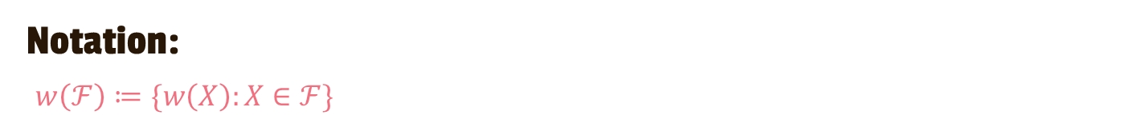


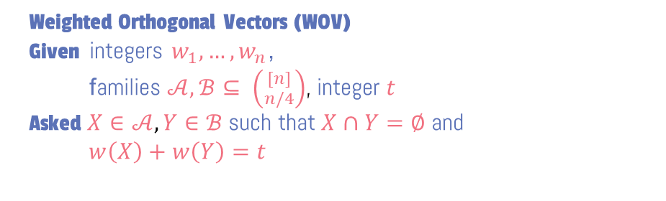

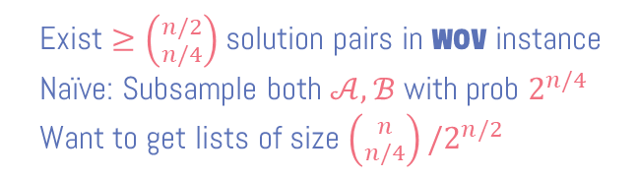
Representation Method for Subset Sum
Notation:
$w\left(ℱ\right)≔\{w\left(X\right):X∈ℱ\}$
Let’s assume $\left|S\right|=n/2$
Naïve reduction to 2-SUM
$$A_{1}≔A_{2}≔ \{w\left(X\right): \left({n \atop n/4}\right)\}$$
Several problems:
1. Solution to 2-SUM may not give solution to SSS
2. $N=\left({n \atop n/4}\right)=2^{0.8113n}>2^{n/2}$
Weighted Orthogonal Vectors (WOV)
Given integers $w_{1},…,w_{n}$,
families $𝒜,ℬ⊆ \left({[n] \atop n/4}\right)$, integer $t$
Asked $X∈𝒜, Y∈ℬ$ such that $X∩Y=∅$ and
$w\left(X\right)+w\left(Y\right)=t$
WOV in $O(\left(\left|𝒜\right|+\left|ℬ\right|\right){n⋅2}^{n}/\left({n \atop n/4}\right))$ time, small space [2]
Reduce to WOV by setting $𝒜:=ℬ≔\left({n \atop n/4}\right)$
Assumption: $\left|w\left(\left({S \atop n/2}\right)\right)\right|≔\left({n/2 \atop n/4}\right)$ (highly non-trivial!)
Idea:
Pick random prime $p≈2^{n/2}$, sample $s∈_{R}ℤ_{p}$
Set $𝒜′≔\{X∈𝒜:w\left(X\right)≡_{p} s\}$
$ℬ′ ≔\{Y∈ℬ :w\left(Y\right)≡_{p}t−s\}$
3. Solve WOV instance $(𝒜′, ℬ′,t)$
Exist $≥\left({n/2 \atop n/4}\right)$ solution pairs in WOV instance
Naïve: Subsample both $𝒜,ℬ$ with prob $2^{n/4}$
Want to get lists of size $\left({n \atop n/4}\right)/2^{n/2}$

Slide 11
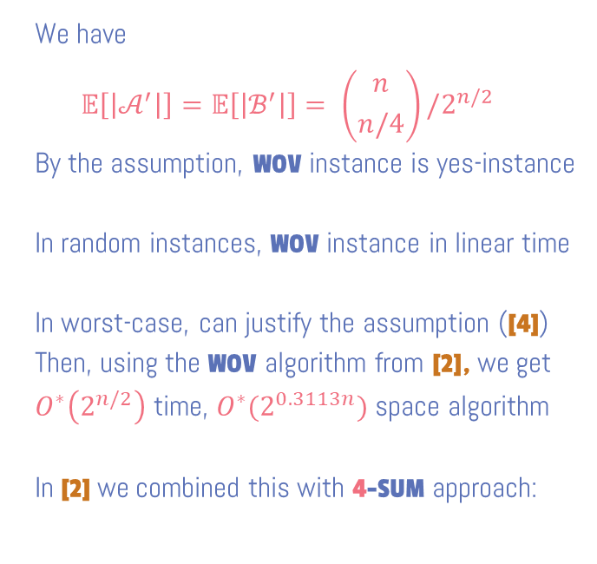
Representation Method for Subset Sum
Notation:
$w\left(ℱ\right)≔\{w\left(X\right):X∈ℱ\}$
We have
$$𝔼\left[\left|𝒜^{′}\right|\right]=𝔼\left[\left|ℬ^{′}\right|\right]= \left({n \atop n/4}\right)/2^{n/2}$$
By the assumption, WOV instance is yes-instance
In random instances, WOV instance in linear time
In worst-case, can justify the assumption ([4])
Then, using the WOV algorithm from [2], we get
$O^{∗}\left(2^{n/2}\right)$ time, ${O^{∗}(2}^{0.3113n})$ space algorithm
In [2] we combined this with 4-SUM approach:
Weighted Orthogonal Vectors (WOV)
Given integers $w_{1},…,w_{n}$,
families $𝒜,ℬ⊆ \left({[n] \atop n/4}\right)$, integer $t$
Asked $X∈𝒜, Y∈ℬ$ such that $X∩Y=∅$ and
$w\left(X\right)+w\left(Y\right)=t$
WOV in $O(\left(\left|𝒜\right|+\left|ℬ\right|\right){n⋅2}^{n}/\left({n \atop n/4}\right))$ time, small space [2]
Assumption: $\left|w\left(\left({S \atop n/2}\right)\right)\right|≔\left({n/2 \atop n/4}\right)$ (highly non-trivial!)
Idea:
Pick random prime $p≈2^{n/2}$, sample $s∈_{R}ℤ_{p}$
Set $𝒜′≔\{X∈𝒜:w\left(X\right)≡_{p} s\}$
$ℬ′ ≔\{Y∈ℬ :w\left(Y\right)≡_{p}t−s\}$
3. Solve WOV instance $(𝒜′, ℬ′,t)$
${O^{∗}(2}^{n/2})$ time, $O^{∗}(2^{0.249999n})$ space

Slide 12
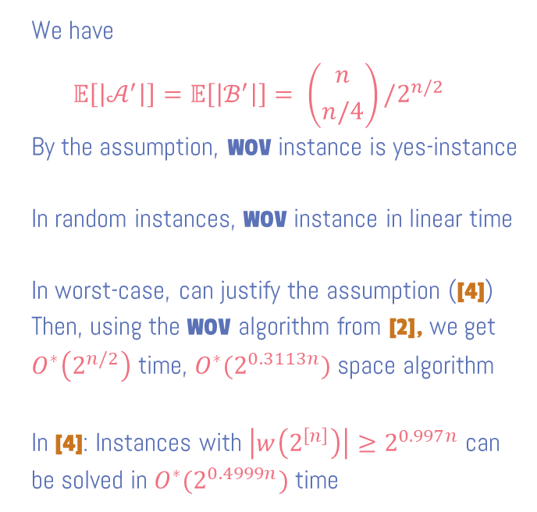
Representation Method for Subset Sum
Notation:
$w\left(ℱ\right)≔\{w\left(X\right):X∈ℱ\}$
We have
$$𝔼\left[\left|𝒜^{′}\right|\right]=𝔼\left[\left|ℬ^{′}\right|\right]= \left({n \atop n/4}\right)/2^{n/2}$$
By the assumption, WOV instance is yes-instance
In random instances, WOV instance in linear time
In worst-case, can justify the assumption ([4])
Then, using the WOV algorithm from [2], we get
$O^{∗}\left(2^{n/2}\right)$ time, ${O^{∗}(2}^{0.3113n})$ space algorithm
In [4]: Instances with $\left|w\left(2^{\left[n\right]}\right)\right|≥2^{0.997n}$ can be solved in ${O^{∗}(2}^{0.4999n})$ time
Weighted Orthogonal Vectors (WOV)
Given integers $w_{1},…,w_{n}$,
families $𝒜,ℬ⊆ \left({[n] \atop n/4}\right)$, integer $t$
Asked $X∈𝒜, Y∈ℬ$ such that $X∩Y=∅$ and
$w\left(X\right)+w\left(Y\right)=t$
WOV in $O(\left(\left|𝒜\right|+\left|ℬ\right|\right){n⋅2}^{n}/\left({n \atop n/4}\right))$ time, small space [2]
Assumption: $\left|w\left(\left({S \atop n/2}\right)\right)\right|≔\left({n/2 \atop n/4}\right)$ (highly non-trivial!)
Idea:
Pick random prime $p≈2^{n/2}$, sample $s∈_{R}ℤ_{p}$
Set $𝒜′≔\{X∈𝒜:w\left(X\right)≡_{p} s\}$
$ℬ′ ≔\{Y∈ℬ :w\left(Y\right)≡_{p}t−s\}$
3. Solve WOV instance $(𝒜′, ℬ′,t)$

Slide 13
Additive combinatorics
(#Distinct Sums vs anti-concentration)
[4] Per Austrin, Petteri Kaski, Mikko Koivisto, Jesper Nederlof
Dense Subset Sum May Be the Hardest. (STACS 2016)

Slide 14
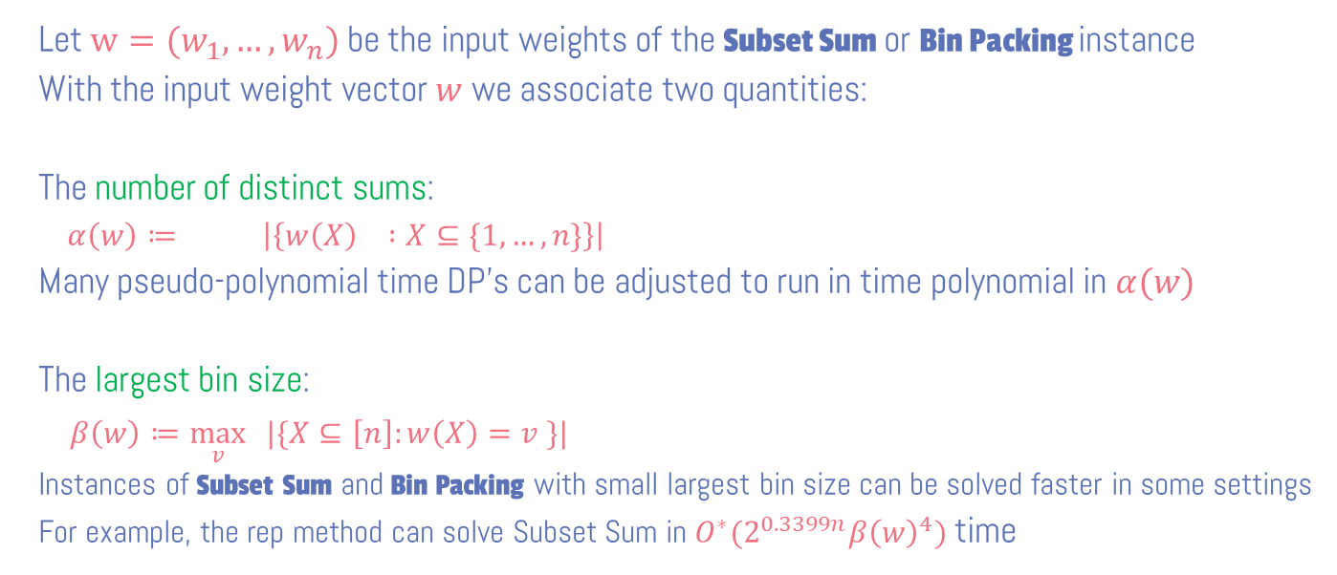
Additive Combinatorics
Let $w=(w_{1},…,w_{n})$ be the input weights of the Subset Sum or Bin Packing instance
With the input weight vector $w$ we associate two quantities:
The number of distinct sums:
$α\left(w\right)≔ \left|\left\{w\left(X\right) :X⊆\{1,…,n\}\right\}\right|$
Many pseudo-polynomial time DP’s can be adjusted to run in time polynomial in $α(w)$
The largest bin size:
$β\left(w\right)≔\max_{v}{ |\{X⊆\left[n\right]:w\left(X\right)=v \}|}$
Instances of Subset Sum and Bin Packing with small largest bin size can be solved faster in some settings
For example, the rep method can solve Subset Sum in ${O^{∗}(2}^{0.3399n}β{\left(w\right)}^{4})$time

Slide 15
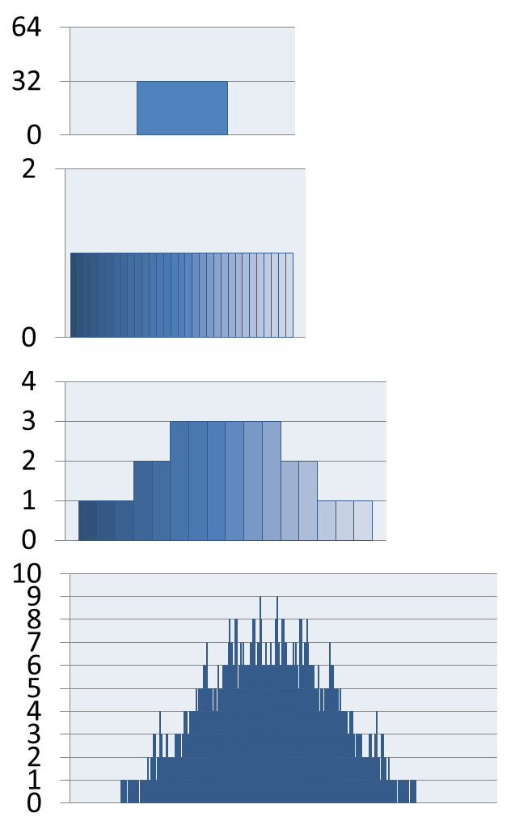
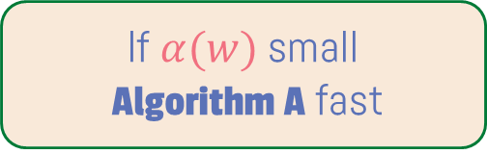

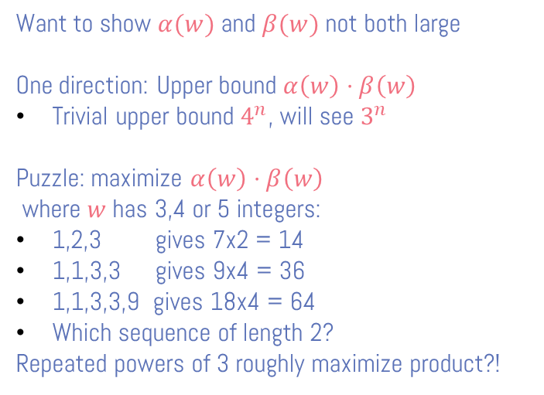
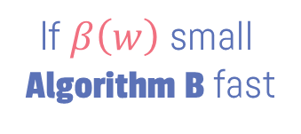
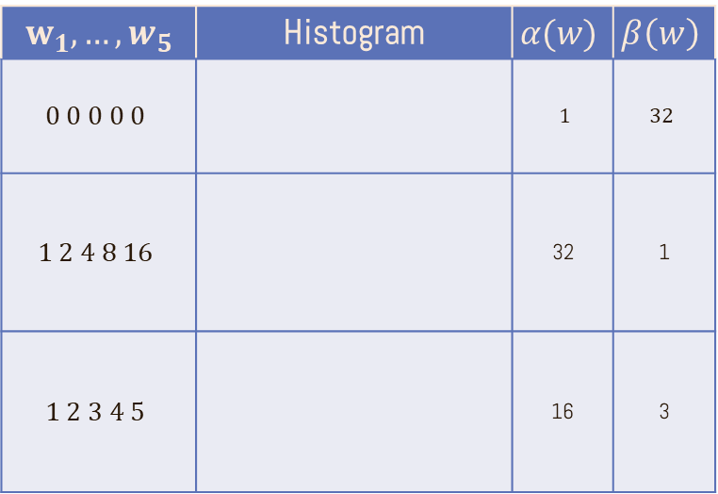
Exploiting Additive Combinatorics
$α\left(w\right)≔ \left|\left\{w\left(X\right) :X⊆\{1,…,n\}\right\}\right|$
$β\left(w\right)≔\max_{v}{ |\{X⊆\left[n\right]:w\left(X\right)=v \}|}$
If $α(w)$ small
Algorithm A fast
If $β\left(w\right)$ small
Algorithm B fast
$$w_{1},…,w_{5}$$ | Histogram | $$α(w)$$ | $$β\left(w\right)$$
$$0 0 0 0 0$$ |  | $1$ | $$32$$
$$1 2 4 8 16$$ |  | 32 | 1
$$1 2 3 4 5$$ |  | 16 | 3
Want to show $α(w)$ and $β(w)$ not both large
One direction: Upper bound $α\left(w\right)⋅β\left(w\right)$
Trivial upper bound $4^{n}$, will see $3^{n}$
Puzzle: maximize $α\left(w\right)⋅β\left(w\right)$
where $w$ has 3,4 or 5 integers:
1,2,3 gives 7x2 = 14
1,1,3,3 gives 9x4 = 36
1,1,3,3,9 gives 18x4 = 64
Which sequence of length 2?
Repeated powers of 3 roughly maximize product?!

Slide 16





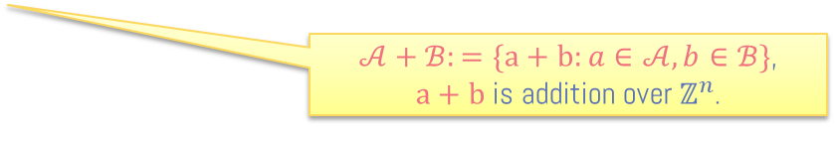

Uniquely Decodable Code Pairs (UDCP’s)
Def (UDCP): A UDCP is a pair $𝒜,ℬ⊆\{0,1\}^{n}$ s.t. $\left|𝒜+ℬ\right|=\left|𝒜\right||ℬ|$.
$𝒜=\{10,01\},ℬ=\{00,01,11\}$ is UDCP:
$𝒜+ℬ=\{10, 11, 21, 01, 02, 12\}$
$𝒜+ℬ:=\{a+b:a∈𝒜, b∈ℬ\}$,
$a+b$ is addition over $ℤ^{n}$.
$$𝒜$$
1011100
1101101
0000000
1010011
0101010
1111101
1100111
1011100
1101101
0000000
1010011
0101010
1111101
1100111
1 0 1 0 0 1 1
1
0
??
2
1
$$ℬ$$
0011001
1010101
0011011
0110110
0
0011001
1010101
0011011
0110110
0 1 1 0 1 1 0
1
0

Slide 17

Uniquely Decodable Code Pairs (UDCP’s)
Def (UDCP): A UDCP is a pair $𝒜,ℬ⊆\{0,1\}^{n}$ s.t. $\left|𝒜+ℬ\right|=\left|𝒜\right||ℬ|$.
$𝒜=\{10,01\},ℬ=\{00,01,11\}$ is UDCP:
$𝒜+ℬ=\{10, 11, 21, 01, 02, 12\}$
$𝒜+ℬ:=\{a+b:a∈𝒜, b∈ℬ\}$,
$a+b$ is addition over $ℤ^{n}$.
Observation: If $𝒜,ℬ⊆\{0,1\}^{n}$ form UDCP, then $\left|𝒜\right|⋅\left|ℬ\right|≤3^{n}$
Why?
$$𝒜+ℬ⊆\{0,1,2\}^{n}$$
Best known bounds:
Exist $𝒜,ℬ$ with $\left|𝒜\right|⋅\left|ℬ\right|≥2^{1.31781n}$
$\left|𝒜\right|⋅\left|ℬ\right|≤2^{1.5 n}$ for any UDCP $𝒜,ℬ$

Slide 18
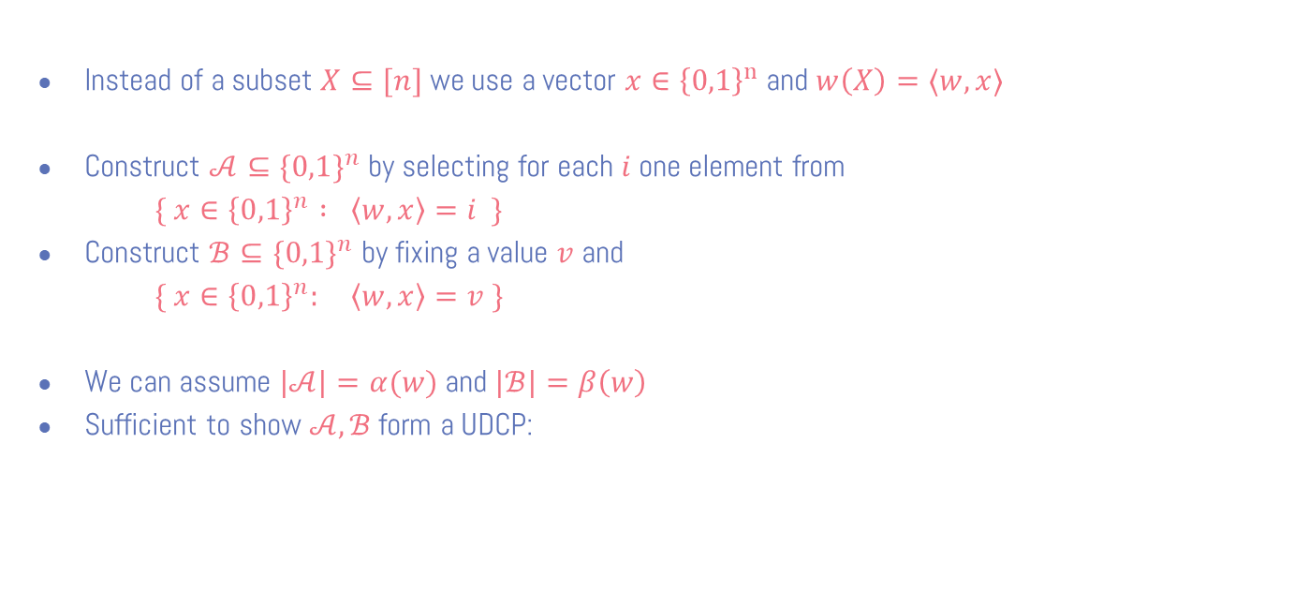

Bounding $α\left(w\right)⋅β\left(w\right)≤3^{n}$ via UDCP’s
$α\left(w\right)≔ \left|\left\{w\left(X\right) :X⊆\{1,…,n\}\right\}\right|$
$β\left(w\right)≔\max_{v}{ |\{X⊆\left[n\right]:w\left(X\right)=v \}|}$
Instead of a subset $X⊆[n]$ we use a vector ${x∈\left\{0,1\right\}}^{n}$ and $w\left(X\right)=⟨w,x⟩$
Construct $𝒜⊆\{0,1\}^{n}$ by selecting for each $i$ one element from
$\{ x∈{\left\{0,1\right\}}^{n} : \left\langle w,x\right\rangle =i \}$
Construct $ℬ⊆\{{0,1\}}^{n}$ by fixing a value $v$ and
$\{ x∈{\left\{0,1\right\}}^{n}: \left\langle w,x\right\rangle =v \}$
We can assume $|𝒜|=α(w)$ and $|ℬ|=β\left(w\right)$
Sufficient to show $𝒜,ℬ$ form a UDCP:
  ○ Suppose $a_{1},a_{2}∈A$ and $b_{1},b_{2}∈B$ s.t. $a_{1}+b_{1}=a_{2}+b_{2}$
  ○ Then $\left\langle a_{1},w\right\rangle =\left\langle a_{1}+b_{1},w\right\rangle −v=\left\langle a_{2}+b_{2},w\right\rangle −v=\left\langle a_{2},w\right\rangle$
  ○ Thus $a_{1}=a_{2}$ and therefore also $b_{1}=b_{2}$

Slide 19
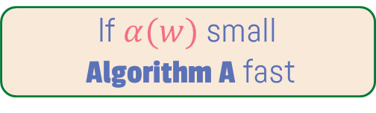
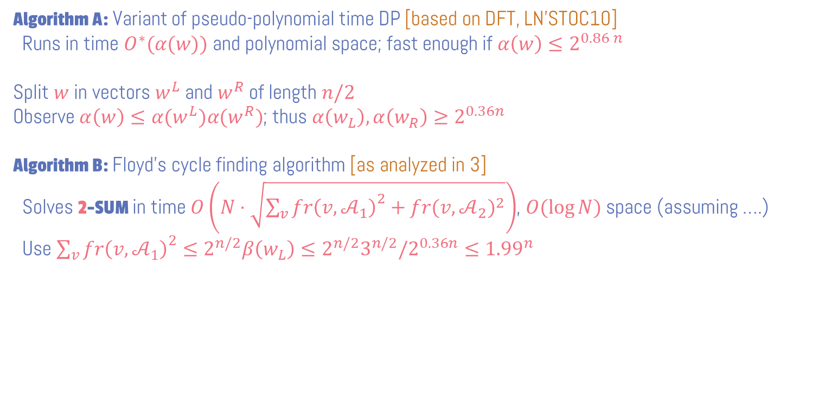

Exploiting Additive Combinatorics
$α\left(w\right)≔ \left|\left\{w\left(X\right) :X⊆\{1,…,n\}\right\}\right|$
$β\left(w\right)≔\max_{v}{ |\{X⊆\left[n\right]:w\left(X\right)=v \}|}$
If $α(w)$ small
Algorithm A fast
If $β\left(w\right)$ small
Algorithm B fast
$O^{∗}(2^{0.86n})$ time, poly space algorithm for Subset Sum [3]
Algorithm A: Variant of pseudo-polynomial time DP [based on DFT, LN’STOC10]
Runs in time $O^{∗}(α(w))$ and polynomial space; fast enough if $α\left(w\right)≤2^{0.86 n}$
Split $w$ in vectors $w^{L}$ and $w^{R}$ of length $n/2$
Observe $α\left(w\right)≤α(w^{L})α(w^{R})$; thus $α\left(w_{L}\right),α\left(w_{R}\right)≥2^{0.36n}$
Algorithm B: Floyd’s cycle finding algorithm [as analyzed in 3]
Solves 2-SUM in time $O\left(N⋅\sqrt{{\sum_{v}{fr\left(v,𝒜_{1}\right)}}^{2}+{fr(v,𝒜_{2})}^{2}}\right)$, $O(\log{N})$ space (assuming ….)
Use ${\sum_{v}{fr\left(v,𝒜_{1}\right)}}^{2}≤2^{n/2}β\left(w_{L}\right)≤2^{n/2}3^{n/2}/2^{0.36n}≤{1.99}^{n}$

Slide 20
Bin Packing
Given integers $w_{1},…,w_{n}$,
capacity $c$, number of bins $m$
Asked partition $S_{1},S_{2},…,S_{m}$ of $\{1,…,n\}$
such that for each $j$: $w\left(S_{j}\right)≔\sum_{i∈S_{j}}{w_{i}}≤c$
Subset Sum
Given integers $w_{1},…,w_{n}$,
target $t$
Asked subset $S⊆\{1,…,n\}$
such that $w\left(S\right)=t$
E. $O^{∗}(c^{m}⁡)$ time (pseudo-polynomial DP)
F. ${O^{∗}(2}^{n})$ time (DP over subsets)
$O^{∗}({\left(2−ε_{m}\right)}^{n})$ for some $ε_{m}>0$ [2]
A. ${O^{∗}(2}^{n})$ time, poly space (brute-force)
$O^{∗}(2^{0.86n})$ time, poly space [1]
B. ${O^{∗}(2}^{n/2})$ time and ${O^{∗}(2}^{n/2})$ space
(reduction to 2-SUM; Horowich Sahni)
OPEN [4]
C. ${O^{∗}(2}^{n/2})$ time, $O^{∗}(2^{n/4})$ space
(reduction to 4-SUM; Schroeppel & Shamir)
${O^{∗}(2}^{n/2})$ time, $O^{∗}(2^{0.249999n})$ space [3]
D. $O^{∗}(t)$ time (pseudo-polynomial DP)

Slide 21
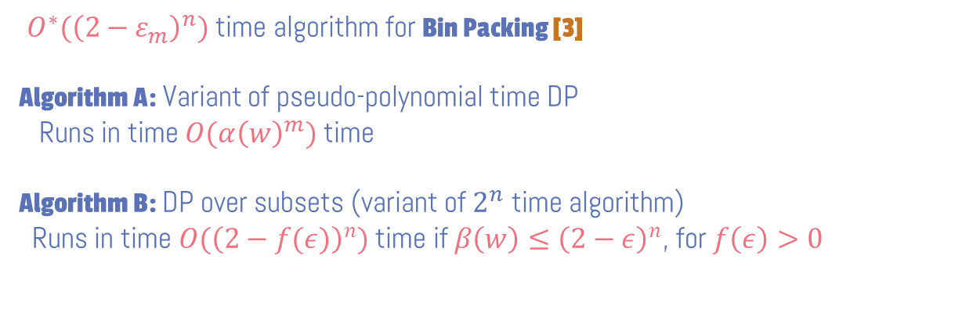
Exploiting Additive Combinatorics
$α\left(w\right)≔ \left|\left\{w\left(X\right) :X⊆\{1,…,n\}\right\}\right|$
$β\left(w\right)≔\max_{v}{ |\{X⊆\left[n\right]:w\left(X\right)=v \}|}$
If $α(w)$ small
Algorithm A fast
If $β\left(w\right)$ small
Algorithm B fast
$O^{∗}({\left(2−ε_{m}\right)}^{n})$ time algorithm for Bin Packing [3]
Algorithm A: Variant of pseudo-polynomial time DP
Runs in time $O({α\left(w\right)}^{m})$ time
Algorithm B: DP over subsets (variant of $2^{n}$ time algorithm)
Runs in time $O({\left(2−f(ε)\right)}^{n})$ time if $β\left(w\right)≤{\left(2−ε\right)}^{n}$, for $f\left(ε\right)>0$

Slide 22
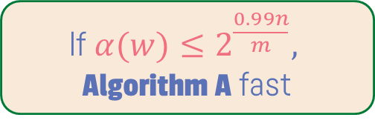
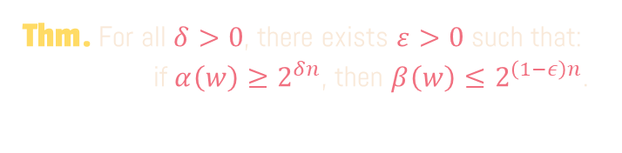
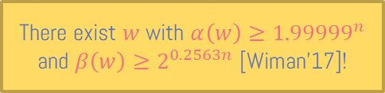
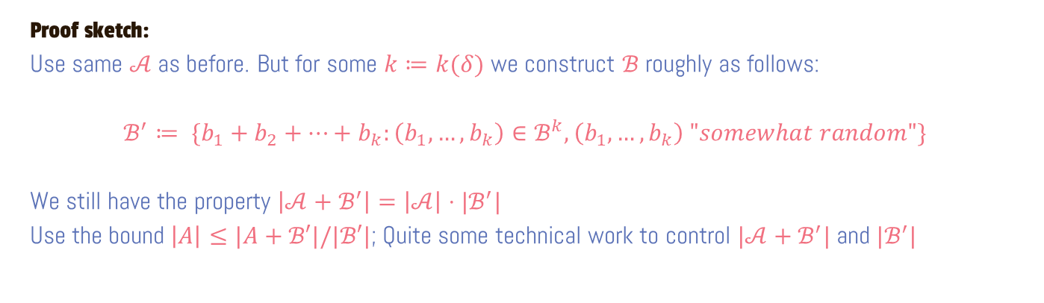
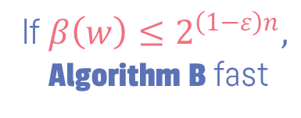
Some Additive Combinatorics
If $α(w)≤2^{\frac{0.99n}{m}},$ Algorithm A fast
If $β\left(w\right)≤2^{\left(1−ε\right)n},$
Algorithm B fast
Thm. For all $δ>0$, there exists $ε>0$ such that:
if $α\left(w\right)≥2^{δn}$, then $β\left(w\right)≤2^{\left(1−ε\right)n}$.
There exist $w$ with $α\left(w\right)≥{1.99999}^{n}$ and $β\left(w\right)≥2^{0.2563n}$ [Wiman’17]!
Proof sketch:
Use same $𝒜$ as before. But for some $k≔k(δ)$ we construct $ℬ$ roughly as follows:
$ℬ^{′}≔ \{b_{1}+b_{2}+…+b_{k}:\left(b_{1},…, b_{k}\right)∈ℬ^{k},\left(b_{1},…, b_{k}\right) "somewhat random"\}$
We still have the property $\left|𝒜+ℬ^{′}\right|=\left|𝒜\right|⋅|ℬ^{′}|$
Use the bound $\left|A\right|≤|A+ℬ′|/|ℬ′|$; Quite some technical work to control $|𝒜+ℬ^{′}|$ and $|ℬ^{′}|$

Slide 23
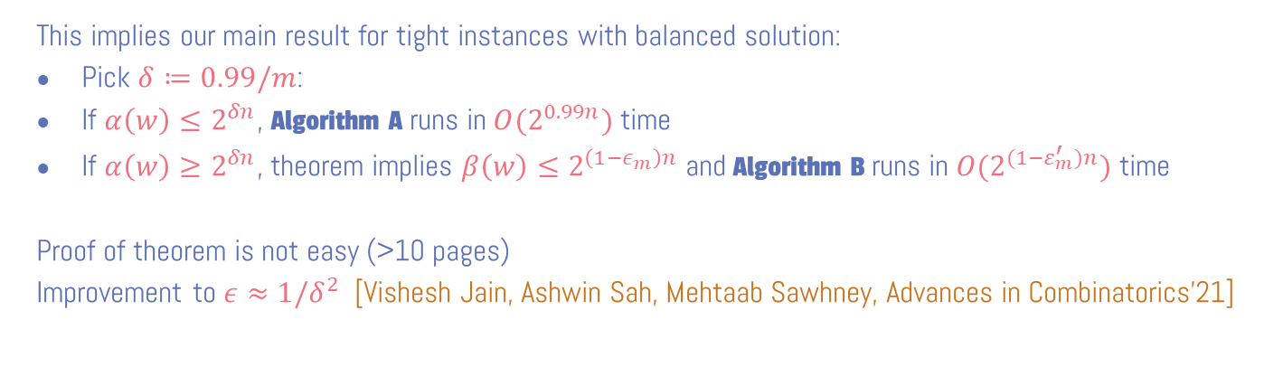
Some Additive Combinatorics
$α\left(w\right)≔ \left|\left\{w\left(X\right) :X⊆\{1,…,n\}\right\}\right|$
$β\left(w\right)≔\max_{v}{ |\{X⊆\left[n\right]:w\left(X\right)=v \}|}$
If $α(w)≤2^{\frac{0.99n}{m}},$ Algorithm A fast
If $β\left(w\right)≤2^{\left(1−ε\right)n},$
Algorithm B fast
Thm. For all $δ>0$, there exists $ε>0$ such that:
if $α\left(w\right)≥2^{δn}$, then $β\left(w\right)≤2^{\left(1−ε\right)n}$.
This implies our main result for tight instances with balanced solution:
Pick $δ≔0.99/m$:
If $α\left(w\right)≤2^{δn}$, Algorithm A runs in ${O(2}^{0.99n})$ time
If $α\left(w\right)≥2^{δn}$, theorem implies $β\left(w\right)≤2^{\left(1−ε_{m}\right)n}$ and Algorithm B runs in ${O(2}^{(1−ε_{m}^{′})n})$ time
Proof of theorem is not easy (>10 pages)
Improvement to $ε≈1/δ^{2}$ [Vishesh Jain, Ashwin Sah, Mehtaab Sawhney, Advances in Combinatorics’21]

Slide 24
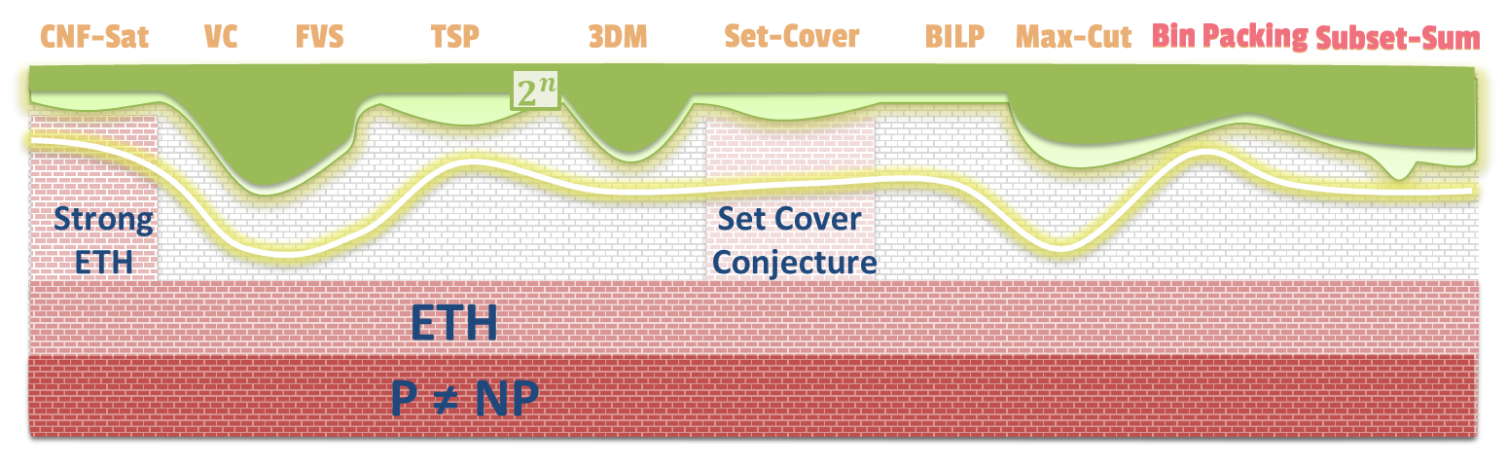
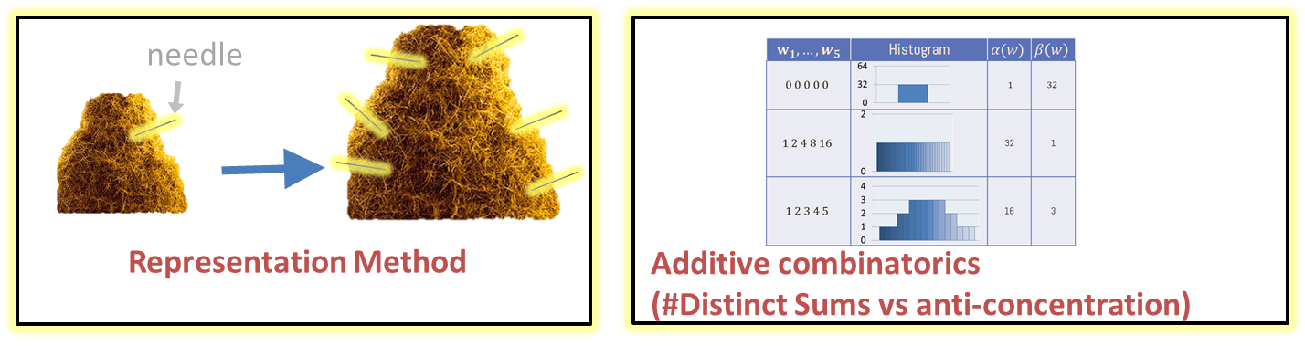
Conclusion
Thanks!!

