Slide 1
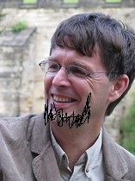
Solving weighted and counting variants of connectivity problems parameterized by treewidth deterministically in single exponential time.
Jesper Nederlof
Joint work with:
Hans Bodlaender, Marek Cygan and Stefan Kratsch

Slide 2
Outline
Introduction
Rank-Based approach
The usual definitions
Naive DP for Steiner Tree
Improving the naive DP
Determinant approach (very briefly)
Other recent work
Conclusions

Slide 3
2011

Slide 4
Conclusions
Theorem
Unweighted Steiner Tree can be solved in randomized time.
Based on some `strange’ transformation of counting the number of solutions modulo 2, combined with `isolation lemma’

Slide 5
Conclusions
Theorem
Unweighted Steiner Tree can be solved in randomized time.
In the paper we obtained lots of other results.
We ask many open problems, but maybe the best one is:
Is it possible to solve connectivity problems parameterized by treewidth in single-exponential time in a deterministic, more intuitive way?
For example, is there some structure present that allows us to always ignore many partial solutions?
Thanks for listening!

Slide 6
2013

Slide 7
Conclusions
Theorem
Unweighted Steiner Tree can be solved in randomized time.
In the paper we obtained lots of other results.
We ask many open problems, but maybe the best one is:
Is it possible to solve connectivity problems parameterized by treewidth in single-exponential time in a deterministic, more intuitive way?
For example, is there some structure present that allows us to always ignore many partial solutions?
Thanks for listening!

Slide 8
Conclusions
Theorem
Weighted Steiner Tree can be solved in time.
In the paper we obtained lots of other results.
We ask many open problems, but maybe the best one is:
Is it possible to solve connectivity problems parameterized by treewidth in single-exponential time in a deterministic, more intuitive way? YES
For example, is there some structure present that allows us to always ignore many partial solutions? YES
Thanks for listening!

Slide 9
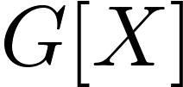
Steiner Tree
Definition( Steiner Tree )
Given: graph , terminals and integer
Asked: Does there exist such that , is connected
and ?
Example ( ).

Slide 10
Steiner Tree
Definition( Steiner Tree )
Given: graph , terminals and integer
Asked: Does there exist such that , is connected
and ?
Example ( ).

Slide 11
Steiner Tree
Definition( Steiner Tree )
Given: graph , terminals and integer
Asked: Does there exist such that , is connected
and ?
Example ( ).

Slide 12
The usual definitions

Slide 13
Treewidth
Refer to as a bag.
Definition
A treedecomposition of graph is a pair where with and a tree with vertex set such that:
: All containing induce a connected subtree

Slide 14
Treewidth
Definition
A treedecomposition of graph is a pair where with and a tree with vertex set such that:
: All containing induce a connected subtree
Example
A
B
C
D
E
F
G
H

Slide 15
Treewidth
Definition
A treedecomposition of graph is a pair where with and a tree with vertex set such that:
: All containing induce a connected subtree
Example
A
B
A
B
C
D
D
E
F
G
H

Slide 16
Treewidth
Definition
A treedecomposition of graph is a pair where with and a tree with vertex set such that:
: All containing induce a connected subtree
Example
A
B
A
B
C
D
B
D
D
E
G
F
G
H

Slide 17
Treewidth
Definition
A treedecomposition of graph is a pair where with and a tree with vertex set such that:
: All containing induce a connected subtree
Example
A
B
A
B
C
D
B
D
D
E
G
D
F
G
F
G
H

Slide 18
Treewidth
Definition
A treedecomposition of graph is a pair where with and a tree with vertex set such that:
: All containing induce a connected subtree
Example
A
B
A
B
C
D
B
B
D
E
D
E
G
G
D
F
G
F
G
H

Slide 19
Treewidth
Definition
A treedecomposition of graph is a pair where with and a tree with vertex set such that:
: All containing induce a connected subtree
Example
A
B
B
C
A
B
C
E
D
B
B
D
E
D
E
G
G
D
F
G
F
G
H

Slide 20
Treewidth
Definition
A treedecomposition of graph is a pair where with and a tree with vertex set such that:
: All containing induce a connected subtree
Example
A
B
B
C
A
B
C
E
D
B
B
D
E
D
E
G
G
D
E
F
G
G
H
F
G
H

Slide 21
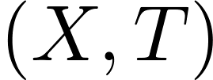
Nice Path Decomposition
Definition
A (very) nice path decomposition is a tree decomposition
where is a path and each bag is of the following type:
Leaf bag: Leaf of , ,
Introduce vertex: Bag with left neighbor and
Forget vertex: Bag with left neighbor and

Slide 22
Nice Path decomposition
Example
A
B
C
D
E
F
G
H
D
D
D
D
D
B
D
B
F
F
F
G
G
A
G
A
G
G
B
G
H
E
H
E
E
E
B
E
B
H
G
G
G
C
G
C
G
G

Slide 23
Naive Dynamic Programming for Steiner Tree

Slide 24
Storing connectivity in partitions
Definition
1
Given define
as the partition of such that
two vertices of are in the same
block in if and only if they are
connected in .
2
3
4
.
5
6
7

Slide 25
Storing connectivity in partitions
Definition
1
Given define
as the partition of such that
two vertices of are in the same
block in if and only if they are
connected in .
2
3
4
.
5
6
7

Slide 26
Using separators for Steiner Tree
If , and ,
is a solution if and only if is a solution.

Slide 27
Using separators for Steiner Tree
For being a solution, we only need the total size to be at most k, the choices of included vertices to be consistent and the overall solutions to be connected.
If , and ,
is a solution if and only if is a solution.

Slide 28
Dynamic programming for Steiner Tree
For every bag , int , , let

Slide 29
Dynamic programming for Steiner Tree
For every bag , int , , let
Leaf bag: and for (boring).

Slide 30
Dynamic programming for Steiner Tree
For every bag , int , , let
Leaf bag: and for (boring).
Forget v bag:
Option 1:
V is not in the solution
Option 2:
V is in the solution and connected in the partition
v
v
v
v

Slide 31
Dynamic programming for Steiner Tree
For every bag , int , , let
Leaf bag: and for (boring).
Forget v bag: .
Option 1:
V is not in the solution
Option 2:
V is in the solution and connected in the partition
v
v
v
v

Slide 32
Dynamic programming for Steiner Tree
For every bag , int , , let
Leaf bag: and for (boring).
Forget v bag: .
Introduce v bag:
If and :
If and :
v
v

Slide 33
Dynamic programming for Steiner Tree
For every bag , int , , let
Leaf bag: and for (boring).
Forget v bag: .
Introduce v bag:
If and :
If and :
If :
v
v

Slide 34
Dynamic programming for Steiner Tree
For every bag , int , , let
Leaf bag: and for (boring).
Forget v bag: .
Introduce v bag:
If and :
If and :
If :
v

Slide 35
Dynamic programming for Steiner Tree
For every bag , int , , let
Leaf bag: and for (boring).
Forget v bag: .
Introduce v bag:
If and :
If and :
If :
Yes instance iff for some .
Takes time ☹.
v

Slide 36
Improving the Naive DP

Slide 37
Using separators for Steiner Tree
The naive DP uses equivalency between partial solutions: if one is extended to a global
solution the same extension works for the other.

Slide 38
Using separators for Steiner Tree
The naive DP uses equivalency between partial solutions: if one is extended to a global
solution the same extension works for the other.
Our key idea is to extend this to group domination.

Slide 39
Group Domination and Representation
In general, a set of partial solutions group dominates a partial solution if for every global solution there exists a global solution with .
This implies that can safely be ignored

Slide 40
Group Domination and Representation
In general, a set of partial solutions group dominates a partial solution if for every global solution there exists a global solution with .
This implies that can safely be ignored
Here, we represent partial solutions by partitions and they combine to a global solutions if they connect everything together.
Definition
Let be a set and a set of partitions of , then group
dominates a partition of if for all partitions of
.
Definition
Let be sets of partitions, then represents if group dominates
every element of .

Slide 41
The tools for speeding up the naive DP
Constant such that 2 nxn matrix can be multiplied in time.
Main theorem
There exists an algorithm that accepts a set of partitions of as input and outputs in time a set of partitions such that represents and .
Preservation lemma
Suppose that represent respectively , then
represents ,
represents ,
represents ,
represents .

Slide 42
Dynamic programming for Steiner Tree
For every bag , int , , let
Leaf bag: and for (boring).
Forget v bag: .
Introduce v bag:
If and :
If and :
If :

Slide 43
Dynamic programming for Steiner Tree
For every bag , int , , let
Leaf bag: and for (boring).
Forget v bag: .
Introduce v bag:
If and :
If and :
If :
Correctness: By induction the reduced entry of represents ,
hence we still have a yes instance iff for some .

Slide 44
Dynamic programming for Steiner Tree
For every bag , int , , let
Leaf bag: and for (boring).
Forget v bag: .
Introduce v bag:
If and :
If and :
If :
Correctness: By induction the reduced entry of represents ,
hence we still have a yes instance iff for some .
Running time: By induction, , thus
takes time. Using binomial theorem we get total time
.

Slide 45
Proofs of tools
Main theorem
There exists an algorithm that accepts a set of partitions of as input and outputs in time a set of partitions such that represents and .
Preservation lemma
Suppose that represent respectively , then
represents ,
represents ,
represents ,
represents .

Slide 46
Proofs of tools
Main theorem
There exists an algorithm that accepts a set of partitions of as input and outputs in time a set of partitions such that represents and .

Slide 47
Main theorem
There exists an algorithm that accepts a set of partitions of as input and outputs in time a set of partitions such that represents and .
Proof sketch
Definition
Let M be the matrix with rows and columns indexed by partitions of U with if and only if .
Lem. 1 (Lin Dependence -> Group Domination)
Let be a set of partitions such that their rows in are dependent and ,
then group dominates .
Proof

Slide 48
Main theorem
There exists an algorithm that accepts a set of partitions of as input and outputs in time a set of partitions such that represents and .
Proof sketch
Definition
Let M be the matrix with rows and columns indexed by partitions of U with if and only if .
Lem. 1 (Lin Dependence -> Group Domination)
Let be a set of partitions such that their rows in are dependent and ,
then group dominates .
Proof
Group domination means that for every , .

Slide 49
Main theorem
There exists an algorithm that accepts a set of partitions of as input and outputs in time a set of partitions such that represents and .
Proof sketch
Definition
Let M be the matrix with rows and columns indexed by partitions of U with if and only if .
Lem. 1 (Lin Dependence -> Group Domination)
Let be a set of partitions such that their rows in are dependent and ,
then group dominates .
Proof
Group domination means that for every , .
In terms of , whenever has a on column , has a 1.

Slide 50
Main theorem
There exists an algorithm that accepts a set of partitions of as input and outputs in time a set of partitions such that represents and .
Proof sketch
Definition
Let M be the matrix with rows and columns indexed by partitions of U with if and only if .
Lem. 1 (Lin Dependence -> Group Domination)
Let be a set of partitions such that their rows in are dependent and ,
then group dominates .
Proof
Group domination means that for every , .
In terms of , whenever has a on column , has a 1.
This follows since every column in has an even number of ’s.

Slide 51
Main theorem
There exists an algorithm that accepts a set of partitions of as input and outputs in time a set of partitions such that represents and .
Proof sketch
Definition
Let M be the matrix with rows and columns indexed by partitions of U with if and only if .
Lem. 1 (Lin Dependence -> Group Domination)
Let be a set of partitions such that their rows in are dependent and ,
then group dominates .

Slide 52
Main theorem
There exists an algorithm that accepts a set of partitions of as input and outputs in time a set of partitions such that represents and .
Proof sketch
Definition
Let M be the matrix with rows and columns indexed by partitions of U with if and only if .
Lem. 1 (Lin Dependence -> Group Domination)
Let be a set of partitions such that their rows in are dependent and ,
then group dominates .
Lem. 2 (Small explicit basis (and thus rank))
The set of cuts with left, i.e., partitions with exactly 2 blocks is a basis of M.
Proof
sketch
.

Slide 53
Main theorem
There exists an algorithm that accepts a set of partitions of as input and outputs in time a set of partitions such that represents and .
Proof sketch
Definition
Let M be the matrix with rows and columns indexed by partitions of U with if and only if .
Lem. 1 (Lin Dependence -> Group Domination)
Let be a set of partitions such that their rows in are dependent and ,
then group dominates .
Lem. 2 (Small explicit basis (and thus rank))
The set of cuts with left, i.e., partitions with exactly 2 blocks is a basis of M.

Slide 54
Main theorem
There exists an algorithm that accepts a set of partitions of as input and outputs in time a set of partitions such that represents and .
Proof sketch
Definition
Let M be the matrix with rows and columns indexed by partitions of U with if and only if .
Lem. 1 (Lin Dependence -> Group Domination)
Let be a set of partitions such that their rows in are dependent and ,
then group dominates .
Lem. 2 (Small explicit basis (and thus rank))
The set of cuts with left, i.e., partitions with exactly 2 blocks is a basis of M.
Construct the matrix where are all cuts of .

Slide 55
Main theorem
There exists an algorithm that accepts a set of partitions of as input and outputs in time a set of partitions such that represents and .
Proof sketch
Definition
Let M be the matrix with rows and columns indexed by partitions of U with if and only if .
Lem. 1 (Lin Dependence -> Group Domination)
Let be a set of partitions such that their rows in are dependent and ,
then group dominates .
Lem. 2 (Small explicit basis (and thus rank))
The set of cuts with left, i.e., partitions with exactly 2 blocks is a basis of M.
Construct the matrix where are all cuts of .
Use Gauss elimination to find a row-basis in , return the corresponding rows

Slide 56
Main theorem
There exists an algorithm that accepts a set of partitions of as input and outputs in time a set of partitions such that represents and .
Proof sketch
Definition
Let M be the matrix with rows and columns indexed by partitions of U with if and only if .
Lem. 1 (Lin Dependence -> Group Domination)
Let be a set of partitions such that their rows in are dependent and ,
then group dominates .
Lem. 2 (Small explicit basis (and thus rank))
The set of cuts with left, i.e., partitions with exactly 2 blocks is a basis of M.
Construct the matrix where are all cuts of .
Use Gauss elimination to find a row-basis in , return the corresponding rows
The output is at most by the rank; represents the input by the basis and Lem. 1.

Slide 57
Further remarks on the RB approach
Rank-Based approach can straightforwardly be extended to weighted problems and other connectivity problems (e.g., minimize the number of connected components).
We also get a linear depence on the graph size relative easily.
Provides more insight in optimal substructure then Cut&Count.
We use some structural property of the partition lattice, generalizations of our rank bound have been studied and given in the field of communication complexity (e.g., Lovasz & Saks)

Slide 58
(A few words and some formula’s on) The Determinant approach

Slide 59
Determinant approach
Main idea is to use a folklore lemma used to prove the
Matrix Tree Theorem:
Let graph and with and be
‘the submatrix with columns of the incidence matrix of an orientation of
with an arbitrary row deleted’,
then if is a tree, and otherwise.

Slide 60
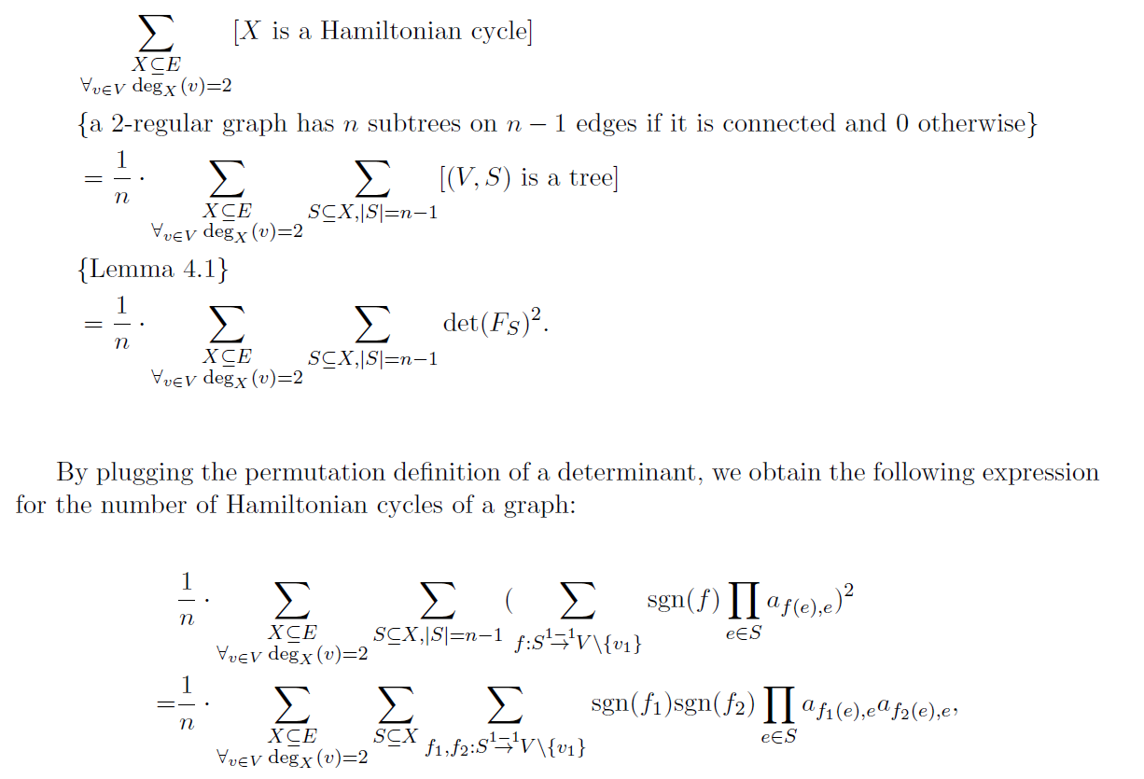
{The mentioned lemma}
By decomposing this formula and applying dynamic programming appropriately we can evaluate this fast.
We order the vertex set in a specific way to be able to ensure that all inversions are between vertices occuring together in one bag.

Slide 61
Further work
Inspired by the work of the presented paper, we further investigated the restriction of the matrix M restricted to all partitions that are matchings, see
‘Fast Hamiltonicity checking via bases of perfect matchings’, (arXiv; STOC 2013).
We found its rank is exactly and used this to obtain a time algorithm for Hamiltonicity and showed it optimal under the Strong ETH.
Via the rank-based approach this result can directly be used for an improved TSP algorithm on treedecompositions.
Might as well be an promising approach for a algorithm for TSP.
Rank proved using some induction based on interesting base cases

Slide 62
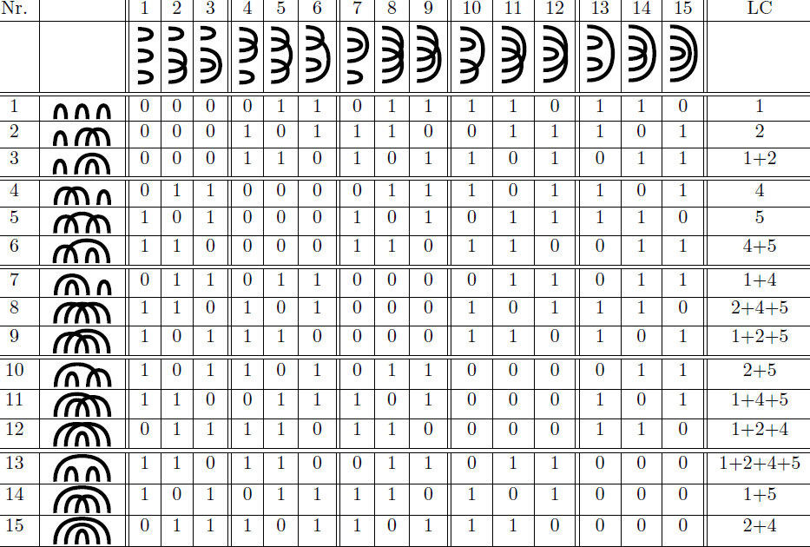

Slide 63
Conclusion
We studied group domination properties of a DP by studying a partial solution vs extension matrix.
This can be studied for any DP!
Generally we are interested in its largest identity submatrix and upperbounding the rank is one way to achieve this.
People in communication complexity study these properties as well
Approach also succesfully applied to matchings connectivity matrix for Hamiltonian path.
Still many open questions left.

Slide 64
Thanks for listening!

