Slide 1
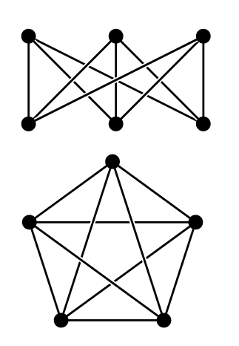
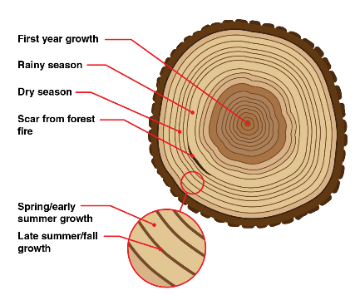
Treewidth meets Planarity
Jesper Nederlof
CO seminar 15/02/2019, Eindhoven

Slide 2
Treewidth meets Planar Separator Theorem
Treewidth measures how well a graph can be `decomposed’ in a tree-like way
Especially effective for planar graphs:
Planar separator theorem: If $G$ is planar, can partition $V(G)$ in $A,S,B$ such that
no edges between $A$ and $B$,
$\left|S\right|≤11\sqrt{n}$,
$\left|A\right|, \left|B\right|≤9n/10$.
A
B
S

Slide 3
Treewidth meets Planar Separator Theorem
Max Independent set (IS): Given $G=(V,E)$ find largest $X⊆V$ without edges
Thm: Max IS on planar graphs in $2^{O(\sqrt{n)}}$ time
Let S be separator, $V_{1},…,V_{k}$ be connected components of $G\left[V∖S\right]$
For every independent set $X$ of $G[S]$
Recursively find max IS of $G[V_{i}∖N(X)]$ for $i=1,…,k$
Return union with $X$
Recurrence: $T\left(\left|V\right|\right)≤2^{\left|S\right|} (\sum_{i}{ T\left(\left|V_{i}\right|\right)})$
Can show that $2^{1000\sqrt{n}}$ fits for $n$ large enough easily:
T(n) $≤$ n $2^{11\sqrt{n}}$T(9n/10) $≤n2^{11\sqrt{n}+1000\sqrt{9n/10}}≤2^{1000\sqrt{n}}$

Slide 4
Treewidth
Refer to as a bag.
Definition
A tree decomposition of graph $G=\left(V,E\right)$ is a pair $(X,T)$ where $X=\{X_{1},…,X_{l}\}$ with $X_{i}⊆V$ and $T$ a tree with vertex set $X$ such that
$\bigcup_{i=1}^{l}{X_{i}=V},$
$E⊆\bigcup_{i=1}^{l}{X_{i }×X_{i}},$
$∀v∈V:$ all $X_{i}$ containing $v$ induce connected subtree if $T$.

Slide 5
Treewidth
Refer to as a bag.
Definition
A tree decomposition of graph $G=\left(V,E\right)$ is a pair $(X,T)$ where $X=\{X_{1},…,X_{l}\}$ with $X_{i}⊆V$ and $T$ a tree with vertex set $X$ such that
$\bigcup_{i=1}^{l}{X_{i}=V},$
$E⊆\bigcup_{i=1}^{l}{X_{i }×X_{i}},$
$∀v∈V:$ all $X_{i}$ containing $v$ induce connected subtree if $T$.

Slide 6
Treewidth
Refer to as a bag.
Definition
A tree decomposition of graph $G=\left(V,E\right)$ is a pair $(X,T)$ where $X=\{X_{1},…,X_{l}\}$ with $X_{i}⊆V$ and $T$ a tree with vertex set $X$ such that
$\bigcup_{i=1}^{l}{X_{i}=V},$
$E⊆\bigcup_{i=1}^{l}{X_{i }×X_{i}},$
$∀v∈V:$ all $X_{i}$ containing $v$ induce connected subtree if $T$.
a
b
c
d
e
f
g
h

Slide 7
Treewidth
Refer to as a bag.
Definition
A tree decomposition of graph $G=\left(V,E\right)$ is a pair $(X,T)$ where $X=\{X_{1},…,X_{l}\}$ with $X_{i}⊆V$ and $T$ a tree with vertex set $X$ such that
$\bigcup_{i=1}^{l}{X_{i}=V},$
$E⊆\bigcup_{i=1}^{l}{X_{i }×X_{i}},$
$∀v∈V:$ all $X_{i}$ containing $v$ induce connected subtree if $T$.
a
b
a
b
c
d
d
e
f
g
h

Slide 8
Treewidth
Refer to as a bag.
Definition
A tree decomposition of graph $G=\left(V,E\right)$ is a pair $(X,T)$ where $X=\{X_{1},…,X_{l}\}$ with $X_{i}⊆V$ and $T$ a tree with vertex set $X$ such that
$\bigcup_{i=1}^{l}{X_{i}=V},$
$E⊆\bigcup_{i=1}^{l}{X_{i }×X_{i}},$
$∀v∈V:$ all $X_{i}$ containing $v$ induce connected subtree if $T$.
a
b
a
b
c
d
b
d
d
e
g
f
g
h

Slide 9
Treewidth
Refer to as a bag.
Definition
A tree decomposition of graph $G=\left(V,E\right)$ is a pair $(X,T)$ where $X=\{X_{1},…,X_{l}\}$ with $X_{i}⊆V$ and $T$ a tree with vertex set $X$ such that
$\bigcup_{i=1}^{l}{X_{i}=V},$
$E⊆\bigcup_{i=1}^{l}{X_{i }×X_{i}},$
$∀v∈V:$ all $X_{i}$ containing $v$ induce connected subtree if $T$.
a
b
a
b
c
d
b
d
d
e
g
d
f
g
f
g
h

Slide 10
Treewidth
Refer to as a bag.
Definition
A tree decomposition of graph $G=\left(V,E\right)$ is a pair $(X,T)$ where $X=\{X_{1},…,X_{l}\}$ with $X_{i}⊆V$ and $T$ a tree with vertex set $X$ such that
$\bigcup_{i=1}^{l}{X_{i}=V},$
$E⊆\bigcup_{i=1}^{l}{X_{i }×X_{i}},$
$∀v∈V:$ all $X_{i}$ containing $v$ induce connected subtree if $T$.
a
b
a
b
c
d
b
b
d
e
d
e
g
g
d
f
g
f
g
h

Slide 11
Treewidth
Refer to as a bag.
Definition
A tree decomposition of graph $G=\left(V,E\right)$ is a pair $(X,T)$ where $X=\{X_{1},…,X_{l}\}$ with $X_{i}⊆V$ and $T$ a tree with vertex set $X$ such that
$\bigcup_{i=1}^{l}{X_{i}=V},$
$E⊆\bigcup_{i=1}^{l}{X_{i }×X_{i}},$
$∀v∈V:$ all $X_{i}$ containing $v$ induce connected subtree if $T$.
a
b
b
c
a
b
c
e
d
b
b
d
e
d
e
g
g
d
f
g
f
g
h

Slide 12
Treewidth
Refer to as a bag.
Definition
A tree decomposition of graph $G=\left(V,E\right)$ is a pair $(X,T)$ where $X=\{X_{1},…,X_{l}\}$ with $X_{i}⊆V$ and $T$ a tree with vertex set $X$ such that
$\bigcup_{i=1}^{l}{X_{i}=V},$
$E⊆\bigcup_{i=1}^{l}{X_{i }×X_{i}},$
$∀v∈V:$ all $X_{i}$ containing $v$ induce connected subtree if $T$.
Separates a, f and ceh.
a
b
b
c
a
b
c
e
d
b
b
d
e
d
e
g
g
d
e
f
g
g
h
f
g
h

Slide 13
Treewidth
Refer to as a bag.
Definition
A tree decomposition of graph $G=\left(V,E\right)$ is a pair $(X,T)$ where $X=\{X_{1},…,X_{l}\}$ with $X_{i}⊆V$ and $T$ a tree with vertex set $X$ such that
$\bigcup_{i=1}^{l}{X_{i}=V},$
$E⊆\bigcup_{i=1}^{l}{X_{i }×X_{i}},$
$∀v∈V:$ all $X_{i}$ containing $v$ induce connected subtree if $T$.
Definition
The width of a treedecomposition is . The treewidth of a graph is the minimum width among all possible tree decompositions of G.

Slide 14
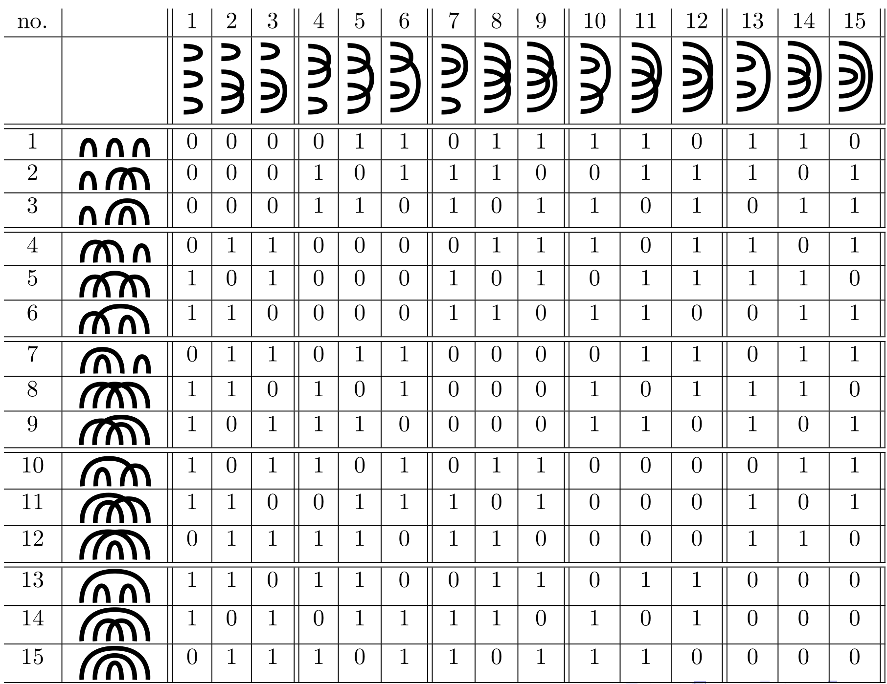
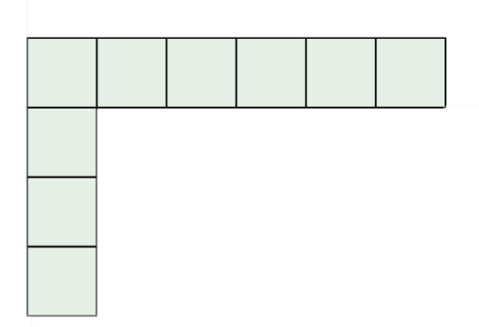
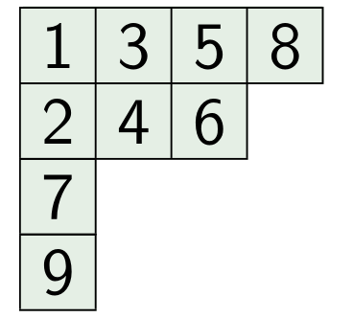
Treewidth meets Planar Separator Theorem
Treewidth is very useful because many NP-complete problems can be solved in $c^{tw}n$ (or more generally $f\left(tw\right)n$)on $n$-vertex graphs of treewidth $tw$
Cool question: try to find optimal $c$! For example:
Thm[CKN]: Hamiltonian cycle in ${\left(2+\sqrt{2}\right)}^{pw}n^{O(1)}$, and not in ${\left(2+\sqrt{2}−ε\right)}^{pw}n^{O(1)}$ unless $n$-var CNF-SAT in ${\left(2−ε\right)}^{n}n^{O(1)}$

Slide 15
Graph Minor
$H$ is a minor of $G$: $H$ can be obtained from $G$ with edge deletion, vertex deletion and edge contraction
Edge contraction:
is a minor of
a
f
a
f
b
d
e
g
b
de
g
c
i
h
c
h
i
Fact: If $H$ is a minor of $G$ and $G$ has treewidth $tw$, then $H$ has treewidth at most $tw$.

Slide 16
Grid Minors
$(l×l)$-grid
Grid Minor Theorem
For every integer $l$, every planar graph either has a $(l×l)$-grid as a minor, or treewidth at most $9l$.
Proof uses max-flow min-cut arguments
Def ($k$-outer planar graphs): If you subsequently remove the vertices on the outer boundary $k$ times, you removed all vertices.
A minor of an $k$-outer planar graph is $k$-outerplanar, thus: $k$-outer planar graphs have no $(k×k)$-grid minor, thus: $k$-outer planar graphs have treewidth $O(k)$.

Slide 17
Baker’s approach for approximation in planar graphs
Given planar graph $G$. Finds IS of size $\left(1−ε\right)|OPT|$ in ${O(2}^{O(1/ε) }n^{2})$ time
Pick vertex $s$ arbitrarily. Do BFS from $s$
Let $L_{i}$ be all vertices at distance $i$
Let $k=1/ε$
Let $V_{i}=\bigcup_{j≠i (mod k)}{L_{j}}$
$$L_{d}$$
$$L_{4}$$
$$L_{3}$$
$$L_{2}$$
$$L_{1}$$
s

Slide 18
Baker’s approach for approximation in planar graphs
Given planar graph $G$. Finds IS of size $\left(1−ε\right)|OPT|$ in ${O(2}^{O(1/ε) }n^{2})$ time
Pick vertex $s$ arbitrarily. Do BFS from $s$
Let $L_{i}$ be all vertices at distance $i$
Let $k=1/ε$
Let $V_{i}=\bigcup_{j≠i (mod k)}{L_{j}}$
For $i=1,…,k$
Find max size IS of $G\left[V_{i}\right]$
Can be done in $2^{O(k)}n$ time: all components of $G\left[V_{i}\right]$ are $k$-outer-planar! Thus $2^{tw}n$ runs in $2^{k}n=2^{1/ε}n$ time
Return largest IS found
$$L_{d}$$
$$L_{4}$$
$$L_{3}$$
$$L_{2}$$
$$L_{1}$$
s
For $i≠j$, ${V∖V}_{i}$ is disjoint from $V∖V_{j}$, thus
for some $i$: $\left|OPT∩V_{i}\right|≥|OPT|(1−1/k)$

Slide 19
`Bidimensionality’
Fancy word for relatively simple `win/win’ trick.
Say want to determine if $G$ has a simple path on $k$ vertices
Think $k≪n$
If $G$ has a $(\sqrt{k}×\sqrt{k}$)-grid minor -> YES
Otherwise treewidth $O(\sqrt{k})$
Can solve the problem in $2^{O(\sqrt{k})}n^{O(1)}$ time
Doesn’t work for all problems …

Slide 20
Beyond Bidimensionality
Theorem(FLMPPS, FOCS’16)
Given planar graph $G$ and int $k$, can in poly time sample $A⊆V(G)$ s.t.:
$G[A]$ has treewidth $O(\sqrt{k}\log{k})$,
for each $P∈\left({V(G) \atop ≤k}\right)$ with $G[P]$ connected, $\operatorname{Pr}\left[P⊆A\right]≥{{(2}^{\tilde{O}\left(\sqrt{k}\right)}|V|)}^{−1}$.
New problems solvable in $2^{\tilde{O}\left(\sqrt{k}\right)}$ probabilistic time. For example:
Weighted, Directed $k$-path, cycle of length exactly $k$
Subgraph Isomorphism with $k$-vertex connected pattern of bounded degree
Still leaves open challenges:
Derandomize
Relax connectivity restriction
$2^{\tilde{O}\left(\sqrt{k}\right)}$ time for counting variants
(in [FLMPPS])
(in several open problem sessions/talks)

