Slide 1
Homomorphic Hashing for Sparse Coefficient Extraction
Petteri Kaski, Mikko Koivisto,
Jesper Nederlof
IPEC 2012

Slide 2
Outline
Introduction
Subset Sum
Linear Sat
CNF-Sat
Concluding remarks
Bonus slide: CNF-Sat result.

Slide 3
Main Idea

Slide 4
Semigroup algebra’s, arithmetic circuits and
coefficient extraction/polynomial interpolation

Slide 5
Semigroup algebra’s, arithmetic circuits and
coefficient extraction/polynomial interpolation

Slide 6
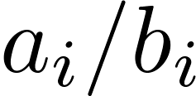
A generic problem
Semigroup algebra’s, arithmetic circuits and
coefficient extraction/polynomial interpolation
Semigroup
Consider the following generic problem:
Fix a set with operator .
Given pairs and .
Find such that .
Subset Sum:
If (or for large ) and .
CNF-Sat:
Given of vars ,
take , , and to be .
are clause containing neg/pos literal of .

Slide 7
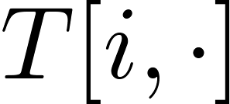
A generic, naive, DP algorithm
Make table entries for every and .
#ways to sum up to with first pairs.
Compute entries given all .
OR: Compute only non-zero entries.
Linear in #non-zero entries.

Slide 8
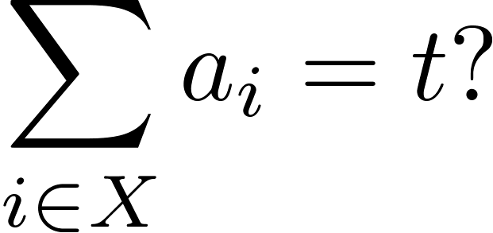
Subset Sum
Given: integers and integer .
Asked: is there such that
Example
Target:
3 20 58 90 267 493 869 961
1000 1153 1246 1598 1766 1922

Slide 9
Subset Sum
Given: integers and integer .
Asked: is there such that
Example
Target:
3 20 58 90 267 493 869 961
1000 1153 1246 1598 1766 1922

Slide 10
DP Subset Sum

Slide 11
 | 1 | 2 | ... | 14
0
1
2
3
4
5
6
7
8
9
10
...
5842 |  |  |  | ?

Slide 12
 | 1 | 2 | ... | 14
0
1
2
3
4
5
6
7
8
9
10
...
5842 |  |  |  | ?

Slide 13
 | 1 | 2 | ... | 14
0
1
2
3
4
5
6
7
8
9
10
...
5842 |  |  |  | ?

Slide 14
 | 1 | 2 | ... | 14
0
1
2
3
4
5
6
7
8
9
10
...
5842 |  |  |  | ?

Slide 15
 | 1 | 2 | ... | 14
0
1
2
3
4
5
6
7
8
9
10
...
5842 |  |  |  | ?

Slide 16
 | 1 | 2 | ... | 14
0
1
2
3
4
5
6
7
8
9
10
...
5842 |  |  |  | ?

Slide 17
 | 1 | 2 | ... | 14
0
1
2
3
4
5
6
7
8
9
10
...
5842 |  |  |  | ?

Slide 18
 | 1 | 2 | ... | 14
0
1
2
3
4
5
6
7
8
9
10
...
5842 |  |  |  | ?

Slide 19
 | 1 | 2 | ... | 14
0
1
2
3
4
5
6
7
8
9
10
...
5842 |  |  |  | ?

Slide 20
 | 1 | 2 | ... | 14
0
1
2
3
4
5
6
7
8
9
10
...
5842 |  |  |  | ?

Slide 21
 | 1 | 2 | ... | 14
0
1
2
3
4
5
6
7
8
9
10
...
5842 |  |  |  | ?

Slide 22
Sparse DP for Subset Sum

Slide 23
 | 1 | 2 | ... | 14
0
1
2
3
4
5
6
7
8
9
10
...
5842 |  |  |  | ?

Slide 24
 | 1 | 2 | ... | 14
0
1
2
3
4
5
6
7
8
9
10
...
5842 |  |  |  | ?

Slide 25
 | 1 | 2 | ... | 14
0
1
2
3
4
5
6
7
8
9
10
...
5842 |  |  |  | ?

Slide 26
 | 1 | 2 | ... | 14
0
1
2
3
4
5
6
7
8
9
10
...
5842 |  |  |  | ?

Slide 27
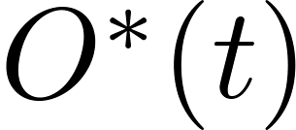
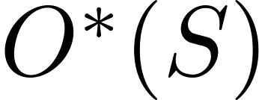
DP for Subset Sum
Naive DP: time.
Sparse DP: time, where
Trivially,
DFT (LN10): time and space.
Can we get a time and space?
Yes. First hash down, then use DFT algo.

Slide 28
DP Subset Sum

Slide 29
DP Subset Sum

Slide 30
 | 1 | 2 | ... | 14
0
1
2
3
4
5
6
7
8
9
10
...
5842 |  |  |  | ?
 | 1 | 2 | ... | 14
0
1
2
3
4
5 |  |  |  | ?
Homomorphic hashing
Homomorphic property: Same recurrence can be used.
Hashing property: No conflicts when extracting.
Only depends on #non-zero entries in last column! (sparse coefficient interpolation)

Slide 31
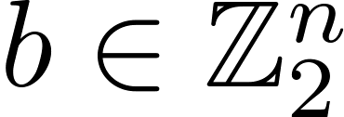
Linear Sat
Given , , and .
Find such that and .

Slide 32
Linear Sat
Given , , and .
Find such that and .
Exhaustive search: time and space.

Slide 33
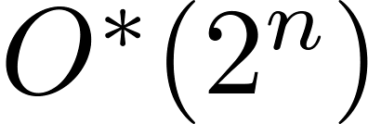
Linear Sat
Given , , and .
Find such that and .
Exhaustive search: time and space.
DP: time and space.

Slide 34
Linear Sat
Given , , and .
Find such that and .
Exhaustive search: time and space.
DP: time and space.
DFT: time and space.

Slide 35
Linear Sat
Given , , and .
Find such that and .
Exhaustive search: time and space.
DP: time and space.
DFT: time and space.
Sparse DP: time and space.

Slide 36
Linear Sat
Given , , and .
Find such that and .
Exhaustive search: time and space.
DP: time and space.
DFT: time and space.
Sparse DP: time and space.
Split and list: time and space.

Slide 37
Linear Sat
Given , , and .
Find such that and .
Exhaustive search: time and space.
DP: time and space.
DFT: time and space.
Sparse DP: time and space.
Split and list: time and space.
Is and space possible?

Slide 38
Linear Sat
Given , , and .
Find such that and .
Exhaustive search: time and space.
DP: time and space.
DFT: time and space.
Sparse DP: time and space.
Split and list: time and space.
Is and space possible? Yes.
Hash down the DP by pre-multiplying and with a random matrix.
Then apply DFT algorithm.

Slide 39
Linear Sat
Given , , and .
Find such that and .
Exhaustive search: time and space.
DP: time and space.
DFT: time and space.
Sparse DP: time and space.
Split and list: time and space.
Is and space possible? Yes.
Is and space possible?

Slide 40
Linear Sat
Given , , and .
Find such that and .
Exhaustive search: time and space.
DP: time and space.
DFT: time and space.
Sparse DP: time and space.
Split and list: time and space.
Is and space possible? Yes.
Is and space possible? Yes.
Use a Win/Win aproach: If A has full rank, there is one solution and it can be found with Gauss elimination; So if high rank: branch to full rank, otherwise hash.

Slide 41
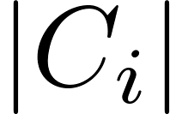
CNF-Sat
Given: over variables.
Asked: Is satisfiable?
Solvable in (BF) and time (DP).
SETH: Not solvable in time,
even when is constant.
Cygan et al. (CCC’12) counting sols not in
time unless SETH fails.

Slide 42
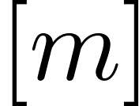
CNF-Sat
Given: over variables.
A set is a projection of if there
exists a variable assignment such that
satisfies iff .
satisfiable iff is a projection of .
Define as the set of all projections of
Clearly .
We count #solutions of in time.
Involves hashing down the DP to a ring associated with
poset obtained by iterative compression.

Slide 43
Concluding remarks
If a dimension of a DP-table is indexed by ints, binary vectors or subsets, it is sometimes possible to hash down the DP to exploit sparsity in the target segment.
Improves space usage of previously known sparse DP algo’s for Subset Sum and Linear Sat
Gives improved algorithm for CNF-Sat with few projections.
Somehow orthogonal to branching (at least for Linear Sat)
Original motivation: Can we combine our approach with ideas ensuring few Subset Sums/projections?
Dissociated Subset Sum: In P or NP-C?

Slide 44
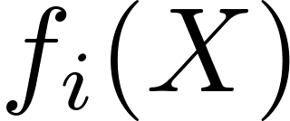
CNF-Sat in time.
Given .
.
.
We construct given .
.
#as. projecting to in .
#as. not satisfying clauses not in in .
Compute in poly time for every
Compute for same using easy
DP in time quadratic in the number of ’s.

