Slide 1
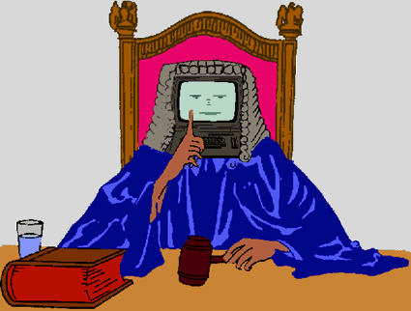


Rule-based AI & Law models of legal Argumentation
https://people.dsv.su.se/~jpalme/
reports/right-wrong.html
Henry Prakken
Lecture series Class AI in Court
Bologna, 19 November 2024

Slide 2
Some press on AI & Law (2023)
Will ChatGPT make lawyers obsolete? (Hint: be afraid)
(reuters.com)
Can ChatGPT replace lawyers? AI-powered robot lawyer is already winning cases …
(businesstoday.in)
How ChatGPT is taking over the legal world (addissons.com)

Slide 3
Some press on AI & Law (2016)
Lawyers could be the next profession to be replaced by computers (cnbc.com)
AI is doing legal work. But it won’t replace lawyers, yet. (nytimes.com)
The robot lawyers are here – and they’re winning (bbc.com)
”Artificially Intelligent ‘judge’ developed which can predict court verdicts with 79% accuracy” (…) “Computer scientists … developed an algorithm which can not only weigh up legal evidence, but also moral considerations.” (Daily Telegraph 24 Oct 2016)

Slide 4
1. History of AI (& Law)

Slide 5


Institutional history
Marek Sergot
Thorne McCarty
Florence conferences 1982,1985,1989
ICAIL conferences since 1987
JURIX conferences since 1988
AI & Law journal since 1992
…
Two landmark papers:
  Taxman (Thorne McCarty, 1977): precedents
  British Nationality Act (Marek Sergot et al., 1985): legislation
Notes:
Rule-based vs case-based approaches are an important dichotomy in AI & law. But even more important is …

Slide 6
History of AI: symbolic vs. data centric
Symbolic/cognitive AI: programming explicit models of aspects of human cognition
  Advantage: transparent
  Disadvantage: ‘symbolic’ input needed
Statistical, data-centric AI:
  Automatic learning of patterns from data
Notes:
Cognitive aspects of cognition: logical reasoning, retrieving information, natural-language translation, visually recognising objects, …

Slide 7
Schedule of lecture series
Today: Rule-based AI & Law models of legal argument
Tomorrow: Case-based AI & law models of legal argument
  + evaluating AI models of legal reasoning
Nov 25: Generative AI & law
Nov 26: Legal judgment prediction
Nov 28: Bayesian reasoning in court
Notes:
The first two topics also since we want that Generative AI can generate such arguments.
I especially focus on reasoning, not so much on knowledge representation.

Slide 8
Focus of this lecture series
Decisions by courts
Legal decisions in public administration
Partly subjective:
  My own research interests
  My own opinions
Not too technical:
  Symbolic AI: ideas, examples
  Data-driven AI: tasks, inputs and outputs

Slide 9
2a. Cognitive approaches
in AI & law –
‘deductive’ rule-based systems
Notes:
Discussed partly since recent experiments with generative AI apply deductive rule-based reasoning.

Slide 10
Legal knowledge-based systems in practice
Quite a few ‘deductive’ rule-based systems in public administration
  Don’t automate legal reasoning, but automate the logic of regulations
    Early days: proof of facts, classification and interpretation largely left to user
    Currently:
      facts often taken from case files and government databases
      Policy or interpretation rules added
(Almost?) non-existent in court and advocacy
  But recent developments, e.g. NeotaLogic
  Rules as Code: draft authoritative legal regulations that are automatically executable
Notes:
Interpretation and proof either left to human or system is only applied in those cases where this can be automated (bulk cases).
The kind of complexity for which the computer is ideally suited:
complex syntactic structure (e.g. cross references, complex boolean conditions of rules)
many relevant regulations
Still problems but by and large these systems induce large efficiency gains. A system does not have to be perfect, as long as it performs better than humans.
Rules as Code: let legislative drafters and engineers draft authoritative codes in collaboration in a way that is directly executable. “drafters and coders develop legal rules together, producing a human-language text as well as an official coded version.” Will this be outdated soon because of LLM?

Slide 11
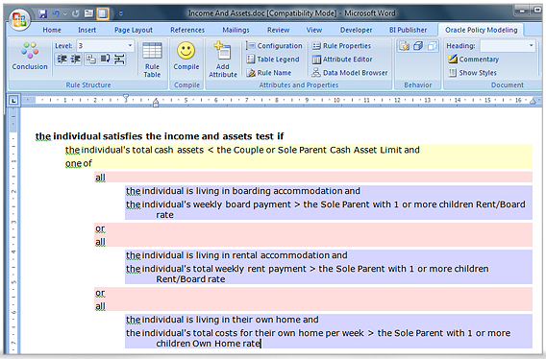
Rules: Oracle Policy Automation
Slide by Giovanni Sartor

Slide 12

Case studies Marlies van Eck
Systems for:
  Determining child support
  Determining fiscal income
Problems found (mostly due to bad design):
  Systems and decisions hard to explain
  Poor or missing documentation
  Ad-hoc interpretation rules by designers
  Non-standard cases don’t fit the system
  Errors or revisions hard to repair through the ‘chain’
  …
B.M.A. van Eck, Geautomatiseerde ketenbesluiten & Rechtsbescherming. Een onderzoek naar de praktijk van geautomatiseerde ketenbesluiten over een financieel belang in relatie tot rechtsbescherming. PhD Thesis Tilburg University. 2018
Notes:
So lack of transparency is not only a problem for machine-learning systems but also for knowledge-based sytems, at least if they are poorly designed. The research field of AI & Law has many recommendations for making a system explainable and transparent but the engineers don’t follow them.
Example of an ad-hoc interpretation of a legal rule: If application is more than 7 days late, then inadmissible, unless there is a reasonable excuse. Implementation of ‘reasonable excuse’: If less then 15 days late then reasonable excuse, otherwise not. Such interpretations should not be made by system designers but by legal decision makers.

Slide 13

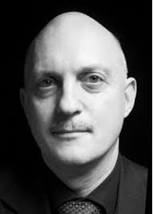
AI & Law research on rule-based reasoning (1)
Trevor Bench-Capon 1987
Research on development methods
Trevor Bench-Capon et al. (1987-1994)
  Use of ontologies
  Intermediate KR formats
  ‘Isomorphic’ representation (mirror structure of regulations, keep track of relations between source text and computational model)
  Benefits validation, maintenance and explanation
Tom van Engers et al. (2001 -)
…
Tom van Engers
T.J.M. Bench-Capon & F.P. Coenen, Isomorphism and legal knowledge-based sytems. Artificial Intelligence and Law, 1 (1992): 65-86.

Slide 14

AI & Law research on rule-based reasoning (2)
Much research on the logical structure of rules and regulations
  Deontic, temporal and action logic
  Rules and exceptions, conflicting rules (nonmonotonic logic)
  …
Very few practical applications
Guido Governatori
H. Prakken & G. Sartor, Law and logic: a review from an argumentation perspective.
Artificial Intelligence 227 (2015): 214-245.

Slide 15
Other developments
Logical Legal English
  Kowalski & Sartor jr.
Legal ontologies, standards
  E.g. Palmirani, Contissa
Notes:
Logical English as syntactic sugar for logic programming languages.

Slide 16

Automating judicial routine decisions
Outcome predictors are unsuitable
With rule-based expert systems?
  Only if the problem is small and well-defined
  And the facts can be automatically collected
mr. Frits Bakker
rechtspraak.nl
Notes:
But could rule-based experts systems still be used to automate routine cases? In 2017 the chairman of the Dutch Council of het Judiciary proposed that routine cases should be automated to give judges more time for non-trivial cases. He seemed to be thinking of outcome predictors, but I have just told you that this is not a good idea.
Useful for default judgments?

Slide 17
Limitations of legal rule-based systems
No non-trivial proof of facts
Fix syntactic interpretation
  Cannot be left to human
Fix semantic interpretation
  Interferes with individual justice
    Lawmakes use vague terms to deal with the unforeseen
No handling of exceptions
No argumentation
Notes:
Say that I will not talk about proving the facts (I did that 2 years ago).

Slide 18
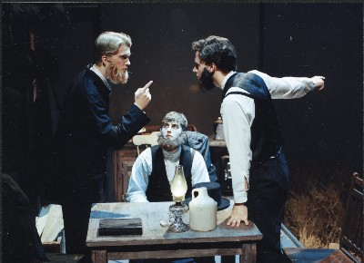
Legal reasoning is adversarial
Legal reasoning forms leave room for doubt
Legal cases involve clashes of interest
Dispute
study constructing and attacking arguments

Slide 19
AI & Law research on legal argument
Legal reasoning as argumentation
  Inference by constructing and comparing arguments and counterarguments
  Combining rules and precedents
  Appeal to principles and values
  …

Slide 20
2b. Cognitive approaches –
Rule-based models of
legal argumentation

Slide 21
2b1. Formal AI models
of argumentation
Notes:
One reason to discuss the remaining topics is to show what explainable machine-learning approaches would have to be able to learn.

Slide 22
Employer is liable
Employer is not liable
Employer breached duty of care
Employee had work-related injury
Employee was careless
Rule 2
Rule 1
No safety instructions
Employee did not secure stairs
Attack on conclusion
Notes:
The next slides introduce argumentation and will also be used to introduce some AI tools for modelling argumentation.

Slide 23
Employer is liable
Employer is not liable
Employer breached duty of care
Employee had work-related injury
Employee was careless
Rule 2
Rule 1
No safety instructions
Employee did not secure stairs
Employee had no work-related injury
Attack on premise
Injury caused by poor physical condition

Slide 24
Employer is liable
Employer is not liable
Employer breached duty of care
Employee had work-related injury
Employee was careless
Rule 2
Rule 1
No safety instructions
Employee did not secure stairs
Employee had no work-related injury
Colleague says so
Colleague is not credible
Attack on inference
Injury caused by poor physical condition
C is friend of claimant

Slide 25
Employer is liable
Employer is not liable
Employer breached duty of care
Employee had work-related injury
Employee was careless
Rule 2
Rule 1
No safety instructions
Employee did not secure stairs
Employee secured the stairs
Employee had no work-related injury
Colleague says so
Colleague is not credible
Camera evidence
Injury caused by poor physical condition
C is friend of claimant
Indirect defence

Slide 26
Employer is liable
Employer is not liable
Employer breached duty of care
Employee had work-related injury
Employee was careless
Rule 2
Rule 1
No safety instructions
Employee did not secure stairs
Employee secured the stairs
Employee had no work-related injury
Colleague says so
Colleague is not credible
Camera evidence
Injury caused by poor physical condition
C is friend of claimant

Slide 27

  1. An argument is In iff all arguments defeating it are Out.
  2. An argument is Out iff it is defeated by an argument that is In.
  Grounded semantics minimises In labelling
  Preferred semantics maximises In labelling
Dung 1995
A
B
C
D
E
P.M. Dung, On the acceptability of arguments and its fundamental role in nonmonotonic reasoning, logic programming, and n–person games.
Artificial Intelligence, 77:321–357, 1995.
Notes:
Arrows are defeat relations. A typical case of mutual defeat is equally strong arguments with contradictory conclusions.
Two typical cases of strict defeat:
- arguments with contradictory conclusions, one of which is stronger.
An ‘undercutter’
Dung’s grounded semantics stops at D, and his preferred semantics then tries to colour the rest in as many alternative ways as possible, satisfying the two labelling conditions.
Take-away message: when you have conflicting arguments and when you know which arguments defeat each other, then there is a calculus for computing which arguments are acceptable.

Slide 28
A
B
C
D
E
Notes:
Arrows are defeat relations. A typical case of mutual defeat is equally strong arguments with contradictory conclusions.
Two typical cases of strict defeat:
- arguments with contradictory conclusions, one of which is stronger.
An ‘undercutter’
Dung’s grounded semantics stops at D, and his preferred semantics then tries to colour the rest in as many alternative ways as possible, satisfying the two labelling conditions.
Take-away message: when you have conflicting arguments and when you know which arguments defeat each other, then there is a calculus for computing which arguments are acceptable.

Slide 29
A
B
Employer is liable
Employer is not liable
Employer breached duty of care
Employee had work-related injury
Employee was careless
Rule 2
Rule 1
No safety instructions
Employee did not secure stairs
Employee secured the stairs
Employee had no work-related injury
Colleague says so
Colleague is not credible
Camera evidence
Injury caused by poor physical condition
E
C is friend of claimant
C
D
Notes:
But never forget that all this is an abstraction, in this case of a theory of rule-based arguments.

Slide 30
Employer is liable
Employer is not liable
IF employer breached duty of care & employee had work-related injury THEN employer is liable UNLESS employee was careless
Employer breached duty of care
Employee had work-related injury
Employee was careless
Rule 2
Rule 1
IF NO safety instructions THEN Employer breached duty of care
IF employee did not secure stairs THEN employee was careless
No safety instructions
Employee did not secure stairs
Employee was not careless
Employee had no work-related injury
IF witness W says P THEN P UNLESS W is not credible
IF employee did not secure a normal stairs THEN employee was NOT careless
Colleague is not credible
IF an employee’s injury is caused by poor physical condition THEN employee had NO work-related injury
Colleague says so
It was a normal stairs
IF witness W is friend of claimant THEN W is not credible
Injury caused by poor physical condition
C is friend of claimant
Notes:
With a rule base with rules like this, arguments can be constructed.

Slide 31
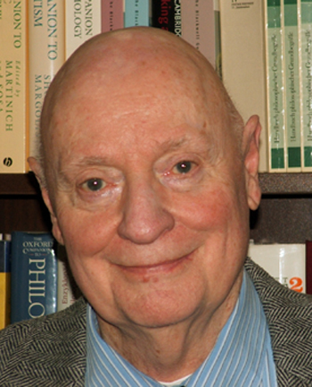



Two accounts of the fallibility of arguments
Tony Hunter
Nicholas Rescher
Plausible Reasoning: all fallibility located in the premises
  Assumption-based argumentation (Kowalski, Dung, Toni,…
  Classical argumentation (Cayrol, Besnard, Hunter, …)
Defeasible reasoning: all fallibility located in the defeasible inferences
  Pollock, Loui, Vreeswijk, Prakken & Sartor, …
ASPIC+ combines these accounts
Robert Kowalski
John Pollock

Slide 32

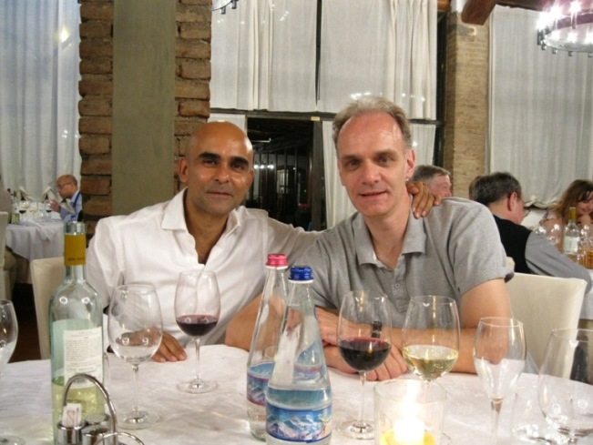
ASPIC+
Sanjay Modgil & me
Gerard Vreeswijk
Chain inferences into arguments with
  Deductive inference rules
    Premises guarantee conclusion
  Defeasible inference rules
    Premises create presumption for conclusion
Attack arguments with counterarguments
  Undermining, rebutting, undercutting
See which attacks result as defeats with preferences
Apply Dung (1995) to arguments + defeat
S. Modgil & H. Prakken, Abstract rule-based argumentation. In P. Baroni et al., Handbook of Formal Argumentation, Vol. 1, pp. 286-361. London: College Publications.
A.J. Hunter (ed.), Tutorials on Structured Argumentation. Special issue of Argument and Computation 5 (2014).
Notes:
If you really want to learn ASPIC+, check Chapter 6 of my reader.

Slide 33
Alternative formalisms
Assumption-based argumentation
  Special case of ASPIC+ with no defeasible rules or preferences
Defeasible Logic Programming
  Looks like ASPIC+ with grounded semantics
  Non-standard (counterintuitive?) semantics
Defeasible Logic
  Not within Dung, ambiguity-blocking
Carneades
  Not within Dung, many features
    Proof standards, audiences, accrual, visualisation, …
Abstract Dialectical Frameworks
  Not within Dung, for encoding defeasible-rule structures(?)
Claim: All equivalent on the fragment of ‘stratified logic programs’
Notes:
Every formalim has its advantages and its disadvantages. E.g. Dung-style allows individuation of arguments, rule-style makes modelling accrual easier(?), …
DeLP is victim of early development.
DL: much work on complexity and on legal KR
Carneades: a bit too complex
ADFs: claimed to generalise Dung, but in fact only used for encoding structures of prioritised defeasible rules.
All these formalims are equivalent on the fragment of ‘stratified logic programs’.

Slide 34

Application: online intake of crime reports
(This and next slides by
Daphne Odekerken)
M. Schraagen, B. Testerink, D. Odekerken & F. Bex, Argumentation-driven information extraction for online crime reports. In Proceedings of International Workshop on Legal Data Analytics and Mining (LeDAM 2018).
Notes:
A project in collaboration with the Dutch police, led by Floris Bex.

Slide 35
The problem
Improve the intake of criminal reports on online trade fraud
  fake webshops
  malicious second-hand dealers on trading platforms
40.000 reports are filed each year
Legal background: article 326 of Dutch Criminal Code
“misleading through false contact details, deceptive tricks or an accumulation of lies”

Slide 36
Knowledge model
ASPIC+ argumentation theory consisting of:
  26 observable facts
  46 inference rules
Based on legislation, case law and expert knowledge

Slide 37
Information extraction
Extract observations from free text
Fictitious example report
I would like to report fraud. I recently saw a bicycle for sale at Marktplaats and contacted advertiser John Doe. Because he said that he lived in North Groningen, we agreed that he would send the bicycle to my home address in Maastricht. I paid him in good faith but still have not received the bike. Mr. Doe does not respond to my e-mails any more. I did some research and saw on his Facebook profile that he lives in Roermond.
False location
Paid
Not delivered

Slide 38
Argumentation graph: simplified example
Not delivered
Waited
False location
False website
Delivery failure
Not sent
Product paid
Deception
Presumably fraud

Slide 39
Argumentation graph: simplified example
Not delivered
Waited
False location
False website
Delivery failure
Not sent
Product paid
Deception
Presumably fraud

Slide 40
Argumentation graph: simplified example
Not delivered
Waited
False location
False website
Delivery failure
Not sent
Product paid
Deception
Presumably fraud

Slide 41
Argumentation graph: simplified example
Not delivered
Waited
False location
False website
Delivery failure
Not sent
Product paid
Deception
Presumably fraud

Slide 42
2bc. Argument(ation) schemes

Slide 43
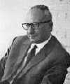
Argumentation patterns
Many arguments (and attacks) follow patterns.
State-of-the-art:
  Much work in argumentation theory (Perelman, Kienpointner, Walton, ...)
  Many applications in AI (& Law)

Slide 44
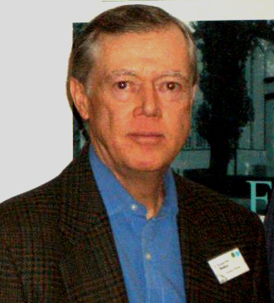
Argument(ation) schemes: general form
Douglas Walton
Premise 1,
… ,
Premise n
Therefore (presumably), conclusion
But also critical questions
In ASPIC+: defeasible rules + undercutters
Notes:
44
Critical questions are pointers to counterarguments.

Slide 45
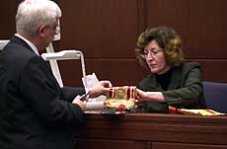
Expert testimony
E is expert on D
E says that P
P is within D
Therefore (presumably), P is the case
Critical questions:
  Is E biased?
  Is P consistent with what other experts say?
  Is P consistent with known evidence?

Slide 46
Arguments from promoting or demoting legal/societal values
Action A causes G,
G promotes (demotes) legal/societal value V
Therefore (presumably), A should (not) be done
Critical questions:
  Are there other ways to cause G?
  Does A also cause something else that promotes or demotes other values?
  ...
Notes:
46

Slide 47
Example (arguments pro and con an action)
We should save DNA of all citizens
We should not save DNA of all citizens
Saving DNA of all citizens leads to solving more crimes
Solving more crimes promotes security
Saving DNA of all citizens makes more private data publicly accessible
Making more private data publicly available demotes privacy
Notes:
47

Slide 48
Example (arguments pro alternative actions)
We should save DNA of all citizens
We should have more police
Saving DNA of all citizens leads to solving more crimes
Solving more crimes promotes security
Having more police leads to solving more crimes
Solving more crimes promotes security
Notes:
48

Slide 49
2bd. Reasoning about priorities

Slide 50
Example
R1: If X is a protected building, then its exterior may not be modified
R2: If X needs restructuring, then its exterior may be modified
P1: If R protects artistic buildings & R’ is a town planning rule, then R’ < R
P2: If R is earlier than R’, then R < R’
R1 protects artistic buildings, R2 is a town planing rule, so R2 < R1
R1 is earlier than R2, so R1 < R2
P2 is earlier than P1, so P2 < P1!
So R2 < R1,
so a protected building that needs restructuring may not be modified.
H. Prakken & G. Sartor sr., A dialectical model of assessing conflicting arguments in legal reasoning.
Artificial Intelligence and Law 4 (1996): 331-368.

Slide 51
Approaches
Prakken & Sartor (1997)
  Extending Dung by refining admissibility
Modgil (2009)
  Extending Dung with attacks on attacks
    Reconstructing PS97
Dung et al. (2019)
  Within Dung’s AFs (but more complex representation of examples)
    Pisano et al. (2021) in ArgtuProlog
Notes:
PS97: Made defence relative to priorities stated in the defending argument.

Slide 52
2be. Burdens of proof

Slide 53
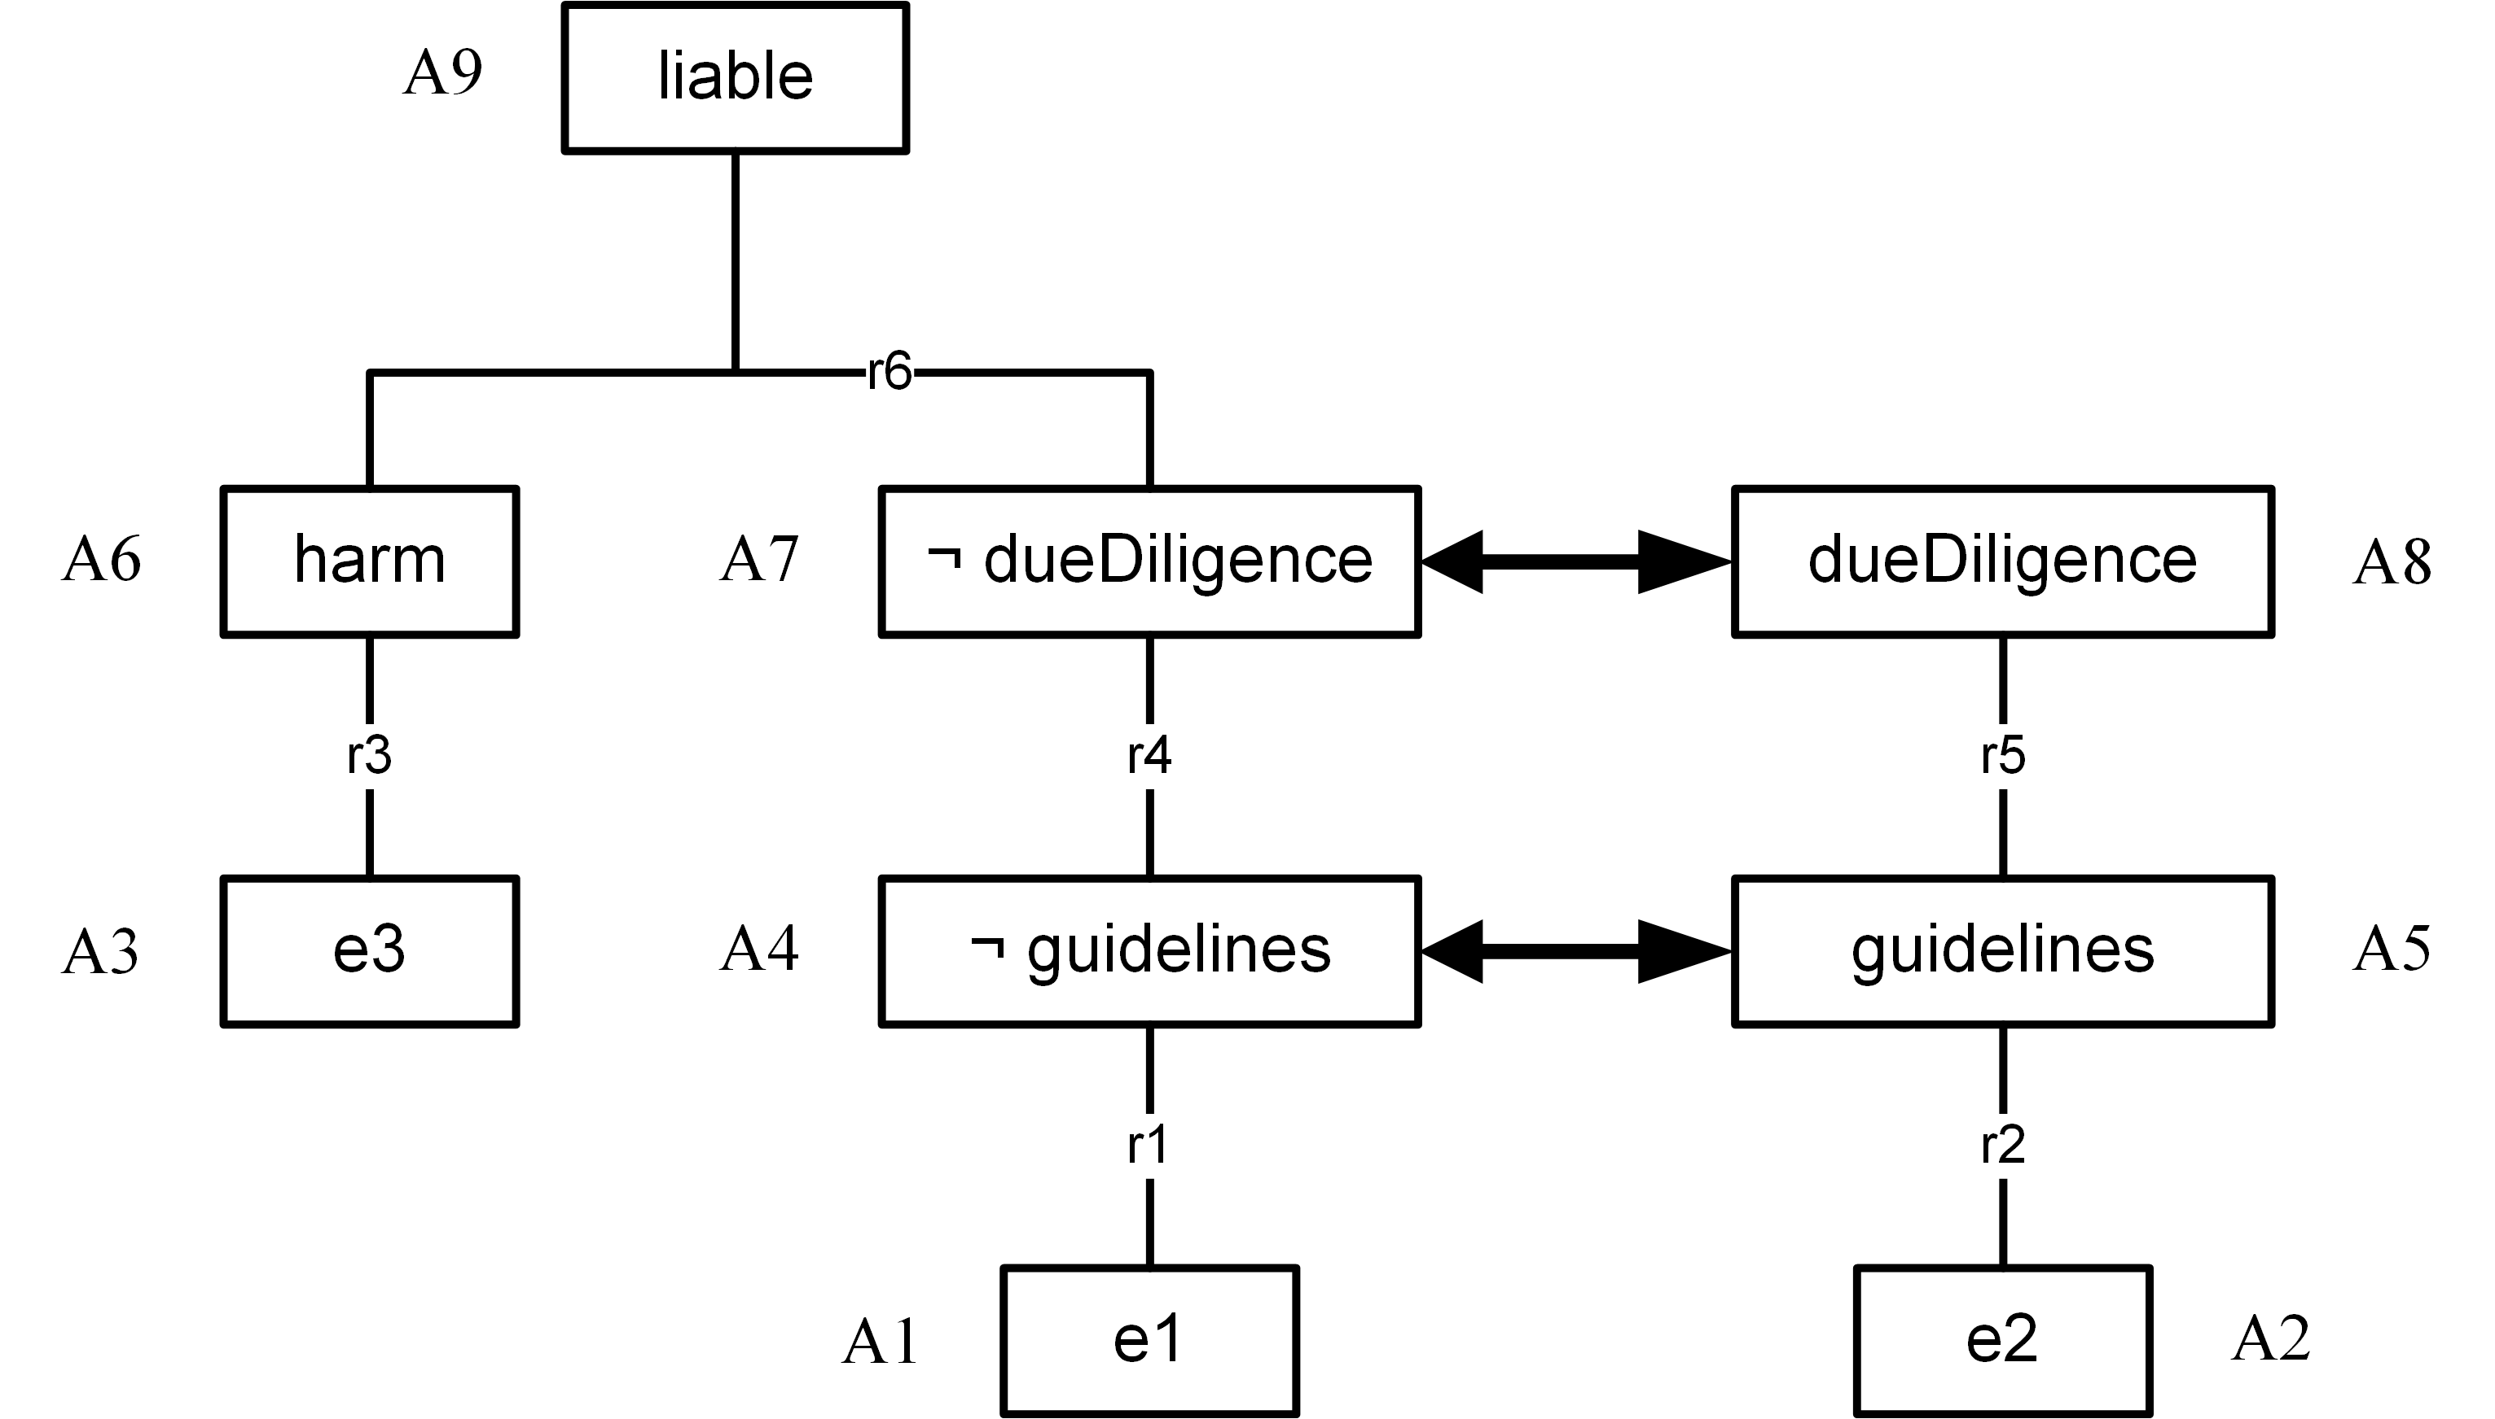
Motivating example: shifts in burden of proof
R6: harm & not dueDiligence ⇒ liable
Burdens of proof: harm, dueDiligence

Slide 54
Shifts in burden of proof: ‘standard’ semantics
R6: harm & not dueDiligence ⇒ liable
Burdens of proof: harm, dueDiligence

Slide 55
Shifts in burden of proof: outcome in law
R6: harm & not dueDiligence ⇒ liable
Burdens of proof: harm, dueDiligence

Slide 56
Some approaches within ASPIC+-style logics
Prakken (FI-2021)
  Not good enough
Prakken & Sartor sr. (JURIX-2011)
  Still not good enough
Pisano et al. (2021,2023)
  Still not good enough
Prakken & Sartor sr. (ICAIL-2023)
  Perfect(?)
Notes:
2011 seemed to repair the shortcoming of HP01, but Sartor showed otherwise. The I took revenge by showing a problem in their approach.

Slide 57
Solution: three subproblems, each with their own semantics
Notes:
The key idea: see evidential and legal reasoning as separate reasoning problems, each with their own semantics.
(And there is a third reasoning problem: determining the burdens of proof.)

Slide 58
What we need
Problem solving modules
  Internal input-output metarules
Global output-input metarules between modules
Both kinds of metarules are ASPIC+ defeasible rules
  So a problem specification is an ASPIC+ application
Notes:
Internal i-o rules allow us to capture conflicting outputs on the basis of (1) conflicting inputs to the same module (2) conflicting outputs of different modules solving the same problem.
Global o-i-rules between modules allow us to capture conflicting inputs to a model based on conflicting outputs of a single other module or of multiple other modules.

Slide 59
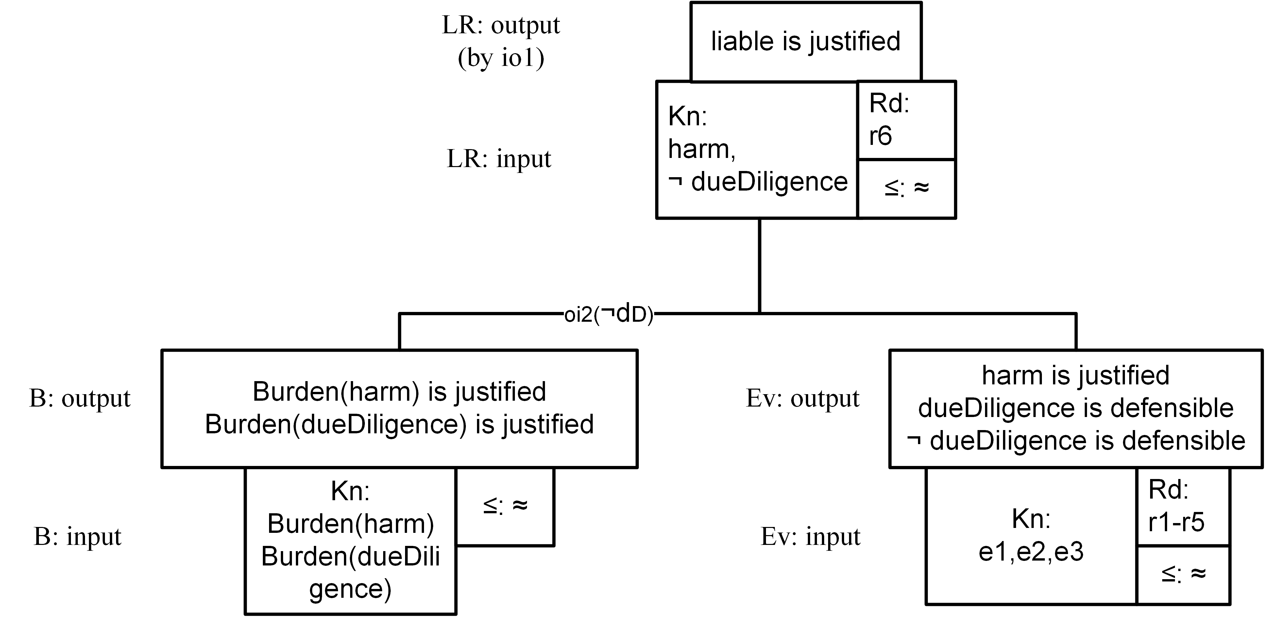
oi1: burden(X) is justified in B, and X is justified in Ev ⇒
X is in Kn of LR
oi2: burden(X) is justified in B, and X is not justified in Ev ⇒ not-X is in Kn of LR
Notes:
This is the problem specification: the set of modules with global output-input rules. All three modules are ASPIC+ modules (or DeLP, DL, Carneades).
This is how the shift in the burden of proof can be expressed in global metarules between the evidential and legal module.
(oi rules simplified compared to paper).

Slide 60
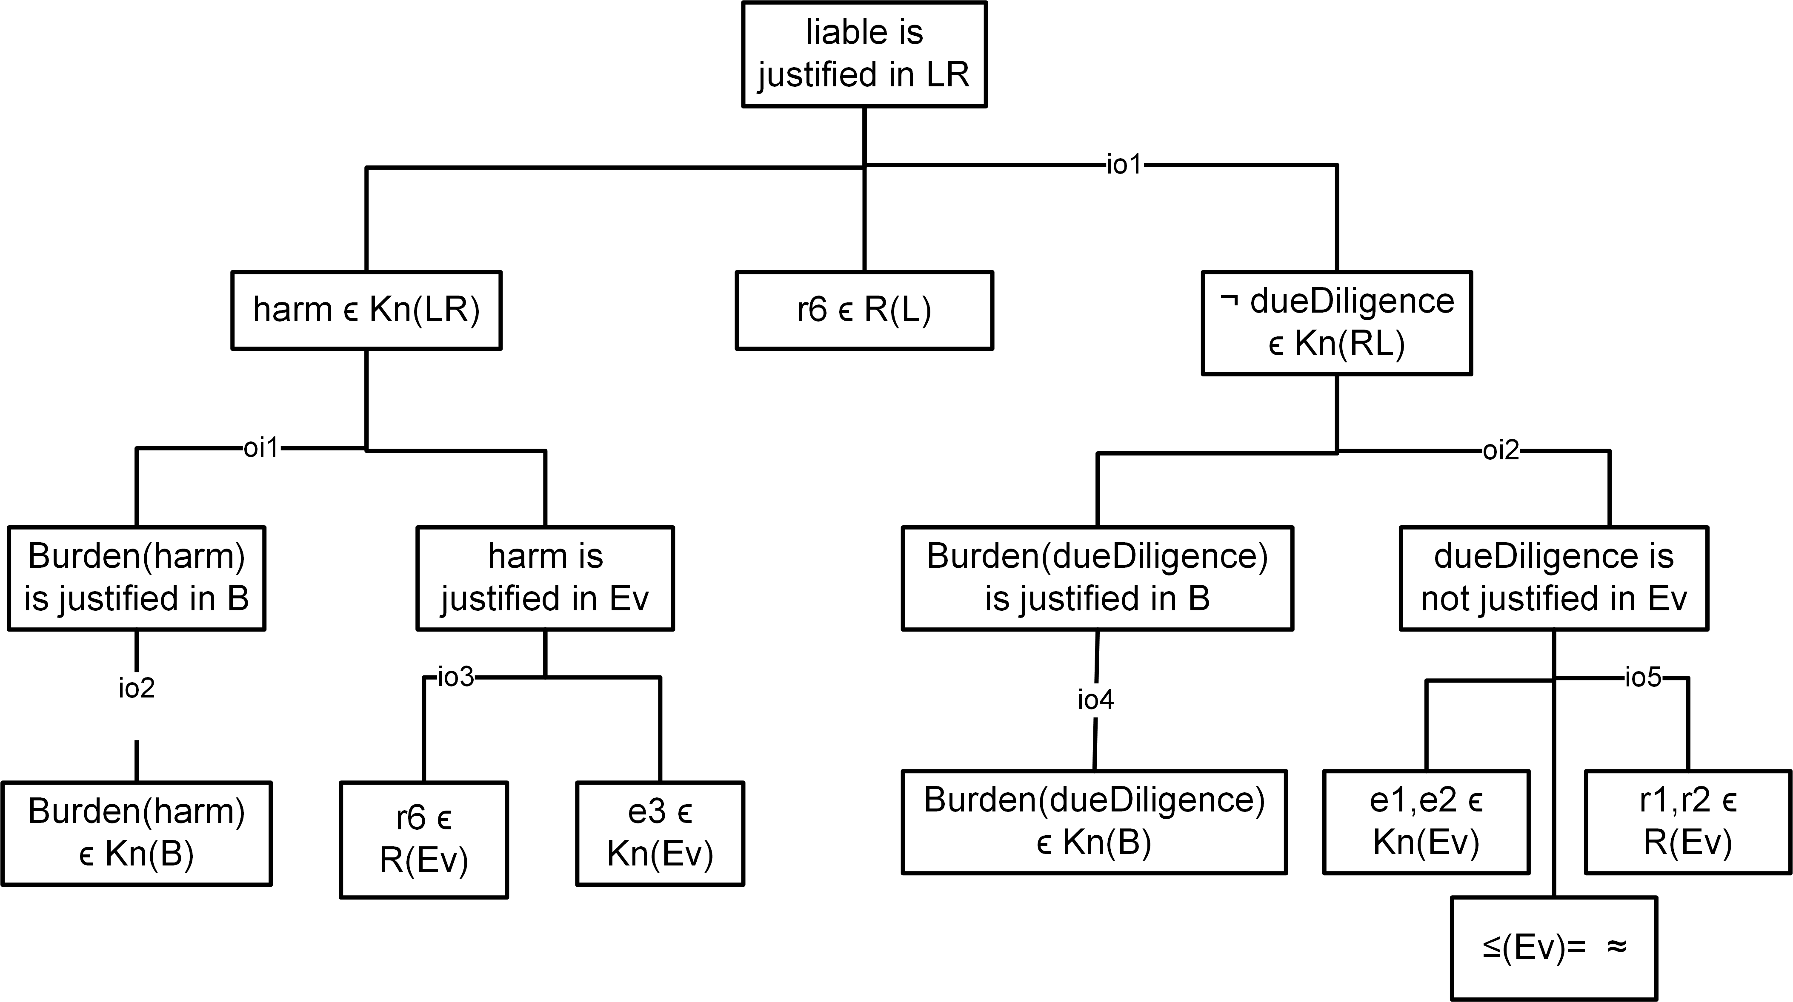
Notes:
This is the corresponding metalevel argument

Slide 61
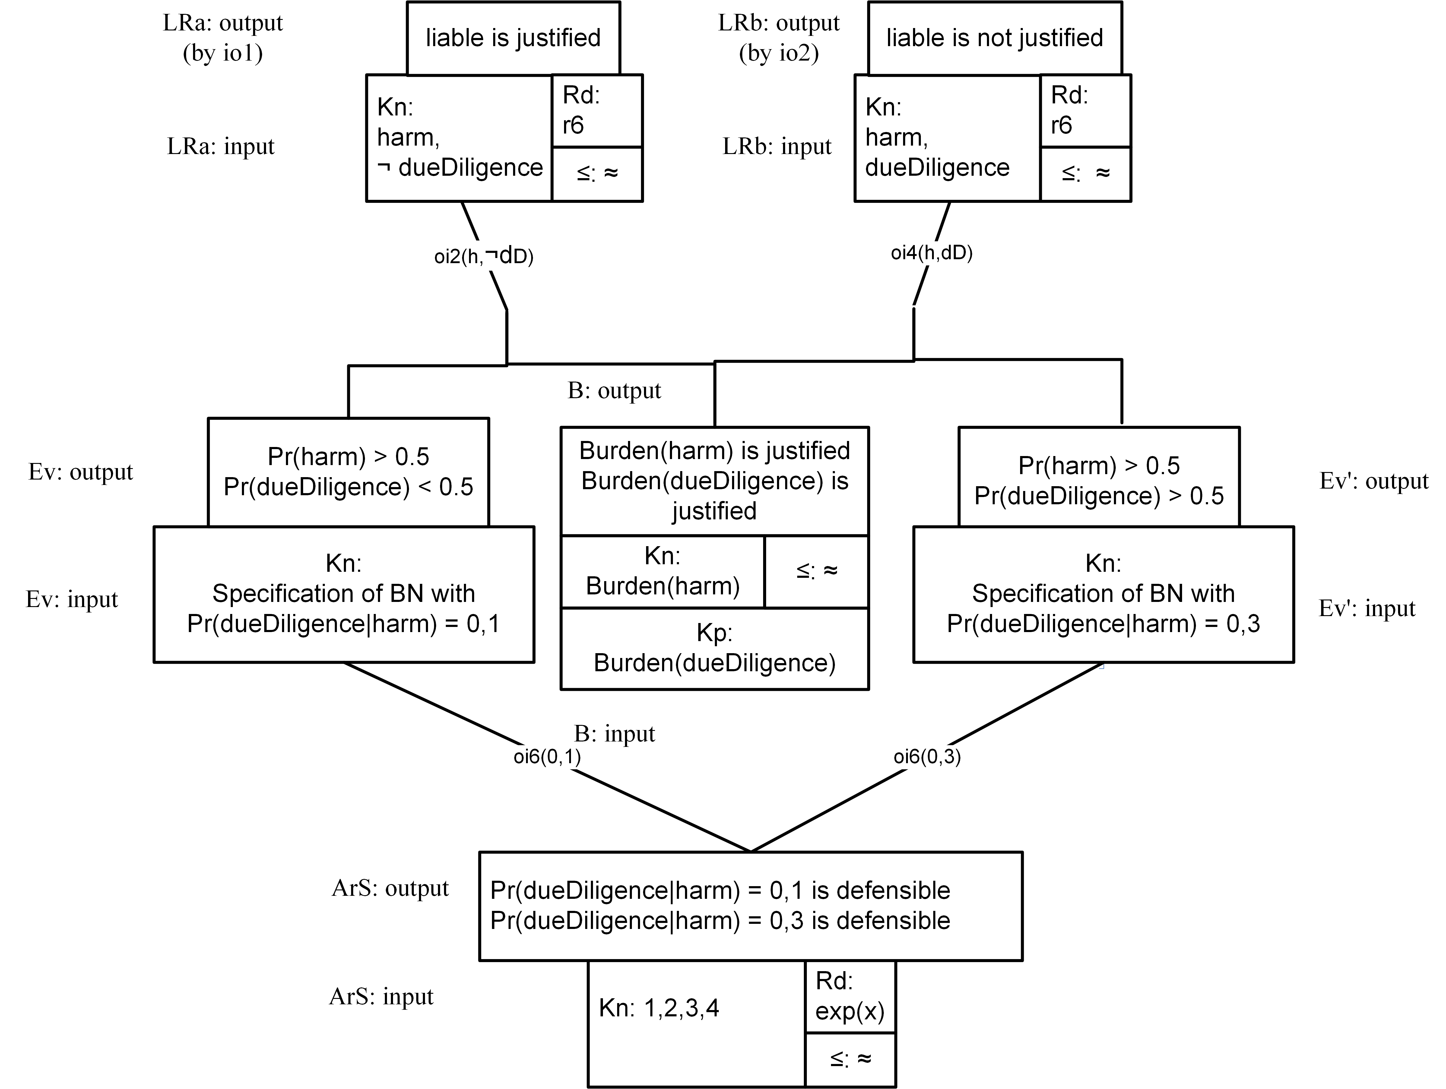
Bla
Notes:
Now there is a conflict between experts at the input side of the BN. This is again modelled as an argumentation module (It could be Carneades, ASPIC+, …).

Slide 62
Conclusions about Prakken & Sartor sr. (2023)
Overall formalism for putting together different modes of reasoning
  Individual methods left as they are
  Room for alternative solutions
  Global semantics is ASPIC+
Research issues:
  Other applications
  Comparison with earlier formal work in AI on combining modes of reasoning

Slide 63
Legal argumentation systems: the knowledge acquisition bottleneck
Realistic models of legal reasoning
  argumentation with precedents, balancing reasons or values, …
But hardly applied in practice:
  Required knowledge is hard to manually acquire and code
Is natural-language technology the solution?
  Learn everything from case law, law journals, …
Notes:
Much theoretical progress, a few modest practical successes, but …
CBR suffers less from the KA bottleneck, since cases are like data. So lecture 2 …

