Slide 1
AI & Law Models of Legal Case-Based Reasoning
Henry Prakken
Lecture series AI in Court
Bologna, 20 November 2024

Slide 2
Contents
Models of case-based reasoning in factor-based domains
HYPO, CATO, IBP
Horty’s model of precedential constraint
Preferences from values in case-based reasoning
Legal argumentation as practical reasoning
Recent developments: CBR for analysing data sets
Evaluating AI models of legal reasoning
Notes:
A step towards data-centric approaches: cases are data points, and there is research on learning the inputs of the models from natural-language sources.

Slide 3
1. Models of case-based reasoning in factor-based domains

Slide 4
Factor-based reasoning
In legal classification and interpretation there are often no clear rules
Often there only are factors: tentative reasons pro or con a conclusion
Often to different degrees
Factors are weighed in cases, which become precedents
But how do judges weigh factors?
And how do precedents constrain new decisions?

Slide 5
Example from US law: misuse of trade secrets
Some factors pro misuse of trade secrets:
F4 Agreed-Not-To-Disclose
F6 Security-Measures
F18 Identical-Products
F21 Knew-Info-Confidential
…
Some factors con misuse of trade secrets:
F1 Disclosure-In-Negotiations
F16 Info-Reverse-Engineerable
…
HYPO
Ashley & Rissland
1985-1990
CATO
Aleven & Ashley
1991-1997
Notes:
Factors are more abstract than facts!

Slide 6
1.1 HYPO, CATO, IBP

Slide 7
HYPO Ashley & Rissland 1987-1990
Kevin Ashley &
Edwina Rissland
Representation language:
Cases: π-factors and δ-factors + decision (π or δ)
Current Fact Situation: π-factors and δ-factors
Arguments:
Citing (for its decision) a case on its similarities with CFS
Distinguishing a case on its differences with CFS
Taking into account which side is favoured by a factor

Slide 8
Example with factors
C₁ (π) C₂ (δ)
CFS
p₁ p₂ p₃
d₁ d₂
p₁ p₂ p₃
d₁ d₂
p₁
d₂ d₃
p₁ p₃
d₃

Slide 9
Example with factors
C₁ (π) C₂ (δ)
CFS
p₁ p₂ p₃
d₁ d₂
p₁ p₂ p₃
d₁ d₂
p₁
d₂ d₃
Cite for π
p₁ p₃
d₃

Slide 10
Example with factors
C₁ (π) C₂ (δ)
CFS
p₁ p₂ p₃
d₁ d₂
p₁ p₂ p₃
d₁ d₂
p₁
d₂ d₃
Distinguish!
p₁ p₃
d₃
Distinguish!

Slide 11
Example with factors
C₁ (π) C₂ (δ)
CFS
p₁ p₂ p₃
d₁ d₂
p₁ p₂ p₃
d₁ d₂
p₁
d₂ d₃
p₁ p₃
d₃
Cite for δ

Slide 12
Example with factors
C₁ (π) C₂ (δ)
CFS
p₁ p₂ p₃
d₁ d₂
p₁ p₂ p₃
d₁ d₂
p₁
d₂ d₃
p₁ p₃
d₃
Distinguish!
Distinguish!

Slide 13
K.D. Ashley. Modeling Legal Argument: Reasoning with Cases and Hypotheticals.
MIT Press, Cambridge, MA, 1990.
Plaintiff:
I should win because as in Bryce, which was won by plaintiff, I took security measures and defendant knew the info was confidential
Defendant:
Unlike in the present case, in Bryce defendant had agreed not to disclose and the products were identical
Defendant:
Unlike Bryce, in the present case the info is reverse engineerable
Defendant:
I should win because as in Robinson, which was won by defendant, plaintiff made disclosures during the negotiations
Plaintiff:
Unlike in Robinson, I took security measures, and defendant knew the info was confidential
Notes:
13
This has been refined in many ways: underlying values, …
This mainly focuses on rhetoric: the designers made no claim that such systems can produce reliable outcomes. The idea was that judges or sollicitors could use such a system as a sparring partner, to test ideas and strategies.

Slide 14
(snapshot of) CATO Factor Hierarchy
Vincent Aleven 1991-1997
Misuse of Trade
Secret (p)
F120: Info legitimately
obtained elsewhere (d)
F101: Info Trade Secret (p)
F104: Info valuable (p)
F102: Efforts to maintain
secrecy (p)
F4: Agreed not to disclose (p)
F1: Disclosures
in negotiations (d)
F6: Security
measures (p)
F15: Unique product (p)
Notes:
We now relax the assumption that the relation between factors and outcome is immediate and that there are no intermediate reasoning steps. Within cases the relation between factors and outcome is still immediate, but they can be explained in terms of intermediate factors.

Slide 15
Distinguishing on missing pro factor
V. Aleven. Using background knowledge in case-based legal reasoning: a computational model and an intelligent learning environment. Artificial Intelligence 150:183-237, 2003.
Misuse of Trade
Secret (p)
F120: Info legitimately
obtained elsewhere (d)
F101: Info Trade Secret (p)
F104: Info valuable (p)
F102: Efforts to maintain
secrecy (p)
F4: Agreed not to disclose (p)
F1: Disclosures
in negotiations (d)
F6: Security
measures (p)
F15: Unique product (p)

Slide 16
Emphasising distinction
Misuse of Trade
Secret (p)
F120: Info legitimately
obtained elsewhere (d)
F101: Info Trade Secret (p)
F104: Info valuable (p)
F102: Efforts to maintain
secrecy (p)
F4: Agreed not to disclose (p)
F1: Disclosures
in negotiations (d)
F6: Security
measures (p)
F15: Unique product (p)

Slide 17
Downplaying by substitution
Misuse of Trade
Secret (p)
F120: Info legitimately
obtained elsewhere (d)
F101: Info Trade Secret (p)
F104: Info valuable (p)
F102: Efforts to maintain
secrecy (p)
F4: Agreed not to disclose (p)
F1: Disclosures
in negotiations (d)
F6: Security
measures (p)
F15: Unique product (p)

Slide 18
Distinguishing on new con factor
Misuse of Trade
Secret (p)
F120: Info legitimately
obtained elsewhere (d)
F101: Info Trade Secret (p)
F104: Info valuable (p)
F102: Efforts to maintain
Secrecy (p)
F4: Agreed not to disclose (p)
F1: Disclosures
In negotiations (d)
F6: Security
measures (p)
F15: Unique product (p)

Slide 19
Emphasising distinctions
Misuse of Trade
Secret (p)
F120: Info legitimately
obtained elsewhere (d)
F101: Info Trade Secret (p)
F104: Info valuable (p)
F102: Efforts to maintain
Secrecy (p)
F4: Agreed not to disclose (p)
F1: Disclosures
In negotiations (d)
F6: Security
measures (p)
F15: Unique product (p)

Slide 20
Downplaying by cancellation
Misuse of Trade
Secret (p)
F120: Info legitimately
obtained elsewhere (d)
F101: Info Trade Secret (p)
F104: Info valuable (p)
F102: Efforts to maintain
Secrecy (p)
F4: Agreed not to disclose (p)
F1: Disclosures
In negotiations (d)
F6: Security
measures (p)
F15: Unique product (p)
Notes:
This cancels F1 with F4.

Slide 21
IBP
≈ Deductive rule-based system with factor-based HYPO applied to each rule condition that has to be interpreted.
K.D. Ashley & S. Brüninghaus (2009). Automatically classifying case law texts and predicting legal outcomes. Artificial Intelligence and Law 17(2): 125-165.
Notes:
Then they did prediction and they studied factor extraction with NLP.

Slide 22
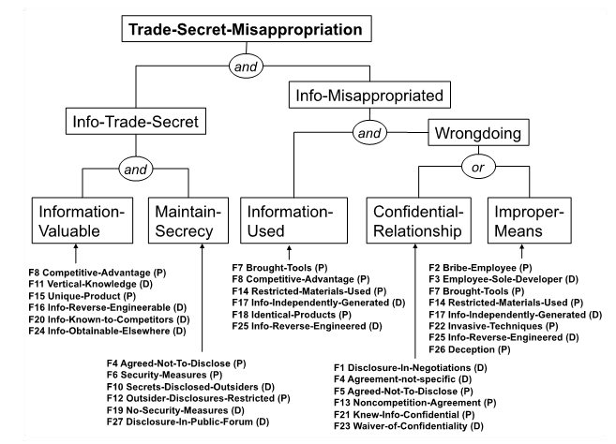
K.D. Ashley (2019). A brief history of the changing roles of case prediction in AI and law. Law in Context 36(1): 93-112.
Notes:
This model is human-made.
It applies HYPO’s factor-based model to the conditions of the rule.

Slide 23
NLP for extracting factors from case law texts
Can legally relevant factors be automatically recognised in legal texts?
Results modest until recently
LLM make it feasible
But human has to indicate what is to be found
K.D. Ashley & S. Brüninghaus (2009). Automatically classifying case law texts and predicting legal outcomes. Artificial Intelligence and Law 17(2): 125-165.
M. Gray, J. Savelka, W. Oliver & K.D. Ashley. Automatic identification and empirical analysis of legally relevant factors. Proceedings ICAIL 2023, pp. 101-110.
Notes:
Note that in knowledge-based systems like HYPO and CATO the factors have to be manually entered by humans; so it is the humans who interpet the natural-language fo the decisions.
Even worse with more refined models, like with values.

Slide 24
Precedential constraint
John Horty
When is a decision in a new case ‘forced’ by a case base?
If the case base contains a precedent for that decision that cannot be distinguished:
All differences make the new case even stronger for the new decision
J. Horty, Rules and reasons in the theory of precedent. Legal Theory 17 (2011): 1-33.
…
H. Prakken, A formal analysis of some factor- and dimension-based accounts of precedential constraint. Artificial Intelligence and Law 29 (2021): 559-585.
…
Notes:
Horty (2011) is the seminal paper although he built on earlier work in AI & Law. For instance, the ideas of case decisions as expressing preferences between pro and con factors, and the idea of a fortiori reasoning were already in Prakken & Sartor (1998).
If you want to know more about how this fits with legal theory on precedential constraint, then read Horty.

Slide 25
1. Precedential constraint
with factors

Slide 26
Precedential constraint: result model
the factors in G
favouring s
(the pro-s factors)
For two fact situations F and G and sides s,s’:
G ≤_{s} F iff G^{s} ⊆ F^{s} and F^{s’} ⊆ G^{s’}
F is at least as good for s as G iff:
F has at least all pro-s factors that G has, and
F has at most all con-s factors that G has
con-s = pro-s’
Notes:
So < is made relative to a side.
So forced if F is at last as good for s as the fact situation in the percedent. (So a fortiori reasoning)
So F <_{s} G iff all differences make G stronger for s than F. All additional factors in G are pro s, and all missing factors in G are pro s’. Or: if G has at least all pro-s factors that F has, and at most all the con-s factors that F has.

Slide 27
Precedential constraint: result model
Deciding fact situation F for s is forced iff there exists a precedent (G,s) such that G ≤_{s} F
Such that F is at least as good for s as G
Deciding F for s is allowed iff deciding F for s’ is not forced.
Notes:
So < is made relative to a side.
So forced if F is at last as good for s as the fact situation in the percedent. (So a fortiori reasoning)
So F <_{s} G iff all differences make G stronger for s than F. All additional factors in G are pro s, and all missing factors in G are pro s’. Or: if G has at least all pro-s factors that F has, and at most all the con-s factors that F has.

Slide 28
Deciding F for s is forced iff there exists a precedent G such that G ≤_{s} F
Case G1 – won by plaintiff G1 ≤_{π} F?
Deceive-plaintiff (π1)
Security measures (π3)
No-unique-product (δ1)
Secrets-disclosed-outsiders (δ3)
Case G2 – won by defendant G2 ≤_{δ} F?
Bribe-Employee (π2)
No-unique-product (δ1)
Secrets-disclosed-outsiders (δ3)
F –
Bribe-Employee (π2)
Security measures (π3)
Info-Reverse-Engineerable (δ2)
Secrets-disclosed-outsiders (δ3)

Slide 29
Deciding F for s is forced iff there exists a precedent G such that G ≤_{s} F
Case G1 – won by plaintiff G1 ≤_{π} F? No
Deceive-plaintiff (π1)
Security measures (π3)
No-unique-product (δ1)
Secrets-disclosed-outsiders (δ3)
Case G2 – won by defendant G2 ≤_{δ} F?
Bribe-Employee (π2)
No-unique-product (δ1)
Secrets-disclosed-outsiders (δ3)
F –
Bribe-Employee (π2)
Security measures (π3)
Info-Reverse-Engineerable (δ2)
Secrets-disclosed-outsiders (δ3)

Slide 30
Deciding F for s is forced iff there exists a precedent G such that G ≤_{s} F
Case G1 – won by plaintiff G1 ≤_{π} F?
Deceive-plaintiff (π1)
Security measures (π3)
No-unique-product (δ1)
Secrets-disclosed-outsiders (δ3)
Case G2 – won by defendant G2 ≤_{δ} F?
Bribe-Employee (π2)
No-unique-product (δ1)
Secrets-disclosed-outsiders (δ3)
F –
Bribe-Employee (π2)
Security measures (π3)
Info-Reverse-Engineerable (δ2)
Secrets-disclosed-outsiders (δ3)

Slide 31
Deciding F for s is forced iff there exists a precedent G such that G ≤_{s} F
Case G1 – won by plaintiff G1 ≤_{π} F?
Deceive-plaintiff (π1)
Security measures (π3)
No-unique-product (δ1)
Secrets-disclosed-outsiders (δ3)
Case G2 – won by defendant G2 ≤_{δ} F? No
Bribe-Employee (π2)
No-unique-product (δ1)
Secrets-disclosed-outsiders (δ3)
F –
Bribe-Employee (π2)
Security measures (π3)
Info-Reverse-Engineerable (δ2)
Secrets-disclosed-outsiders (δ3)

Slide 32
Following, distinguishing and overruling precedents (Horty)
Following a precedent = deciding the current case as the precedent
Distinguishing a precedent = deciding the current case contrary to the precedent where this is allowed
Overruling a precedent = deciding the current case contrary to the precedent where this is not allowed
Notes:
Overruling e.g. makes sense when the times have changed (less socialist, more liberal) so that het same factors should now be weighed differently.
And following a precedent can change the law.

Slide 33
2. Precedential constraint
with dimensions

Slide 34
From two-valued to many-valued factors (dimensions)
Dimensions can have a value from an ordered range of values
Numbers
Anything else that can be ordered
Dimensions have polarities:
con
<
pro
Notes:
34

Slide 35
Example dimensions in HYPO
Number of outsider disclosees (0,1,….)
plaintiff
defendant
0 1 2 3 4 5, …....
Notes:
35

Slide 36
Example dimensions in HYPO
Security measures (minimal measures, acces to premises controlled, entry by visitors restricted, entry by employees restricted)
defendant
plaintiff
minimal < access controlled < entry visitors restr < entry employees restr
Notes:
36

Slide 37
Dimensions: Horty’s result model
For any two fact situations F and FG given a set of dimensions:
G ≤_{s} F iff F is for every dimension at least good for s as G.
Deciding fact situation F for s is forced iff there exists a precedent with fact situation G and decided for s such that G ≤_{s} F
Notes:
NB: we assume that all cases assign a value to the same set of dimensions.
So F is at least as good for s as F’ iff F is on all dimensions at least as good for s as F’.
It can be shown that if all dimensions are two-valued, then this reduces to the factor-based models. So the factor-based result model is a special case.
Formulating a dimension-based reason model turns out to be surprisingly complicated.

Slide 38
Example (result model for dimensions)
Case 1 – won by plaintiff
d1: Deceive-plaintiff = yes
d2: Bribe-Employee = no
d3: Security measures = Entry-By-Visitors-Restricted
d4: Unique-product = no
d5: Info-Reverse-Engineerable = no
d6: Secrets-disclosed-outsiders = 5
Case 2 –
d1: Deceive-plaintiff = yes
d2: Bribe-Employee = yes
d3: Security measures = Minimal
d4: Unique-product = no
d5: Info-Reverse-Engineerable = no
d6: Secrets-disclosed-outsiders =20
d1: Deceive-plaintiff = {no <_{π} yes}
d2: Bribe-Employee = {no <_{π} yes}
d3: Security-Measures = {Minimal-Measures <_{π}
Access-To-Premises-Controlled <_{π}
Entry-By-Visitors-Restricted <_{π}
Restrictions-On-Entry-By-Employees}
d4: Unique-product = {yes <_{δ} no}
d5: Info-Reverse-Engineerable = {no <_{δ} yes}
d6: Secret-disclosed-outsiders = {0 <_{δ} 1 <_{δ} 2 <_{δ} …}

Slide 39
1.3. Preferences from values in case-based reasoning
Notes:
Of toch kort, om te laten zien wat ChatGPT allemaal zou moeten kunnen? But skip if no time.

Slide 40
Justifying factor preferences with value preferences
Intellectual property
Confidentiality
Freedom of information
Fair competition
VJAP
Grabmair & Ashley 2013-2017
M. Grabmair, Predicting trade secret case outcomes using argument schemes and learned quantitative value effect tradeoffs. Proceedings of ICAIL 2017, pp. 89-98.
Notes:
Put on the research agenda by Berman & Hafner, ICAIL 1993, then pursued by Bench-Capon, then Sartor, Prakken, then Grabmair.
Or ‘value trade-offs’.

Slide 41
Basic scheme for value-based reasoning with precedents
Deciding case pro when it contains P promotes value V
Deciding current pro promotes set of values V1
Deciding current con promotes set of values V2
V1 is preferred over V2
Therefore, current should be decided pro
T. Bench-Capon, H. Prakken, A. Wyner & K. Atkinson, Argument schemes for reasoning with legal cases using values. Proceedings of ICAIL 2013, pp. 13-22.
Notes:
41
How are non-forced precedents decided? We now model the idea that deciding a case when a certain is present promotes a legal or societal value.
This can be modelled with argument schemes and so formalized in ASPIC+.
Grabmair tried to learn the third premises from data sets. But …

Slide 42
Value preferences from precedents
Deciding precedent pro promotes set of values V1
Deciding precedent con promotes set of values V2
precedent was decided pro
Therefore, V1⁺ is preferred over V2 ⁻
V1+ = V plus zero or more additional pro-values
V2- = V minus zero or more con-values
Notes:
42
This is similar to the reason model with factors, but now the sets that are weighed are the sets of values promoted (or demoted) in a case.
V1+ is V1 plus possibly more values promoted by deciding a case pro.
V2- is any subset of V2.

Slide 43
From factors to values (2)
Plaintiff took security measures to protect his intellectial-property interests
Deciding for plaintiff since defendant knew the information was confidential, protects confidentiality
Plaintiff, by making disclosures during the negotiations, waived confidentiality
Deciding for defendant promotes fair competition

Slide 44
Value-based reasoning in the trade secrets domain (HP)
Deciding for side 1 promotes set of values V1
Deciding for side 2 promotes set of values V2
V1 is preferred over V2
Therefore, Proposal 1 should be adopted
Deciding for the plaintiff promotes {IP interests, confidentiality}
Deciding for the defendant promotes {fair competition}
{IP interests, confidentality} is preferred over {fair competition}
Therefore, the case should be decided for the plaintiff
Notes:
With case-based reasoning we assumed that the value set preference can be derived from precedents.
Interestingly, the court does not give an argument for its preference.

Slide 45
Further refinements
Promotion and demotion of values
Degrees of promotion or demotion
Absolute or marginal
Probability of promotion or demotion
Notes:
Ashley (in Festschrift for TBC) said “This is not how we lawyers do this”. Here are some reasons why.

Slide 46
3. Recent developments

Slide 47
Follow-up work Wijnand van Woerkom
Discovering dimension orderings in datasets
Intermediate factors in result model of precedential constraint
Assuming a CATO-style factor hierarchy
Generalising it to dimensions
allowed intervals
Implementations with SAT solver
W. van Woerkom et al. A Fortiori Case-Based Reasoning: From Theory to Data. JAIR 81 (2024): 401-441.
W. van Woerkom et al., Hierarchical precedential constraint. Proceedings of ICAIL 2023, pp. 333-342.
W. van Woerkom et al., Hierarchical a fortiori reasoning with dimensions. Proceedings of JURIX 2023, pp. 43-52.

Slide 48
Hierarchical precedential constraint
Apply precedential constraint to
decide on intermediate factors
decide on the final outcome given intermediate factors
TBC’s criticism (sometimes established with different strengths)
Notes:
Allows to reuse “portions of precedents” on intermediate decisions.
The idea for the second sub-bullet: you get more similarities at the intermediate level. This constrains more decisions at the abstract level(s)

Slide 49
Misuse of Trade
Secret (p)
F120: Info legitimately
obtained elsewhere (d)
F101: Info Trade Secret (p)
F104: Info valuable (p)
F102: Efforts to maintain
secrecy (p)
F4: Agreed not to disclose (p)
F1: Disclosures
in negotiations (d)
F6: Security
measures (p)
F15: Unique product (p)
Notes:
Allows to reuse “portions of precedents” on intermediate decisions.
The idea for the second sub-bullet: you get more similarities at the intermediate level. This constrains more decisions at the abstract level(s)

Slide 50
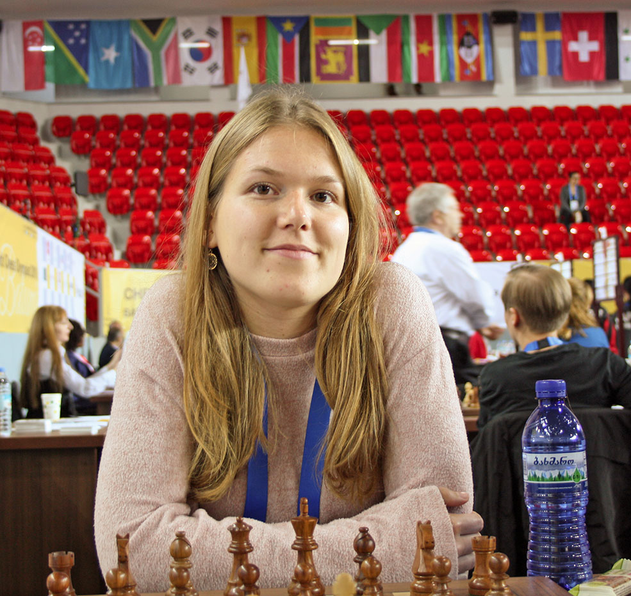
Consistency of datasets
Rosa Ratsma
Joeri Peters
A case base is inconsistent iff it forces opposite outcomes for the same fact situation
Degree of consistency of a CB:
The rate of pairs (F,s), (G,s’) for which F ≤_{s} G
Authoritativeness of a case (F,s): the proportion of cases (G,s) and (G,s’) such that F ≤_{s} G
H. Prakken & R. Ratsma, A top-level model of case-based argumentation for explanation: formalisation and experiments. Argument and Computation 13 (2022): 159-194
J. Peters et al., Justifications derived from inconsistent case bases using authoritativeness. In Proceedings of ArgXAI 2022.
Notes:
What to do with inconsistent CB?
Look at all cases that are at least as good for s as (F,s) and see whether they agree or disagree with (F,s). The degree to which a case base agrees with a precedent.
Leads to refined notion of constraint. From: “Cases like this always receive this outcome” to “… usually receive this outcome”

Slide 51
Decision support for deciding on fitness to drive
At Dutch Central Driving License Office
“No machine learning”
Not transparent or explainable
“Is standard CBR useful?”
Standard CBR:
assumes ‘features’ without preferences for decisions
applies numerical similarity measures
suggests decision of precedent(s) with highest similarity to current case
Notes:
Another applications:
Using for explaining outcomes of machine-learning models.
Decision-support at the Dutch police: classifying fraudulous web shops

Slide 52
Joep Nouwens: Msc project AI-UU
Combine and compare with AI & law style CBR:
Features with preferences for decisions
Not all differences are relevant!
Decision-making by precedential constraint
Example dimensions
Heart disease?
Bipolar disorder?
Eye sight
Epiliptic attacks
…
Notes:
Hope: improved explainability, more rational decision-making.

Slide 53
Experiment
Case base: 15.843 cases, 123 dimensions
80% used as precedent
20% used as test case
Four decision rules:
Standard CBR: predict decision with highest similarity
Precedential constraint with if both allowed/forced:
predict ‘fit’
predict ‘unfit’
predict decision of case with highest similarity according to standard CBR
Notes:
Most dimensions have the same value, since persons have just a few health problems.
Preferences on dimensions determined with statistical methods followed by human check.
‘Predict fict’ gives drives benefit of the doubt, ‘predict unfit’ is cautious.
The case base had an inconsistency degree of 45%.

Slide 54
Experiments with accuracies
Case base: 15.843 cases, 123 dimensions
80% used as precedent
20% used as test case
Four decision rules:
Standard CBR: predict decision with highest similarity (92%)
Precedential constraint with if both allowed/forced:
predict ‘fit’ (70%)
predict ‘unfit’ (64%)
predict decision of case with highest similarity according to standard CBR (91%)
Notes:
So precedential constraint does not give better accuracy, but only better explainability.

Slide 55
The value of predictive experiments
“High predictive accuracy is evidence of legal correctness of the model”
Aleven, Ashley
HP: only true if system and humans:
apply the same knowledge
reason with it in the same way
Notes:
On assumptions: always predicting that the accussed is found guilty is >92% accurate.
Have HYPO and CATO ever been evaluated in the traditional way? CATO yes, with law students.

Slide 56
5. Evaluating systems

Slide 57
Basic concepts
Evaluation = verification + validation
Building the system right vs building the right system
Performance v. usefulness
Laboratory studies v. field studies
History versus current trends
Notes:
Building the system right vs building the right system
Good performance in laboratory does not imply usefulness in practice (for many reasons).

Slide 58
Evaluating GOFAI
MYCIN (1970s)
Lab, performance
8 experts + MYCIN diagnosed and ‘treated’ infections
3 senior experts rated quality
MYCIN performed best
Buchanan, B. G.; Shortliffe, E. H. (1984). Rule Based Expert Systems: The MYCIN Experiments of the Stanford Heuristic Programming Project. Reading, Massachusetts: Addison-Wesley.
Online at https://www.shortliffe.net

Slide 59
Evaluating GOFAI&Law
Tessec (Nieuwenhuis 1989):
Lab, real workers, supported or not
Usefulness
Better decisions with support
Tessec (De Bakker & Wassink 1991):
Before intro Tessec: 34 of 50 cases had errors
After intro Tessec: 18 of 50 cases had errors
J. Svensson (2002), The use of legal expert systems in administrative decision making.
In A. Gronlund (ed.): Electronic Government: Design, Applications and Management. London etc. Idea Group Publishing, pp. 151-169.
Notes:
Tessec: real cases with real social-assistance workers. Without support 2 of 24 correct, with support run-time 11 of 24 correct, with support post-hoc 16 of 24 correct.
So Tesseco was really used for a while, further developed into commercial MRE product.
On research gate you can ask the author for a copy.

Slide 60
Evaluation of CATO
Field test (Legal writing class)
Usefulness
Comparing groups instructed with resp. CATO and human instructor
Pre- and post-test written argument exams, graded by instructor
Both groups improved significantly and equally
Notes:
Note that CATO is more than an implemented model of legal argument. It comes with an instructional environment; it is an intelligent tutoring system.
30 first-year law students.
So CATO did equally well as an experienced human instructor.

Slide 61
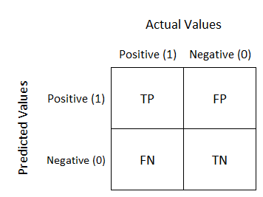
Confusion matrix
https://towardsdatascience.com/understanding-confusion-matrix-a9ad42dcfd62

Slide 62
Key metrics
https://towardsdatascience.com/understanding-confusion-matrix-a9ad42dcfd62
https://www.youtube.com/watch?v=RYFViaaJxE8
Notes:
Accuracy: Correct / All
We have separate precisions for P and N
Accuracy: Pr(X predicted | X) How many of the cases in which X was true did you predict X?
Precision: Pr(P | P predicted) How many of the cases in which you predicted P was P true?
Many things to say, but for present purposes: these measures are much easier than old-style evaluation. That’s why researchers often do not more evaluation than this. What is worse, they don't do research any more that requires such evaluation (testing usefulness, testing quality of arguments, ...). They use proxies.

