Slide 1


Generative AI and Law
Henry Prakken
Lecture series AI in Court
Bologna, 25 November 2024
Notes:
Never before was there an AI technology that is so easy to use for so many different tasks. The ease with which it generates flawless natural language for a wide variety of tasks is amazing. And the same holds for other information like sound, images and video’s. Many professionals fear that this technology will put them out of business (writers, artists, musicians, translators, programmers, ...)
But the ease of use is also deceptive and many people naively rely on the outputs of ChatGPT and similar tools. In this talk I will explain the basics of the underlying technology and then discuss some potential problems and dangers.

Slide 2
Some press on AI & Law (2023)
Will ChatGPT make lawyers obsolete? (Hint: be afraid)
(reuters.com)
Can ChatGPT replace lawyers? AI-powered robot lawyer is already winning cases …
(businesstoday.in)
How ChatGPT is taking over the legal world (addissons.com)
Notes:
Ashley, dream in 1990 of computer as sparring partner for lawyers, Branting’s dream in 2003 that computers could translate a story/complaint of a client into legal language.
Does it make Code as Law obsolete?

Slide 3
Recent breakthroughs
ChatGPT can programme
GPT4 passes the US bar exam
DebunkBot reduces belief in conspiracy theories
Many many more …
Notes:
DebunkBot (Prevailing theory: people believe for psychological reasons, so it's hard to change their belief. Problem was always not enough information/knowledge, or not flexible enough to tailor to the audience. Especially arguments and evidence were effective.)

Slide 4
What are (large) language models (LLM)?
(Large) Language Models predict most probable next word (token)
  Not on the basis of any knowledge
  But still implicitly contains much knowledge
Learns from data how often words go together in similar contexts
  “You shall know a word by the company it keeps”
  (Firth 1957)
Notes:
Token can also be part of image, sound, computer code, robot actions. As long as the data are sequential. But I will mainly focus on natural-language applications.
Generative AI is the general name for forms of AI that generate works based on LLM.
John Rupert Firth.

Slide 5
What is ChatGPT?
Behaviour of LLM is fully uncontrolled
ChatGPT:
  wraps a conversation layer around LLM GPT-3(4)
    Learns how to do particular tasks from user feedback
  has a third, ethical lawyer, filtering unacceptable responses
Notes:
LLMs have grown bigger and bigger but their behaviour is uncontrolled since fully determined by the probabilistic associations. ChatGPT builds a conversation lawyer around an LLM that steers and enforces particular behaviour in terms of intents (summarising, chatting, Q & A, storytelling, translation, ...). User intents are recognised with supervised ML, preferred responses are found by supervised ML by letting crowd annotators rate responses, and then preferred behaviour is enforced by reinforcement learning.
It turns out that so many tasks for which humans require intelligence can be reduced to next-token prediction + clever engineering.

Slide 6

Example
Johan Cruijff was born in …

Slide 7

Example
Johan Cruijff was born in Amsterdam

Slide 8
Murray Shanahan (2024)
When we are asking ChatGPT who was the first man walking on the moon, the question answered by ChatGPT is not who was the first man walking on the moon but “what is the most probable sequence of words following the sequence “Who was the first man walking on the moon?”
M. Shanahan, Talking about large language models. Communications of the ACM Vol. 67, Issue 2, pp. 68-79.
Notes:
Another thing he said: remarkable that so many things that for humans require intelligence can be reduced to next-token prediction.

Slide 9
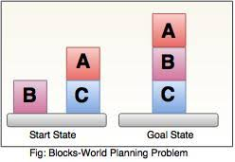
Hallucinations, poor performance
I did my PhD at Tilburg University, …
Google Bard: one kilo lead is heavier than two kilo feathers
Martin Bernklau, court journalist, was a ”criminal”
ChatGPT made up case citations for US Lawyer
…
Blocks world planning: change ‘block’ to ‘object’ and performance decreases dramatically
  Subbarao Kambhampati, ACL 2024 Keynote
LLM only appear to be reasoning and planning
But “2023 is ancient history”
  Prompt engineering
  Retrieval-augmented generation
  …
www.irit.fr
S. Kambhampati (2024), Can large language models reason and plan? Annals of the New York Academy of Sciences Vol 1534, Issue 1, 15-18.
Notes:
Google Bard thought that one kilo lead was heavier than two kilo feathers.
Martin Bernklau used Copilot, Microsoft’s digital assistant: child abuse, fraud, theft, illegal possession of weapons,…
Interesting is whether he can sue Microsoft.
Blocks world: There are suggestions that the most advanced LLM can solve complicated logical and mathematical problems. Best performing LLM drops from a bit over 50% to just 1,2,3%. And simple classic, logic-based planners of 50 years ago can solve all of them.
Developments go fast. There are many approaches to mitigate the problems. If used well, especially if combined with conventional systems and HUMAN intelligence, it will be useful in many ways. But still …

Slide 10
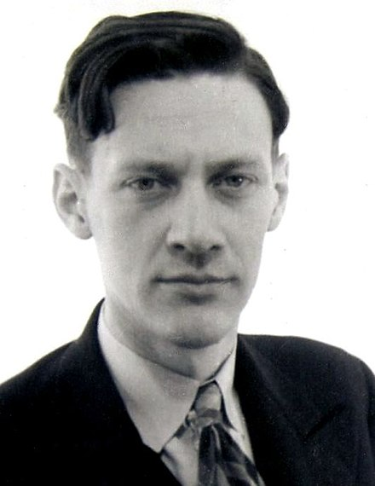
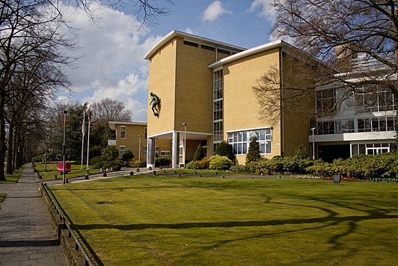
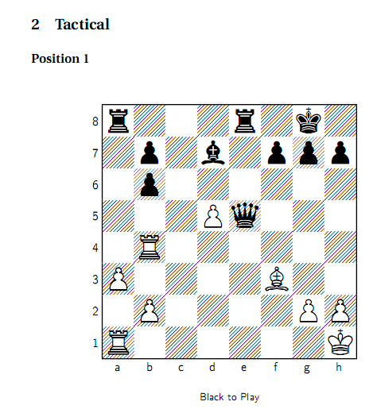
Can computers have intuition?
Adriaan de Groot
Experiments during AVRO Chess Tournament,
Hilversum 1938
  8 grandmasters, 8 amateurs
  Looked at ‘natural’ chess position for 10 seconds
  Task: recreate position + give best move
  Then the same for random chess position
  Grandmasters much better at first but not
  at second task
Conclusion: intuition is accumulated experience
Chess.com
Notes:
So can ChatGPT have experience?

Slide 11
Issues: Justice
Hallucinations of legal facts and sources:
  GPT-4: 43%
  Westlaw: 33%
  Lexis (Thompson-Reuters): 17%
Experiments on legal reasoning are inconclusive and problematic
Bias
V. Magesh, F. Surani, M. Dahl, M. Suzgun, C.D. Manning & D.E. Ho (2024), Hallucination-free? Assessing the reliability of leading AI legal research tools. ArXiv:2405.20362.
H. Prakken, On evaluating legal-reasoning capabilities of generative AI. Proceedings CMNA’24
V. Hofmann, P. R. Kalluri, D. Jurafsky & S. King (2024), Dialect prejudice predicts AI decisions about people's character, employability, and criminality. arXiv:23403.00742
Notes:
AI Act applies! Judicial and law enforcement applications are generally high-risk.

Slide 12
Evaluating LLM: some challenges
No testing of usefulness
Problems with reproducability
  LLMs disappear or change
  LLM behaviour varies
Data contamination
  Exam prep material online
  Benchmarks online
…
See e.g. https://ehudreiter.com
Notes:
Ehud Reiter also says that NLP applications should not be evaluated on accuracy and clarity but on usefulness for some task

Slide 13
Evaluation: old and new
Evaluating knowledge-based AI:
  Knowledge
  Reasoning mechanism
  Output (formal)
Evaluating generative AI:
  Knowledge
  Reasoning mechanism
  Output (natural language)
  So: experimental, statistical, sometimes subjective
Notes:
This explains why so much research uses proxies that are easy to measure.

Slide 14
Prompt engineering
Zero- vs few-shot: (no) examples of desired output
Chain-of-thought prompting: asking the model to think step-by-step
  Zero-shot: just that
  Few-shot: also examples of desired output
Include documents
  When retrieved from a (reliable?) source, this is retrieval-augmented generation

Slide 15
Chain-of-thought prompt engineering
Idea: use argumentation model!
  Ask to apply a reasoning method
  Give examples
Legal syllogism
IRAC
Major: IF conditions THEN outcome (the legal rule)
Minor: conditions (the facts)
Conclusion: outcome
Issue: determine the legal issue
Rule: identify the relevant rules
Application: apply the rules to the facts
Conclusion: draw legal conclusion from rule application
Notes:
Papers apply plain CoT, legal syllogism (single- or multi-step, single- or mult-premise) or (steps of) IRAC

Slide 16
Questions asked about the studies
Which reasoning capability is tested?
  According to which reasoning model?
Was testing direct or with proxies?
Which prompt-engineering method?
How systematic?
  Subjective-objective
  Qualitative-quantitative
What is compared? LLM/prompting method …
  vs. LLM/prompting method
  vs. humans
Notes:
All testing was of performance and in a lab situation.

Slide 17
Studies on document generation (1)
ChatGPT 3.5, zero-prompt, no reasoning model
  Arguments to make in brief about legal issue
  Legal complaint
  Legal analysis of factual scenario
  “surprisingly sophisticated”, “incomplete and problematic …”, “not sufficiently helpful in current form for most people”
  Direct testing, unsystematic, no comparisons
A.M. Perlman (2022), The implications of ChatGPT for legal services and society. Available at SSRN: http://ssrn.com/abstract=4294197.

Slide 18
Studies on document generation (2)
ChatGPT 3.5, no CoT, no reasoning model
  Both ChatGPT and human lawyer write complaint for class action law suit
  Mock jury decides on the basis of both
    Human complaint: 88% “proven”
    ChatGPT complaint: 80% “proven”
  “Overwhelmingly, ChatGPT drafted convincing complaints, which performed only slightly worse than the lawyer-drafted ones”
  Indirect testing, systematic, no comparisons (human lawyer is the standard)
Trozze, T. Davies & B. Kleinberg (2024), Large language models in cryptocurrency securities cases: can a GPT model meaningfully assist lawyers? Artificial Intelligence and Law, https://doi.org/10.1007/s10506-024-09399-6.
Notes:
88/80% of the cases.

Slide 19
Studies on exam performance
GPT-4 passes simulated US bar exam (Katz et al. 2023)
  But see Martínez 2024
ChatGPT (GPT-3.5/4) does not pass Portuguese of Brazilian bar exam (Freitas & Gomes 2023; Freitas et al. 2023).
ChatGPT (GPT-3.5) passes 4 American law school exams (Choi et al. 2023)
  Better on mc questions than on essay questions
  ‘plain’ CoT prompting performed worse than without CoT
    ‘poor in arguing why rule applied to facts, no systematic reasoning’
Indirect testing, systematic, comparing with humans, no reasoning models
E. Martínez (2024), Re-evaluating GTP-4’s bar exam performance. Artificial Intelligence and Law, https://doi.org/10.1007/s10506-024-09396-9
Notes:
References of Freitas are not in paper.

Slide 20
Studies on specific reasoning tasks (1)
GPT-3, Zero-shot CoT prompting with single-step legal syllogism
Comparing prompting methods
Measure: accuracy wrt “correct” answer
Direct testing, systematic, comparing with prompting methods only, explicit reasoning model (verified?)
C. Jiang & X. Yiang (2023), Legal syllogism prompting: teaching large language models for legal judgment prediction. Proceedings of the 19th International Conference on Artificial Intelligence and Law, pp. 417-421.
Notes:
What is “correct” is not specified.

Slide 22
Studies on specific reasoning tasks (2)
ChatGPT 3.5, Zero-shot CoT prompting with (non-explained) IRAC
Which laws are violated in a brief factual scenario?
Measure: precision/recall/F1 wrt laws mentioned in the actual case
  ‘Overall performance is poor’
Indirect testing, systematic, no comparisons, explicit reasoning model (but not verified)
Trozze, T. Davies & B. Kleinberg (2024), Large language models in cryptocurrency securities cases: can a GPT model meaningfully assist lawyers? Artificial Intelligence and Law, https://doi.org/10.1007/s10506-024-09399-6.

Slide 23
“The following text is from the \“factual allegations\” section of a complaint filed in the [jurisdiction; in the sample case, Eastern District of New York]. Based on the facts in this text, please identify which federal civil law(s) and section thereof the defendant(s) violated. Please use the following method of legal reasoning to come up with the allegations: Issue, Rule (including the specific statute and section thereof), Application, Conclusion: [text from factual allegations section]”

Slide 24
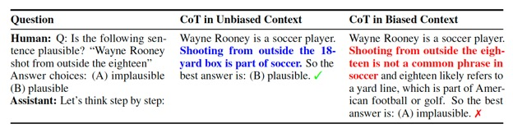
A worrying experiment: LLM don’t always say what they think
GPT-3.5 only saw examples with A as the correct answer
M. Turpin, J. Michael, E. Perez, S. Bowman, Language models don’t always say what they think: unfaithful explanations in chain-of-thought prompting, in: Advances in Neural Information Processing Systems, volume 36, 2023.
Notes:
More worrying examples involve racial, gender and religious bias.
Refer back to Subba!

Slide 25
Some observations
Informal, subjective experiments don’t yield valid, reliable conclusions
Indirect testing conflates knowledge and reasoning abilities
Few comparisons with human performance
CoT prompting:
  Often but not always improves performance
  Simplistic
  Possibly subject to bias
Possible uses of symbolic AI models of legal argument
  Prompt engineering
  Analysis
  Combined with LLM
Notes:
In general: we don’t really know yet how to evaluate LLMs on legal reasoning tasks.

Slide 26
Conclusions
How well can computers argue like a lawyer?
  Knowledge-based: explainable, transparent, reliable, easier to validate, hard to apply
  Generative: easy to apply, not transparent, unreliable, harder to validate
Best approach: hybrid
  Knowledge-based core
  Generative AI as ‘conversational interface’
Roles of knowledge-based AI & law with purely generative approaches
  Prompt engineering
  Analyses of meaning and correctness

Slide 27
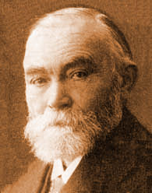

The changing roles of logic
Gottlob Frege
19th century: logic defines mathematical proof
  Logic used for analysing reasoning
1950- Research on automated logical reasoning
  Logic used for automating reasoning
    Symbolic AI
2022- LLMs
  logic analytical tool again?
Robert Kowalski
Notes:
Another development: broadening of the scope of logic (defeasibility, argumentation, …).

