Slide 1
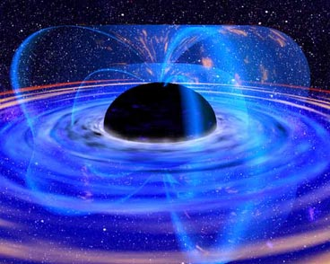
Black holes as Information Scramblers
How information survives falling into a black hole
Master thesis Wilke van der Schee
Supervised by prof. Gerard ’t Hooft
August 19, 2010

Slide 2
Introduction
Theoretical concepts
Hawking radiation
Information paradox
S-Matrix using gravitational interactions
Black hole complementarity
Research
Number of Hawking particles
Information in flat space
Conclusion and discussion

Slide 3
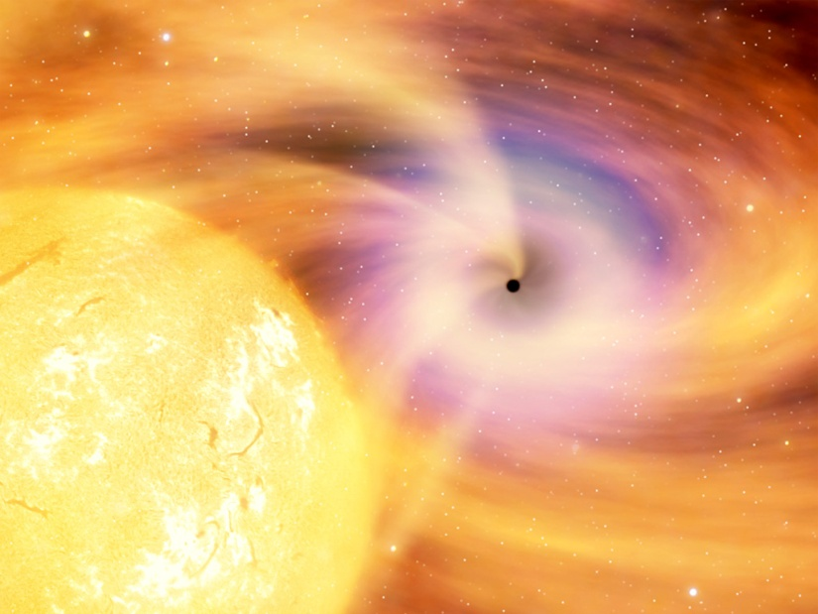
Black holes
Spherical solution to Einstein equation:
Time stops at the horizon ( )
Critical density
Collapse is (almost) inevitable
Notes:
Time from outside perspective. Clock will read time moment it passes the horizon.

Slide 4
Angular momentum a and Charge Q
More complicated
Where
Roots Δ give horizons:
Extremal black holes (no physical evidence, 2 horizons)
→ string theory
Notes:
r+ - r- is macroscopic even in extremal case!

Slide 5
Thermodynamics
Second law of black hole thermodynamics
The total area of black holes can never decrease
→ Area ~ entropy! (Bekenstein, 1973)
Schwarzschild
First law of black hole thermodynamics
τ ‘temperature’, Ω ‘angular velocity’, φ ‘electric potential’
Notes:
Increase in energy is of course really \phi dQ and \omega dJ (with dQ and dJ particle, phi omega in black hole)

Slide 6
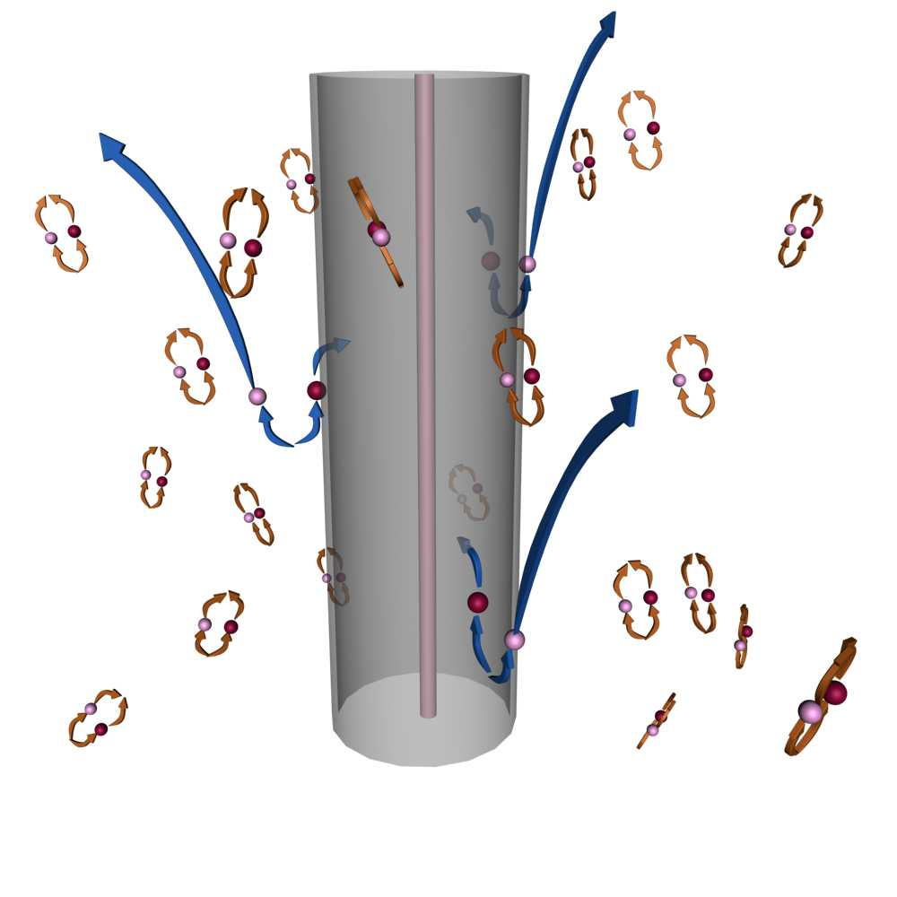
Hawking radiation
QFT + General relativity in semi-classical limit
Violation of ‘nothing can come out of black hole’!
Assume vacuum condition for freely falling observers
Jacobson (1993, Hawking with cut-off)
(cannot be proven, Jacobson)
S.W. Hawking, Particle Creation by Black Holes (1975)
T. Jacobson, Black hole evaporation in the presence of a short distance cut-off (1993)
Notes:
Semiclassical: treat gravity as classical geometry, matter as quantum field

Slide 7
Calculation Parikh and Wilczek
Vacuum fluctuations tunnel through horizon
Important: virtual particles can become real when crossing horizon (energy changes sign)
Self gravitation provides barrier (back reaction)
M → M – ω (in metric)
M.K. Parikh, F. Wilczek, Hawking radiation as tunneling (1999)
Notes:
Self gravitation = barrier & reason that kinematically allowed

Slide 8
Amplitude
Actually two times, also negative energy tunneling in.
Using contour integration and change of variable (or iε-prescription). Note that r_{in}>r_{out}.
Boltzmann factor as usual, with
Amplitude equals phase factor!
Notes:
Sum over final states, average over initial states

Slide 9
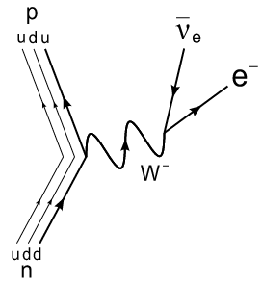
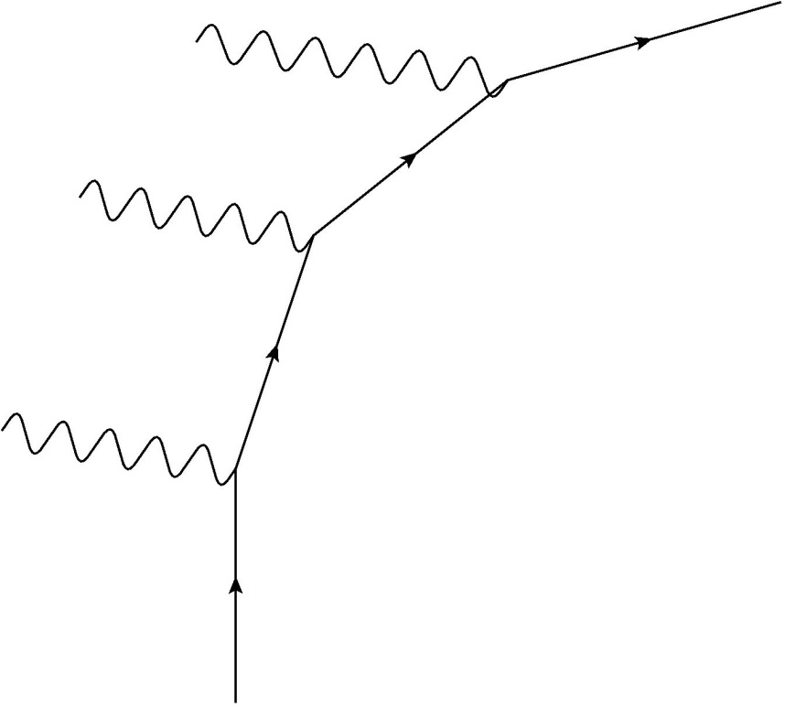
Unruh effect
Accelerating observer:
However: dual interpretation
For Hawking effect this is more subtle
“Although we are used to saying that the proton has emitted a positron and a neutrino, one could also say that the accelerated proton has detected one of the many high-energy neutrinos .. in the proton’s accelerated frame of reference”, Unruh (1976)
W.G. Unruh, Notes on black-hole evaporation, 1976

Slide 10
Information paradox
Pure state:
Or: density matrix with
Mixed state, density matrix:
p_{i} chance of state to be in i.
Thermal Hawking radiation seems to be mixed!
Information seems lost after event horizon

Slide 11
Unitarity
Pure states evolve into pure states, via Hamiltonian.
Unitarity required for energy conservation
Hawking acknowledged in 2005 that QG is unitary.
Via gravitational path integral and AdS/CFT
So we search:
T. Banks and L. Susskind, Difficulties of evolving pure states into mixed states (1984)
S.W. Hawking, Information Loss in Black Holes

Slide 12
S-Matrix Ansatz
All physical interaction processes that begin and end with free, stable particles moving far apart in an asymptotically flat space-time, therefore also all those that involve the creation and subsequent evaporation of a black hole, can be described by one scattering matrix S relating the asymptotic outgoing states to the ingoing states .
Perturb around this matrix by using ordinary interactions.
G. 't Hooft, The Scattering Matrix Approach for the Quantum Black Hole: an overview, 1996
Notes:
It is an ansatz, comparable to equivalence principle, but one would run into trouble if the ansatz were violated.

Slide 13
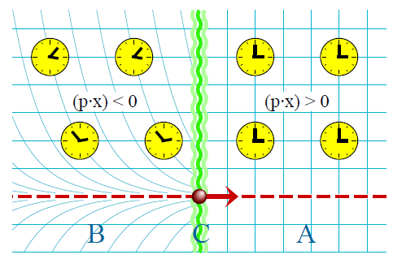
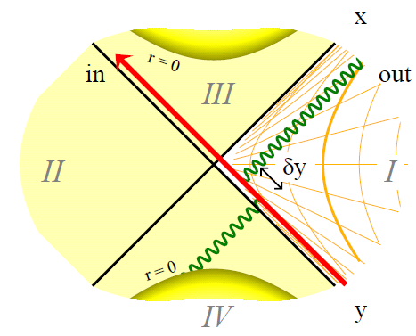
Picture of gravitational shockwave
Gravitational field of fast-moving particle (shockwave)
Generalizes to black hole surrounding in analog manner.
r is transverse distance, u velocity particle
G. 't Hooft, The Scattering Matrix Approach for the Quantum Black Hole: an overview, 1996

Slide 14
Longitudinal gravitational interaction
Outgoing particle (wave )
Coordinate shift at transverse distance results in:
This leads to a translation:
(promoting momentum to an operator)
G. ’t Hooft, Strings from Gravity, Physica Scripta, 1987

Slide 15
Unitary S-Matrix
When all states can be generated this way:
Unitary in appropiate basis
Limited range of validity
Similar to string theory!
G. ’t Hooft, Strings from Gravity, Physica Scripta, 1987
Notes:
Can maybe include other interactions

Slide 16
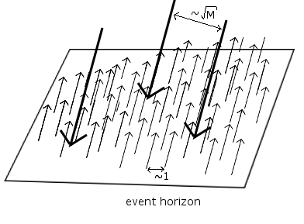
Picture of Hawking particles
Energies of particles very small, so
Very little entropy per Hawking particle (only one bit)
Notes:
Add one particle and another 10^25 come out!

Slide 17
Problematic aspects of approach
Ultra high energies
Energy collission can easily exceed total energy universe!
Transverse gravity is weak, but very important
Hawking particles fall back into black hole
Mechanism of information transfer remains mysterious
Very unlike Unruh radiation.

Slide 18
Black hole complementarity
Infalling observers describe BH’s radically differently
No violation of fundamental laws detectable
No quantum xeroxing detectable
Requires fast scrambling
Stretched horizon forms long before black hole
 | Infalling observer | Outside observer
Stretched Horizon | Nothing special | Thermal properties
Information | Falling in BH | Radiated out from horizon
Hawking radiation | Vacuum fluctuations | Carries information
L. Susskind, L. Thorlacius, J. Uglum, The Stretched Horizon and Black Hole Complementarity (1993)
Yasuhiro Sekino, L. Susskind, Fast Scramblers (2008)
Notes:
Susskind argues for a gravitational dressing, similar to electromagnetic dressing. Propagator ‘leaks’ out of lightcone.

Slide 19
Black hole complementarity (2)
Observables/particles traced back in time collided with Planck-size energy do not commute
→ complementarity is not restricted to event horizons
According to an outside observer the interior of a black hole need not even exist!
Observer dependence is similar in cosmology
Y. Kiem, H. Verlinde, E. Verlinde, Black Hole Horizons and Complementarity (1995)

Slide 20
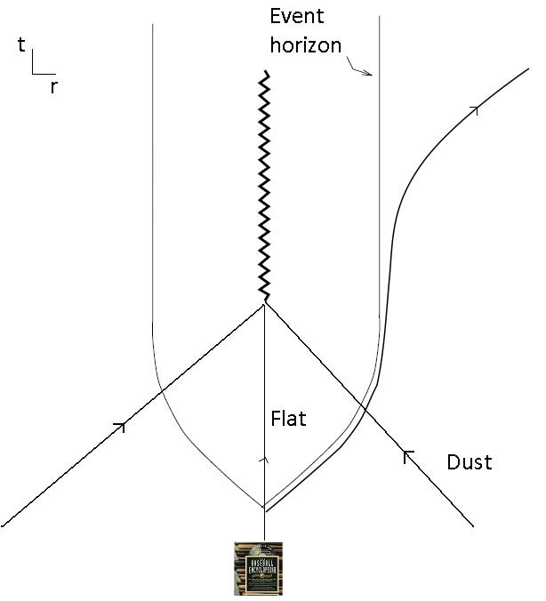
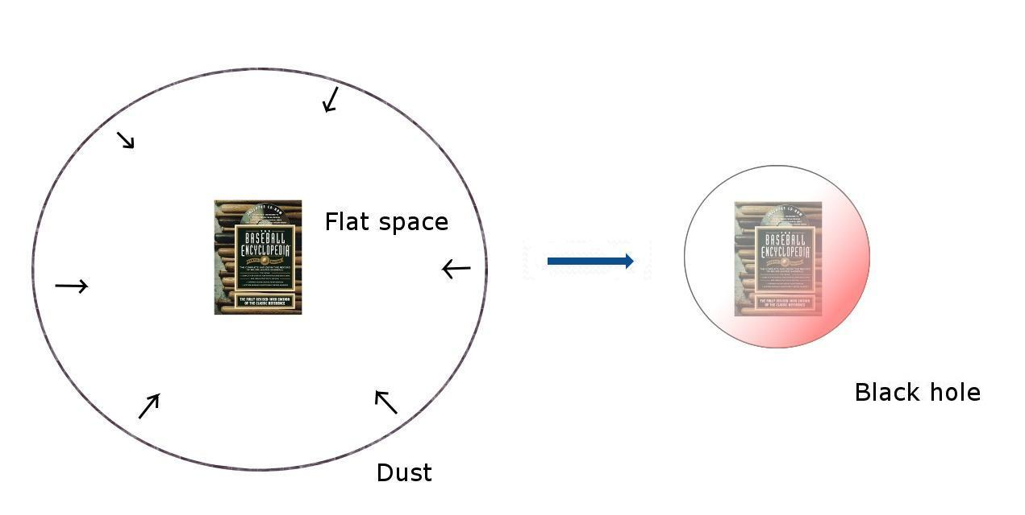
A problematic thought experiment
Particles passing horizon while in flat space
No violent gravitational interactions
Information in vacuum fluctuations (and geometry)
Notes:
Apparent horizon is necessary for Hawking radiation
Caustic? Matter of language.

Slide 21
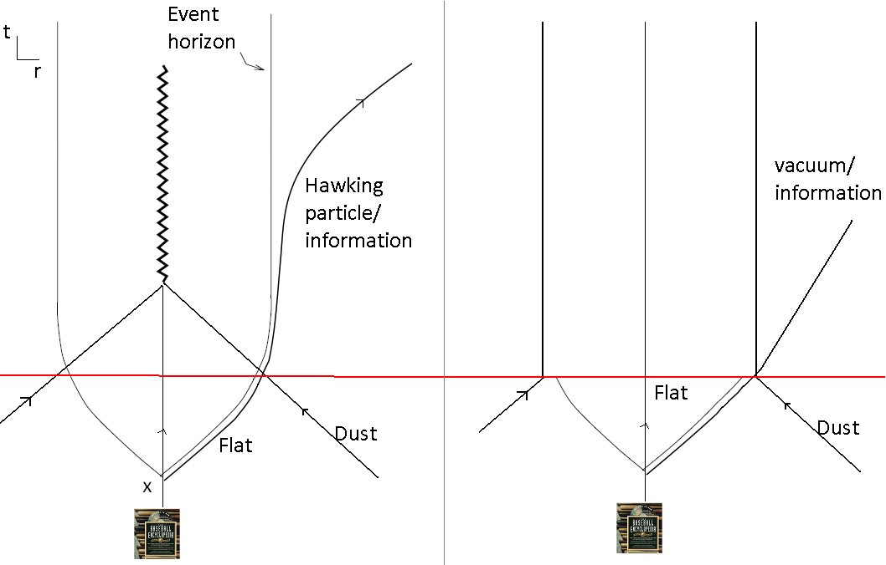
Complementarity and causality
What if the collapse stops?
Information must be always present in vacuum and geometry

Slide 22
Conclusion and discussion
In some cases S-matrix is explicitly unitary
By using only basic physics!
Information transfer is a mystery, not a paradox
Complementarity is necessary
Information, vacuum and geometry are linked
Entropic gravity?

