Slide 1
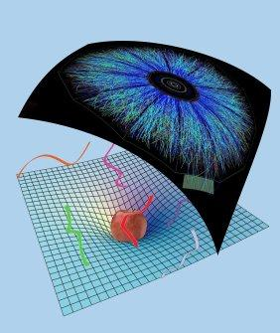
Gauge/gravity, thermalisation and energy loss
Why, when and how do we use gravity?
Work with Michał Heller, David Mateos, Michał Spalinski, Diego Trancanelli and Miquel Triana
References: 1202.0981 (PRL 108) and 1211.2218
Reviews: 0907.4503 (Paul Chesler) and 1101.0618 (Jorge Casalderrey-Solana et al)
Wilke van der Schee
Supervisors: Gleb Arutyunov, Thomas Peitzmann,
Koenraad Schalm and Raimond Snellings
Heavy Quark Production in Heavy-Ion Collisions, Utrecht
November 17, 2012

Slide 2
Outline
Motivation: using gravity for strong coupling
Thermalisation by black hole formation/radial flow
Drag force on a quark (time permitting)
Message: gravity is a model which works well in some cases
Notes:
Many states + linearized

Slide 3
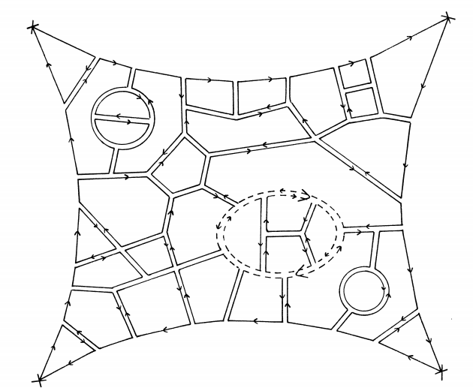
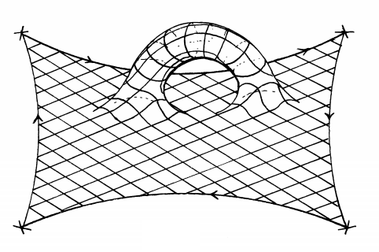
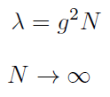
Large N gauge theories
At strong coupling we can get GR
Planar limit:
fixed
G. ’t Hooft, A planar diagram theory for strong interactions (1974)

Slide 4
When does gravity work?
If theory is at strong coupling
Asymptotic freedom is very hard
If N_{c} can be regarded as large (usually fine)
If QCD can be approximated by
Susy is broken at finite temperature
Can add quarks, but usually

Slide 5
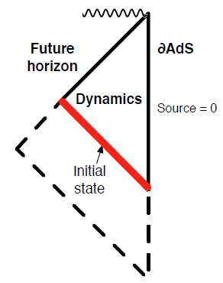
How do we use graviy?
Choose simple metric (homogeneous)
Take initial state (or source)
Evolve Einstein equations numerically
Look at anisotropy
System relaxes to hydro
P.M. Chesler and L.G. Yaffe, Horizon formation and far-from-equilibrium isotropization in supersymmetric Yang-Mills plasma (2008)
Notes:
Opposed to Chesler Yaffe approach

Slide 6
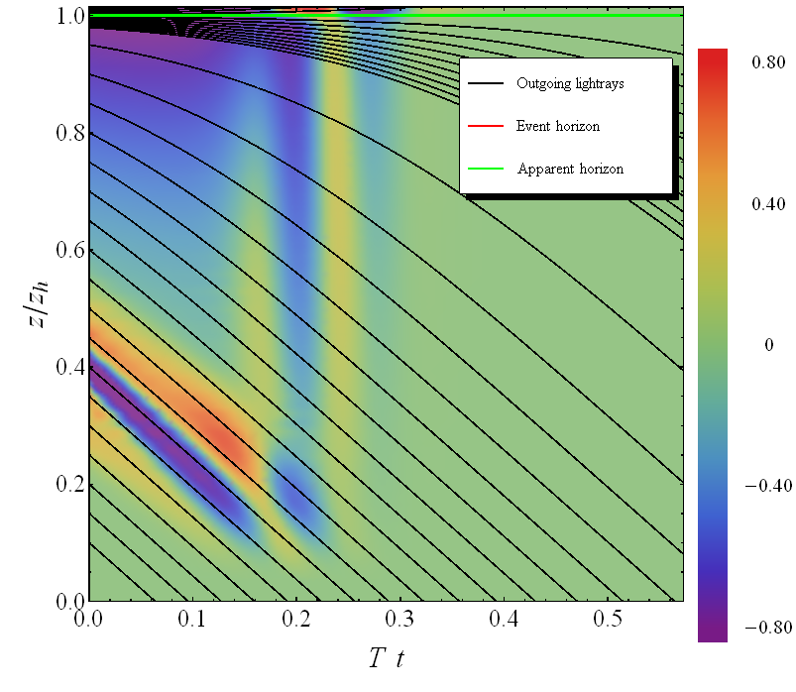
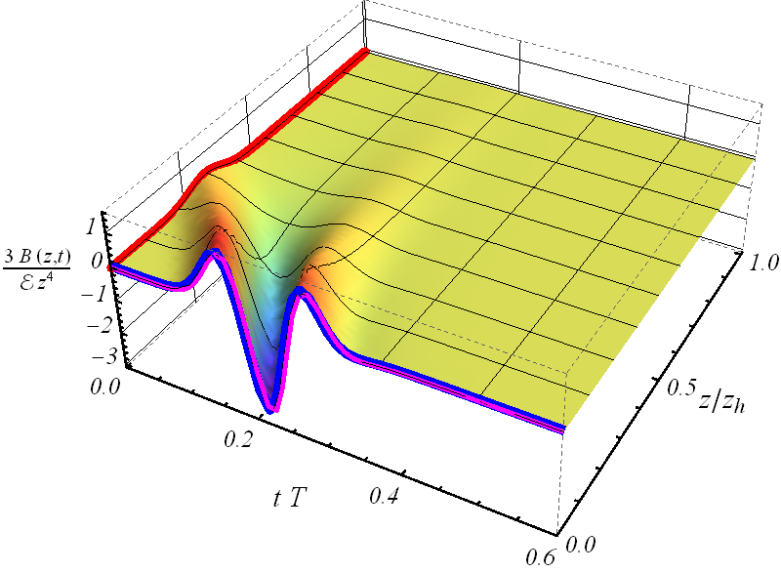
Bouncing off the boundary

Slide 7
What does gravity say?
Fast thermalisation
Studied over 2000 states (homogeneous+boost-invariant)
Small viscosity
Large energy loss (beyond hydro)
Hydro effects: Mach cone, Cherenkov radiation

Slide 8
Radial flow
Calculation incorporating longitudinal and radial expansion
Numerical scheme very similar to colliding shock-waves:
Assume boost-invariance on collision axis
Assume rotational symmetry (central collision)
→ 2+1D nested Einstein equations in AdS
P.M. Chesler and L.G. Yaffe, Holography and colliding gravitational shock waves in asymptotically AdS₅ spacetime (2010)
Notes:
Pressure in transverse plane is not the same

Slide 9
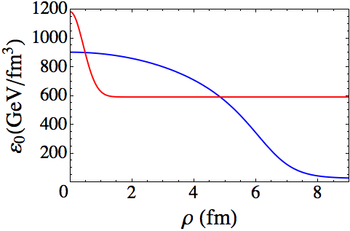
Radial flow – initial conditions
Two scales: T and size nucleus
Energy density is from Glauber model (~Gaussian)
No momentum flow (start at τ ~ 0.1fm/c)
Scale solution such that
Metric functions ~ vacuum AdS (can try other things!)
H. Niemi, G.S. Denicol, P. Huovinen, E. Molnár and D.H. Rischke, Inﬂuence of the shear viscosity of the quark-gluon plasma on elliptic ﬂow (2011)

Slide 10
Radial flow – results

Slide 11
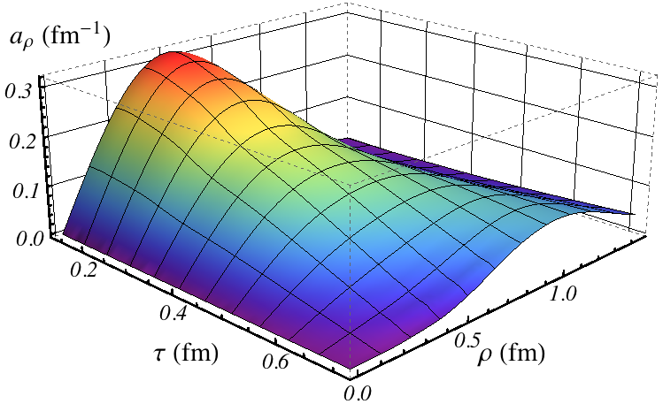
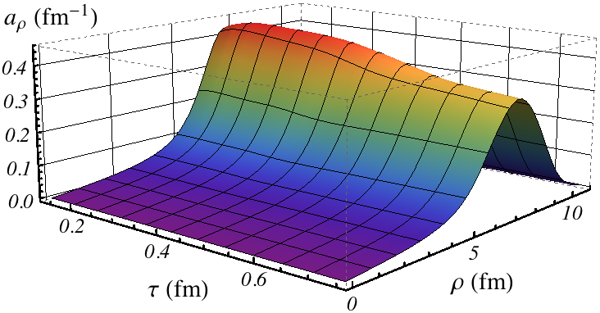
Radial flow - acceleration
Velocity increases rapidly:
Fluctuation spreads out, nucleus keeps accelerating

Slide 12
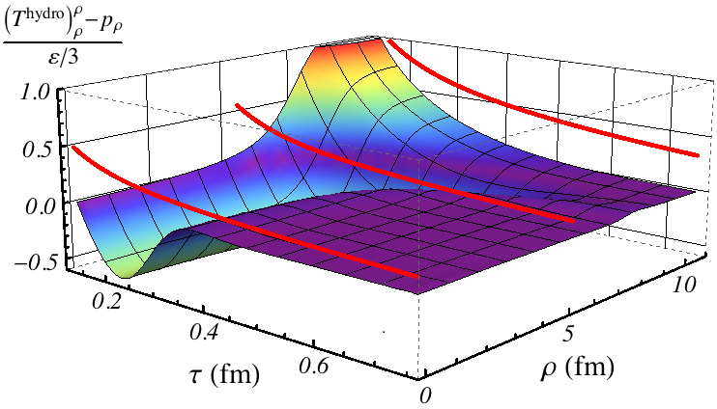
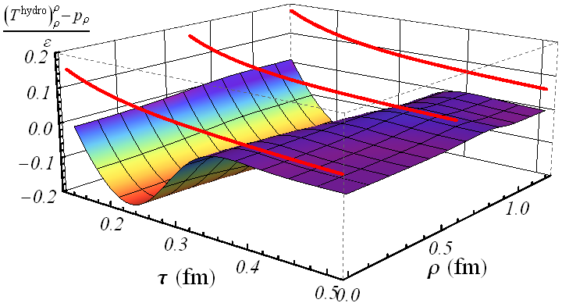
Radial flow - hydrodynamics
Thermalisation is quick, but viscosity contributes

Slide 13
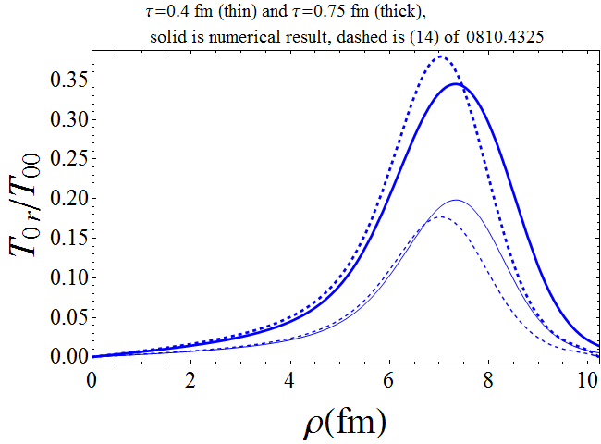
Radial flow - discussion
Gives AdS/CFT comparison to i.e. Vredevoogd and Pratt:
Initial condition is slightly ad-hoc, need more physics?
Input welcome ☺
J. Vredevoogd, S. Pratt, Universal Flow in the First Stage of Relativistic Heavy Ion Collisions (2008)

Slide 14
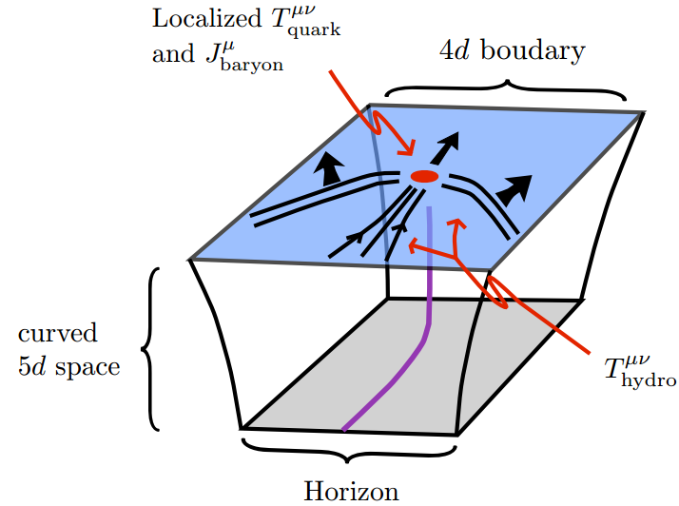
Drag force
Classical string
Does not include back reaction:
Picture:
Fig: P. Chesler, Gauge/gravity duality and jets in strongly coupled plasma (2009)

Slide 15
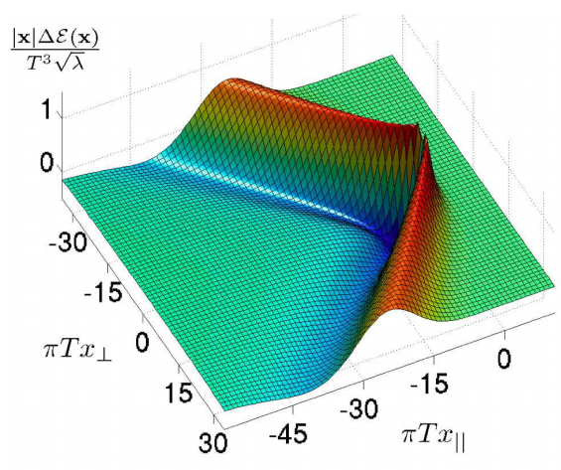
Drag force – results
Simple formula (equilibrium):
Also studied
Light/heavy quarks: light quarks lose energy later
Far-from-equilibrium (quite the same)
Fig: P. Chesler, Gauge/gravity duality and jets in strongly coupled plasma (2009)
P. Chesler, M. Lekaveckas, K. Rajagopal, Far-from-equilibrium heavy quark energy loss at strong coupling (2012)

Slide 16
Can we do better?
Use string theory:
Include different D-branes
Use different compactifications (10→5 dimensions)
Include quantum-corrections (1/N_{c} corrections)
Include string loops (hard, 1/λ corrections)
Include extra fields (scalars, vectors etc)
Conserved charges (like Baryon number)
Running coupling (but stays strong!)
Holographic superconductors

Slide 17
Conclusion
Can study many questions @ strong coupling
Thermalisation, viscosity, drag force
Radial flow, fluctuations, elliptic flow
More fundamental problems:
How strong is the coupling?
N seems to be large here…
Influence of SUSY?
Maybe add U(1) or dilaton?
Message: gravity is a model which works well in some cases

