Slide 1
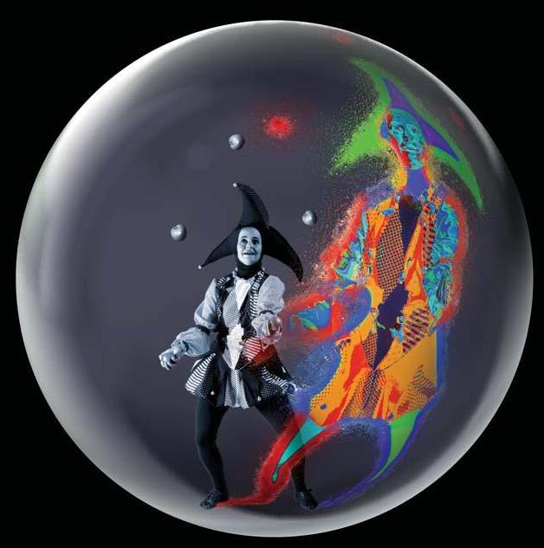
Gauge/gravity and Heavy ion physics
How string theory might say something about strong coupling
Wilke van der Schee
June 29, 2011

Slide 2
Outline
Introduction AdS/CFT
Sample calculation: drag force
Out of equilibrium dynamics and elliptic flow
Conclusion

Slide 3
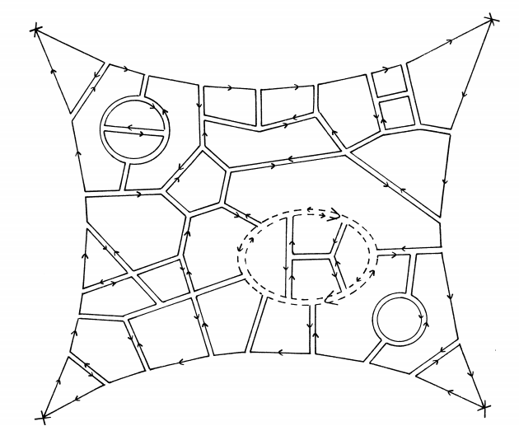
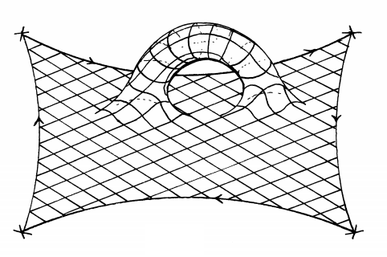
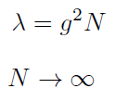
Compulsory history
Large N field theory
Planar limit:
fixed
G. ’t Hooft, A planar diagram theory for strong interactions (1974)

Slide 4
The holographic principle
Black hole thermodynamics:
Black hole entropy = area black hole
Black hole entropy is maximum
Any theory of quantum gravity (like string theory) in d+1 dimensions is equal to a d dimensional theory
G. ’t Hooft, Dimensional Reduction in Quantum Gravity (1993)
L. Susskind, The World as a Hologram (1994)

Slide 5
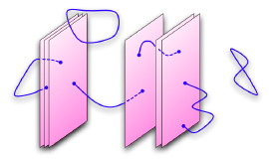
The correspondence
Look at N stacked D3-branes from two perspectives:
= 4 SU(N) SYM-theory on brane
AdS₅ gravitational theory
(both with supergravity in flat space)
Two limits:
Large N
Very strong coupling
Planar limit
Small string length
J. Maldacena, The large N limit of superconformal field theories and supergravity (1997)
Notes:
Heavily relies on realisation that D-branes are solutions of classical sugra [Polchinsky]
SUGRA means horizon > planck scale: many D-branes
Perturbative SYM means small N (due to large N)

Slide 6
Quite remarkable
Ex. 1. It is obviously absurd to claim that a four-dimensional quantum field theory is the same as a ten-dimensional string theory. Give one or more reasons why it can't be true.
Ex. 2. Figure out why your answer to the previous problem is wrong
Quantum gravity in terms of well-defined field theory
Realisation of large N limit + holography
Strong – weak duality: useful for field theory
J. Polchinski, Introduction to Gauge/Gravity Duality (2010)

Slide 7
AdS/CFT
In formula:
Bulk (AdS) | Boundary (CFT)
Field (metric) | Operator (Stress-Energy)
Local symmetry (diffeomorphism) U(1) gauge field (Photon) | Global symmetry (Poincare) Global U(1) symmetry (chemical potential)
Black hole | Thermal state (analytic Euclidean space)
Notes:
Zbulk = PI (exp(iS) )

Slide 8
Gauge/Gravity
The duality can easily be generalised:
May add probe branes
May put a black hole in the centre
Add matter fields in bulk
Not pure AdS (but gravitational)
Must be a boundary: asymptotically conformally flat
Not CFT (but gauge theory)
But has to have strong coupling and conformal in UV
Often no explicit string theory (consistent truncation)

Slide 9
Is AdS/CFT ‘proven’?
AdS/CFT is a strong/weak duality:
Both very useful and very hard to prove!
The derivation is in a lot of cases quite intuitive
String picture, large N picture, holography
Most importantly: a lot of (mathematical) evidence
Protected quantities
Integrable systems
Experimental evidence?

Slide 10
The big problem with AdS/CFT
Cannot do any strong coupling calculation
Two ways out:
Try to modify model closer to calculation you want to do (compactification, Branes etc)
Hope that answer in another field theory will share same features (universality class)
Calculations can be involved…

Slide 11
AdS/QCD
First logical start: YM-theory at strong coupling
=4 SYM very different from QCD:
4 supersymmetries
Exact scale invariance (no confinement, asymptotic freedom)
3 ≠ ∞
@QGP this seems to be quite OK!
Deconfined, but strongly coupled
Confining models (not perfect):
Would correspond to Hawking-Page transition:
black hole — thermal gas ~ deconfinement—confinement

Slide 12
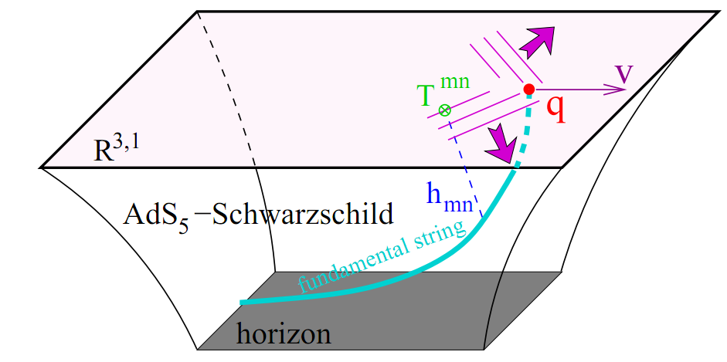
Drag force in QGP
One of easiest examples: quark with constant v
One of only explanations of ‘jet quenching’ time

Slide 13
Action/e.o.m.
Standard string action:
Metric is Schwarzschild-AdS₅
Vary action:
Put back:

Slide 14
Shape of string
Choose coordinates s.t.
Derive: ,
Conclude force (with a little algebra+regularity):

Slide 15
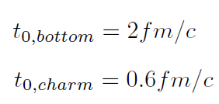
Comparison with QGP
Heavy quarks:
By putting in + dictionary
Note: toy calculations, can be improved (a little)
Flavour branes in AdS
Stress-energy produced by drag

Slide 16
Thermalisation using AdS/CFT
High energy → Gravity may dominate
Thermalisation is interesting question
Black hole formation!
Entropy is experimental variable → black hole entropy?
G. ’t Hooft, Graviton dominance in ultra-high-energy scattering (1987)

Slide 17
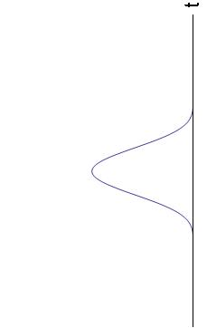
Strategy
Assume boost and translations invariance:
1D-problem in gauge side, 2D in gravity
Perturb boundary metric AdS for some time
Solve Einstein equation (numerically)
Perturbation causes gravitational waves
Metric ←→ Stress energy:
Inject energy, localised in time
Anisotropic in transverse/longitudinal direction
P. Chesler, L. Yaffe, Boost invariant flow, black hole formation, and far-from-equilibrium dynamics in N = 4 SYM (2009)

Slide 18
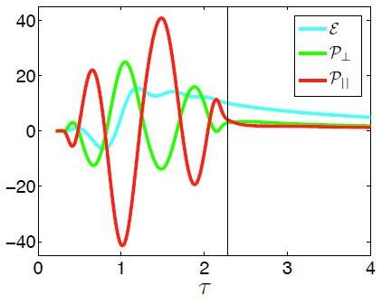
Results
Black hole forms in ~ 1/T
Interesting: how fast does the system isotropise?
→Fast!

Slide 19
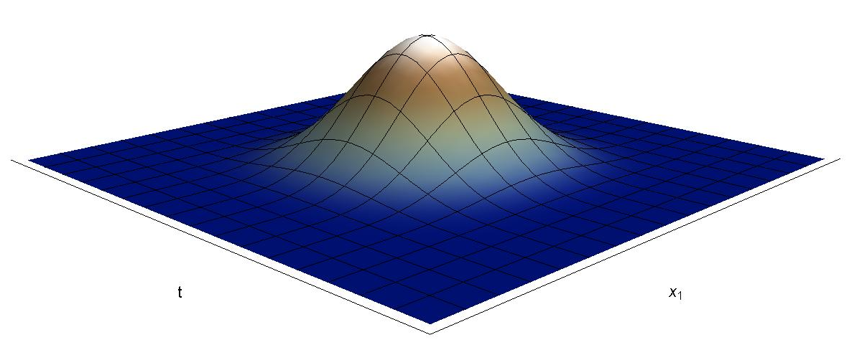
Outlook
Inject energy localised in space:
Then spend some months computing ☺

Slide 20
Discussion
Gauge/gravity cannot be used for specific theories
Some experimental confirmation
(but basically qualitatively)
However, easy (and sometimes only) tool to study qualitative features of strong coupling
Notes:
But probably there are good general reasons that the preferred way of understanding a strongly coupled field theory as a gavitational theory as well as many indications that this approach works.

