Slide 1
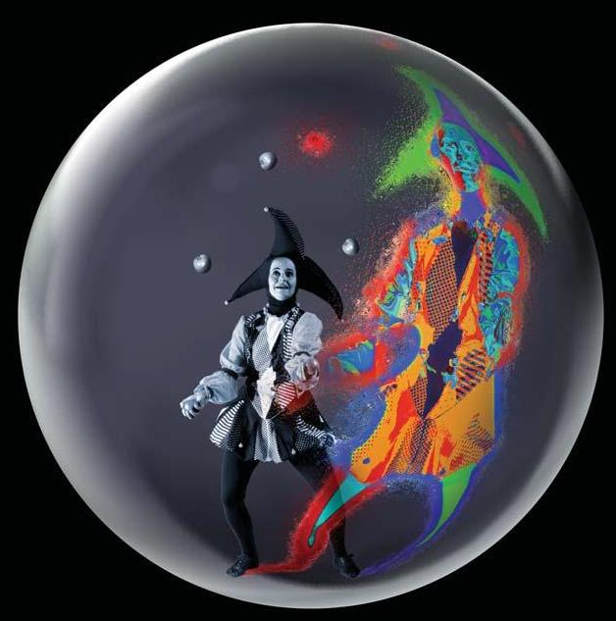
Gauge/gravity and condensed matter
How string theory might say something about strong coupling
Wilke van der Schee
June 24, 2011

Slide 2
Outline
Introduction AdS/CFT
Gauge/gravity in general
Sample calculation: conductivity
Holographic superconductors and discussion
S. Hartnoll, Lectures on holographic methods for condensed matter physics (2009)

Slide 3
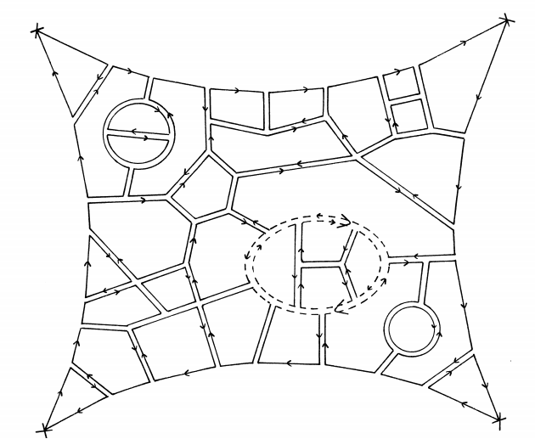
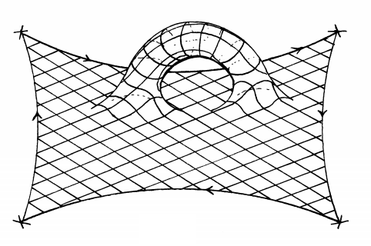
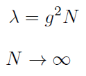
Compulsory history
Large N field theory
Planar limit:
fixed
G. ’t Hooft, A planar diagram theory for strong interactions (1974)

Slide 4
The holographic principle
Black hole thermodynamics:
Black hole entropy = area black hole
Black hole entropy is maximum
Any theory of quantum gravity (like string theory) in d+1 dimensions can be reduced to d deimensions
G. ’t Hooft, Dimensional Reduction in Quantum Gravity (1993)
L. Susskind, The World as a Hologram (1994)

Slide 5
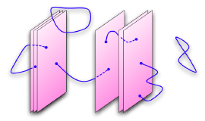
The correspondence
Look at N stacked D3-branes from two perspectives:
SU(N) SYM-theory on brane
AdS₅ gravitational theory
(both with supergravity in flat space)
Two limits:
Very strong coupling
Large N
Small string length
Planar limit
J. Maldacena, The large N limit of superconformal field theories and supergravity (1997)
Notes:
Heavily relies on realisation that D-branes are solutions of classical sugra [Polchinsky]
SUGRA means horizon > planck scale: many D-branes
Perturbative SYM means small N (due to large N)

Slide 6
Quite remarkable
Ex. 1. It is obviously absurd to claim that a four-dimensional quantum field theory is the same as a ten-dimensional string theory. Give one or more reasons why it can't be true.
Ex. 2. Figure out why your answer to the previous problem is wrong
Quantum gravity in terms of well-defined field theory
Realisation of large N limit + holography
Strong – weak duality: useful for field theory
J. Polchinski, Introduction to Gauge/Gravity Duality (2010)

Slide 7
AdS/CFT
In formula:
Bulk (AdS) | Boundary (CFT)
Field (metric) | Operator (Stress-Energy)
Local symmetry (diffeomorphism) U(1) gauge field (Photon) | Global symmetry (Poincare) Global U(1) symmetry (chemical potential)
Black hole | Thermal state (analytic Euclidean space)
Notes:
Zbulk = PI (exp(iS) )

Slide 8
Is AdS/CFT ‘proven’?
AdS/CFT is a strong/weak duality:
Both very useful and very hard to prove!
The derivation is in a lot of cases quite intuitive
String picture, large N picture, holography
Most importantly: a lot of (mathematical) evidence
Protected quantities
Integrable systems
Experimental evidence?

Slide 9
Gauge/Gravity
The duality can easily be generalized:
May add probe branes
May put a black hole in the center
Add matter fields in bulk
Not pure AdS (but gravitational)
Must be a boundary: asymptotically conformally flat
Not CFT (but gauge theory)
But has to have strong coupling and conformal in UV
Often no explicit string theory (consistent truncation)

Slide 10
The big problem with AdS/CFT
Cannot do any strong coupling calculation
Two ways out:
Try to modify model closer to calculation you want to do (compactification, Branes etc)
Hope that answer in another field theory will share same features (universality class)
Calculations can be involved…

Slide 11
AdS/CMT
Condensed matter physics is great:
use your favourite gauge theory!
Natural start: quantum criticality (don’t understand this very well)
Spacetime scale invariance
Lack of weakly coupled quasiparticles
Breaking of continuous symmetry at T=0 (quantum)
Describes heavy fermion superconductors
Note: AdS/CFT is almost only tool to calculate analytical transport coefficients in such systems.

Slide 12
Superconductivity
High T_{C}, unlike BCS
System is effectively 2D
Interacting disordered strongly coupled system
Use Gauge/gravity to study characteristics
HOPE!

Slide 13
Electric and thermal conductivity
Consider 2+1D relativistic system at finite chemical potential and zero momentum, close to equilibrium
Introduce global U(1) field in field theory (neglect photons)
Corresponds to Maxwell field in bulk
Electric and thermal current sourced by electric field and thermal gradient (NB: linear response around equilibrium)
S. Hartnoll, Lectures on holographic methods for condensed matter physics (2009)
Notes:
Note: heat is transported by charge -> gradient causes current
Relate operator (J and Q) to field deformation (A and g)

Slide 14
Linear response
Operator in field theory excited by field in dual
Boundary condition at boundary
Ingoing boundary at horizon, regularity requires retarded propagator (little subtle)

Slide 15
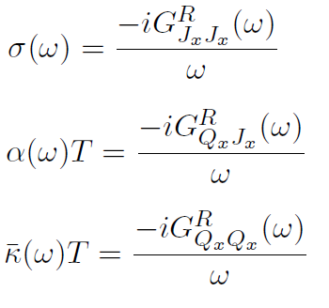
Retarded Green functions
Linear relation between source and expectation value:
(in general: )

Slide 16
Green functions in AdS/CFT
Background is Reissner-Nordström-AdS₄ metric
Solve linear Einstein-Maxwell equations
Subject to boundary conditions for small and

Slide 17
Green functions in AdS/CFT
Use partition function to compute Green functions:
Differentiating in is easy:
Conductivity requires solving differential equation+ingoing boundary condition:

Slide 18
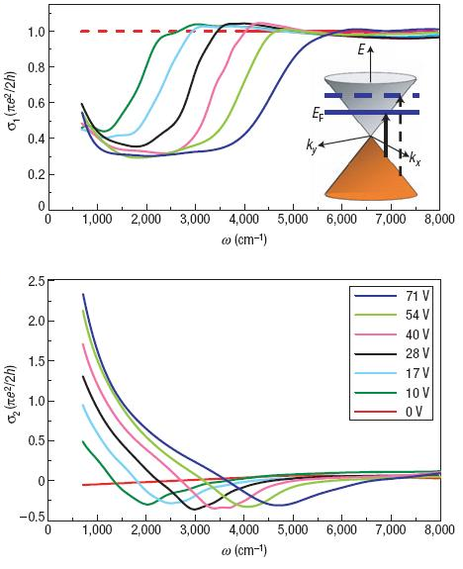
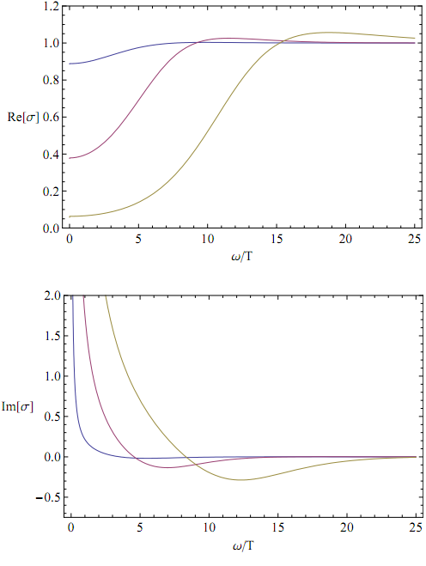
Comparison with graphene
Theory
Experiment
S. Hartnoll, C. Herzog, G. Horowitz, Holographic Superconductors (2008)
Z. Li et al, Dirac charge dynamics in graphene by infrared spectroscopy (2008)

Slide 19
Holographic superconductor
Add charged field (for spontaneous sym breaking)
s-wave: scalar field
No potential for scalar field
Parameters: chemical potential + temperature

Slide 20
Holographic superconductor
Equations of motion for scalar:
Search for instability (pole in retarded propagator in upper half plane)
Free parameters:
Dimension operator (related to mass in gravity)
Relative strength gravity/electromagnetism γq

Slide 21
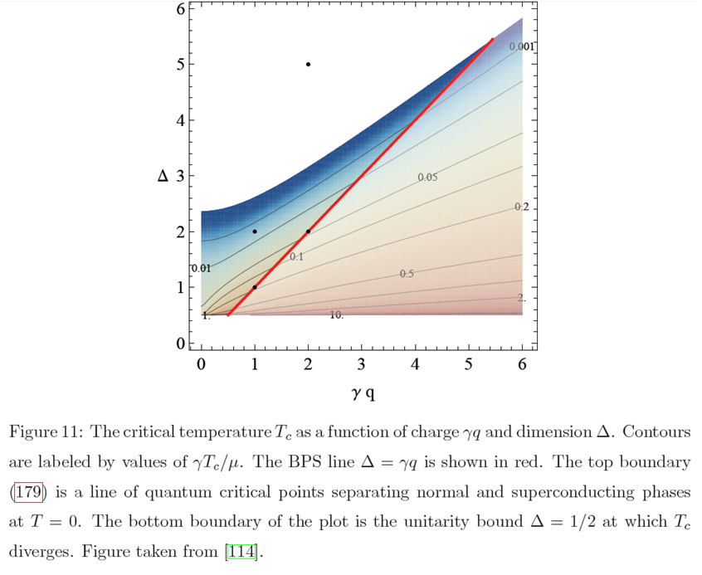
T_{c} in units of γ/μ

Slide 22
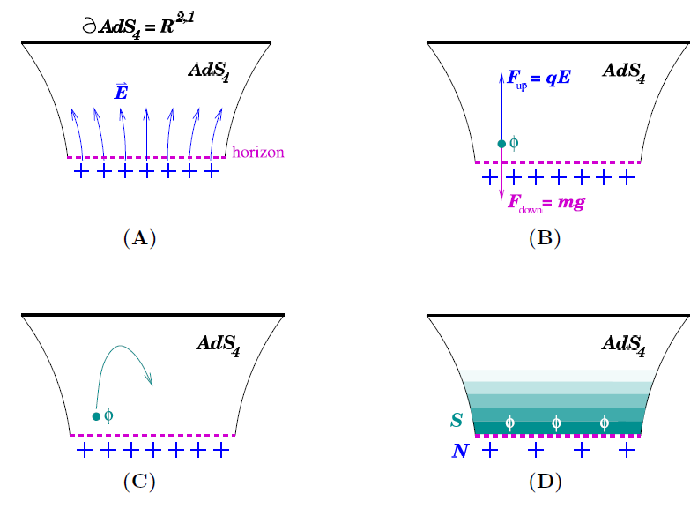
Condensate
Charged scalar condenses when surface gravity is smaller than electric field
S. Gubser, TASI lectures (2010)

Slide 23
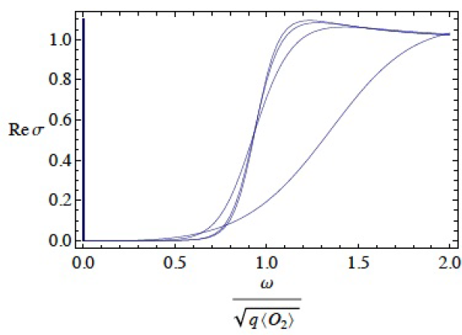
Conductivity in superconductors
Delta function at origin (again)
Due to neglecting impurities → doesn’t seem to be
Mass gap , high Tc?

Slide 24
Non-relativistic theories
Lorentz symmetry may be broken (quantum criticality):
In AdS this ammounts to deforming metric (adding vector):
Note: no string theory model exists! (maybe recently)
S. Kachru et al, Gravity Duals of Lifshitz-like Fixed Points (2008)
Notes:
Z=2 is particularly interesting (multicritical points in magnetic materials, liquid cristals)

Slide 25
Other applications
(Fractional) Quantum Hall Effect
Chern-Simons gauge theory, topology etc.
Holographic neutron stars
Rather different: star has gravity (is in AdS)
Quantum phase transition in fermi liquid
Fermion sign problem: try calculate in AdS
Navier-Stokes equations
Study turbulence (strongly coupled liquid)

Slide 26
Don’t exaggerate
Gauge/gravity cannot be used for specific theories
Some experimental confirmation
(but graphene example was best I could find)
However, easy tool to study qualitative features of strong coupling
Notes:
But probably there are good general reasons that the preferred way of understanding a strongly coupled field theory as a gavitational theory as well as many indications that this approach works.

Slide 27
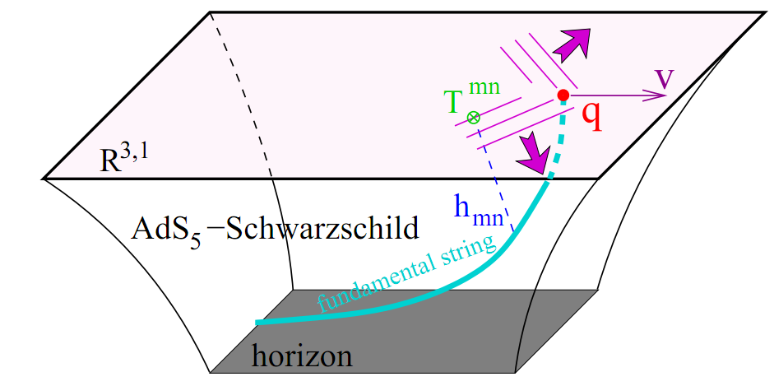
Drag force in QGP
One of easiest examples: e.o.m. of string near BH
One of only explanations of ‘jet quenching’ time

Slide 28
Heavy Ion Collisions
High energy → Gravity may dominate
In some sense simple: N=4 SYM ~ QCD
(at least in deconfined phase)
Thermalization is interesting question
Black hole formation!
Entropy is experimental variable → black hole entropy?
G. ’t Hooft, Graviton dominance in ultra-high-energy scattering (1987)

