Slide 1
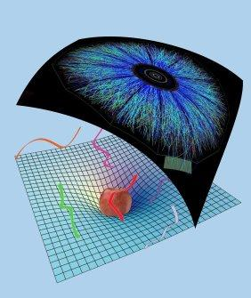
Strong coupling isotropization simplified
Why linearized Einstein’s equations may be enough
Wilke van der Schee
Work with Michał Heller, David Mateos and Diego Trancanelli, 1202.0981
Universitat de Barcelona,
March 22, 2012

Slide 2
Outline
Motivation: heavy ion collisions
QCD dual very far away, but encouraging results
Simple set-up for anisotropy
Full & linearized calculation
Pictures/conclusions/outlook
Notes:
Many states + linearized

Slide 3
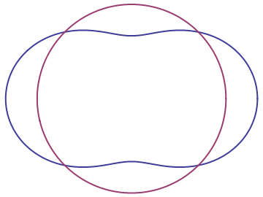
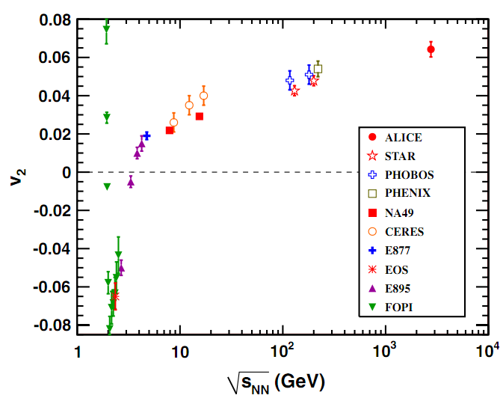
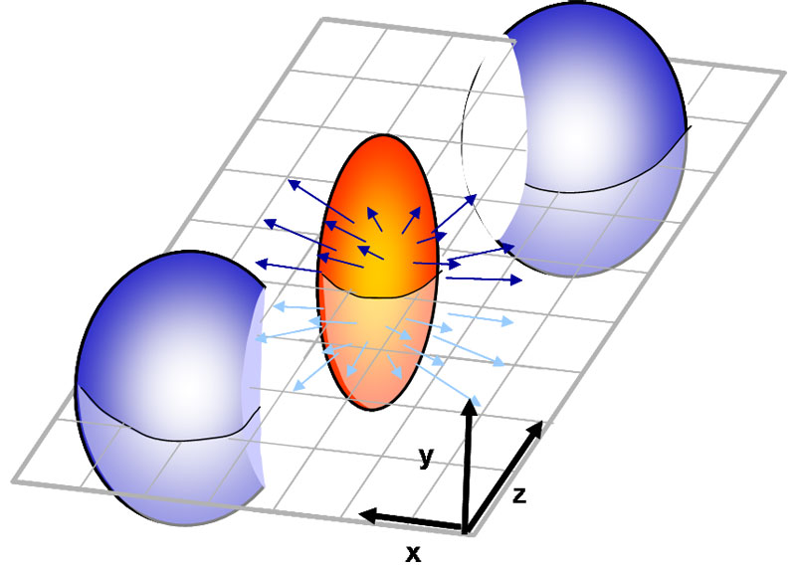
Elliptic flow: v₂
How anisotropic is the final state?
Ideal gas/weak coupling
Perfect fluid/strong coupling
K. Aamodt et al, Elliptic Flow of Charged Particles in Pb-Pb Collisions at √s_{NN}=2.76 TeV (2010)

Slide 4
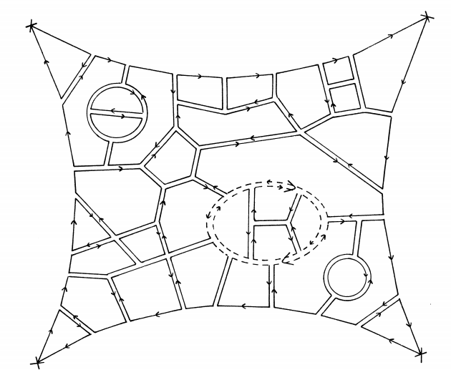
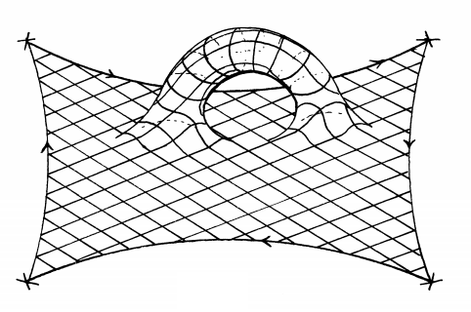
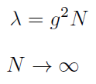
Large N gauge theories
At strong coupling we can get GR
Planar limit:
fixed
G. ’t Hooft, A planar diagram theory for strong interactions (1974)

Slide 5
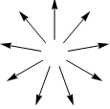
Holographic context
Simplest set-up:
Pure gravity in AdS₅
Background field theory is flat
Translational- and SO(2)-invariant field theory
We keep anisotropy:
Caveat: energy density is constant so final state is known
P.M. Chesler and L.G. Yaffe, Horizon formation and far-from-equilibrium isotropization in supersymmetric Yang-Mills plasma (2008)

Slide 6
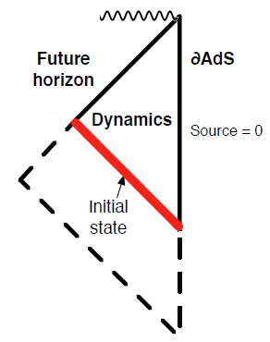
The geometry
Symmetry allows metric to be:
A, B, Σ are functions of r and t
B measures anisotropy
Einstein’s equations simplify
Null coordinates
Attractive nature of horizon
Key differences with Chesler, Yaffe (2008) are
Flat boundary
Initial non-vacuum state
Notes:
Opposed to Chesler Yaffe approach

Slide 7
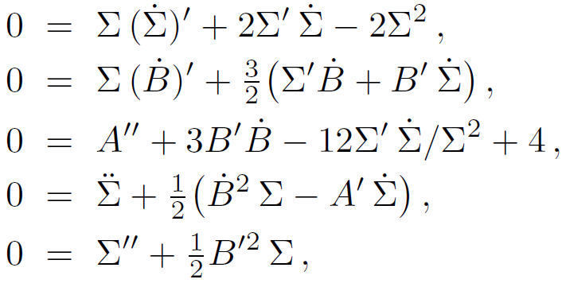
Full evolution
The Einstein equations are particularly simple
Take derivatives along null directions:
Nested set of linear ordinary differential equations
Take , obtain and respectively
Try to keep event horizon on grid
H. Bondi, Gravitational Waves in General Relativity (1960)
P.M. Chesler and L.G. Yaffe, Horizon formation and far-from-equilibrium isotropization in supersymmetric Yang-Mills plasma (2008)

Slide 8
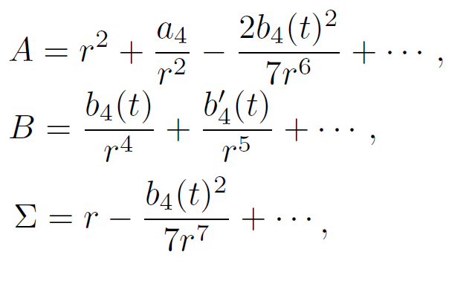
Boundary conditions
AdS requires boundary conditions:
Non-normalizable: metric field theory
Normalizable: stress-energy tensor
Implies asymptotic behaviour metric:
AdS/CFT
Notes:
Important energy is constant (due to homogeneity)

Slide 9
The close-limit approximation
Early work of BH mergers in flat space
Suggests perturbations of an horizon are always small
→ Linearize evolution around final state (planar-AdS-Schw):
Evolution determined by single LDE:
R. H. Price and J. Pullin, Colliding black holes: The Close limit (1994)

Slide 10
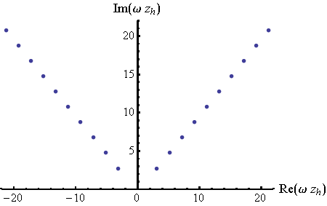
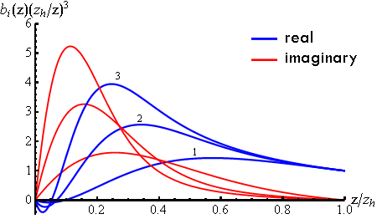
Quasi-normal mode expansion
Expansion:
Solution possible for discrete
Imaginary part always positive
G.T. Horowitz and V.E. Hubeny, Quasinormal Modes of AdS Black Holes and the Approach to Thermal Equilibrium(1999)
J. Friess, S. Gubser, G. Michalogiorgakis, and S. Pufu, Expanding plasmas and quasinormal modes of anti-de Sitter black holes (2006)

Slide 11
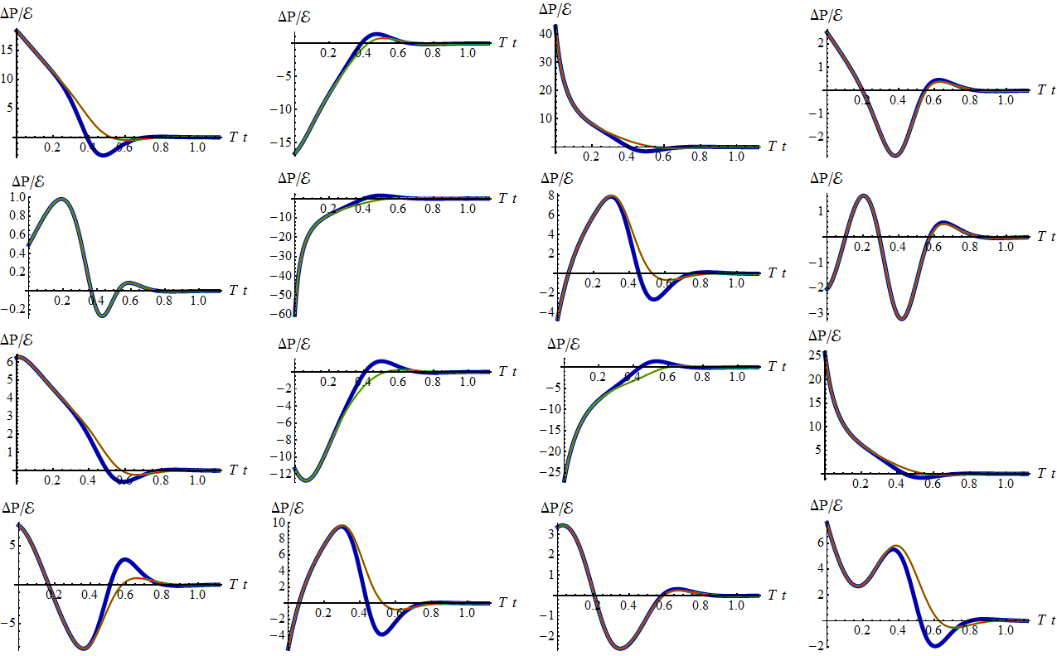
First results (Full/Linearized/QNM)
Notes:
Note the QNM-expansion, only 10 complex numbers! Note: initial agreement very unexpected.

Slide 12
Initial states
Wide range of initial states
Random: ratio 10th order polynomials, minus subtraction
Near boundary (UV), middle, near horizon (IR)
Wiggly ones, combinations
Thermalized: dynamics ≈ hydrodynamics
Homogeneous → no flow → no anisotropy
Our criterion:

Slide 13
A subtlety: B_{max}
Try to get state “maximally” far from equilibrium
and implies curvature singularity!
Should be behind event horizon (physically/numerically)
We tried:
Start with some B, with B not too big
Multiply B with 1.1, stop if numerics are unstable
In practice: (where z_{h}=1)
In this way we can get low initial entropies!
NB: no limit on (anisotropy), but needs to be in UV

Slide 14
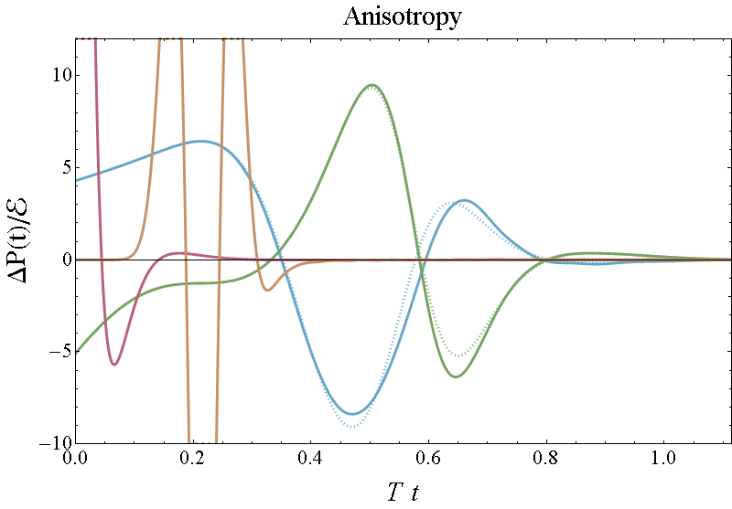
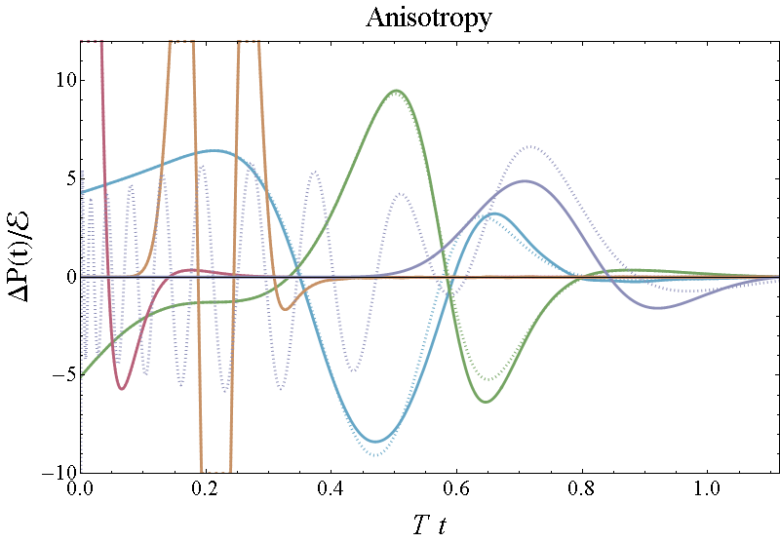
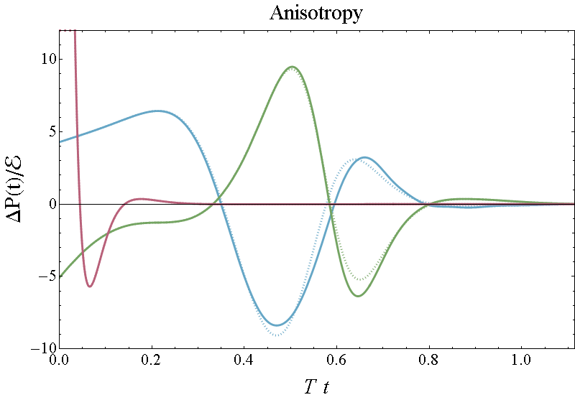
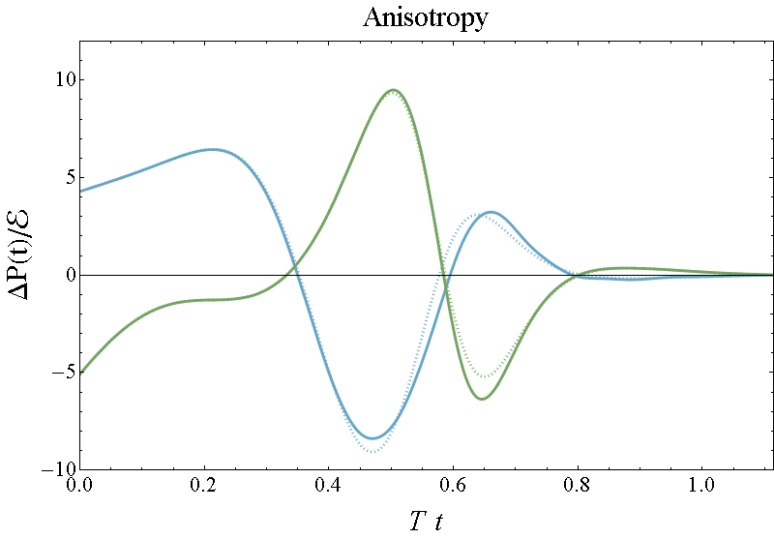
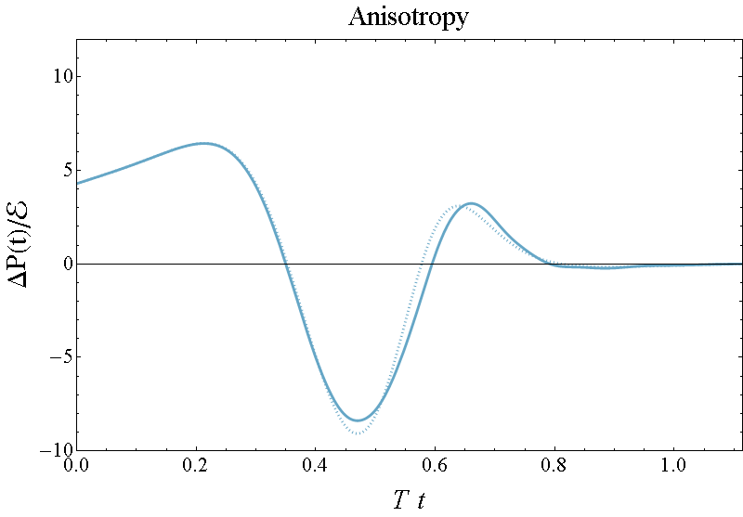
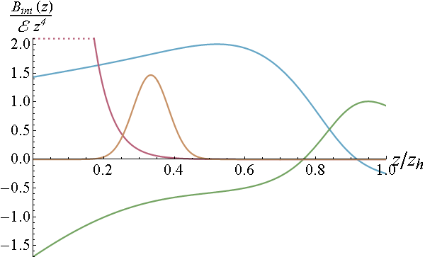
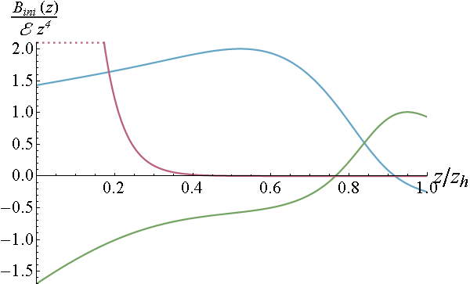
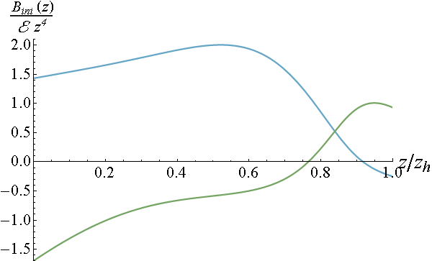
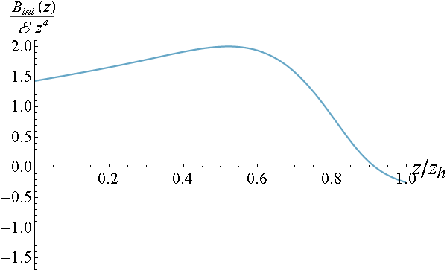
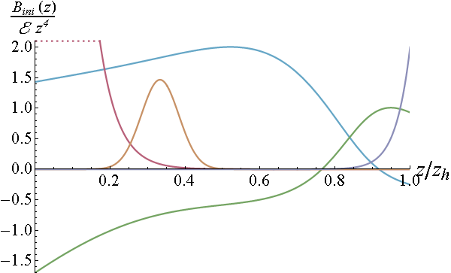
Anisotropy
Linearized approximation works very well! (dashed)
Last one with QNM
Profiles located in IR (near horizon) thermalize later
M. Heller, R. Janik and P. Witaszczyk, The characteristics of thermalization of boost-invariant plasma from holography (2011)

Slide 15
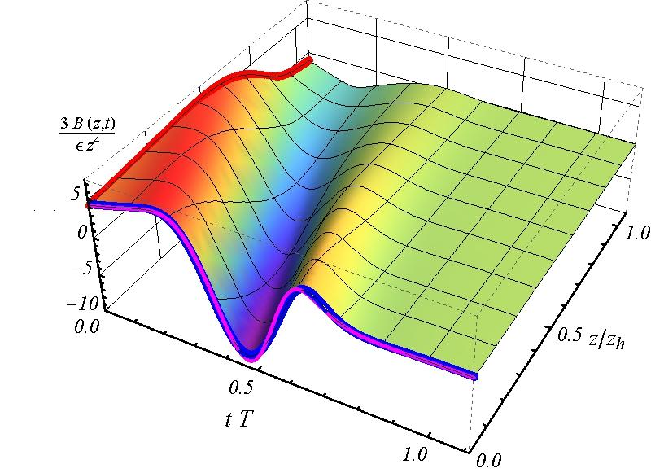
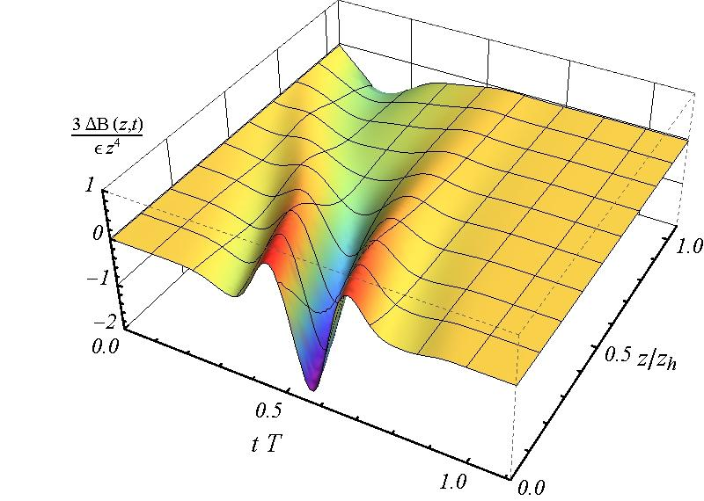
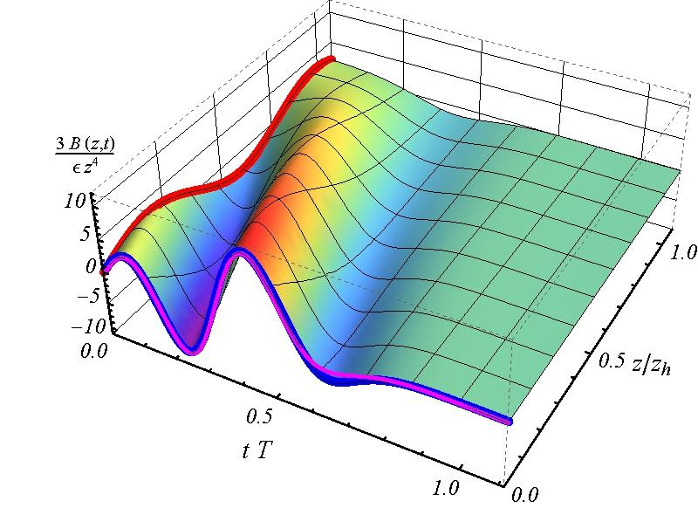
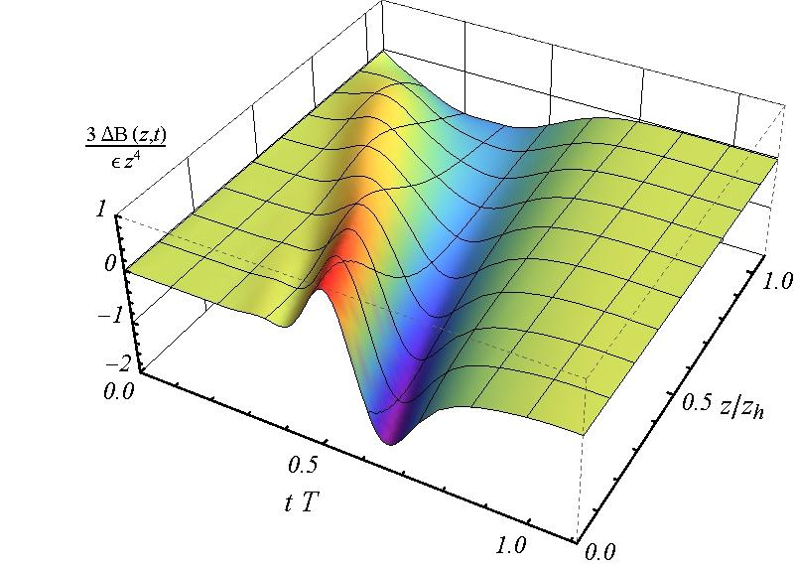
B(z, t) and the linearized error

Slide 16
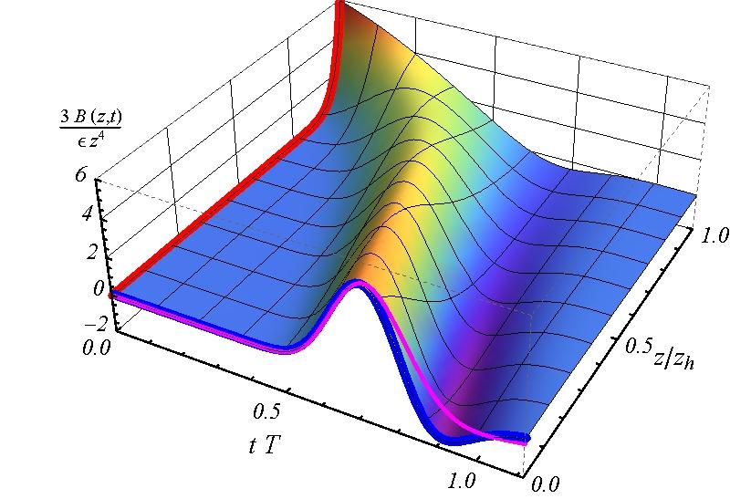
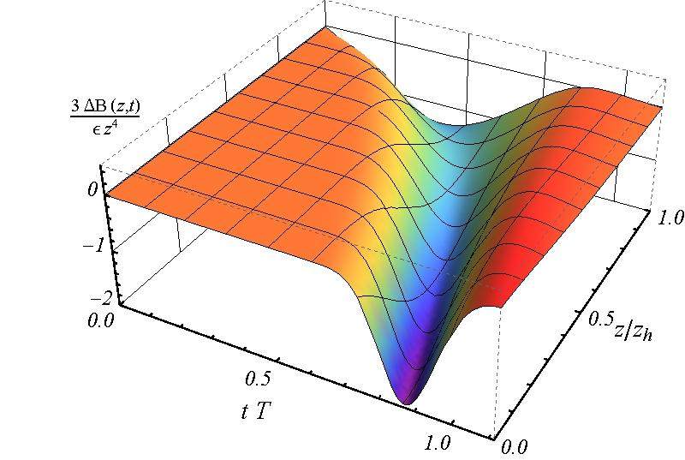
B(z, t) and the linearized error
Extreme IR example:

Slide 17
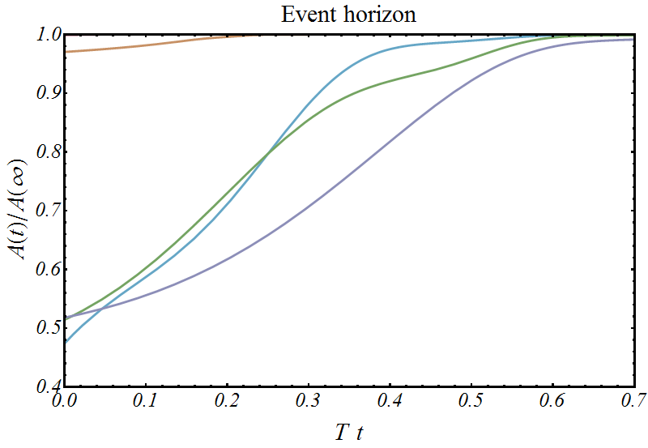
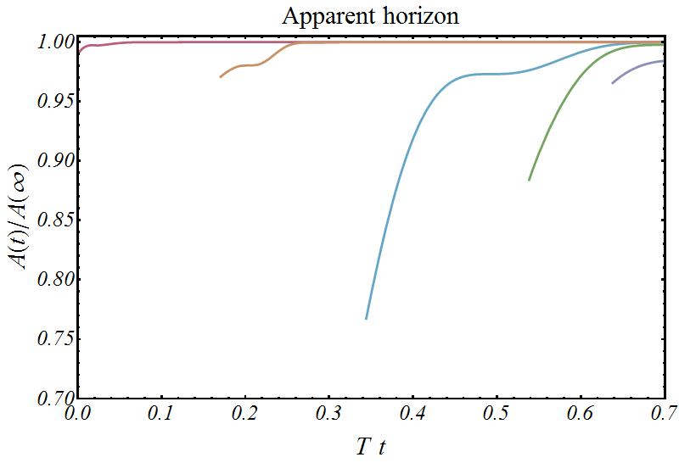
Area horizons
“Entropy” rises quickly
Not always an apparent horizon; always inside event horizon

Slide 18
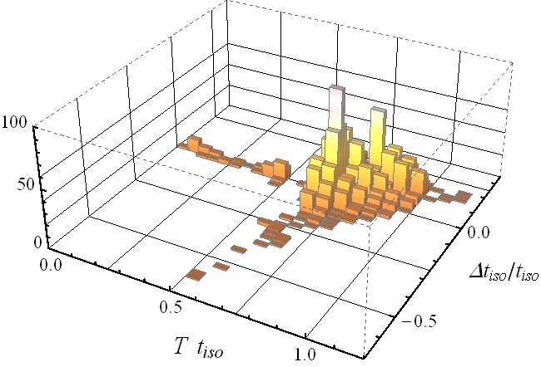
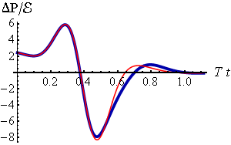
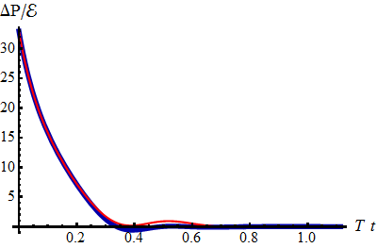
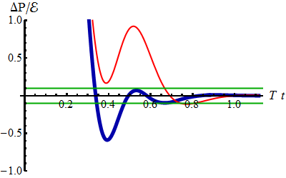
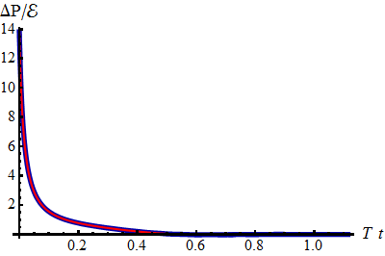
Statistics of 2000 profiles
Notes:
Thermalization time is (usually!) very fast:
Linear approximation always accurate within “20%”

Slide 19
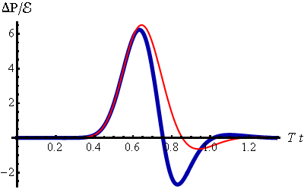
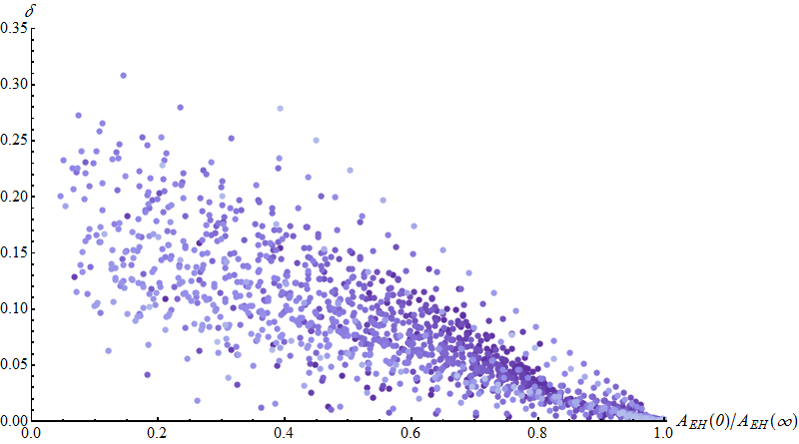
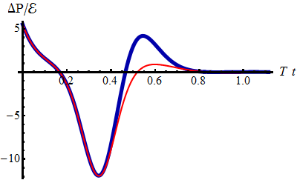
Statistics of 2000 profiles
An accuracy measure (angle in L²-space):
Notes:
Note correlation with “entropy production”. Actually correlation with Bmax is much better.

Slide 20
Connection with heavy ions
Hard to say:
Homogeneous system → no flow
Pure gravity only provides toy model
But encouraging results:
Linearized approximation works excellent for normal
Initial profile is expected near the boundary (UV)
Maybe it works well in more realistic cases? (in progress!)

Slide 21
Conclusion
Studied (fast!) isotropization for over 2000 states
UV anisotropy can be large, but thermalizes fast
Linearized approximation works unexpectedly well
Works even better for UV profiles
Caveats:
Homogeneous system, final state already known
No hydrodynamic modes
Future directions: higher order, boost-invariant flow, shockwave collisions, non-local observables

Slide 22
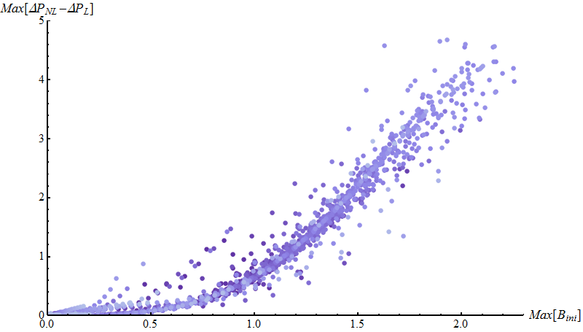
Better correlation
The maximum of B and the maximum of ΔP_{NL}-ΔP_{L}

