Slide 1
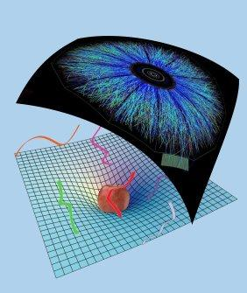
Holographic Thermalisation with Radial Flow
Black hole formation and numerics
Work with Michał Heller, David Mateos, Michał Spalinski, Diego Trancanelli and Miquel Triana
References: 1202.0981 (PRL 108) and 1211.2218
Wilke van der Schee
Supervisors: Gleb Arutyunov, Thomas Peitzmann,
Koenraad Schalm and Raimond Snellings
Instituto de Física Teórica UAM/CSIC, Madrid
December 3, 2012

Slide 2
Outline
Motivation: heavy ion collisions
QCD dual very far away, but encouraging results
Simple homogeneous set-up for anisotropy
Full & linearised calculation
Little harder: boost-invariant radial flow
Radial expansion & fluctuation
Notes:
Many states + linearized

Slide 3
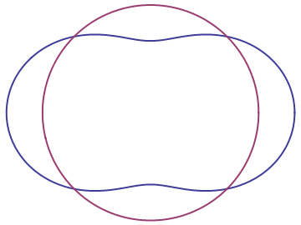
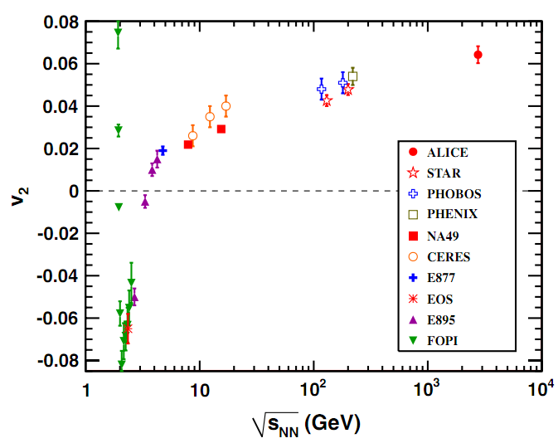
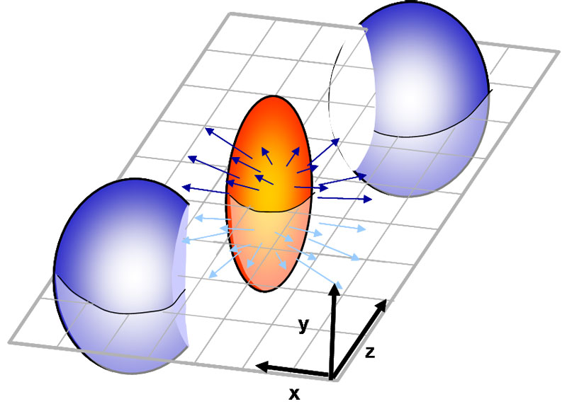
Elliptic flow: v₂
How anisotropic is the final state?
Ideal gas/weak coupling
Perfect fluid/strong coupling
K. Aamodt et al, Elliptic Flow of Charged Particles in Pb-Pb Collisions at √s_{NN}=2.76 TeV (2010)

Slide 4
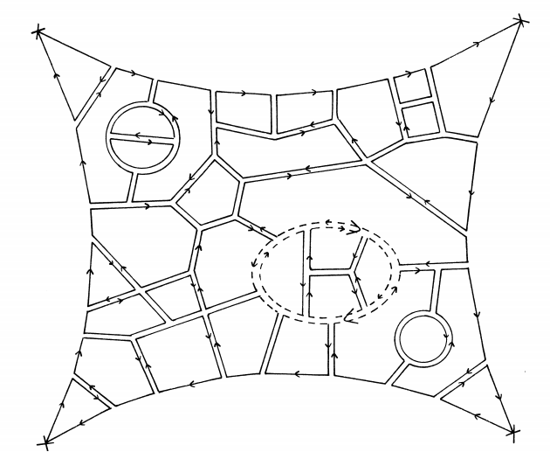
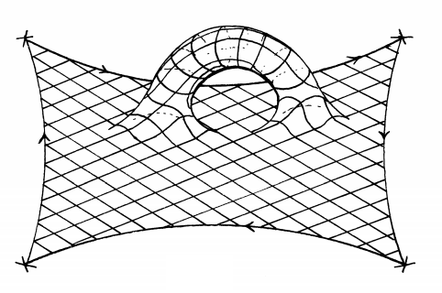
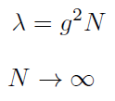
Large N gauge theories
At strong coupling we can get GR
Planar limit:
fixed
G. ’t Hooft, A planar diagram theory for strong interactions (1974)

Slide 5
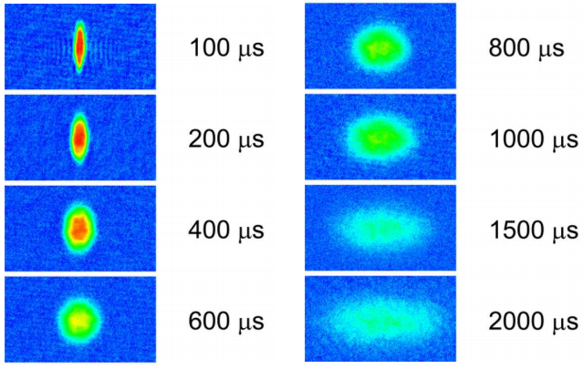
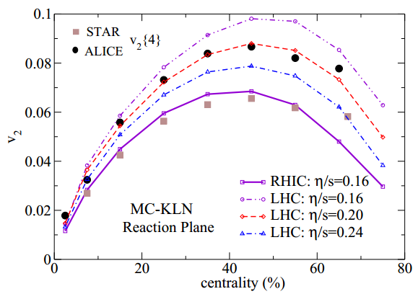
The most perfect liquid?
Famous viscosity:
Fermions at unitarity Quark-gluon plasma
K. O'Hara, S. Hemmer, M. Gehm, S. Granade and J. Thomas, Observation of a Strongly-Interacting Degenerate Fermi Gas of Atoms, 2002
U. Heinz, C. Shen and H. Song, The Viscosity of Quark-Gluon Plasma at RHIC and the LHC, 2011

Slide 6
Holographic isotropisation
Simplest set-up:
Pure gravity in AdS₅
Background field theory is flat
Translational- and SO(2)-invariant field theory
We keep anisotropy:
Caveat: energy density is constant so final state is known
P.M. Chesler and L.G. Yaffe, Horizon formation and far-from-equilibrium isotropization in supersymmetric Yang-Mills plasma (2008)

Slide 7
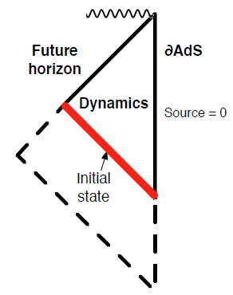
The geometry
Symmetry allows metric to be:
A, B, Σ are functions of r and t
B measures anisotropy
Einstein’s equations simplify
Null coordinates
Attractive nature of horizon
Key differences with Chesler, Yaffe (2008) are
Flat boundary
Initial non-vacuum state
Notes:
Opposed to Chesler Yaffe approach

Slide 8
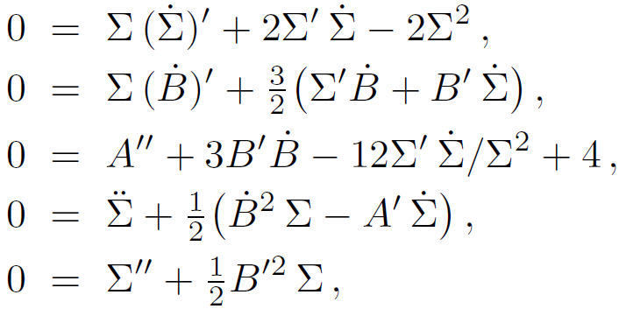
Full evolution
The Einstein equations are particularly simple
Take derivatives along null directions:
Nested set of linear ordinary differential equations
Take , obtain and respectively
P.M. Chesler and L.G. Yaffe, Horizon formation and far-from-equilibrium isotropization in supersymmetric Yang-Mills plasma (2008)

Slide 9
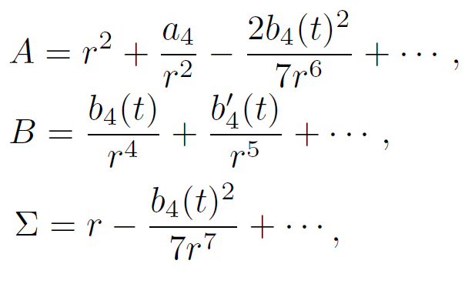
Boundary conditions
AdS requires boundary conditions:
Non-normalisable: metric field theory
Normalisable: stress-energy tensor
Implies asymptotic behaviour metric:
AdS/CFT
Notes:
Important energy is constant (due to homogeneity)

Slide 10
Hints on technicalities
Solve equations spectrally (Chebyshev etc…)
Each LDE = inverting 26x26 matrix
Accurate time-stepping & 10.000 steps
Functions diverge at boundary
Subtract divergencies analytically
Keep event horizon on the grid, but no more
Try tracing apparent horizon (can be tricky)
J. P. Boyd, Chebyshev and Fourier Spectral Methods (2000)

Slide 11
The close-limit approximation
Early work of BH mergers in flat space
Suggests perturbations of a horizon are always small
→ Linearise evolution around final state (planar-AdS-Schw):
Evolution determined by single LDE:
R. H. Price and J. Pullin, Colliding black holes: The Close limit (1994)

Slide 12
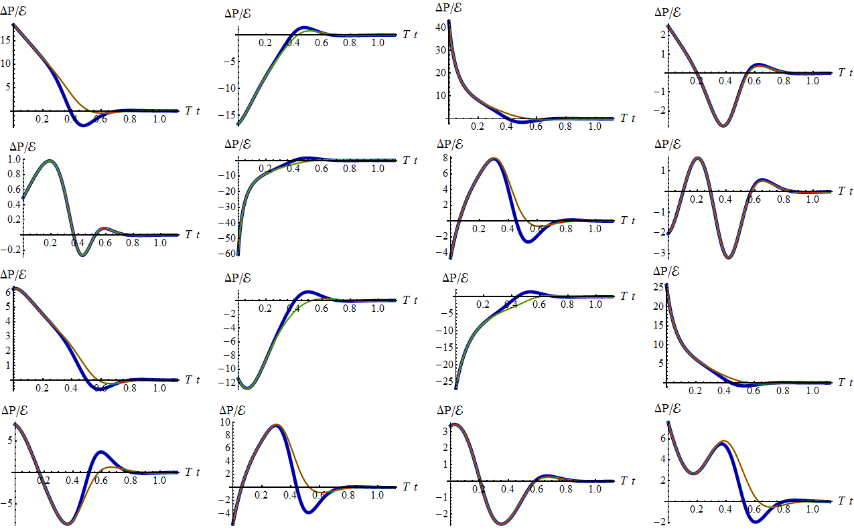
First results (Full/Linearised/QNM)
Notes:
Note the QNM-expansion, only 10 complex numbers! Note: initial agreement very unexpected.

Slide 13
A subtlety: B_{max}
Try to get state “maximally” far from equilibrium
We tried:
Start with some B, with B not too big
Multiply B with 1.1, stop if numerics are unstable
In practice:
In this way we can get low initial horizon areas!
NB: no limit on (anisotropy), but needs to be in UV

Slide 14
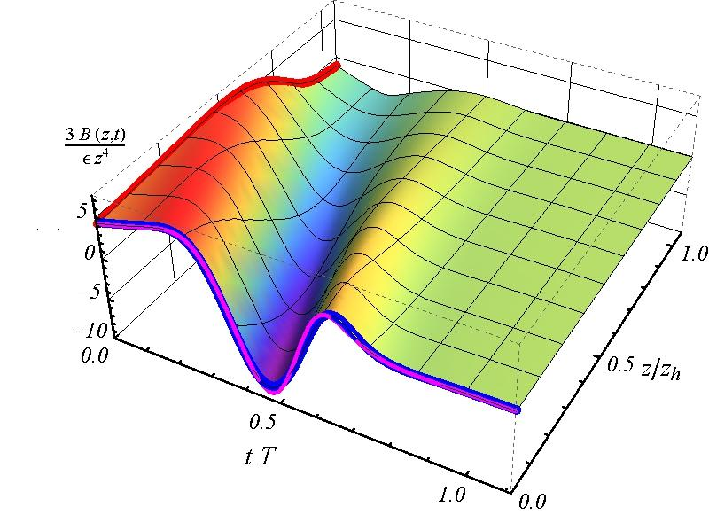
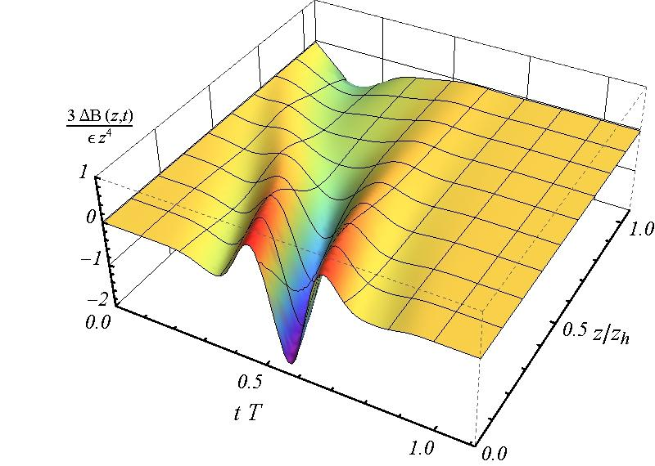
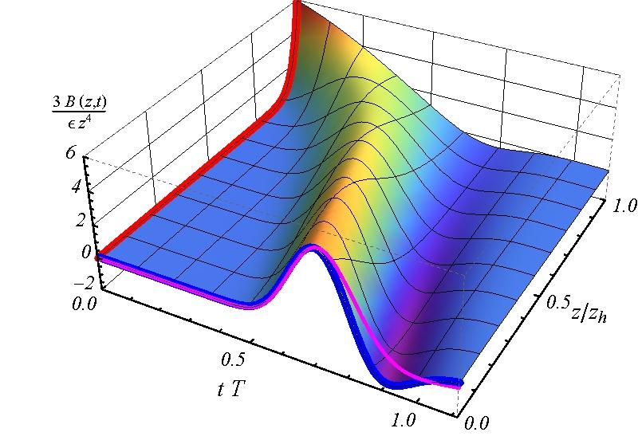
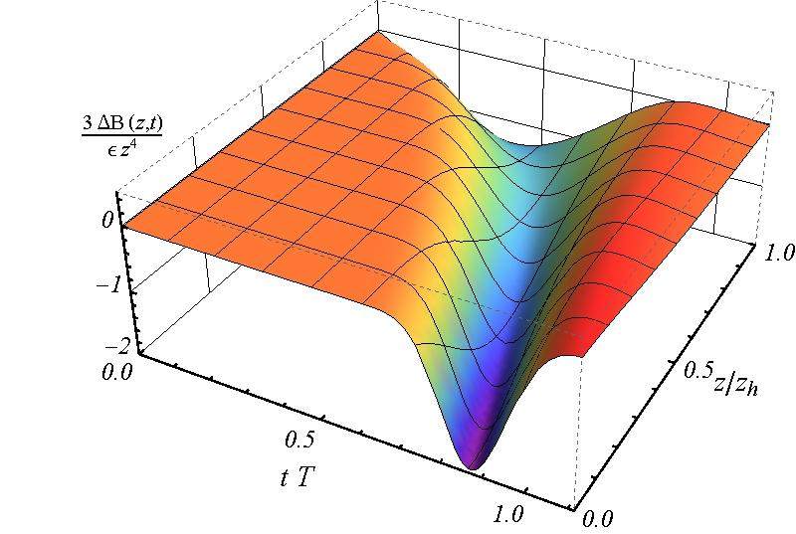
B(z, t) and the linearised error

Slide 15
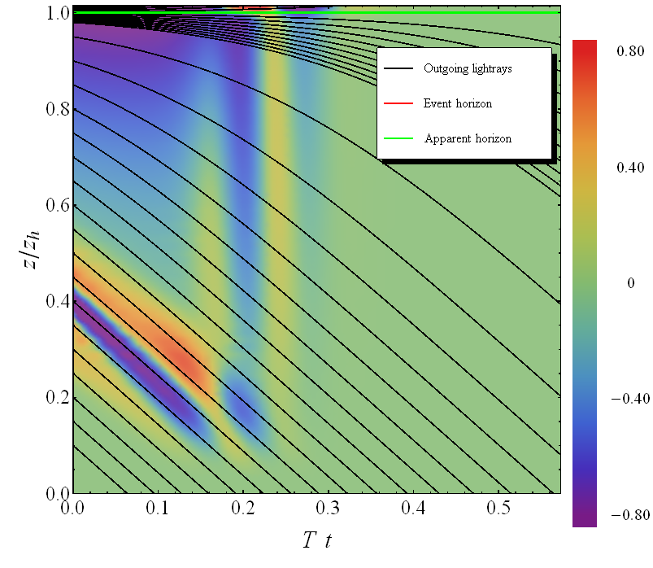
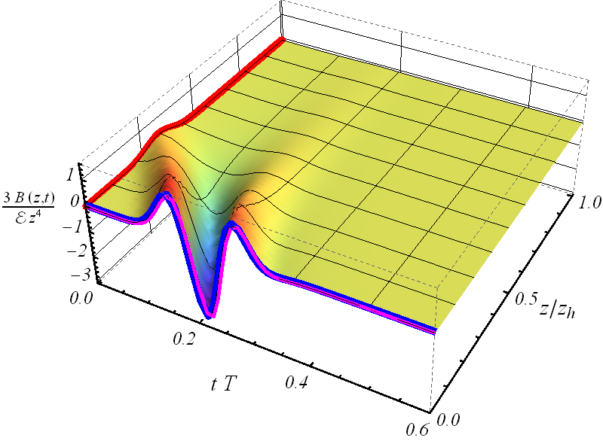
Bouncing off the boundary

Slide 16
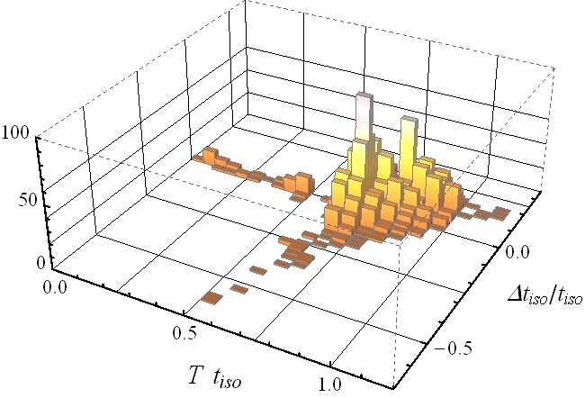
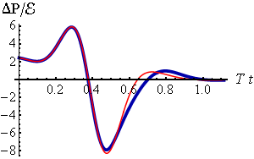
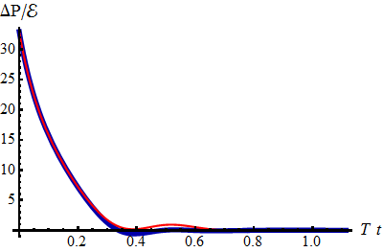
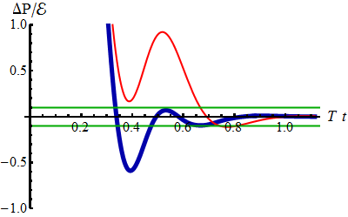
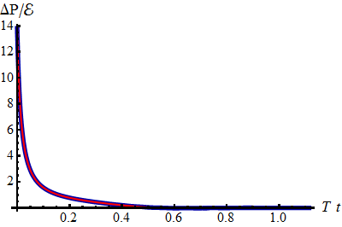
Statistics of 2000 profiles
Notes:
NOTE: thermalization defined as hydro works
Thermalization time is (usually!) very fast:
Linear approximation always accurate within “20%”

Slide 17
Recent additions
Same linearised calculations with a boost-invariant direction
Subtlety: final state is not known initially
Add-on: non-homogeneous and includes hydrodynamics
Works well ☺
Second till fifth order corrections
The expansion seems to converge
Works well ☺

Slide 18
Radial flow
Calculation incorporating longitudinal and radial expansion
Numerical scheme very similar to colliding shock waves:
Assume boost-invariance on collision axis
Assume rotational symmetry (central collision)
→ 2+1D nested Einstein equations in AdS
P.M. Chesler and L.G. Yaffe, Holography and colliding gravitational shock waves in asymptotically AdS₅ spacetime (2010)
Notes:
Pressure in transverse plane is not the same

Slide 19
Radial flow – technicalities
Use Chebyshev twice (but transform: )
Add regulator energy density (~3%)
Avoid having to solve all the way to Poincare horizon
Avoid caustics, have a planar horizon
Interpret boundary conditions naturally
Avoid imposing conditions in ρ-direction by hand

Slide 20
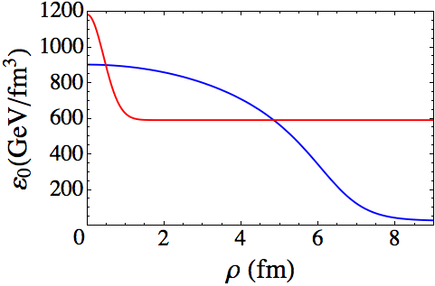
Radial flow – initial conditions
Two scales: energy density and size nucleus
Energy density is from Glauber model (~Gaussian)
No momentum flow (start at τ ~ 0.1fm/c)
Scale solution such that
Metric functions ~ vacuum AdS (can try other things!)
H. Niemi, G.S. Denicol, P. Huovinen, E. Molnár and D.H. Rischke, Inﬂuence of the shear viscosity of the quark-gluon plasma on elliptic ﬂow (2011)

Slide 21
Radial flow – results
WS, Holographic thermalization with radial flow (2012)

Slide 22
Radial flow – results

Slide 23
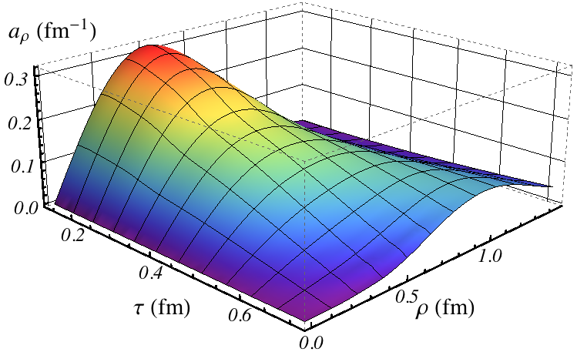
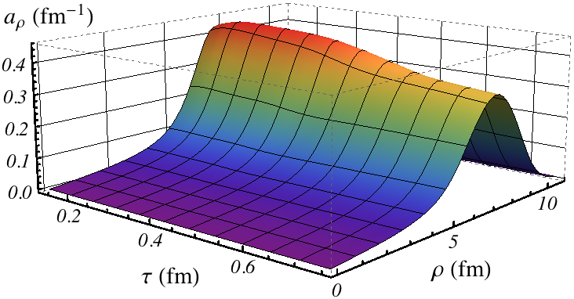
Radial flow – acceleration
Velocity increases rapidly:
Fluctuation spreads out, nucleus keeps accelerating

Slide 24
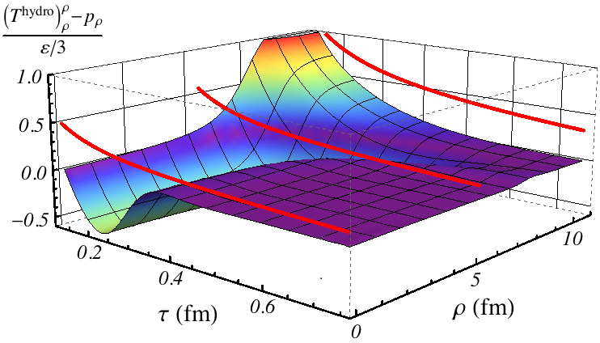
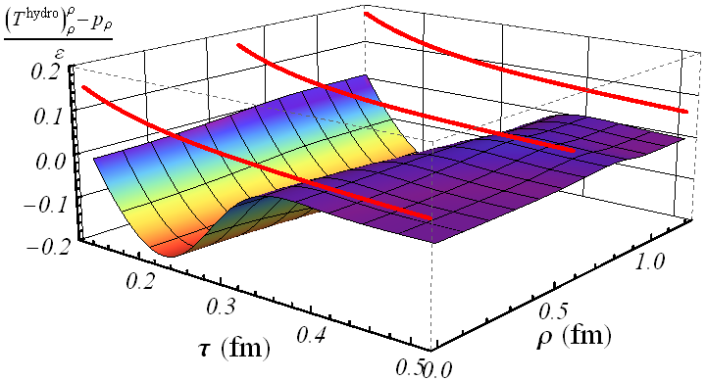
Radial flow – hydrodynamics
Thermalisation is quick, but viscosity contributes

Slide 25
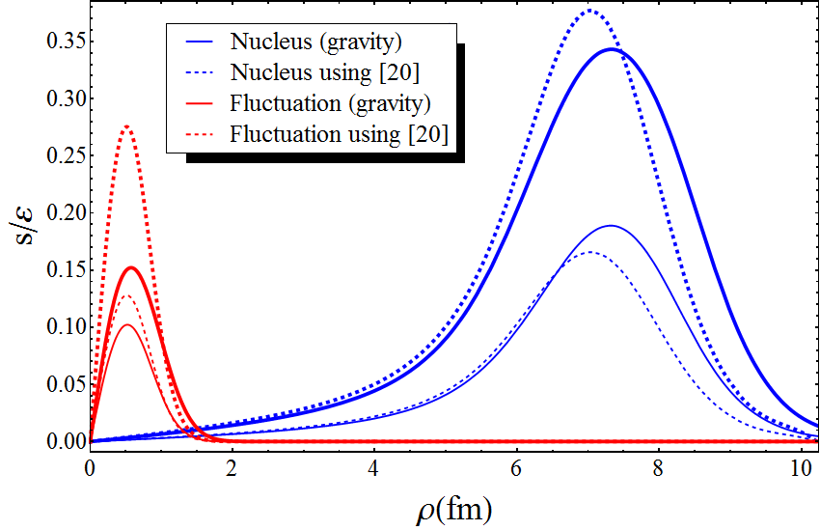
Radial flow – a comparison
Gives AdS/CFT comparison to i.e. Vredevoogd and Pratt:
So have a local formula for velocity at some time
Works especially well at larger scales
s: flux in stress tensor
ε: energy density
ε₀: initial energy density
J. Vredevoogd, S. Pratt, Universal Flow in the First Stage of Relativistic Heavy Ion Collisions (2008)

Slide 26
Discussion
Studied (fast!) isotropisation for over 2000 states
UV anisotropy can be large, but thermalises fast
Linearised approximation works unexpectedly well
Numerical scheme provides excellent basis
Radial flow, fluctuations, elliptic flow
Looks like velocity is determined locally
Initial state for radial flow is slightly ad-hoc
What happens universally?
Various problems: very strong coupling, susy, large N etc…

