Slide 1
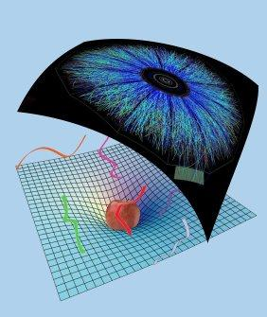
Collisions in AdS and holographic thermalisation
Towards more realistic models of the QGP thermalisation
Work with Michał Heller, David Mateos, Michał Spalinski, Diego Trancanelli and Miquel Triana
References: 1202.0981 (PRL 108), 1211.2218 (PRD) and 1303.xxxx
Wilke van der Schee
Supervisors: Gleb Arutyunov, Thomas Peitzmann,
Koenraad Schalm and Raimond Snellings
Lunch seminar, Stonybrook
March 1, 2013

Slide 2
Outline
Wilke van der Schee, Utrecht
Motivation: heavy ion collisions
QCD dual very far away, but encouraging results
Simple homogeneous set-up for anisotropy
Linearised calculation works very well
Little harder: boost-invariant radial flow
Radial expansion & fluctuation
New results on shock waves
Notes:
Many states + linearized

Slide 3
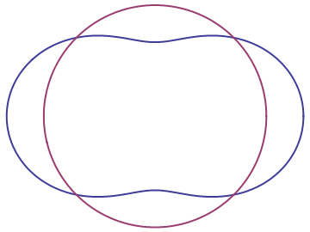
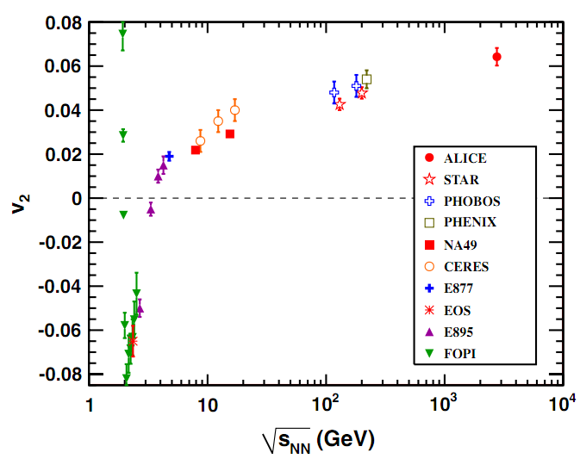
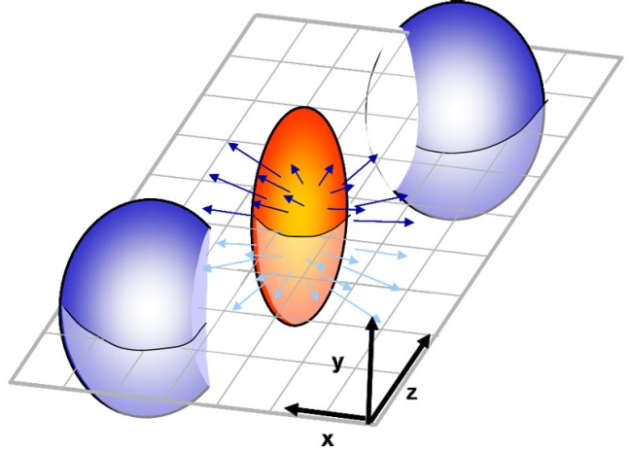
Elliptic flow: v₂, QGP is interesting
Wilke van der Schee, Utrecht
How anisotropic is the final state?
Ideal gas/weak coupling
Perfect fluid/strong coupling
K. Aamodt et al, Elliptic Flow of Charged Particles in Pb-Pb Collisions at √s_{NN}=2.76 TeV (2010)

Slide 4
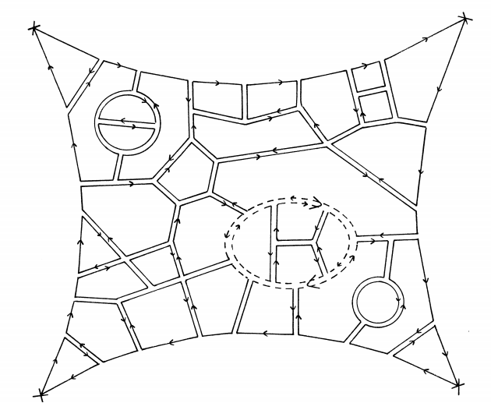
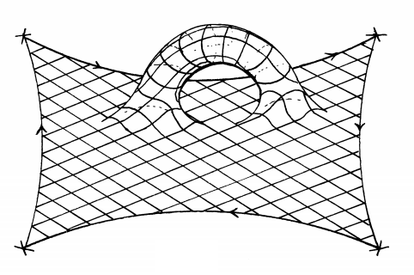
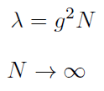
Large N gauge theories
Wilke van der Schee, Utrecht
At strong coupling we can get GR
Planar limit:
fixed
G. ’t Hooft, A planar diagram theory for strong interactions (1974)

Slide 5
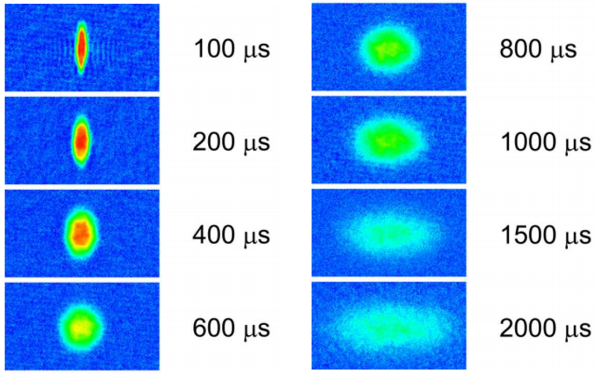
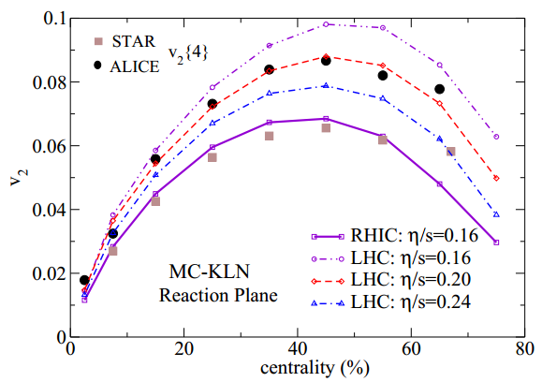
The most perfect liquid?
Wilke van der Schee, Utrecht
Famous viscosity:
Fermions at unitarity Quark-gluon plasma
K. O'Hara, S. Hemmer, M. Gehm, S. Granade and J. Thomas, Observation of a Strongly-Interacting Degenerate Fermi Gas of Atoms, 2002
U. Heinz, C. Shen and H. Song, The Viscosity of Quark-Gluon Plasma at RHIC and the LHC, 2011

Slide 6
Holographic isotropisation
Wilke van der Schee, Utrecht
Simplest set-up:
Pure gravity in AdS₅
Background field theory is flat
Translational- and SO(2)-invariant field theory
We keep anisotropy:
Caveat: energy density is constant so final state is known
P.M. Chesler and L.G. Yaffe, Horizon formation and far-from-equilibrium isotropization in supersymmetric Yang-Mills plasma (2008)

Slide 7
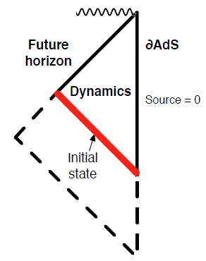
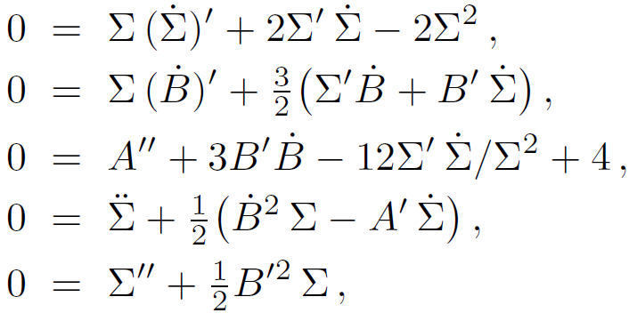
The geometry + evolution
Wilke van der Schee, Utrecht
Symmetry allows metric to be:
The Einstein equations are a linear nested set:
P.M. Chesler and L.G. Yaffe, Horizon formation and far-from-equilibrium isotropization in supersymmetric Yang-Mills plasma (2008)

Slide 8
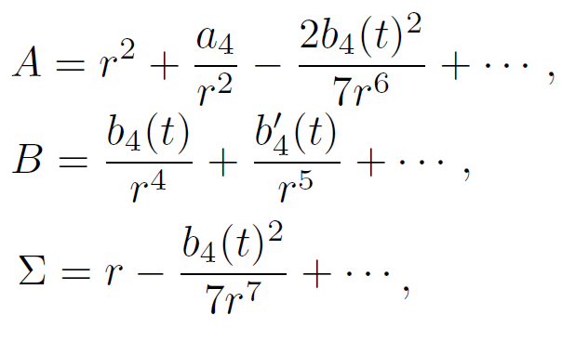
Boundary conditions
Wilke van der Schee, Utrecht
AdS requires boundary conditions:
Non-normalisable: metric field theory
Normalisable: stress-energy tensor
Implies asymptotic behaviour metric:
AdS/CFT
Notes:
Important energy is constant (due to homogeneity)

Slide 9
Hints on technicalities
Wilke van der Schee, Utrecht
Solve equations spectrally (Chebyshev etc…)
Each LDE = inverting 26x26 matrix
Accurate time-stepping & 10.000 steps
Functions diverge at boundary
Subtract divergencies analytically
Keep event horizon on the grid, but no more
Try tracing apparent horizon (can be tricky)
J. P. Boyd, Chebyshev and Fourier Spectral Methods (2000)

Slide 10
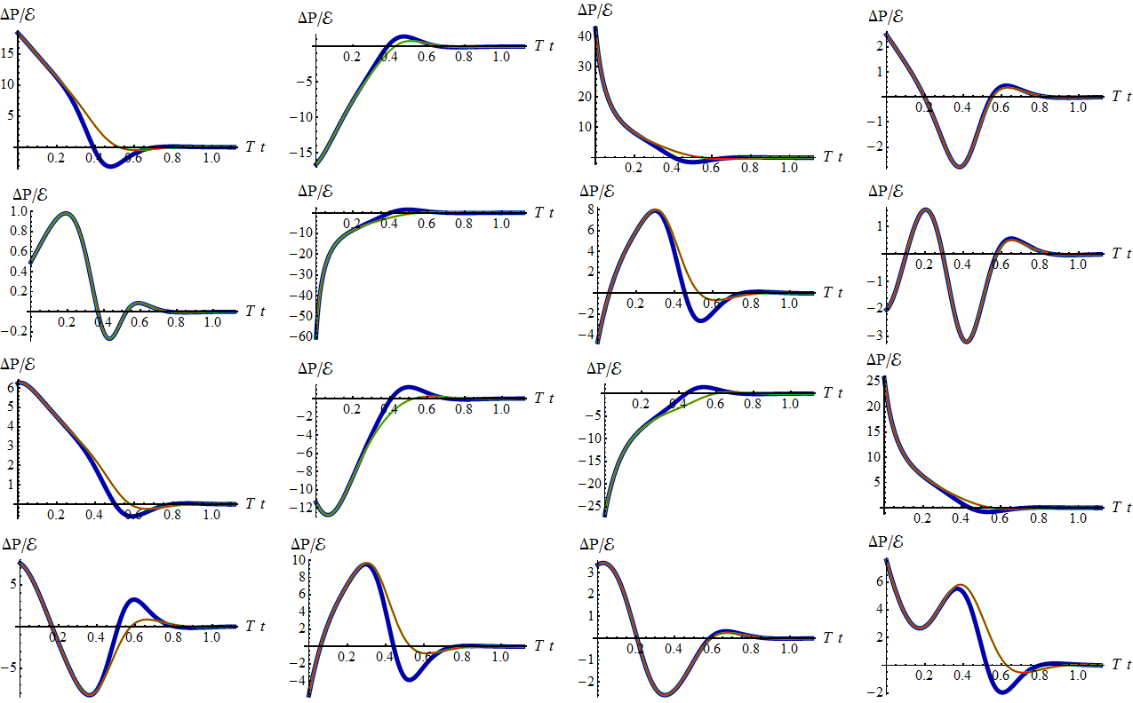
First results (Full/Linearised/QNM)
Notes:
Note the QNM-expansion, only 10 complex numbers! Note: initial agreement very unexpected.

Slide 11
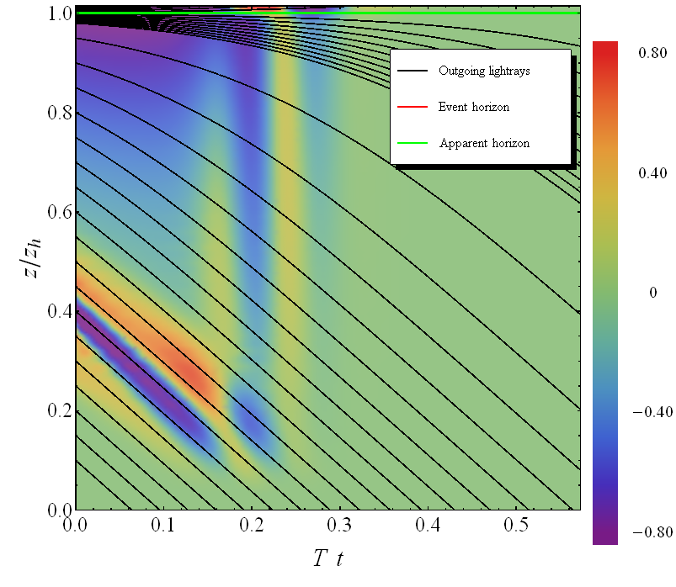
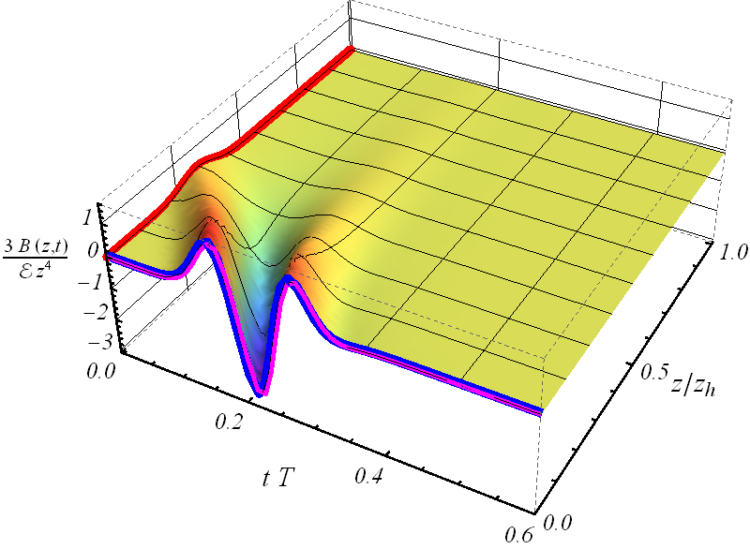
Bouncing off the boundary
Wilke van der Schee, Utrecht

Slide 12
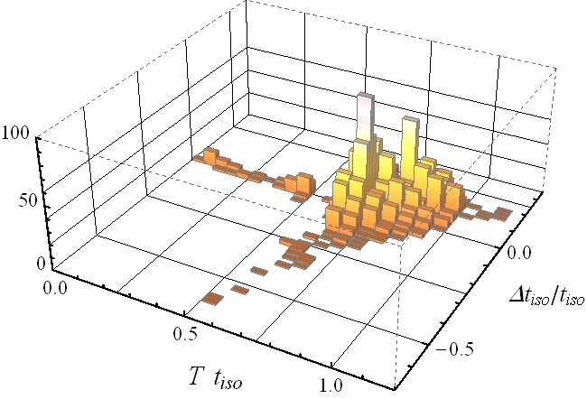
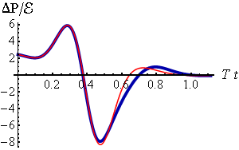
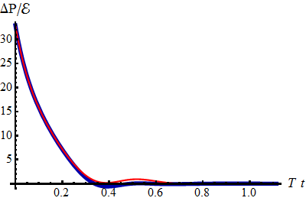
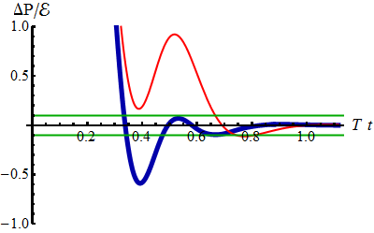
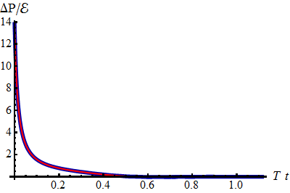
Statistics of 2000 profiles
Wilke van der Schee, Utrecht
Notes:
NOTE: thermalization defined as hydro works
Thermalization time is (usually!) very fast:
Linear approximation always accurate within “20%”

Slide 13
Recent additions
Wilke van der Schee, Utrecht
Same linearised calculations with a boost-invariant direction
Subtlety: final state is not known initially
Add-on: non-homogeneous and includes hydrodynamics
Works well ☺
Second till fifth order corrections
The expansion seems to converge, if not too large
Works well ☺

Slide 14
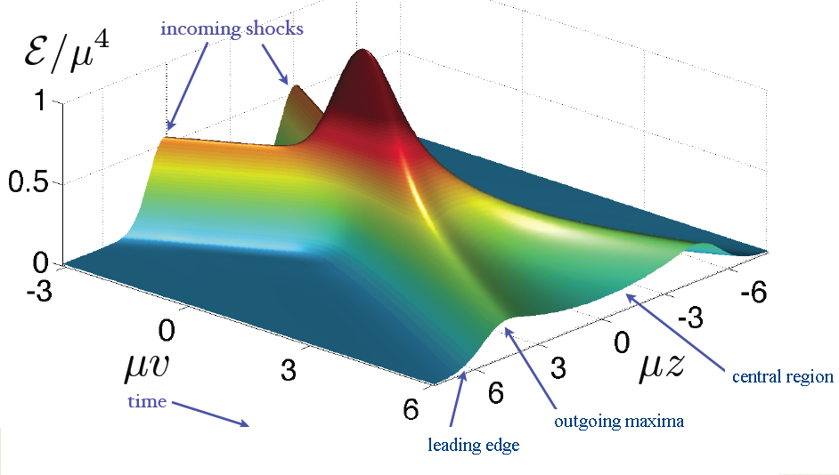
Shock waves
Wilke van der Schee, Utrecht
Famous example:
Homogeneous in transverse plane (‘infinite nucleus’)
Final energy density not boost-invariant (feature or drawback?)
P.M. Chesler and L.G. Yaffe, Holography and colliding gravitational shock waves in asymptotically AdS₅ spacetime (2010)

Slide 15
On boost-invariance
Wilke van der Schee, Utrecht
‘simple’ realistic model of expanding plasma:
R.P. Feynman, Very High-Energy Collisions of Hadrons (1969)
J.D. Bjorken, Highly relativistic nucleus-nucleus collisions: the central rapidity region (1983)
PHOBOS collaboration, New results from the PHOBOS experiment (2005)

Slide 16
Radial flow
Wilke van der Schee, Utrecht
Calculation incorporating longitudinal and radial expansion
Numerical scheme very similar to colliding shock waves:
Assume boost-invariance on collision axis
Assume rotational symmetry (central collision)
→ 2+1D nested Einstein equations in AdS
P.M. Chesler and L.G. Yaffe, Holography and colliding gravitational shock waves in asymptotically AdS₅ spacetime (2010)
Notes:
Pressure in transverse plane is not the same

Slide 17
Einstein equations in characteristic formulation
Wilke van der Schee, Utrecht
Very old trick:
Use null coordinates
Split out determinant spatial part metric
Write time derivatives along geodesics:
The real trick:
H. Bondi, Gravitational Waves in General Relativity (1960)
P.M. Chesler and L.G. Yaffe, Horizon formation and far-from-equilibrium isotropization in supersymmetric Yang-Mills plasma (2008)

Slide 18
Radial flow - einstein equations
Wilke van der Schee, Utrecht
Einstein equations:
Stress-energy tensor:
With etc
Notes:
Disclaimer: I knew what to look for from 1+1D problem.

Slide 19
Radial flow – technicalities
Wilke van der Schee, Utrecht
Use Chebyshev twice (but transform: )
Add regulator energy density (~3%)
Avoid having to solve all the way to Poincare horizon
Avoid caustics, have a planar horizon
Interpret boundary conditions naturally
Avoid imposing conditions in ρ-direction by hand

Slide 20
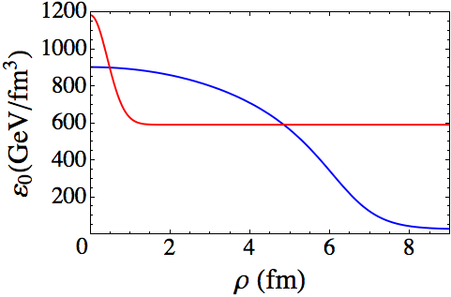
Radial flow – initial conditions
Wilke van der Schee, Utrecht
Two scales: energy density and size nucleus
Energy density is from Glauber model (~Gaussian)
No momentum flow (start at τ ~ 0.1fm/c)
Scale solution such that
Metric functions ~ vacuum AdS (can try other things!)
H. Niemi, G.S. Denicol, P. Huovinen, E. Molnár and D.H. Rischke, Inﬂuence of the shear viscosity of the quark-gluon plasma on elliptic ﬂow (2011)

Slide 21
Radial flow – results
Wilke van der Schee, Utrecht
WS, Holographic thermalization with radial flow (2012)

Slide 22
Radial flow – results
Wilke van der Schee, Utrecht

Slide 23
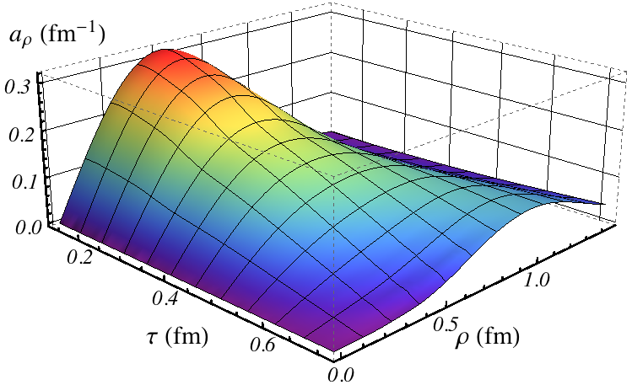
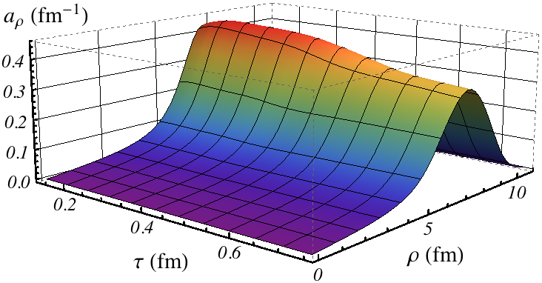
Radial flow – acceleration
Wilke van der Schee, Utrecht
Velocity increases rapidly:
Fluctuation spreads out, nucleus keeps accelerating

Slide 24
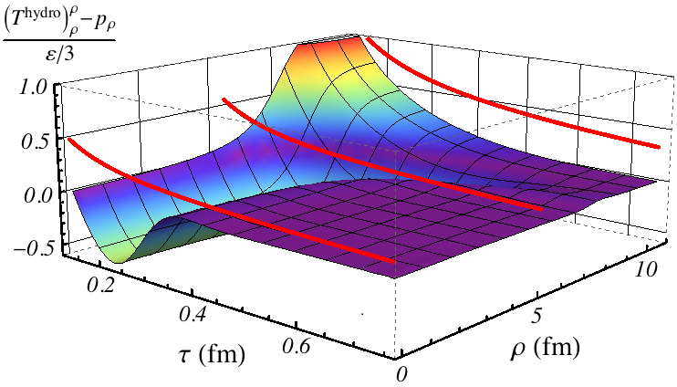
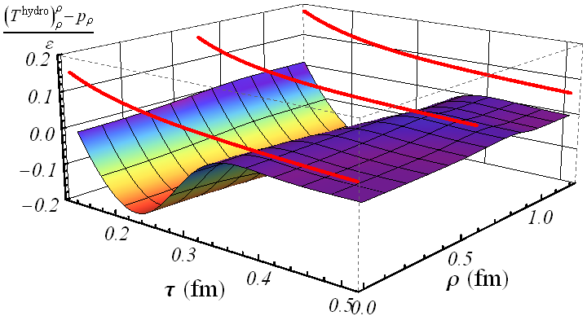
Radial flow – hydrodynamics
Wilke van der Schee, Utrecht
Thermalisation is quick, but viscosity contributes

Slide 25
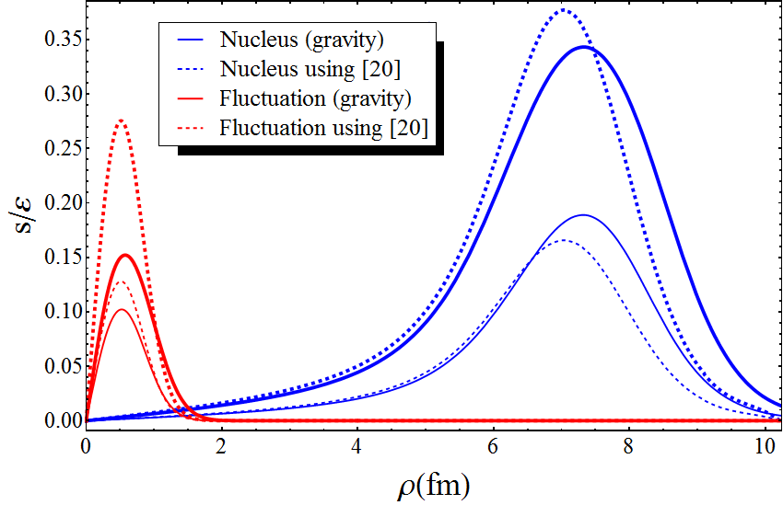
Radial flow – a comparison
Wilke van der Schee, Utrecht
Gives AdS/CFT comparison to i.e. Vredevoogd and Pratt:
So have a local formula for velocity at some time
Works especially well at larger scales
s: flux in stress tensor
ε: energy density
ε₀: initial energy density
J. Vredevoogd, S. Pratt, Universal Flow in the First Stage of Relativistic Heavy Ion Collisions (2008)

Slide 26
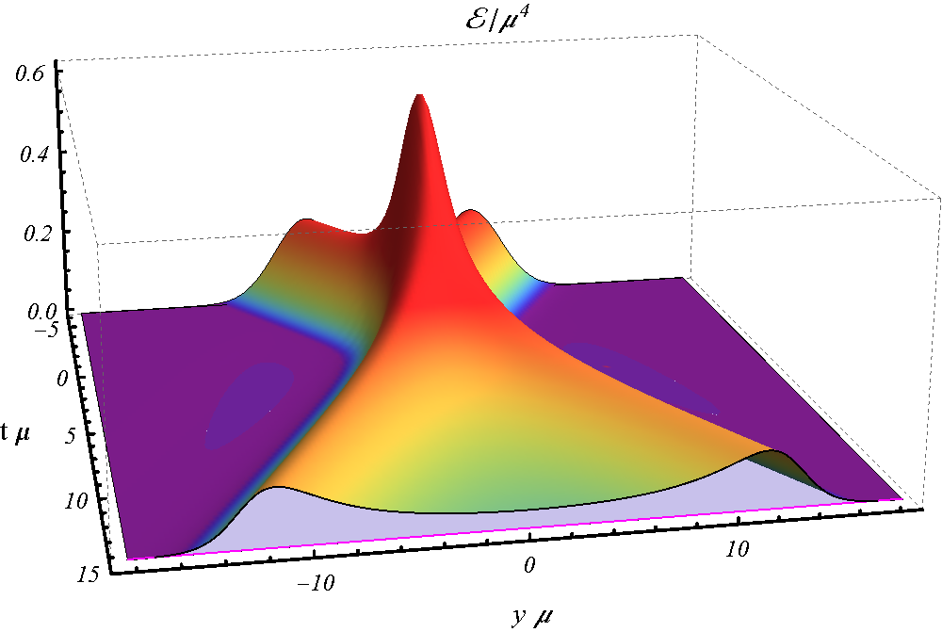
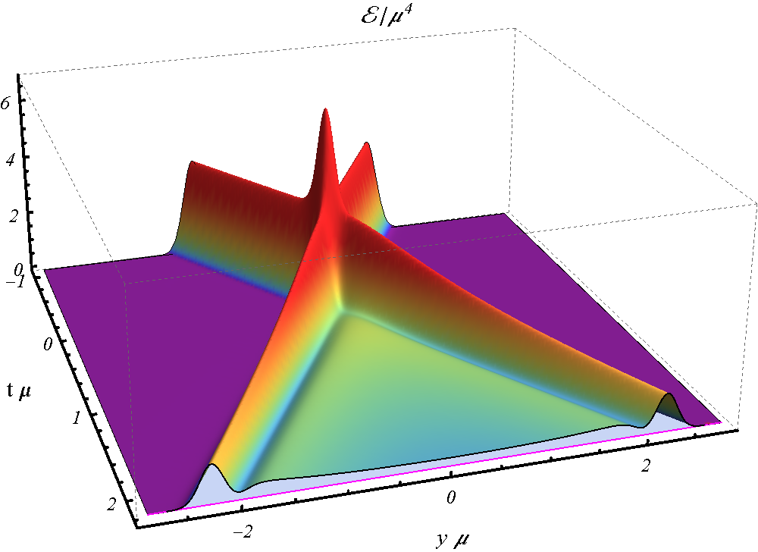
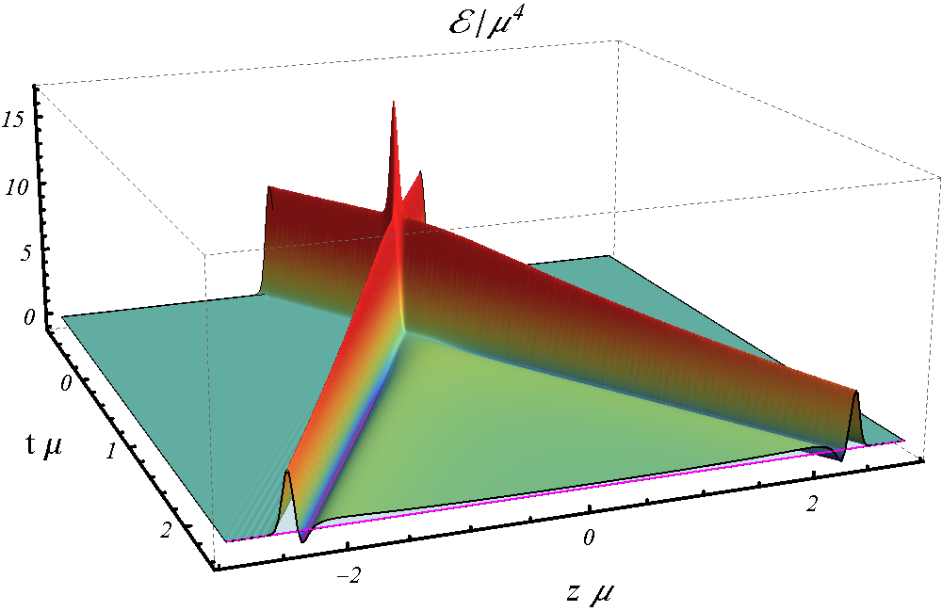
Shock waves – varying the width
Wilke van der Schee, Utrecht

Slide 27
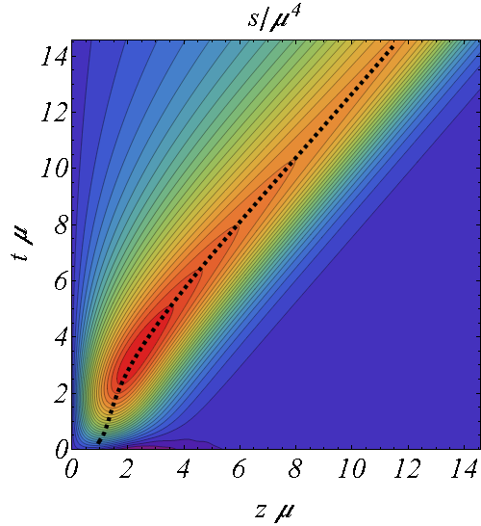
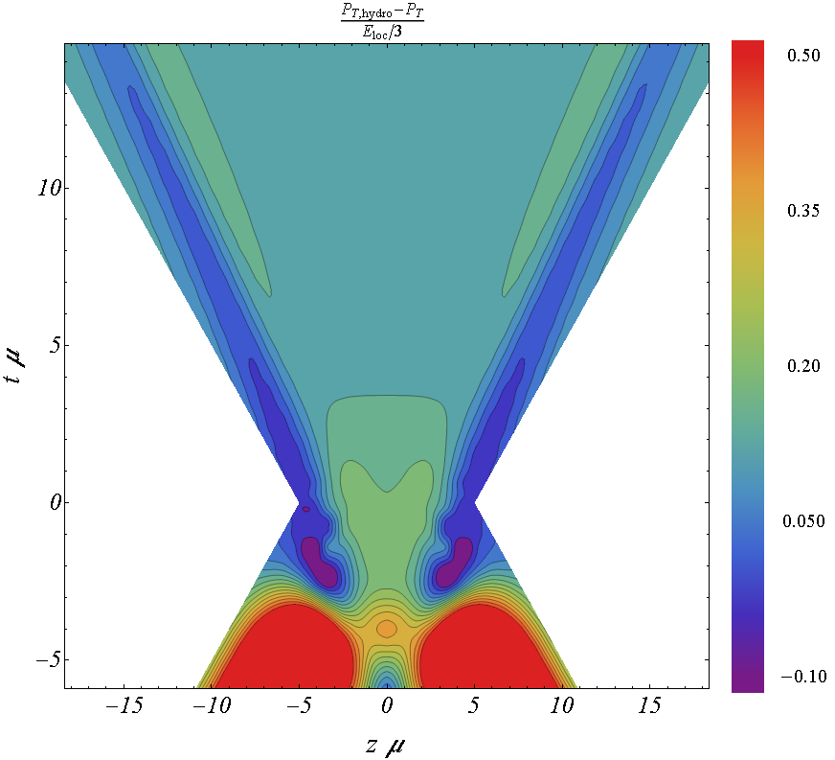
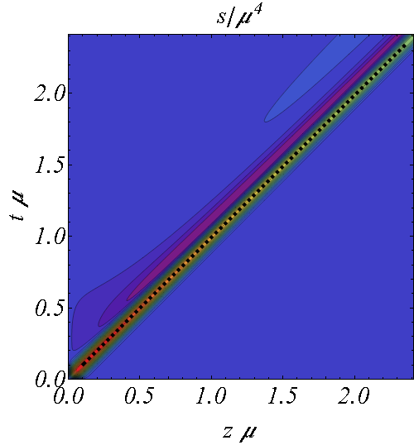
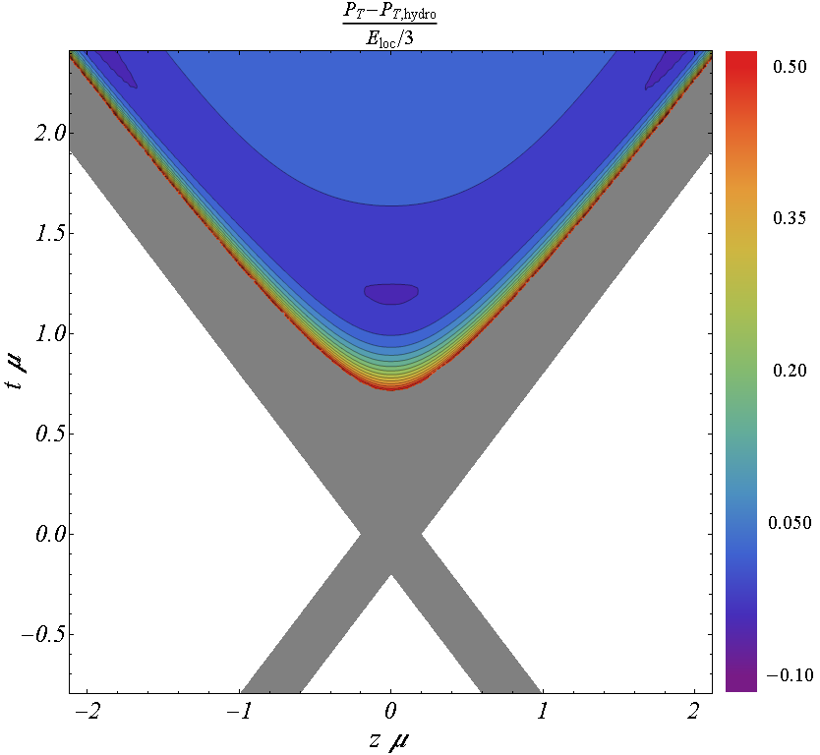
A dynamical cross-over
Low energy:
Stopping
Expansion by hydro
High energy:
no stopping
plasma forms slowly
negative energy

Slide 28
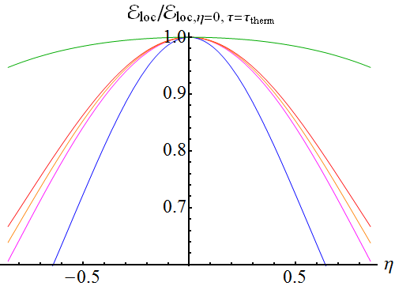
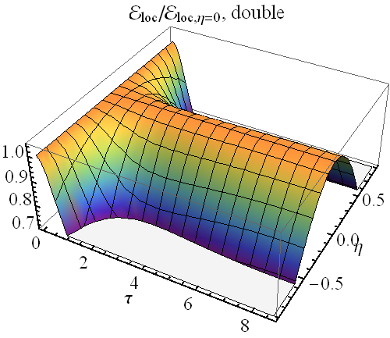
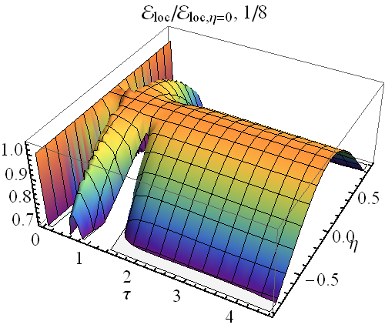
Shock waves – boost-invariance
Wilke van der Schee, Utrecht
(Small) indications of boost-invariance:

Slide 29
Shock waves from the bulk
Wilke van der Schee, Utrecht
Non-trivial dynamics in the bulk:

Slide 30
Shock waves from the bulk
Interesting interplay between temperature & width:
Non-linearity roughly comes from horizon
Touches front-end latest: by causality!

Slide 31
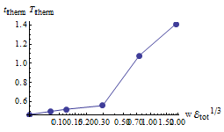
Shocks quantitatively
One relevant parameter (CFT):
Counterintuitive: higher energy = wider shock
Counterintuitive: delta-function = small energy
We used (CY: ):

Slide 32
Discussion
Wilke van der Schee, Utrecht
General framework for more realistic thermalising models
Homogeneous model: fast and linearised thermalisation
Radial flow: flow quite hydro-like
Shock waves: Strong coupling ≠ full stopping
Several (linearised) opportunities/combinations
Fluctuations
What is the initial state/width?? (radial flow/shocks)
Various problems: very strong coupling, susy, large N etc…

