Slide 1
Scientific Visualization and Computer Graphics Shape analysis and visual analytics
Prof. dr. Alex Telea
Institute Johann Bernoulli (CS) Faculty of Science and Engineering
University of Groningen, Netherlands

Slide 2
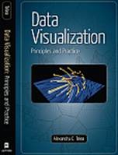
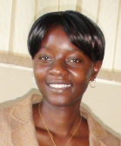
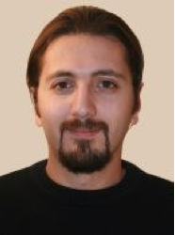
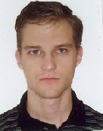
Introduction
Who am I?
professor in computer science / multiscale analytics @ RuG (since 2007)
steering committee chair ACM SOFTVIS / IEEE VISSOFT (since 2007)
15 PhD students, 70+ MSc students
over 200 international publications in visual analytics for data science
co-founder SolidSource BV
www.cs.rug.nl/~alext
www.solidsourceit.com
Data Visualization: Principles and Practice A. K. Peters, 2008 / 2014
www.cs.rug.nl/svcg

Slide 3
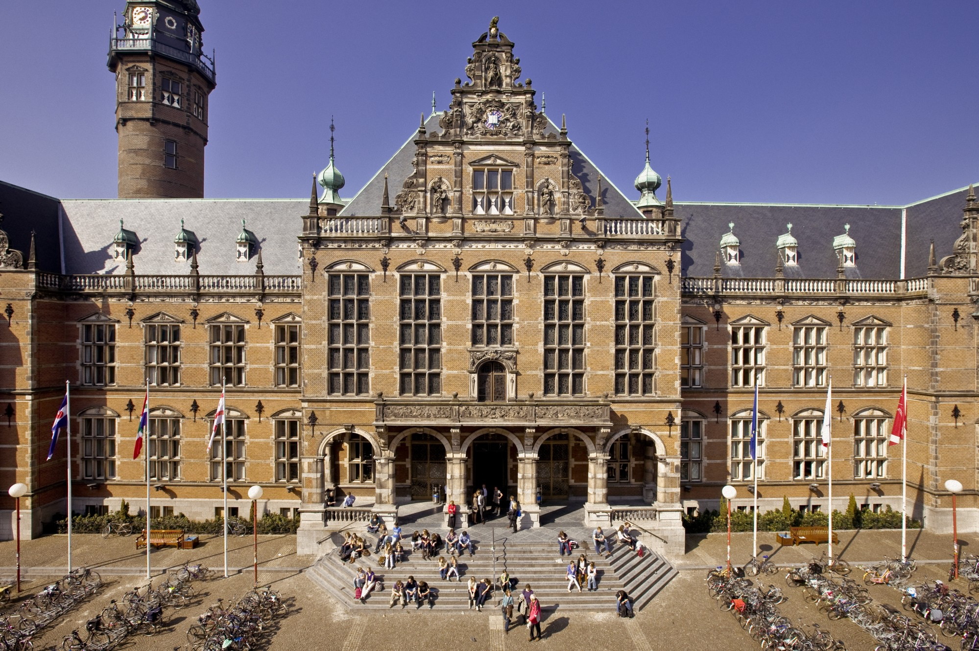
University of Groningen (1614 – ∞)
Second-oldest
in Netherlands
11 faculties
6000 tenured (3000 research)
>800 million EUR yearly budget
400 full professors
500 PhD theses/yr
>170 million EUR contract research
Top 100 university (Shanghai ranking)

Slide 4
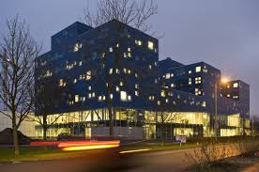
Faculty of Science and Engineering (FSE)
12 institutes
Math & computer science
Artificial intelligence
Energy & sustainability
Engineering & technology
Biotechnology
Life sciences
Pharmacy
Science education
Astronomy
Physics
Chemistry
Advanced materials

Slide 5
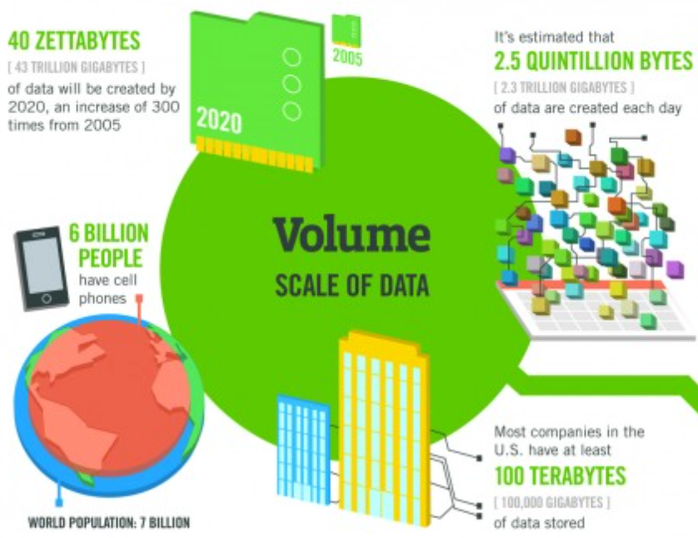
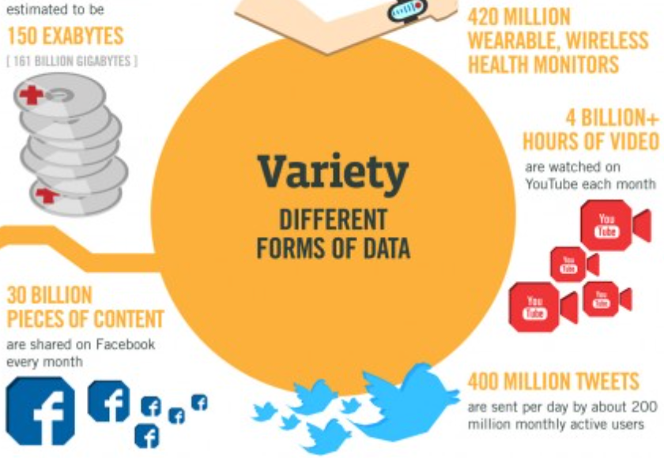
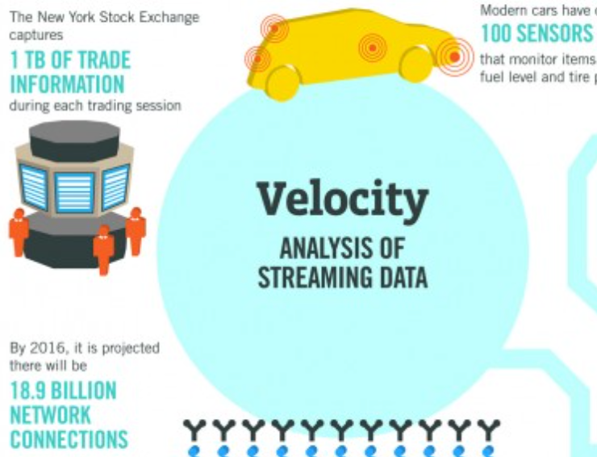
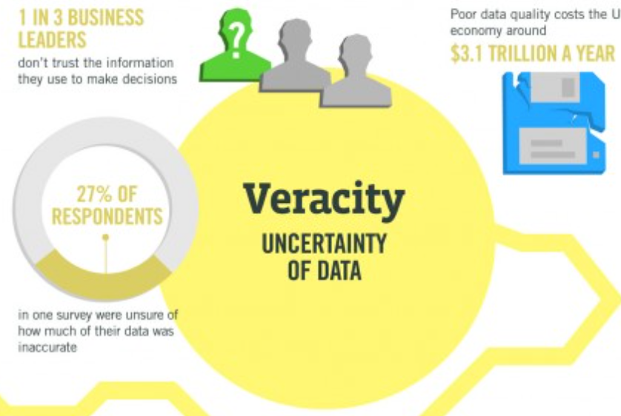
Unifying Theme:
The ‘Big Data’ Challenge – The Four ‘V’ Story
Engineering & Science
Information Systems
Software Engineering
FE simulations: 1B elements,
15 DoF/element, 10K timesteps
Astronomical observations
Data warehouses: 10K tables,
100K rows/table,
200 columns/table
Code repositories: 10K files,
10K lines/file, 1K versions,
years of development
www.cs.rug.nl/svcg

Slide 6
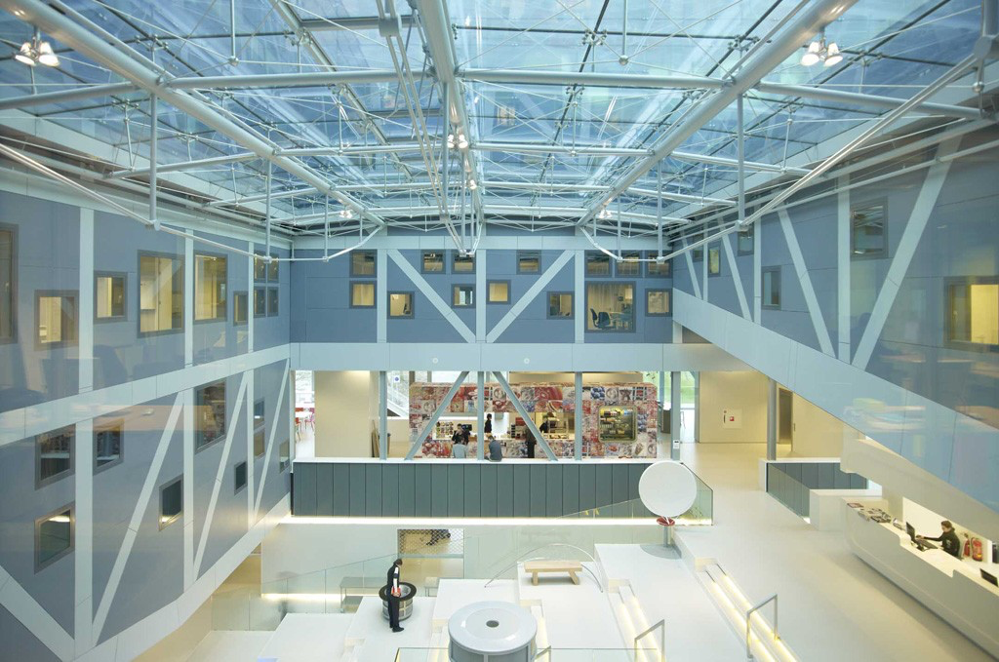
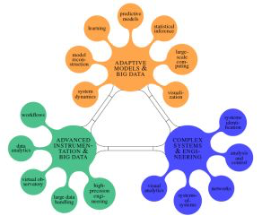
Data Science and Systems Complexity (DSSC)
Institute Johann Bernoulli for Mathematics and Computer Science
Scientific Visualization & Computer Graphics
Intelligent Systems
Software Engineering & Architecture
Distributed Systems
Fundamental computing
Information Systems
www.rug.nl/research/jbi

Slide 7
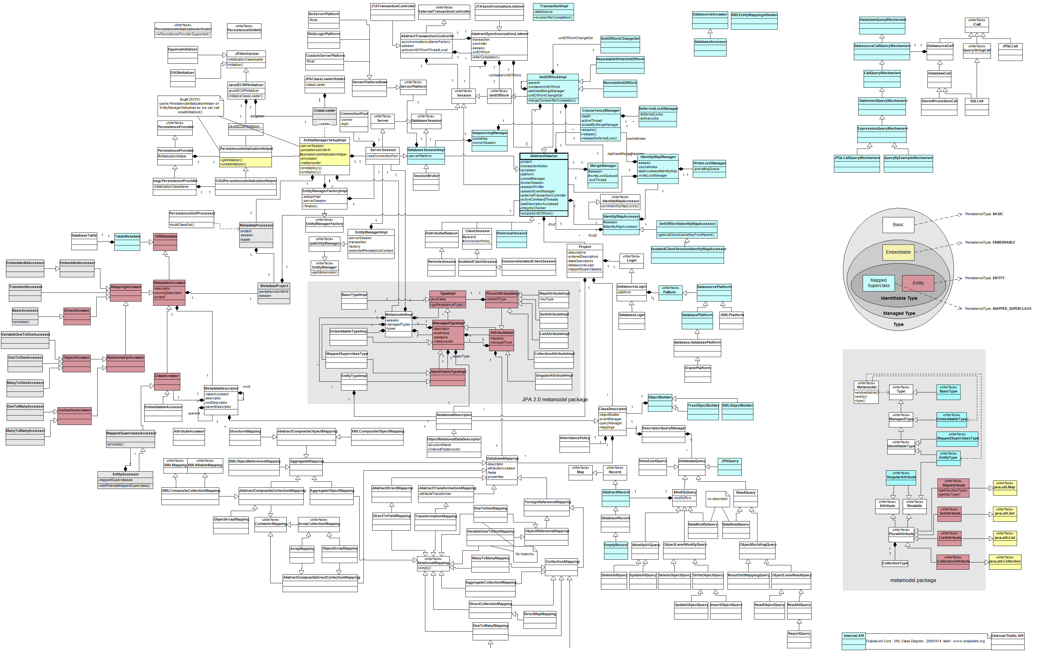
Software Engineering & Architecture (SEARCH)
www.cs.rug.nl/search
Pattern-based
architecture design
Architecture-centric
software evolution
Architectural knowledge modeling
Reverse engineering
Service-oriented architectures
Software comprehension

Slide 8
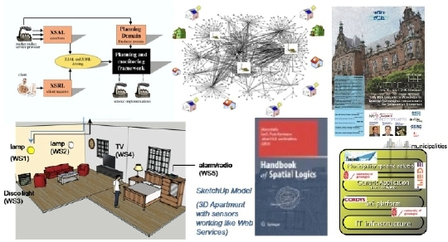
Distributed Systems (DS)
www.cs.rug.nl/ds
Spatial reasoning
Semantic web
Distributed knowledge modeling
Cloud computing
Sustainable buildings
Service-oriented computing
sustainablebuildings.nl

Slide 9
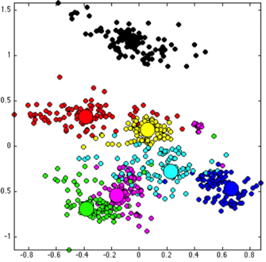
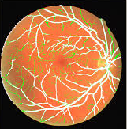
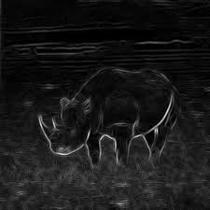
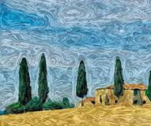
Intelligent Systems (IS)
www.cs.rug.nl/is
Computer vision
Image processing
Pattern recognition
Machine learning
Data science
Mathematical morphology

Slide 10
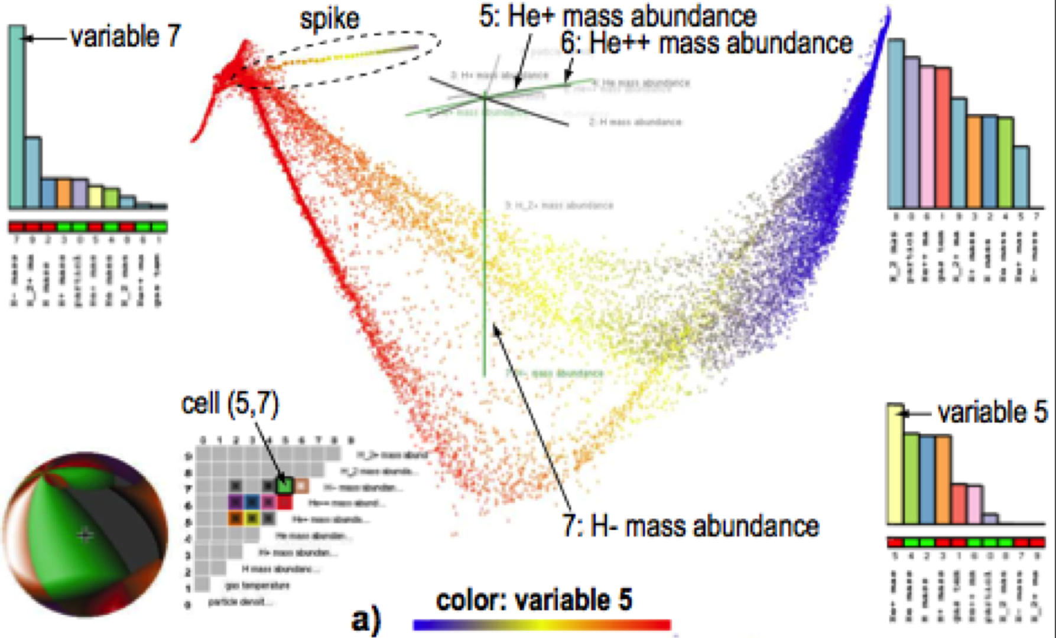
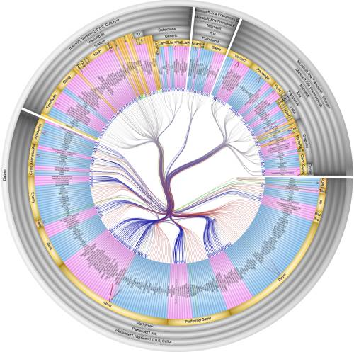
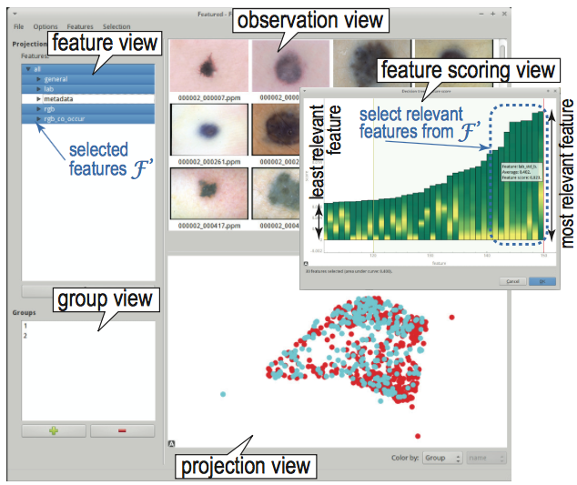
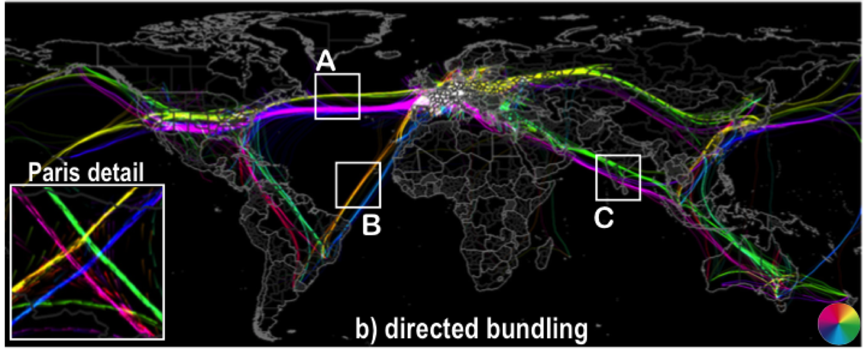
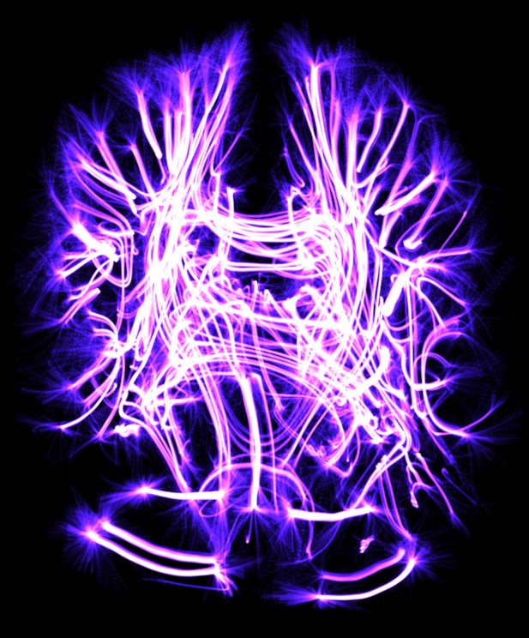
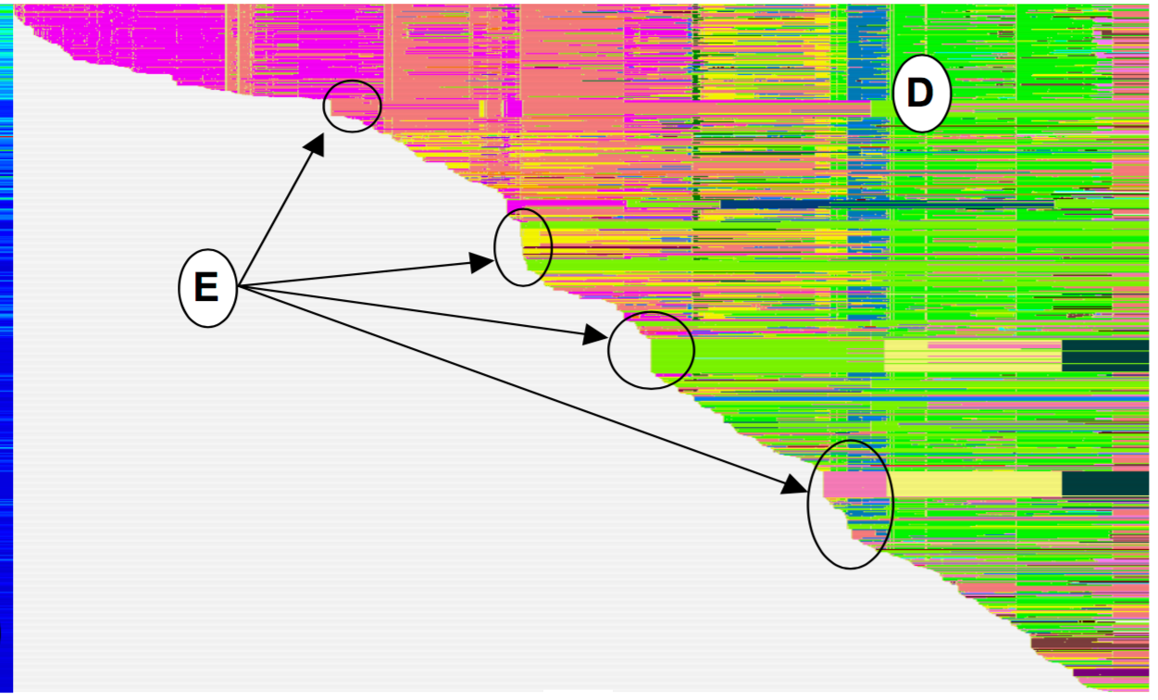
Scientific Visualization and Computer Graphics (SVCG)
www.cs.rug.nl/svcg
Scientific visualization
Information visualization
Medical image segmentation
Software visualization
3D shape processing
Visual analytics & machine learning
Brain (f)MRI visualization
Large network visualization
Data Visualization – Principles and Practice (CRC Press)
www.solidsourceit.com

Slide 11
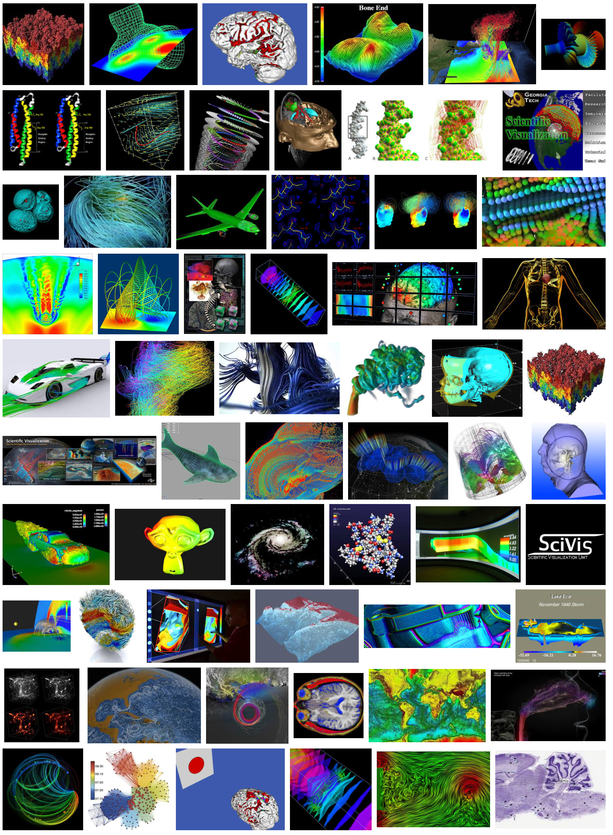
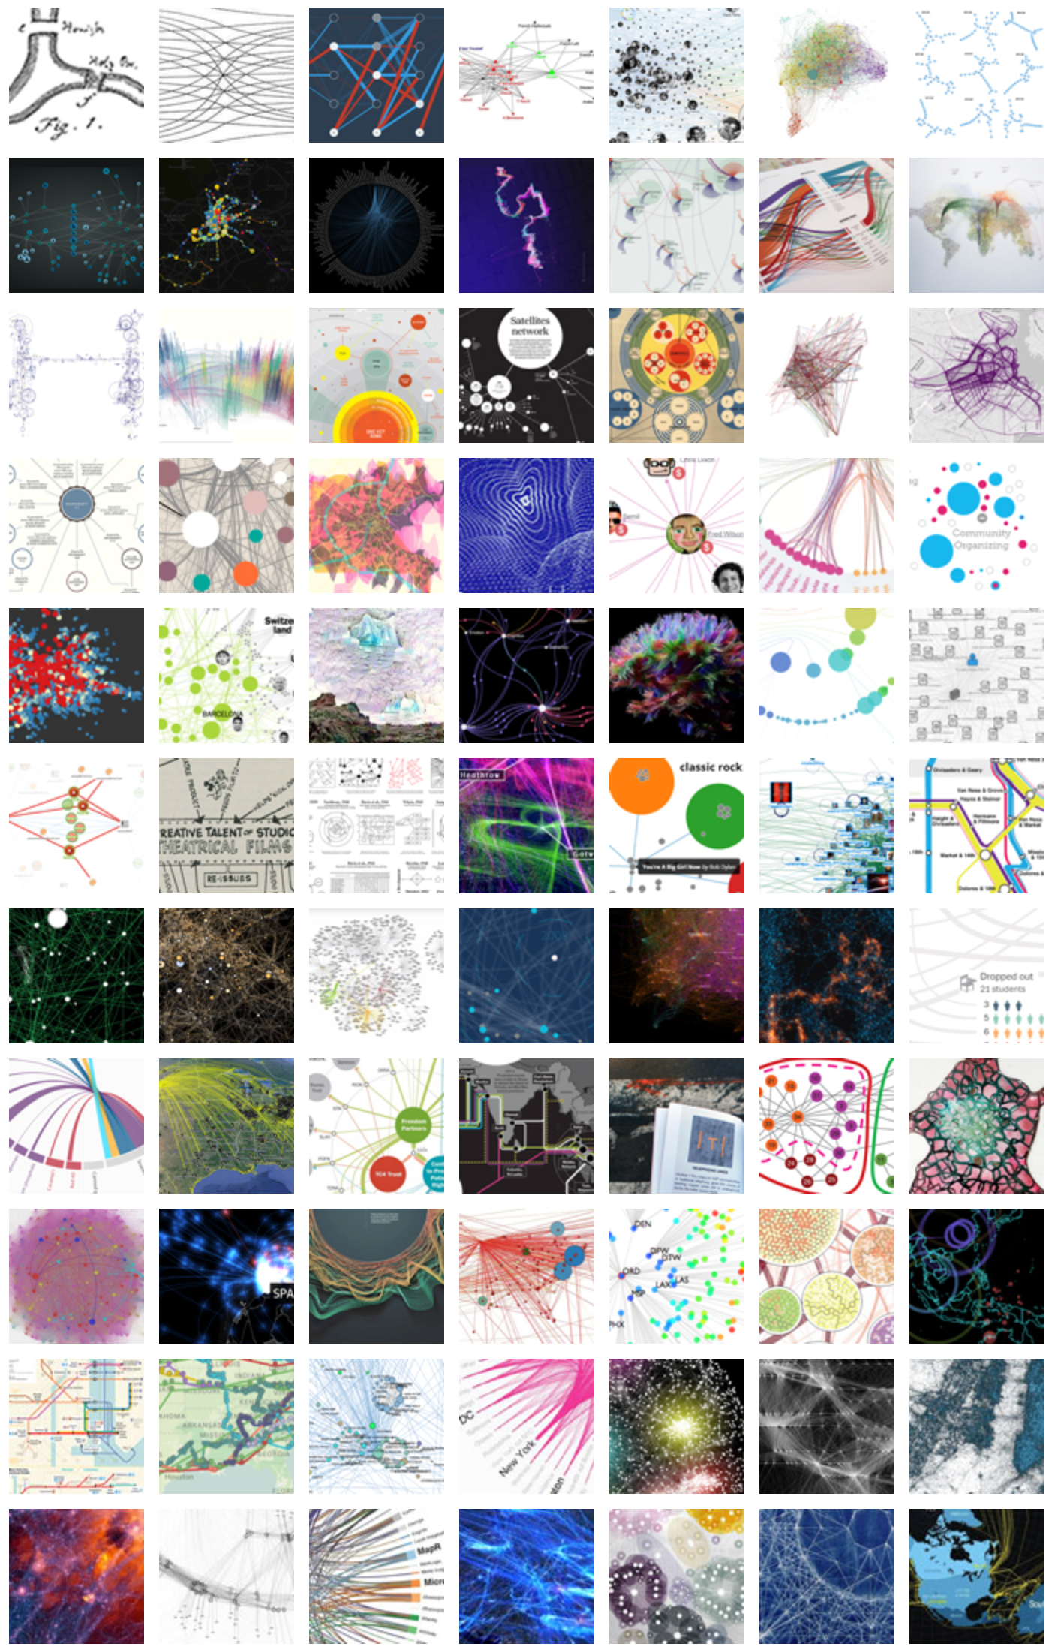
Scivis vs Infovis
what are the differences?
what are the similarities?
how to unify them to better
understand
explain
use
…Big Data collections

Slide 12
Technique 1/4: Medial Descriptors
S(Ω) = {x∈Ω|∃y≠z∈∂Ω,||x-y||=||x-z||=DT_{∂Ω}(x)}
2D skeleton:
1D structure
centers of maximally inscribed discs
3D surface skeleton:
2D structure
centers of maximally inscribed balls
3D curve skeleton
1D structure
no agreed formal definition

Slide 13
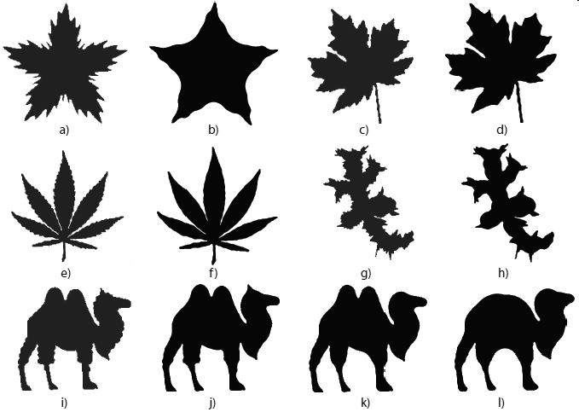
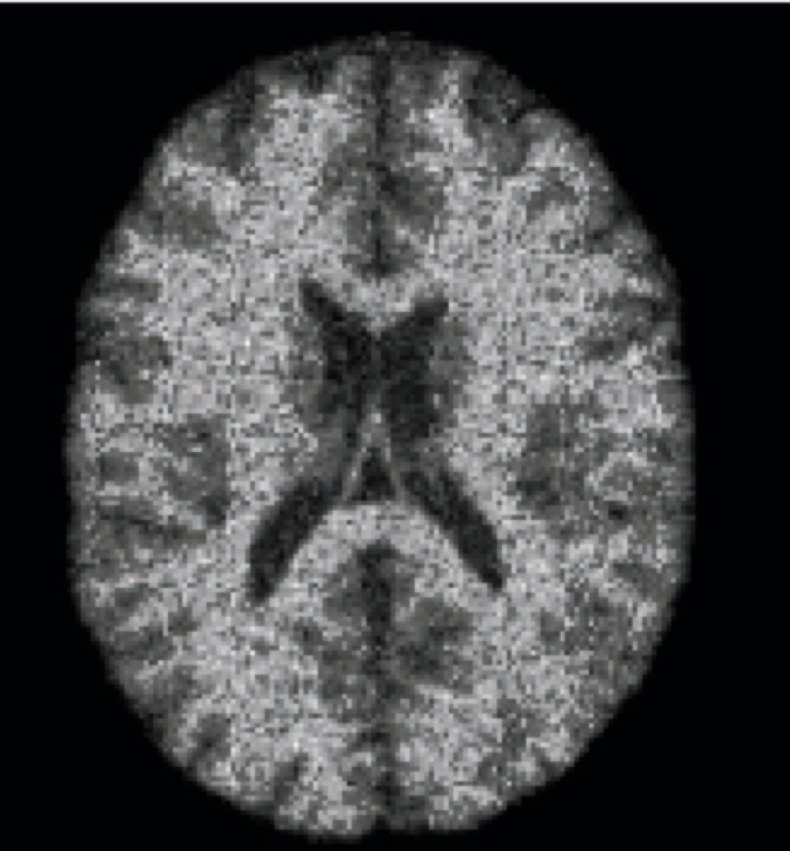
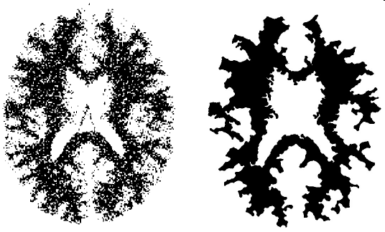
App 1: Multiscale detail-preserving shape simplification
[Telea & Van Wijk’03]
[Telea ‘08]
The only real-time pixel-accurate 2D skeletonization toolset in existence
www.cs.rug.nl/svcg/Research/CUDASkel

Slide 14
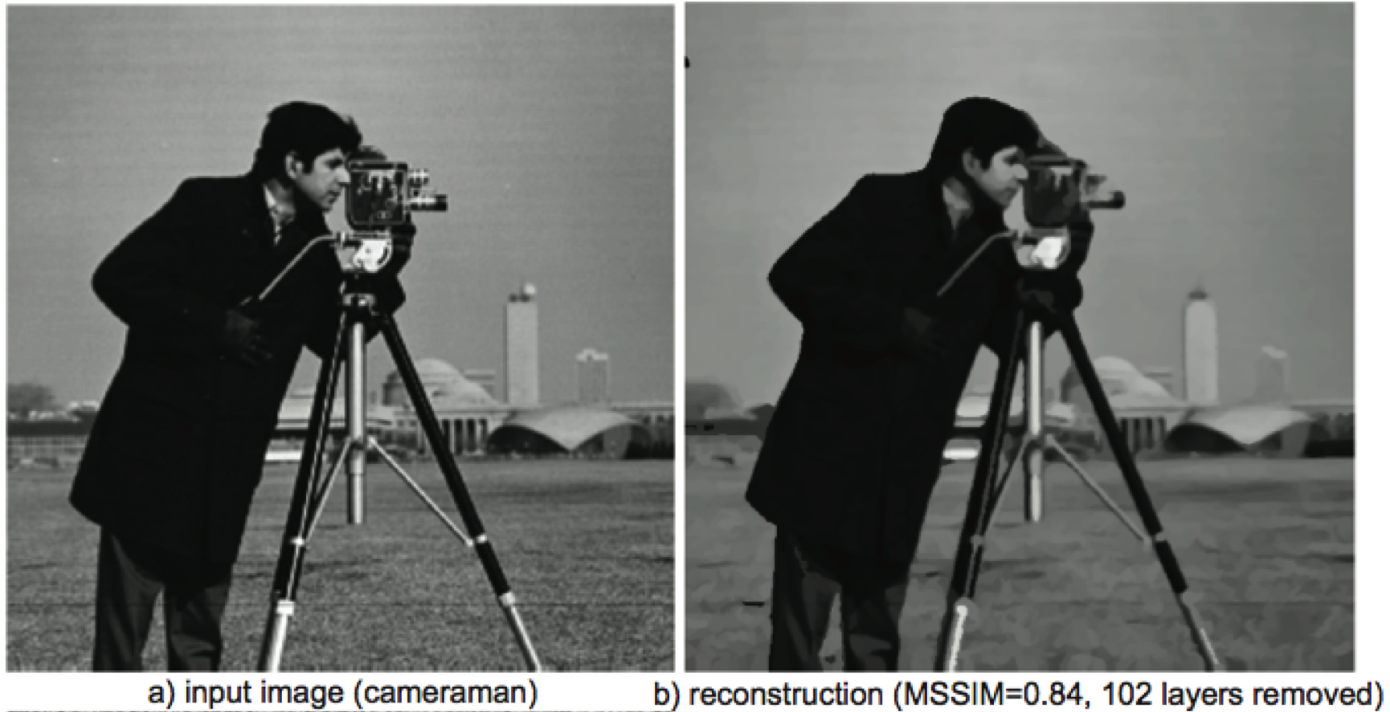
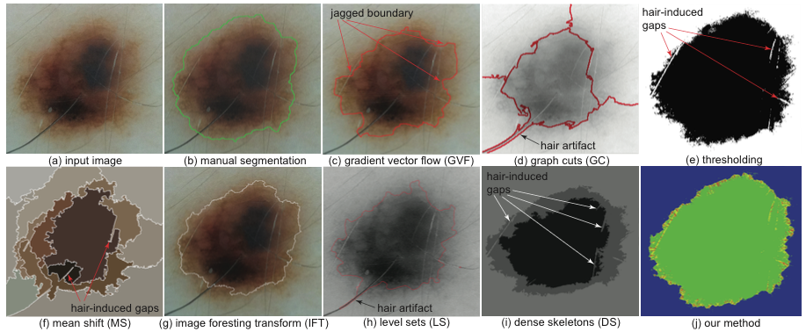
App 2: Image compression and image segmentation
[Van der Zwan et al. ‘13]
[Sobiecki et al. ‘15]

Slide 15
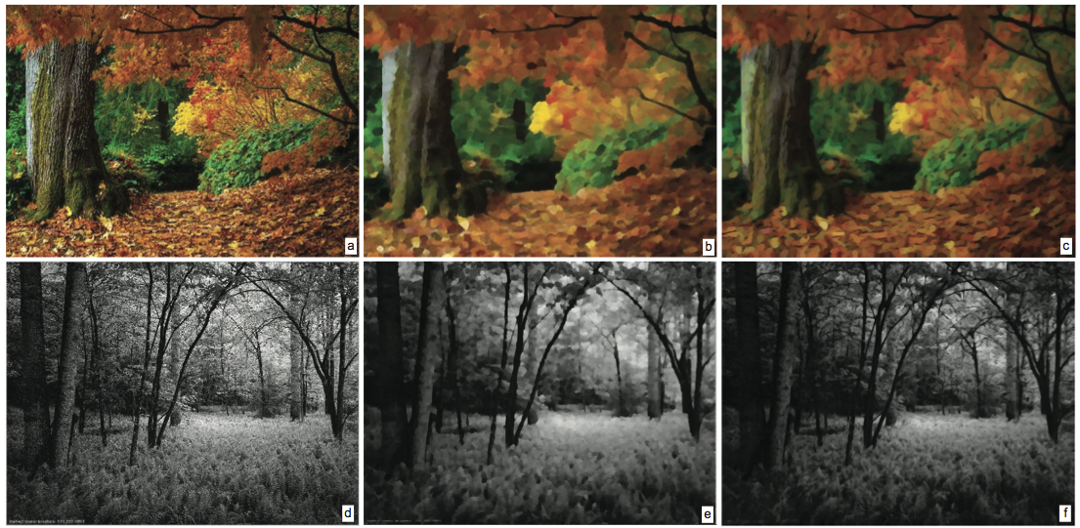
App 3: Image nonphotorealistic manipulation
How can we create a painting from a regular photo?
input images
Papari et al., TPAMI’07
our method
[Van der Zwan et al. ‘13]

Slide 16
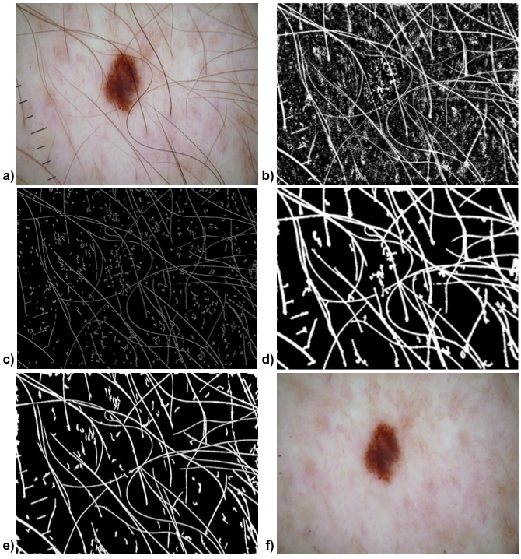
App 4: Digital hair removal for dermatoscopic images
How to help dermatologists analyze images by removing their hair?
[Koehoorn et al. ‘16]

Slide 17
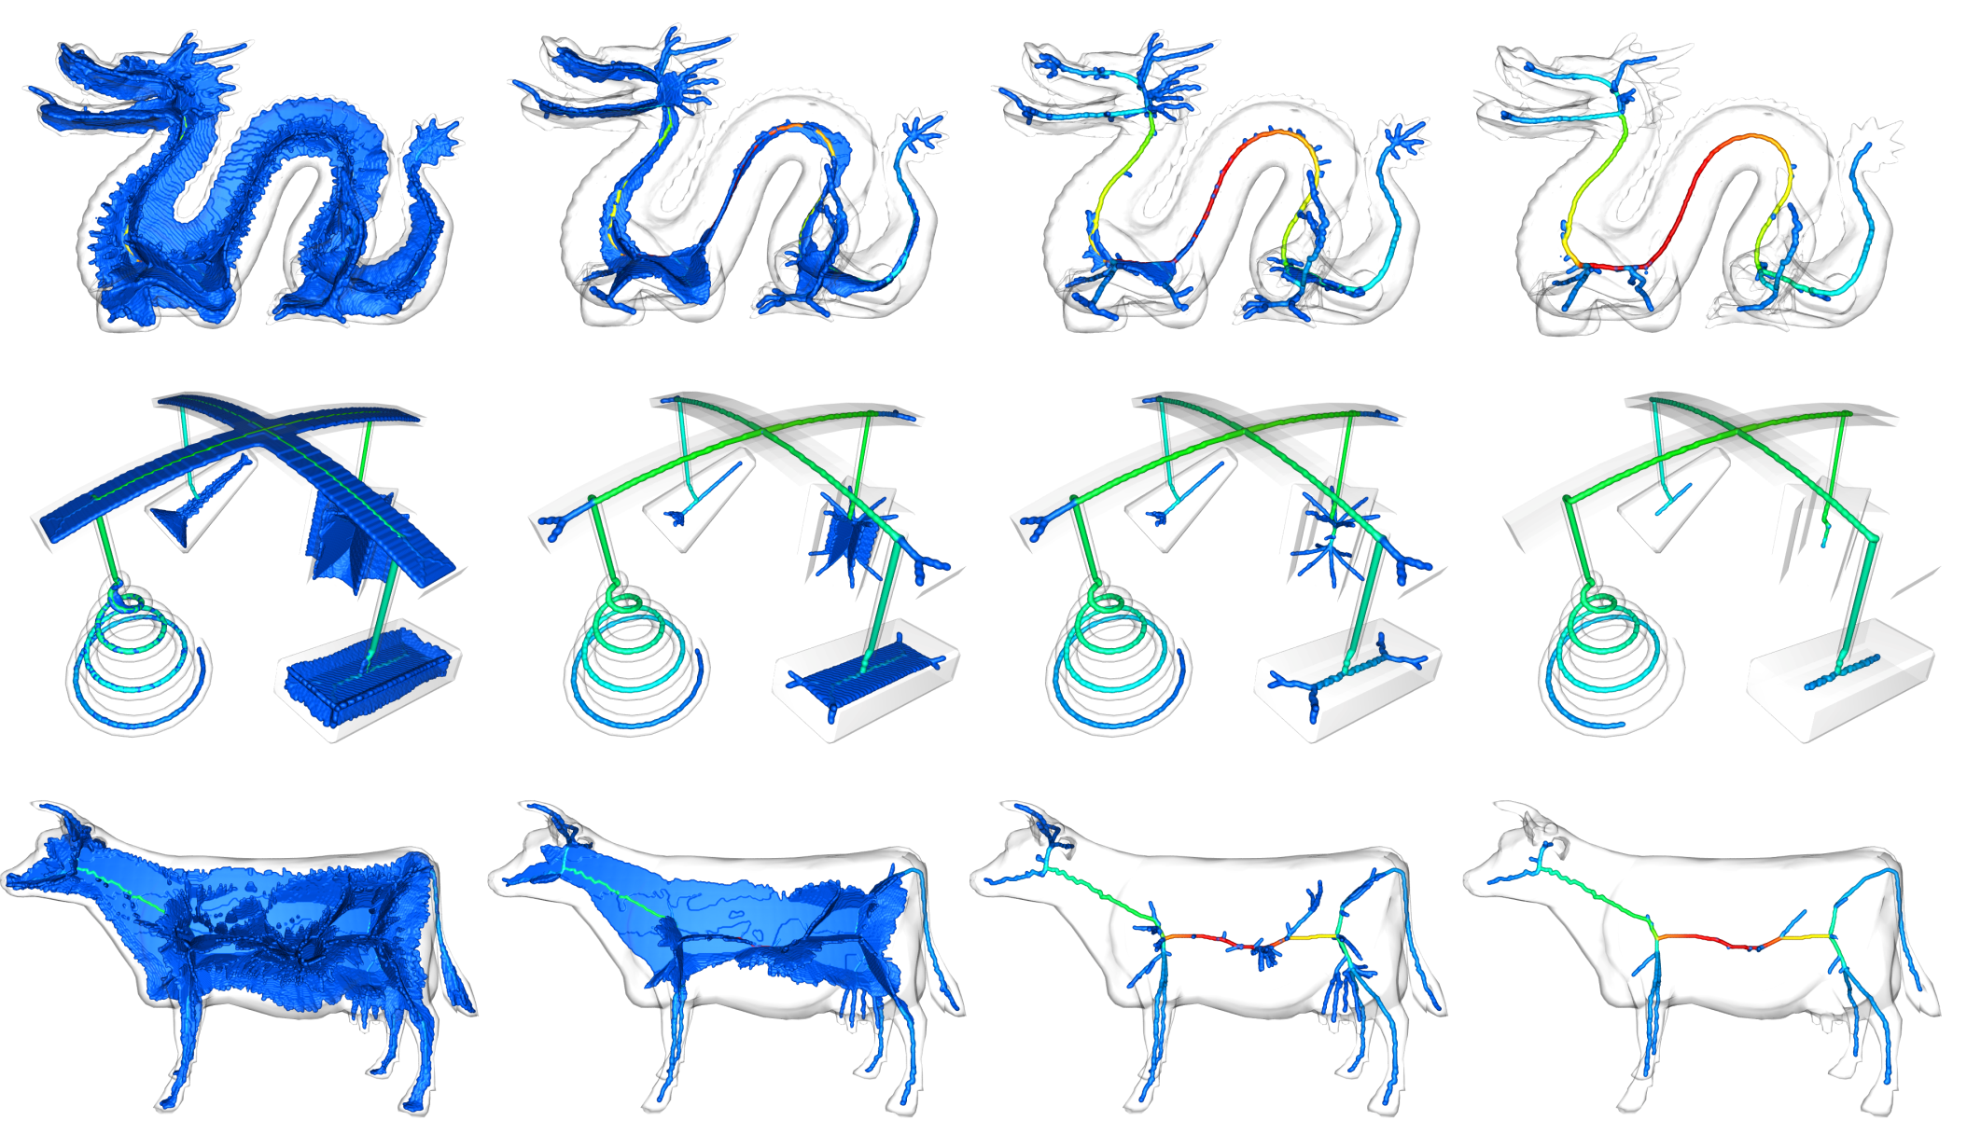
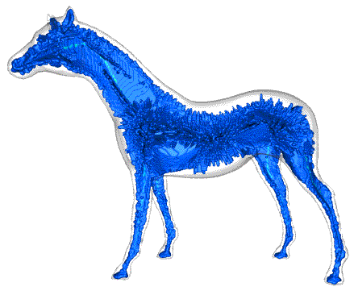
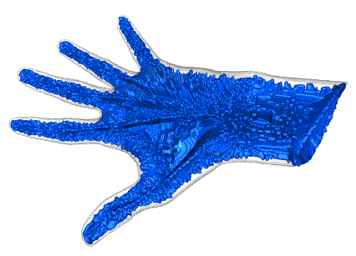
App 5: Multiscale 3D Shape Simplification and Segmentation
[Reniers et al. ’08]

Slide 18
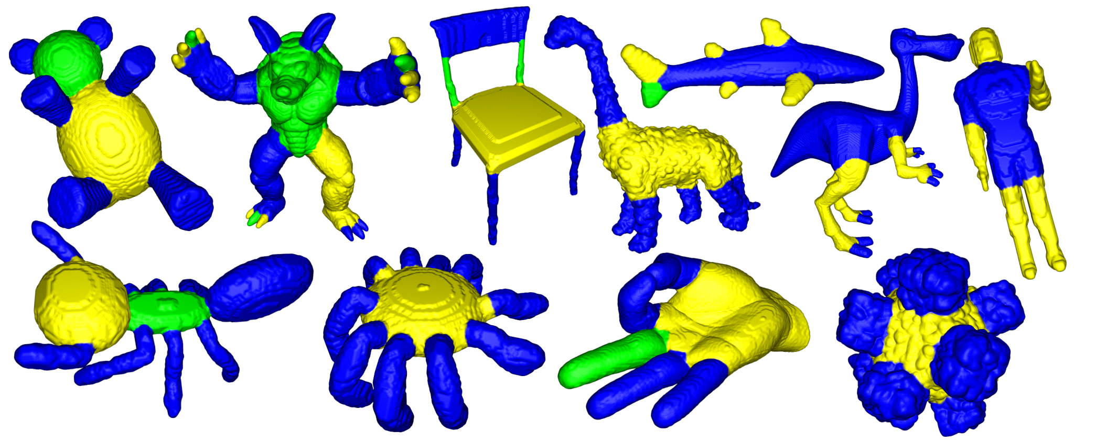
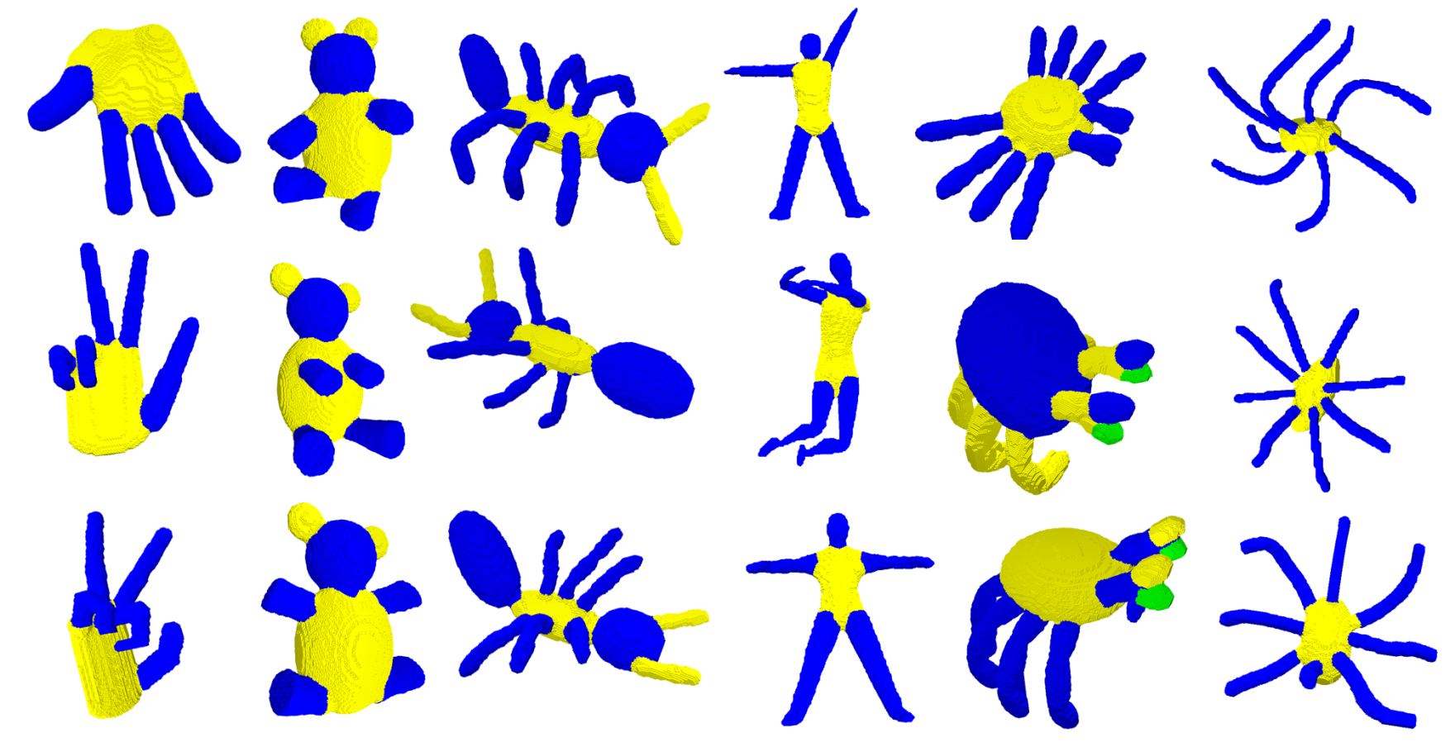
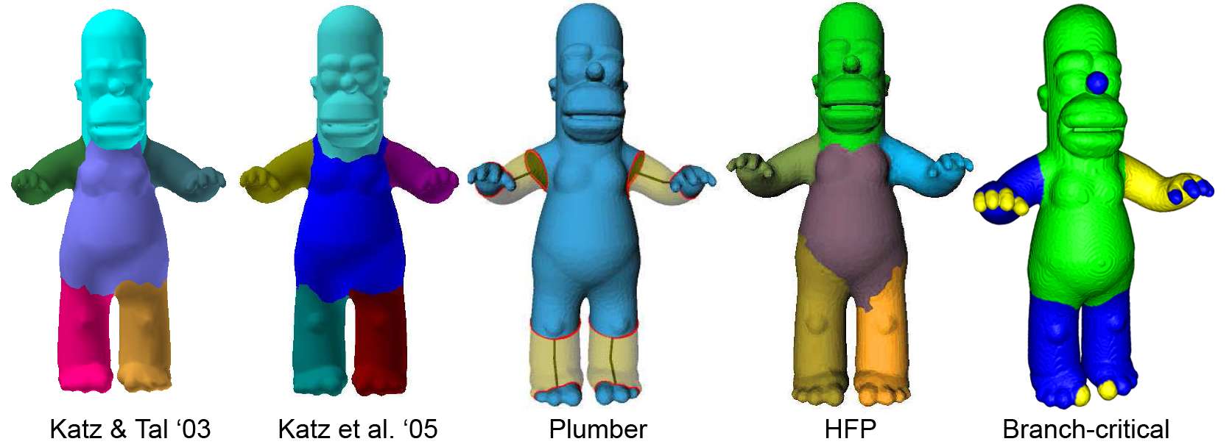
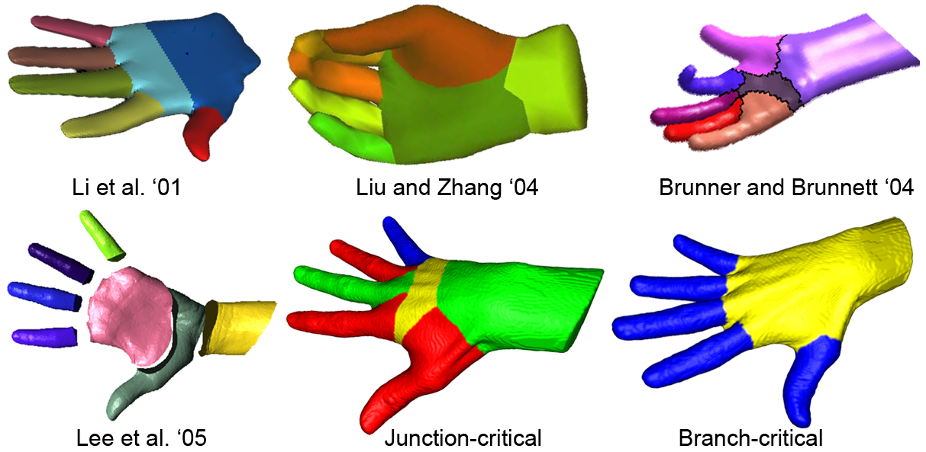
App 6: 3D Shape Segmentation
How to find the natural parts of a shape?
[CGF’08, TVC’08, SMI’07, SMI’08]

Slide 19
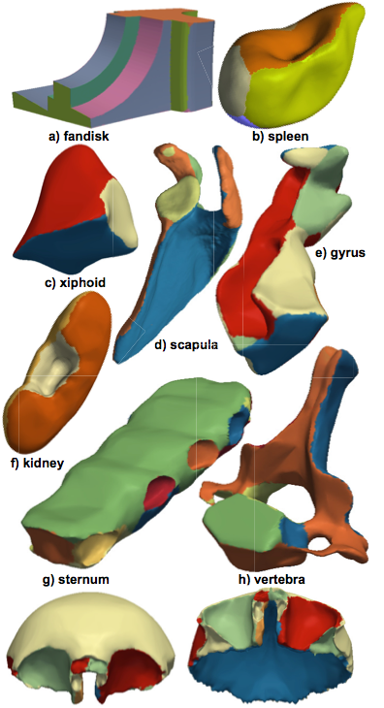
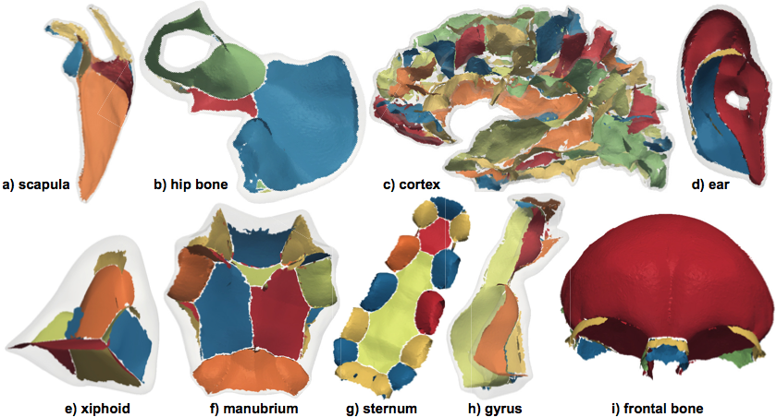
App 6: 3D Shape Segmentation (continued)
How to find the natural parts of a shape?
surface skeleton segmentation
shape segmentation

Slide 20
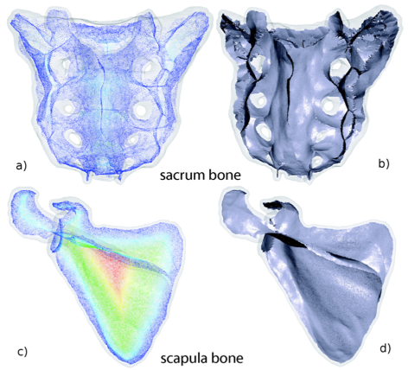
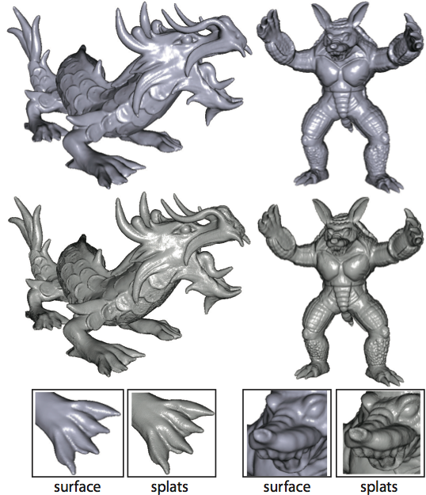
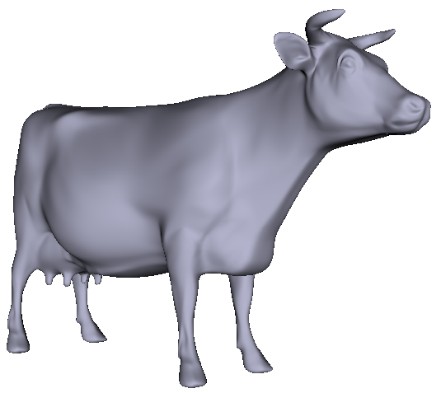
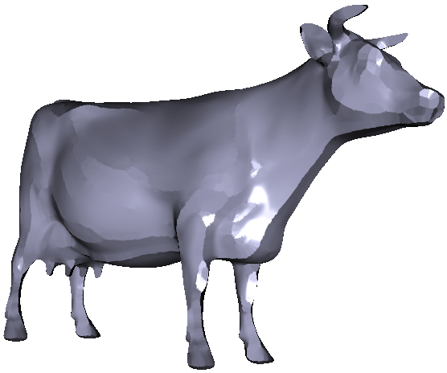
App 7: Large-scale 3D shape reconstruction
shape reconstruction
surface skeleton
[Jalba et al., TPAMI’12]
[Jalba et al., TPAMI’14]

Slide 21
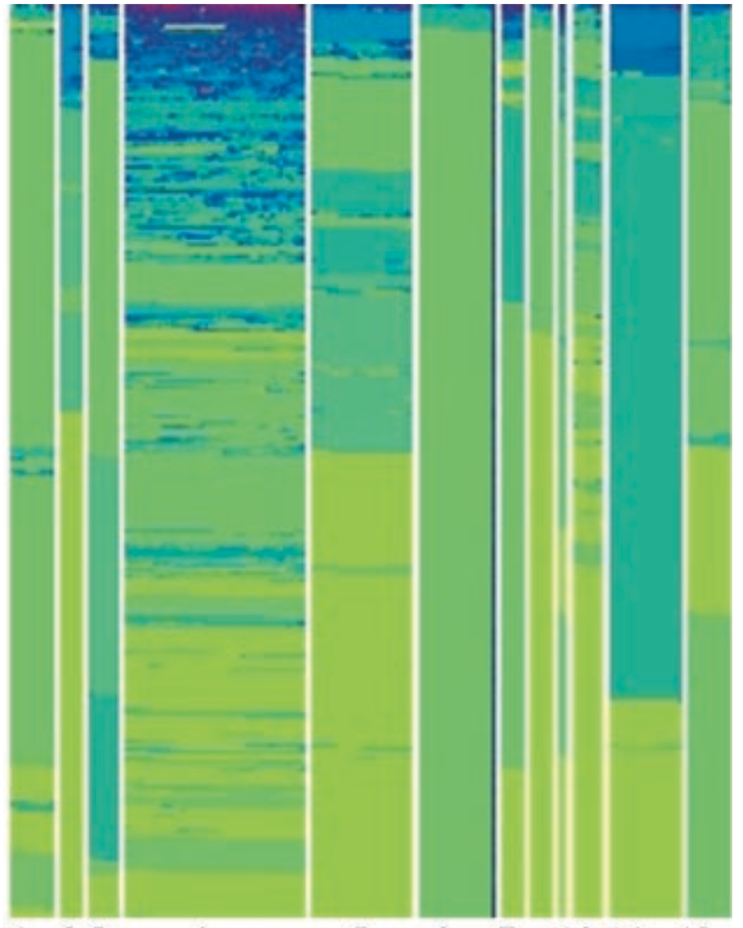
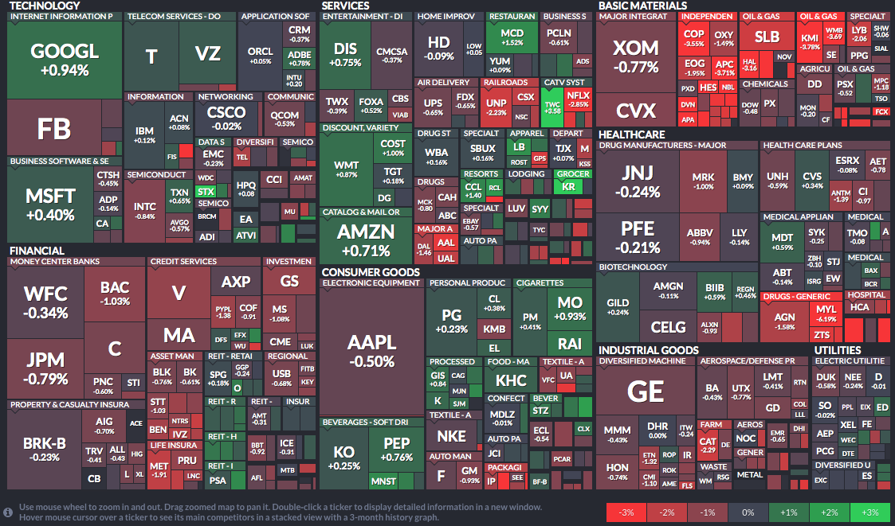
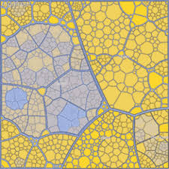
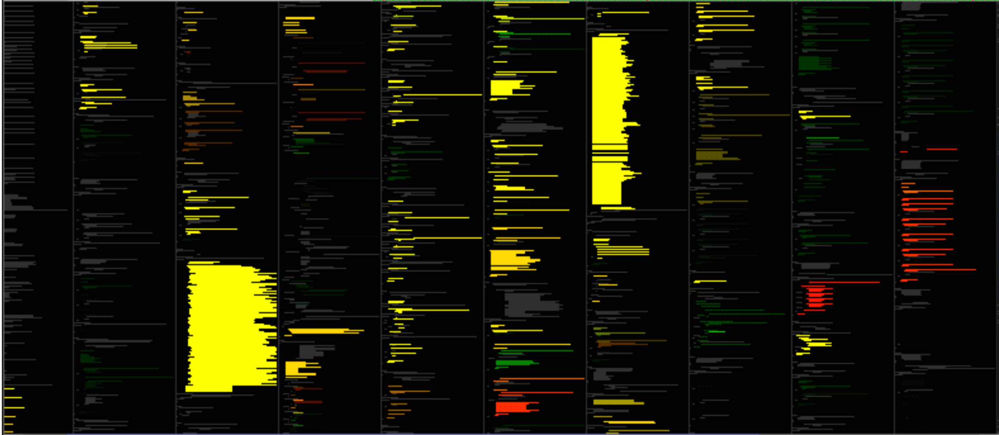
Technique 2/4: Dense Pixel Displays
every pixel shows information (little..no whitespace, output=dense field)
close pixels = similar/related data items (again, related to field notion)
pixel bar charts (2002)
evolution spectrographs (2005)
map of the market (2008)
Voronoi treemaps (2005)
pixel-line text (2002)
Notes:
-pixek bar charts (Keim et al, 2002)
-spectrographs: CVSscan/CVSgrab, 2005-2006
-treemaps: Shneiderman (early 1990s); squarified (Bruls et al, 2000); : finviz.com, follower of map of the market (Wattenberg)
-Voronoi treemaps (Balzer and Deussen, 2005)
-pixel-line text: Tarantula (Jones and Stasko, 2002); based on original SeeSoft idea (Eick et al, 1992)

Slide 22
App 1: Understanding large software archives
Given a 10-year archive (50K files, 200K changes), how to spot trends?
software maintenance (Philips, Bosch, Continental, ASML)
financial/healthcare data (Pervasive, Momentum, Credit Suisse)
most active
files
files sorted
by activity
file creation time
Images generated with SolidSTA tool (www.solidsourceit.com)

Slide 23
Technique 3/4: Graph and Trail Bundling
Graph Bundling
Trail Bundling
straight lines
edge bundles

Slide 24
Graph and Trail Bundling: Technical Details
Dataset
graph
trail-set
Drawing
D
Bundling
B
P = {p_{i}}
D(P) = {D(p_{i})}
B(D(P))={B(D(p_{i}))}
similar paths…
…yield close bundles
δ : distance between two curves in drawing space
κ : dissimilarity between two paths in data and drawing spaces
A. Lhuillier, C. Hurter, A. Telea (2017) State-of-the-art in graph and trail bundling; CGF (EuroVis STAR)
Notes:
Let’s start with the data we bundle. This can be either a graph G or a trail-set T, the difference being that a trail-set has a spatial embedding, while a graph not.
We call the input generically a path-set P.
What we actually bundle is a drawing of a path-set (which for graphs requires a layout, and for trails is implicit).
We call such a drawing D(P), and the bundled result B(D(P)).
Then, bundling can be defined as an operator which basically brings paths (similar in data and drawing space) very close to each other (in drawing space).
Interesting… operators are what we know in image processing..

Slide 25
App 1: Understanding large software systems
How to measure a system’s modularity?
hard to quantify in a metric…
…but extremely easy to see!
Modular system
Monolithic system
Decoupled system
blue = caller, red = called
all functions in the yellow file call the purple class
green file has many self-calls
blue = virtual, green = static functions
red class has many virtual calls (possible interface class)
many intra-module calls
few inter-module calls
typical for library software
Images generated with SolidSX tool (www.solidsourceit.com)
www.cs.rug.nl/svcg

Slide 26
App 2: Supporting software maintenance
How to efficiently see and remove duplication in a 5M lines code archive?
useful to detect wasted effort, lack of modularity, copy-paste
but also recurrent patterns (e.g. in text archives)
Images generated with SolidSDD tool (www.solidsourceit.com)
www.cs.rug.nl/svcg

Slide 27
App 3: Improving software execution
Given several executions of a program, how to spot differences?
used for finding performance/quality problems (Deutsche Post)
trace differences = potential problems
Images generated with TraceDiff tool (http://www.hpi.uni-potsdam.de)
www.cs.rug.nl/svcg

Slide 28
App 4: Understanding large-scale software evolution
How to show changes between a graph and the previous/next one?
Changes of code duplication (clones) in the evolution of a software system
…
…
[Ersoy et al. ‘14]

Slide 29
App 5: Understanding large-scale airline data
US flights (Aug 2008)
(~20K flights)
How to show changes in a large graph?
use dynamic bundling (simple!)
World flights (June 2013) (~1M flights)
[Ersoy et al. ‘14]

Slide 30
App 6: Understanding eye-tracking data
How to analyze how people see scenes?
evaluate/optimize user-interface design for highly-critical devices (e.g. aircraft, surgery)
bundle the eye-gaze tracks (recorded by an eye tracker)
V. Peysakhovich et al. (2014) Attribute-Driven Edge Bundling for General Graphs with Applications in Trail Analysis; IEEE PacificVis

Slide 31
Technique 4/4: Multivariate data
Question: What is harder to understand?
1000 samples of 1 attribute
100 samples of 10 attributes
1000 samples x 1 attribute
100 samples x 10 attributes
1D graphs/charts
work pretty well ☺
many chart kinds, many problems
(not scalable, cluttered, abstract, …)
Univariate data: typically compare pattern pairs
m-variate data: We have m²/2 pairs to compare!

Slide 32
Technique 4/4: Multivariate projections
Data Table
2D projection
a table row gets mapped to a point
2D point distance reflects nD row distance
color map values of a selected column
extremely compact: one n-dimensional point = 1 pixel
fast to compute (on GPU: 500K 100-dim points: <1 second)
show underlying data grouping in classes
shown by well-known scatterplot visualization

Slide 33
App 1: Visualize projection veracity
How to understand how well a projection displays high-dimensional data?
false positives: points close in 2D but far in nD
false negatives: points close in nD but far in 2D
False positives map
(false neighbors)
False negatives map
(missing neighbors)
[Martins et al’14]

Slide 34
App 2: Explain projections to end-users
How to see the nD variables?
unannotated projection
biplot axes (good projection)
biplot axes (bad projection)
two viewpoints for a 3D projection showing usefulness of axis legends
[Coimbra et al’15]

Slide 35
App 3: Visual analytics for image classification
Application
want to build an efficient and effective classifier for skin lesion images
to be used for automatic melanoma (skin cancer) detection
Proposed pipeline
tool OK:
validate
deploy
tool
tool not OK:
iterate…
image
acquisition
tumor
segmentation
feature
extraction
classifier
construction
visual
analytics
expert
validation
guided
feature extraction
guided
feature selection
Advantages
we see why classifier works (or not)
we see which features are good (or not)
visual analytics guides us towards improvement
open the ‘black box magic’ of classifier design
www.cs.rug.nl/svcg

Slide 36
Way of working (1/7): Start with 346 features…

Slide 37
Way of working (2/7): Reduce to 150 features…

Slide 38
Way of working (3/7): Select most relevant 30 features…

Slide 39
Way of working (4/7): Reduce to 30 features…

Slide 40
Way of working (5/7): Reduce to 15 features…

Slide 41
Way of working (6/7): Solve confusions by adding 1 feature…

Slide 42
Way of working (7/7): Explain remaining confusion zones
Results
reduced 346 features to 16, keeping good classification accuracy (~75%)
found which images are wrongly classified, got insights in what new features we need
our tool: classification accuracy 82%, better than state-of-the-art commercial tools

Slide 43
App 4: Opening the black box of deep neural networks
expensive!
manual exploration
machine learning
input data
output (insights)
expensive too!

Slide 44
App 4: Opening the black box of deep neural networks
How well has a neural network learned from a training set?
Bundled observation paths
We observe how
group separation increases (from complete clutter to perfect separation)
groups increasingly diverge
paths are quite straight/smooth (no canceling of learning)
paths don’t link different-color groups
Conclusions
Learning is very effective
Knowledge accumulates as desired
Few/no ‘hesitations’ during learning
MNIST dataset, last CNN hidden layer, 100 training epochs
[Rauber et al’17]

Slide 45
Visual big data analytics at SVCG / Univ. Groningen
synergy of visual computing, multiscale techniques, machine learning
visual aspect is crucial
hypothesis forming: discover the unknown
communication: show findings intuitively to users
computing aspect is crucial
GPU techniques: solution to the volume/velocity problem
real opportunity, happening right now
applications: healthcare, IT, traffic, engineering, finance, …
Thank you for your interest!
a.c.telea@rug.nl
www.cs.rug.nl/svcg
examples, applications
code
datasets
papers

