Slide 1
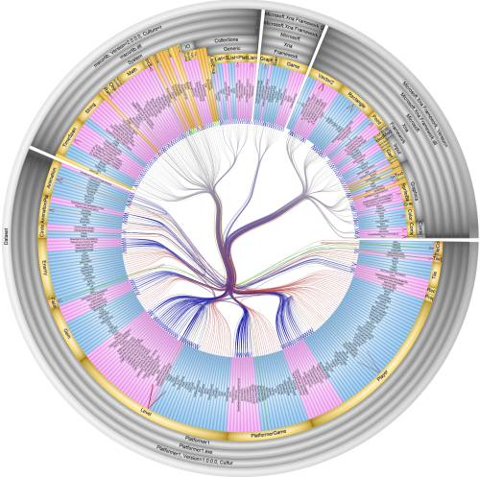
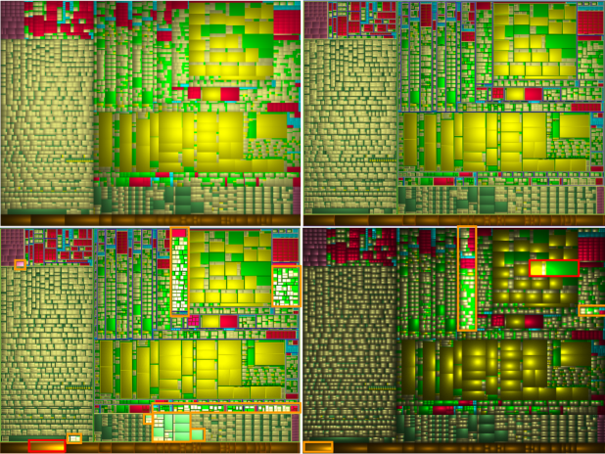
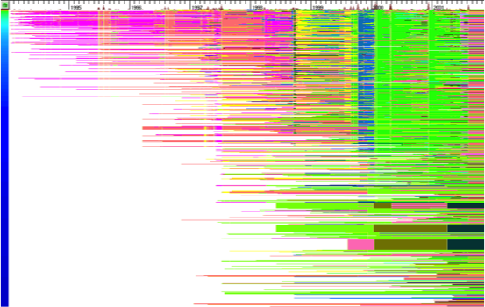
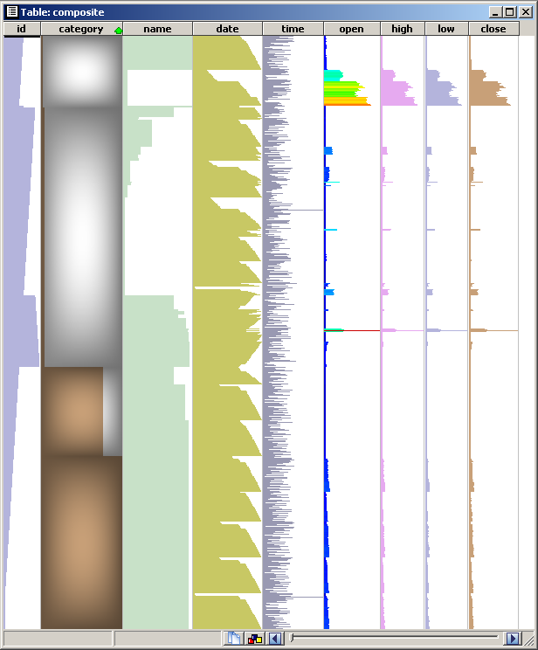

Software Visual Analytics
prof. dr. Alexandru (Alex) Telea
Department of Information and Computing Science
Utrecht University, the Netherlands

Slide 2
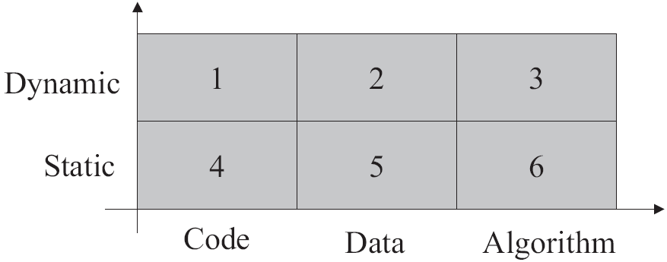
Software Visualization Taxonomies
1. Matrix of techniques [Myers, 1990]
data dynamics
type of data
2. Technique hierarchy [Oudshoorn et al., 1996]
3. Recent taxonomies [Diehl, 2006; Lanza and Marinescu, 2007]
structure visualization
behavior visualization
evolution visualization
simple and clear, so we’ll use this!

Slide 3
Software Visualization Pipeline
Software analysis
software
engineering
software
data
data
acquisition
internal
data
data
filtering
design
development
testing
maintenance
static analysis
dynamic analysis
debugging
evolution analysis
graph extraction
metric computation
dataflow analysis
control flow analysis
insight,
decisions
enriched data
Software visualization
human
interpretation
image
graphics
rendering
visual
representations
data
mapping
graph layouts
attribute mapping
graph drawing
texture mapping
antialiasing
interaction
The two sub-pipelines are typically weakly connected (very unfortunately)

Slide 4
Part 1:
Software Structure Visualization

Slide 5
Software Data to Visualize
Three types of data (used by structure/behavior/evolution visualizations)
1. Text
source code
commit logs
2. Attributes
file type
quality metrics, AST values (types, etc)
commit details (authors, date)
profiling & testing data
3. Relations
containment
associations (calls, uses, includes, inherits, clones, authors, ...)

Slide 6
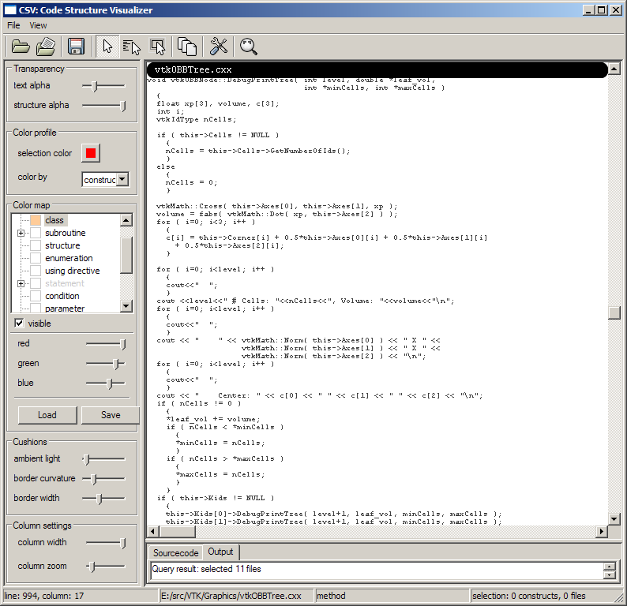
Source code structure
classical code editor
indentation shows some structure
Images from CSV tool (www.cs.rug.nl/svcg/SoftVis/VCN)

Slide 7
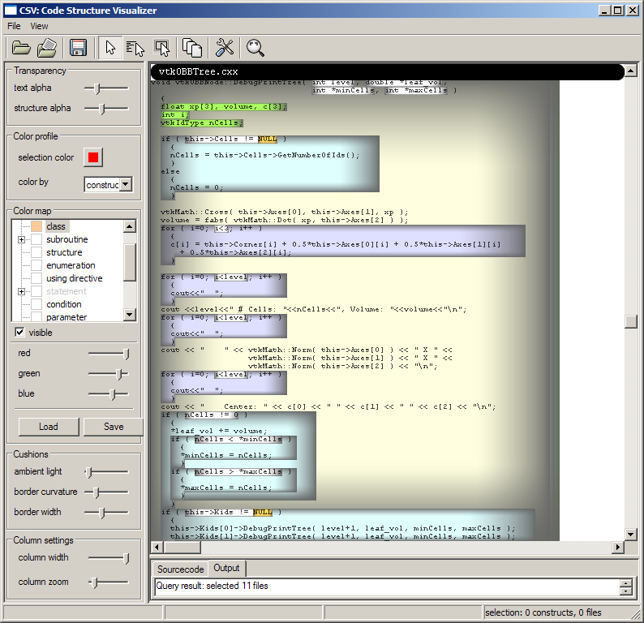
Source code structure
blend in structure cushions…
color shows construct type (functions, loops, control statements, declarations, …)
Images from CSV tool (www.cs.rug.nl/svcg/SoftVis/VCN)

Slide 8
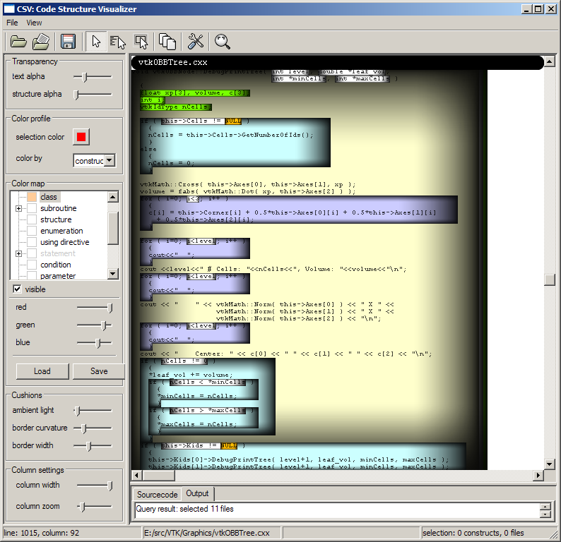
Source code structure
more structure cushions…
Images from CSV tool (www.cs.rug.nl/svcg/SoftVis/VCN)

Slide 9
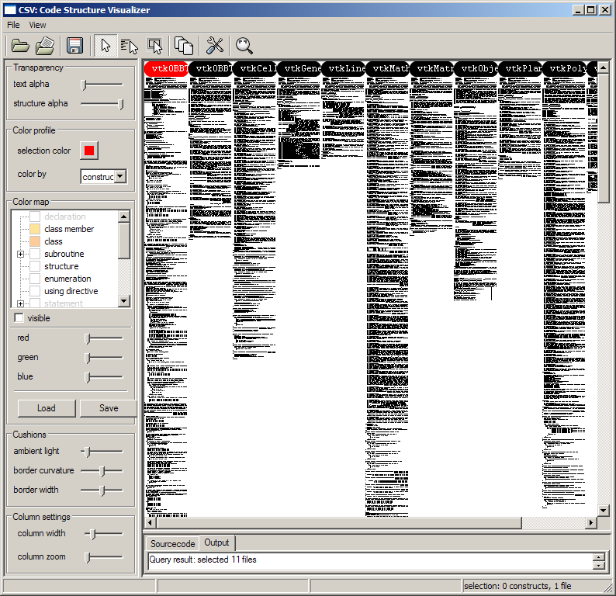
Source code structure
Dense pixel techniques
good to show data attributes (code age, bugs, quality metrics, …)
does not show structure
VTK class library
1 C++ file
10 headers
~7000 lines
VTK library: www.kitware.org/vtk

Slide 10
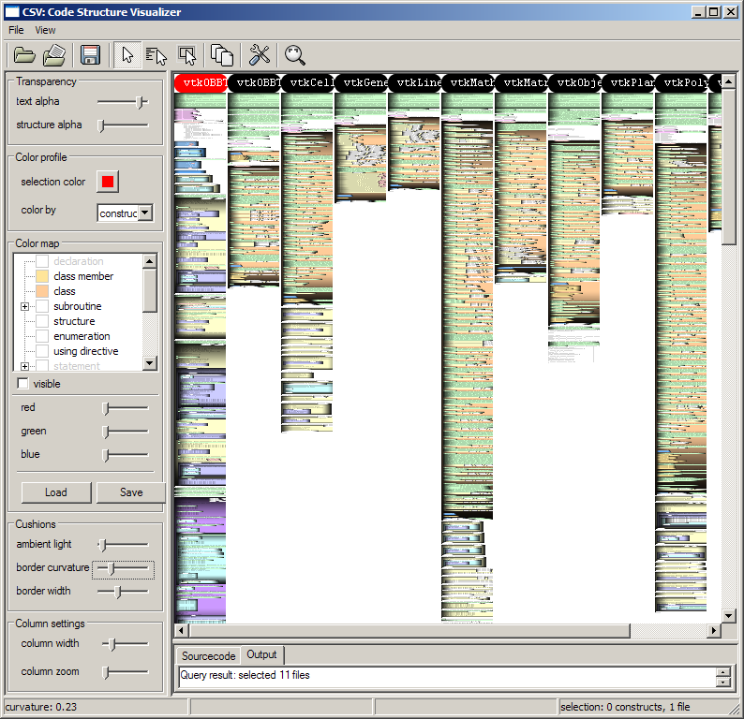
Source code structure
Add structure cushions
we start seeing things
source
headers
comment
class
iteration
if
…..
VTK library: www.kitware.org/vtk

Slide 11
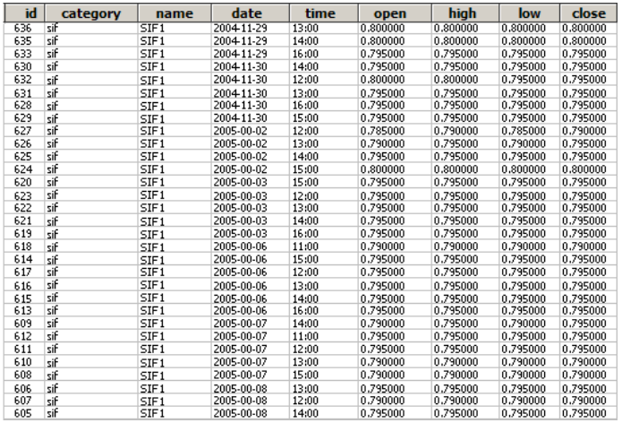
Tables
table: set of rows (observations) and columns (dimensions)
columns can have different types
rows and columns are not uniquely ordered
drawing a large table (> 10 columns or 50 rows) becomes useless…
How to visualize big tables?
Example: stock exchange data
m transactions
n attributes of a transaction

Slide 12
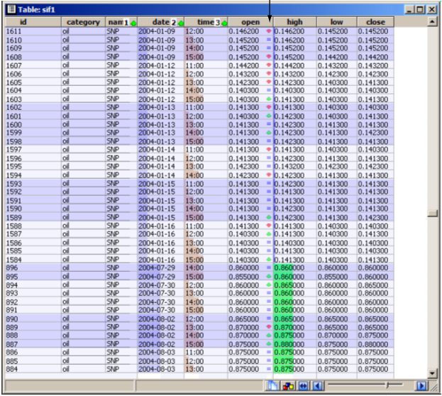
Tables
First enhancement: overlay bar charts on columns
Added value
quickly scrolling through the table pre-attentively highlights minima, maxima, and large changes
this allows us to explore large tables easily
minimal values for
‘stock value’ column
date
time
stock value
abrupt change for
‘stock value’ column
maximal values for
‘stock value’ column

Slide 13
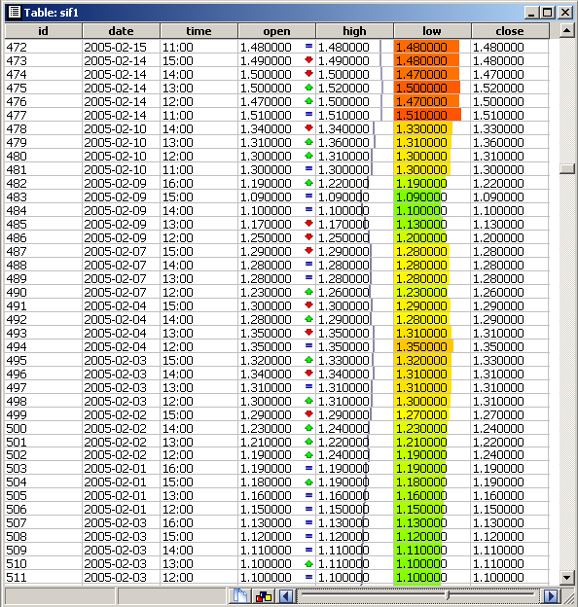
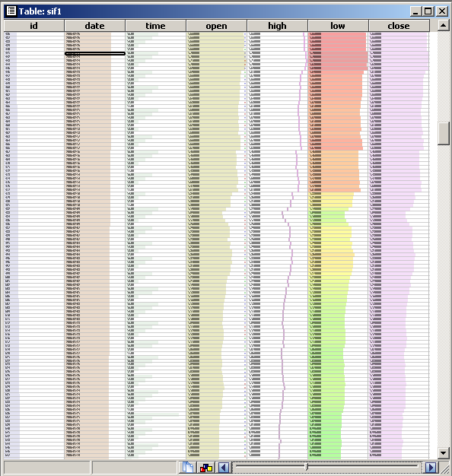
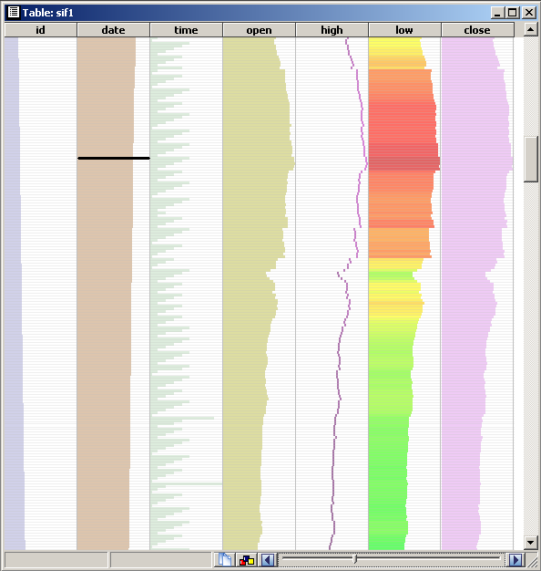
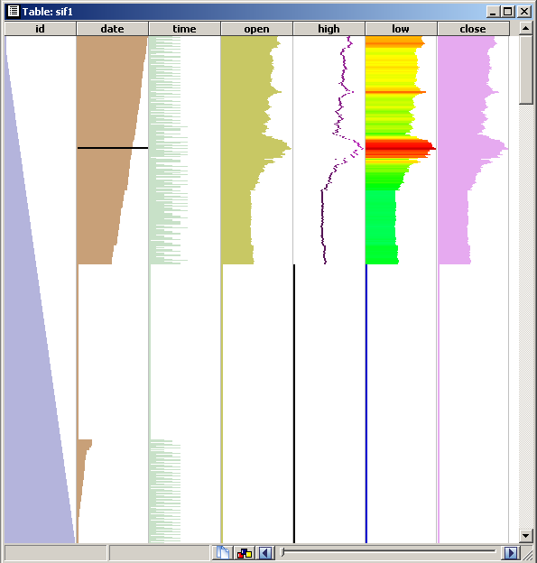
Tables
Second enhancement: the ‘table lens’technique [Rao et al, ’94]
shows the table at any user-chosen level of detail
text opacity=1
font size=12pt
text opacity ↓
font size ↓
text not drawn
bar opacity↑
bar opacity=1
simplification=on
min
zoom level
max
R. Rao, S. Card (1994) The table lens: merging graphical and symbolic representations in an interactive focus + context visualization for tabular information, Proc. ACM CHI, 318-322

Slide 14
Tables
Third enhancement: single-column sorting
sort table on values of user-selected column (attribute)
zoom-out mode shows distribution and correlation of column values
Stock data example
inversely correlated
directly correlated
table sorted on transaction ID

Slide 15
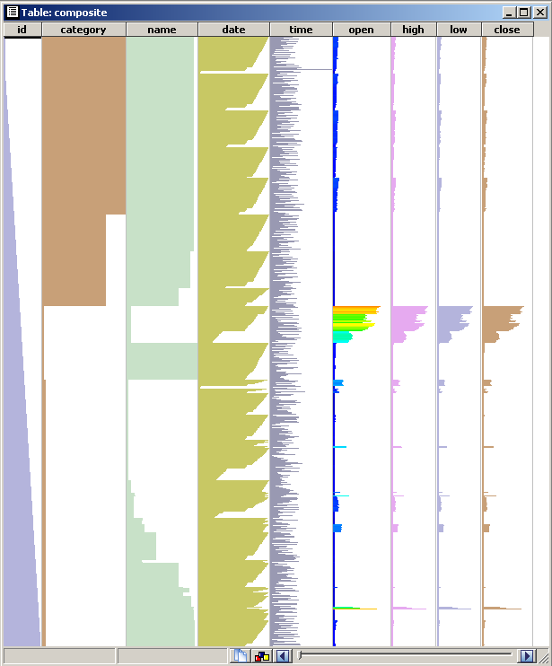
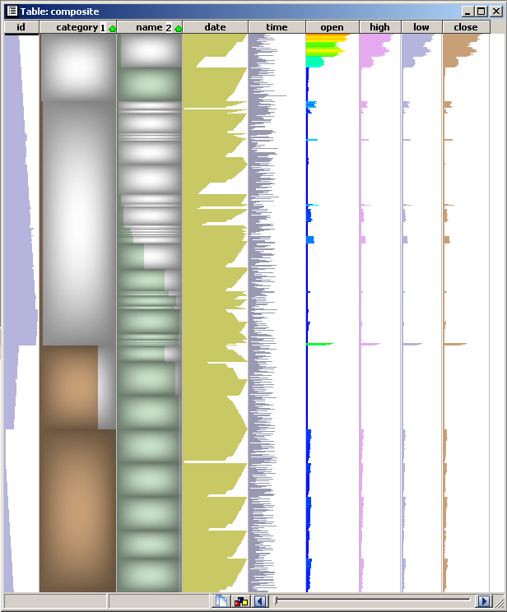
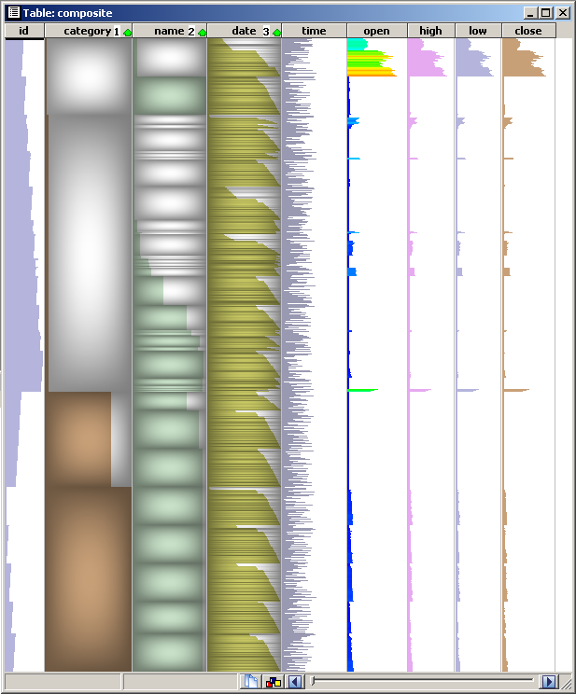
Tables
Fourth enhancement: multiple-column sorting and row grouping
sort table on multiple user-selected column values
emphasize same-value column ranges with cushions¹
Show stock data grouped by industry, company, and date
1
1
2
1
2
3
no sort
sort on industry
next sort on company
next sort on date
sorting has two roles
  group rows having same value in an attribute
  show how other attributes vary within a group
¹J. J. van Wijk, H. van de Wetering (1999) Cushion Treemaps: Visualization of Hierarchical Information, Proc. InfoVis, 73-81

Slide 16
Tables
Multiple sorting: generates on-the-fly a hierarchy (tree) from the table
one tree-level per sort
one node per group of sorted rows having the same value
We’ll see soon how to visualize this tree!
1
1
2
1
2
3
1. sort on
industry
2. sort on
company
…
3. sort on
date
…
…
…
…
…
…
…
…
…
…
…
…

Slide 17
Design Question: Trees or Tables?
Consider this simple table:
can do this…
Name | Age | Salary | Function
John Doe | 47 | 65K | management
Bill Smith | 35 | 40K | IT
Fanny Mae | 37 | 35K | administration
group by value
of Function to
create tree levels
create tree from table
each tree level =
add 1 column
All employees
or this…
mgmt
IT
admin
IT
IT
IT
IT
IT
IT
IT
IT
IT
IT
IT
IT
IT
IT
IT
IT
IT
IT
IT
IT
IT
IT
IT
IT
IT
IT
IT
IT
IT
IT
IT
IT
IT
IT
IT
IT
Conclusion
both designs are possible
‘right’ one depends on type of task
  compare items per category:
  use tree design
  compare all items across categories:
  use table design
All employees
mgmt
IT
admin
IT
IT
IT
IT
IT
IT
IT
IT
IT
IT
IT
IT
IT
IT
IT
IT
IT
IT
IT
IT
IT
IT
IT

Slide 18
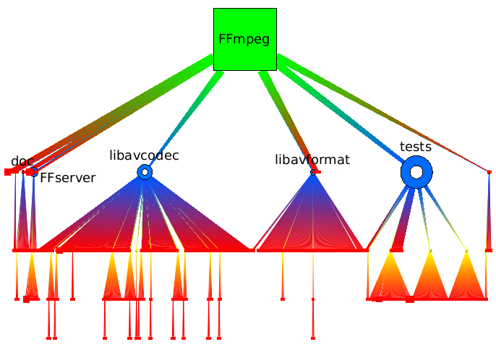
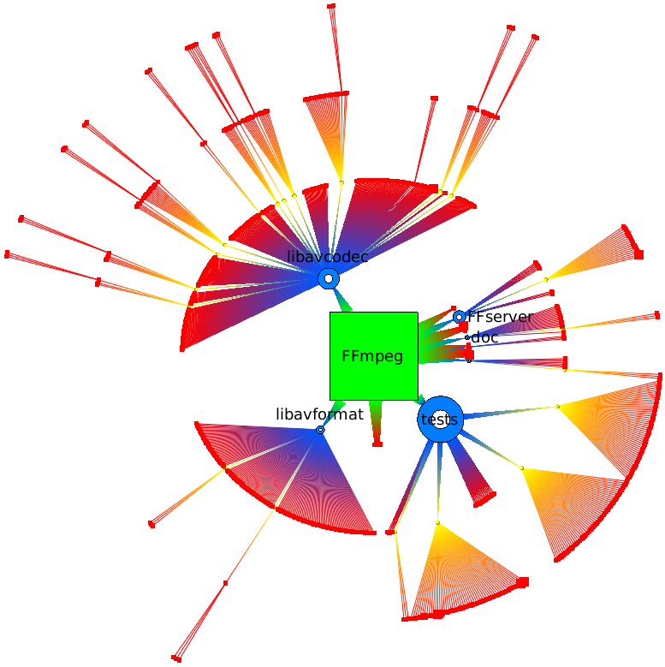
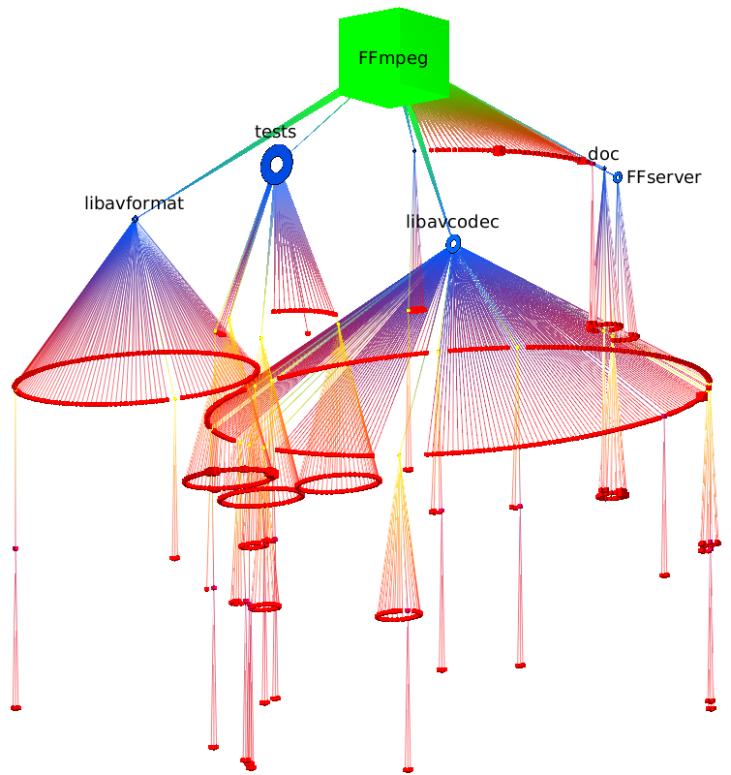
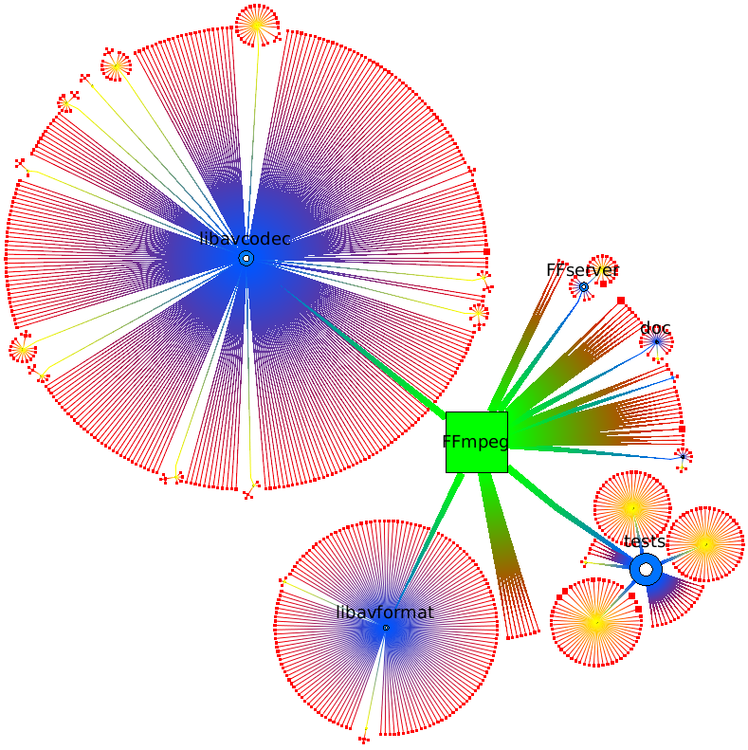

Hierarchies: Node-link layouts
most widespread: very intuitive
do not scale well to large hierarchies (more than 1K nodes)
Examples
icon size: folder size
icon shape+color: level in tree
ffmpeg video codec library: 785 files, 42 folders
rooted tree
radial tree
cone tree
bubble tree
Layouts generated with the Tulip visualization system (www.labri.fr/tulip)

Slide 19

Icicle plots
Basic idea
  nodes: rectangles; edges: not drawn explicitly, but shown by node positions
  one level per vertical band (root at left, leaves at right)
  siblings stacked vertically within a band
compact display, no clutter; node size = sum of subtree importance
root-to-leaves
sibling nodes on the same level
table lens, multiple sorting
icicle plot¹
We shall see several variations of the icicle plot further!
¹J. Kruskal, J. Landwehr, Icicle plots: Better displays for hierarchical clustering, JSTOR, 1983

Slide 20
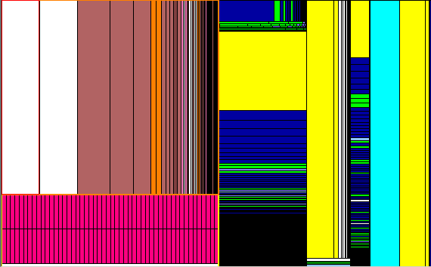

Treemaps [Shneiderman ‘92]
ffmpeg library
Basic idea: ‘slice and dice’ layout
1 node = 1 rectangle
child node rectangles: nested in the parent node rectangle (recursive subdivision)
leaf rectangle size and color show data attributes
edges: not drawn explicitly!
very compact: tens of thousands of nodes on one screen! no pixel wasted
aspect ratios are not very good; hierarchy depth unclear
How can we improve the basic idea?

Slide 21
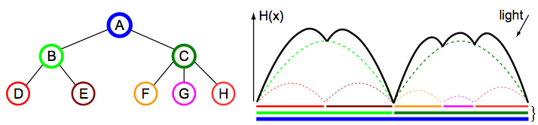
Squarified Cushion Treemaps
Two extensions:
enforce near-square aspect ratios during rectangle subdivision [Bruls et al ‘00]
use shading: cushion profiles to convey hierarchical structure [Van Wijk et al ’99]
for each rectangle r_{i} (except root)
  define 2D parabola h_{i} (x,y) with height H_{i} = f ^{d} (d = depth of r_{i} in tree)
compute global height h = Σ_{i} h_{i}
for each image pixel I(x,y)
  I(x,y) = shading (h(x,y))
  use an oblique light source for better results
tree
cushion profile
treemap (shown in 1D)
M. Bruls, K. Huizing, J. J. van Wijk (1999) Squarified Treemaps, Proc. VisSym, 322-330
J. J. van Wijk, H. van de Wetering (1999) Cushion treemaps: Visualization of hierarchical information, Proc. InfoVis, 135-142

Slide 22
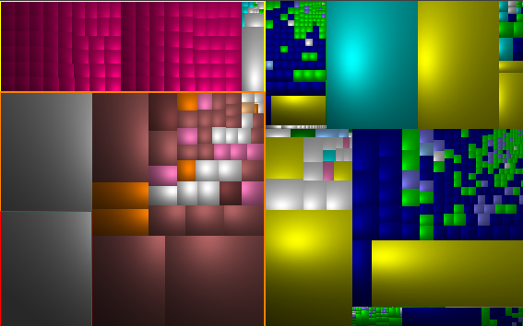
Squarified Cushion Treemaps
Two extensions:
enforce near-square aspect ratios during rectangle subdivision [Bruls et al ‘00]
use shading: cushion profiles to convey hierarchical structure [Van Wijk et al ’99]
ffmpeg C library
rectangle borders are not explicitly drawn → gain space
borders are implicit in the shading discontinuities
discontinuity strength conveys tree depth levels
near-square aspect ratio of cells allows easier size (area) comparison
SequoiaView tool (www.win.tue.nl/sequoiaview)

Slide 23
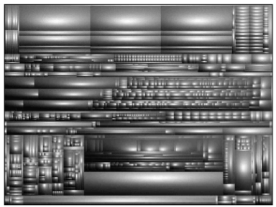
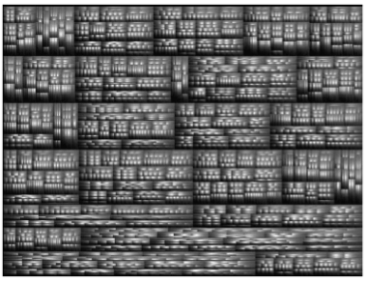
Squarified Cushion Treemaps
Comparison of methods
hard disk, ~30K files
Slice and dice layout
unbalanced cell sizes
(hard to compare)
tree structure is not very clear
Squarified layout
balanced cell sizes
(easier to compare)
tree structure is extremely salient
SequoiaView tool (www.win.tue.nl/sequoiaview)

Slide 24
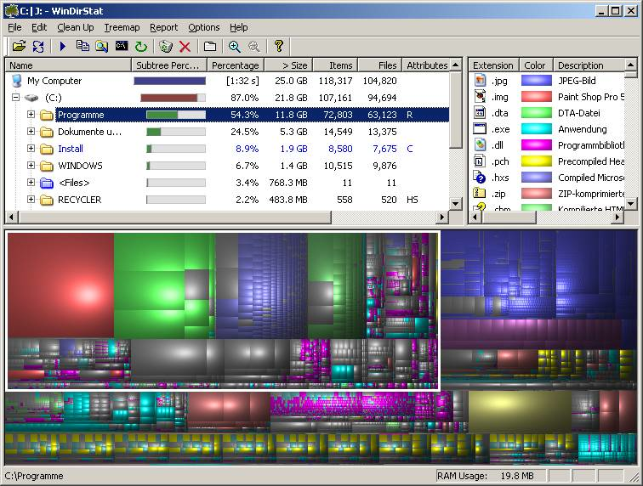
Squarified Cushion Treemaps
Example 1: WinDirStat tool¹
visualize a file system (e.g. your hard disk)
¹ http://windirstat.info

Slide 25
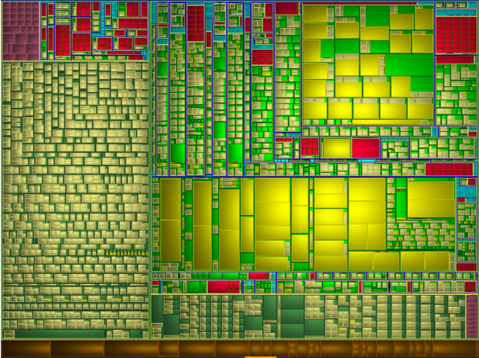
Interface structure
Interface: symbols organized as headers or namespaces
visualize with treemaps
  cell size: #lines of code / #arguments (function) or #fields (compound type)
  cell color: symbol type
‘public’
symbols
in files
arguments
functions
fields
typedefs
global vars
files
files

Slide 26
Interface structure
Targeted questions:
- what kind of symbols are in a library’s headers?
- how are namespaces used in interface headers?
- does a header have a simple / uniform structure or not?
- are there heavy functions from a parameter-passing view?
C global
namespace
C++ std namespace
symbols
in file
brushed
file

Slide 27
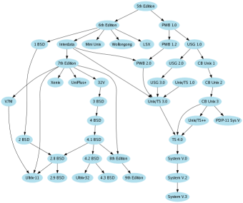
Directed acyclic graphs (DAGs)
class hierarchies (multiple inheritance)
organization structure (multiple bosses)
also created from general graphs by removing cycles
Hierarchical layout [Sugiyama et al ’81]
UNIX system history
(top->down = timeline)
Layout made with the GraphViz package (www.graphviz.org)

Slide 28
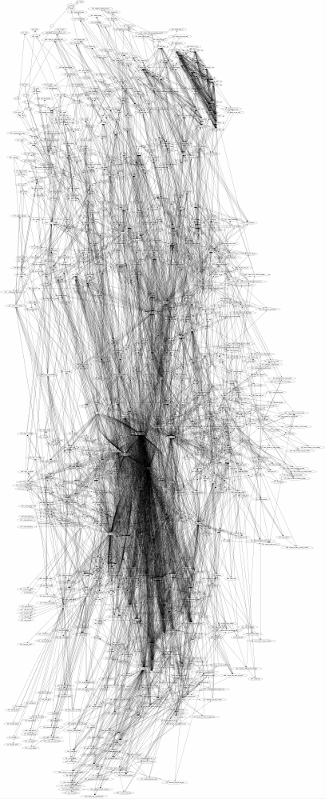
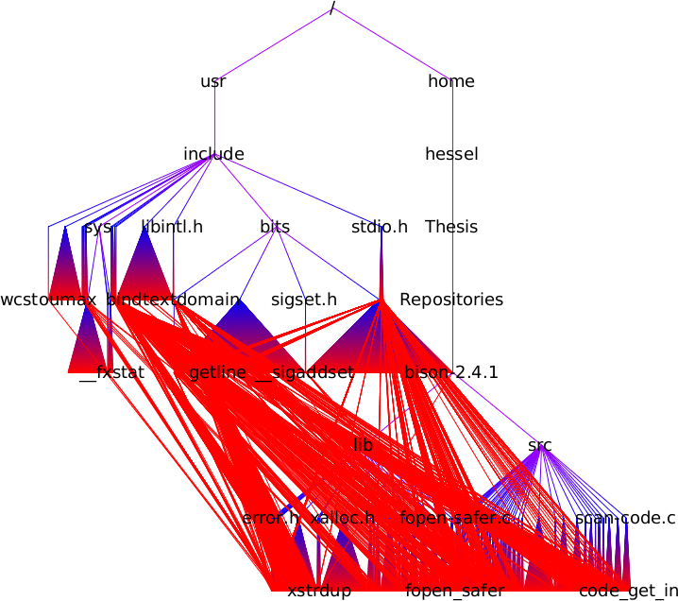
Directed acyclic graphs (DAGs)
Hierarchical layout scalability
OK for < 1000 nodes or edges
too many crossings and/or bad aspect ratios for larger graphs
Bison library call graph (3.214 nodes, 14.382 edges)
GraphViz¹ hierarchical
DAG layout
Tulip² hierarchical
DAG layout
¹ www.graphviz.org ² tulip.labri.fr

Slide 29
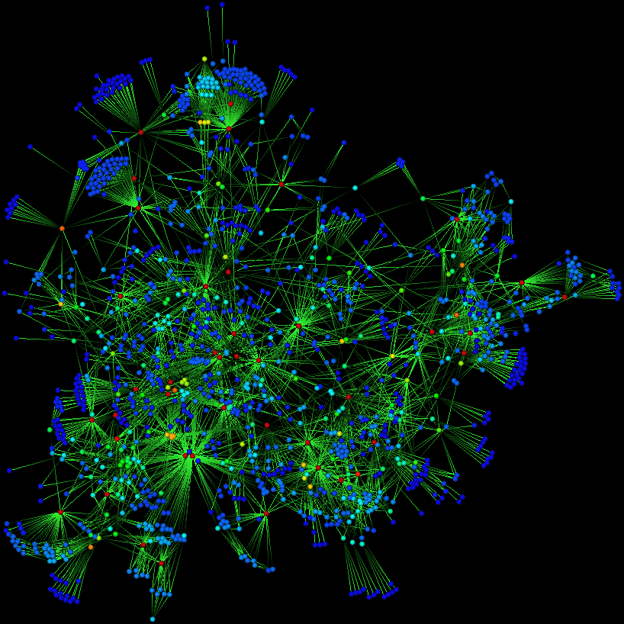
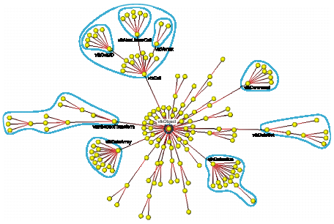
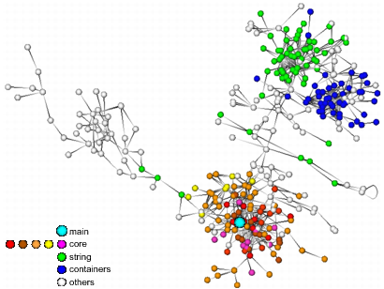
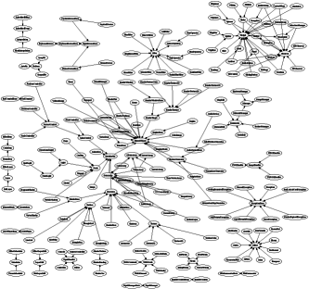
General graphs
not necessarily directed; can have cycles too
laid out by computing the 2D node placement that minimizes the sum of edge lengths without creating too much crowding
no good layout engine for graphs with more than ~1000 nodes/edges
call graph
inheritance tree
call graph
Layouts created by neato tool, GraphViz package

Slide 30
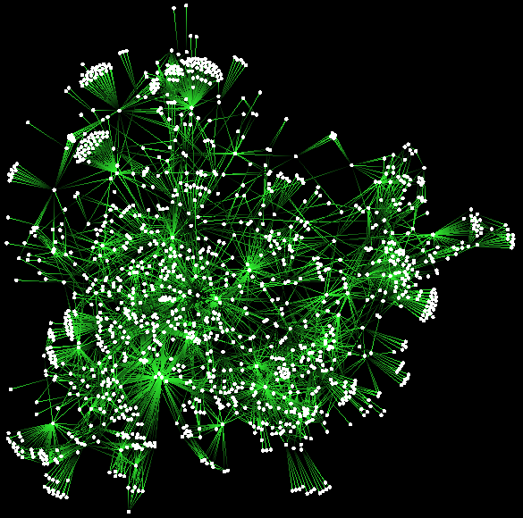
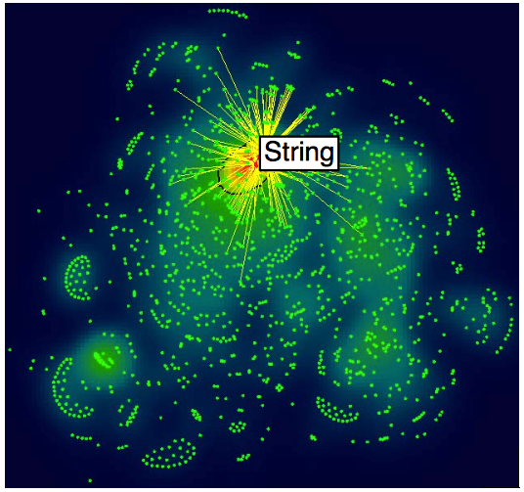
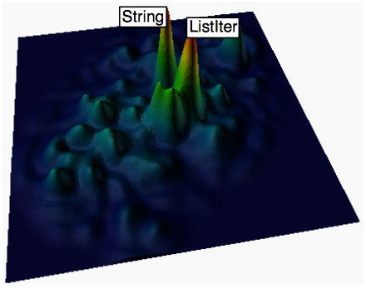
Graph splatting
Going from discrete scatterplots to continuous fields
Main idea
transform the discrete scatterplot (graph drawing) into a continuous field
visualize this field using classical SciVis methods
  continuous color coding (e.g. using rainbow colormap)
  3D height plots, contours
abstract from details, show overview (good for big data)
original graph layout
can get cluttered for large data
color-coded density field
we see local point density well
color-and-height coded density field
we see local point density even better

Slide 31
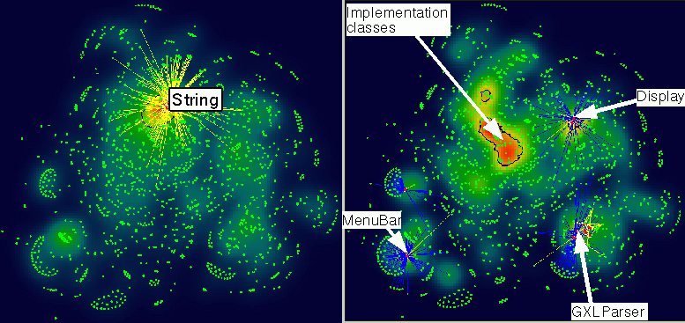
Graph splatting
use factor k_{i} to specify the importance of i^{th} node
example: k_{i} = number of requirements / provisions of a component (out/ingoing edges)
high densities denote strongly connected clusters / important nodes
components using String class
package requirements
Java call graph (5000 nodes, 2000 relations), courtesy Nokia Research

Slide 32
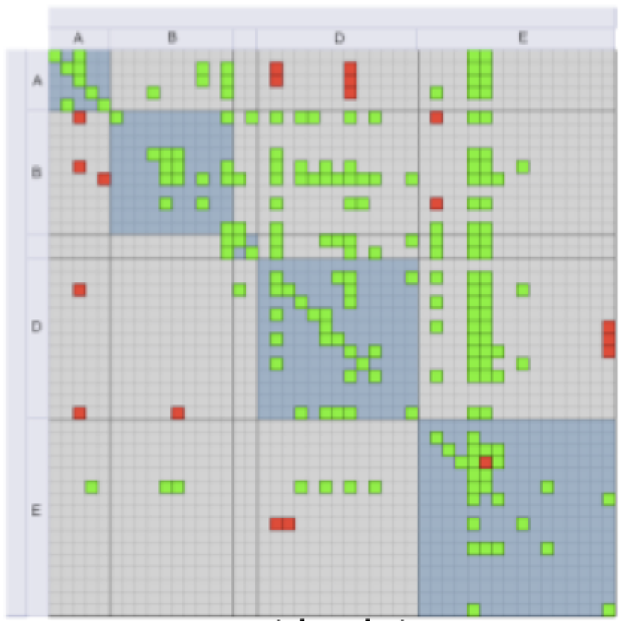
Matrix plots
a graph can be represented as an adjacency matrix
ingoing edges
1
2
3
4
1
2
3
4
1
X | X
X
 | X |  | X
 | X
1
X | X
X |  | X | X
 | X |  | X
 | X | X
3
2
2
1
2
3
3
4
4
4
graph
directed adjacency matrix
undirected adjacency matrix
Call graph & architecture
Order of rows and columns highly impacts the visualization effectiveness, e.g. spotting clusters
¹ J. Abello, F. van Ham (2004) Matrix Zoom: A Visual Interface to Semi-External Graphs. Proc. IEEE InfoVis

Slide 33
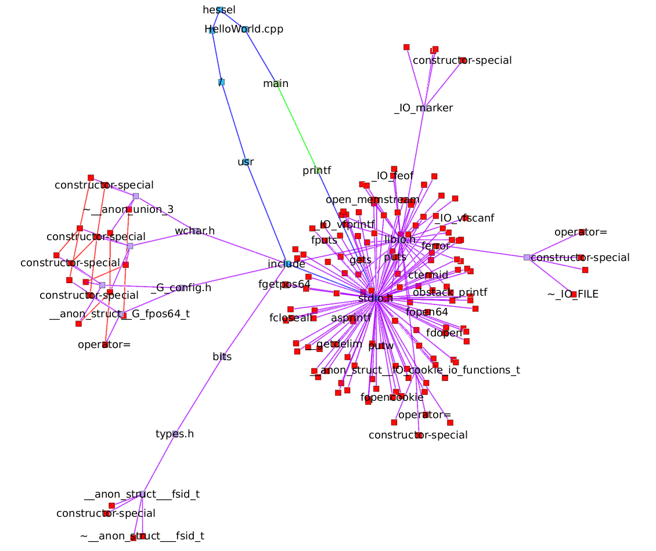
Compound graphs
Two types of edges
containment (method in class; function in file; file in folder; variable in scope; ...)
association (any relation e.g. calls, uses, reads/writes, depends on, defines, ...)
Node-link layouts
very bad choice!
mix containment and association edges
occlusions, clutter
layout changes significantly if you
  add/remove a few nodes/edges
  change the layout parameters
how to read such a layout?
Compound digraph of a C Hello World program
folders & files
functions

Slide 34
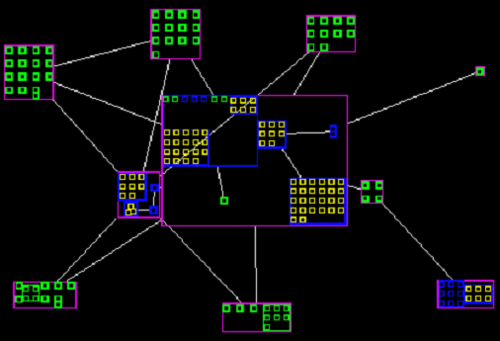
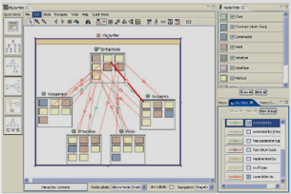
Compound graphs: Nested layouts
Main idea
containment: spatial nesting
associations: node-link metaphor
SHriMP layout (Simple Hierarchical Multi-Perspective) [Storey and Muller ’95]
  very popular, tens of tool implementations
  limited scalability, clutter
SoftVision tool [Telea et al. ’02]
Creole tool (www.thechiselgroup.org/creole)

Slide 35
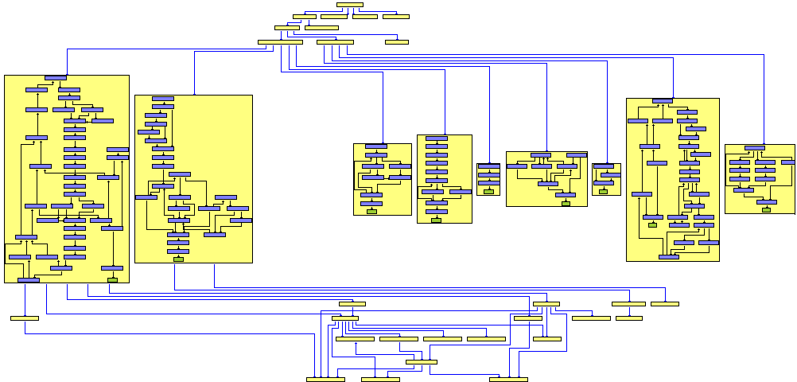
Compound graphs: Nested layouts
State of the art
aggregate relations via parent nodes
works OK up to few hundred nodes, few hierarchy levels
G. Sander, Graph Layout through the VCG tool, Proc. Graph Drawing, 1995
Practical intro: T. Würthinger, Visualization of Program Dependence Graphs, http://ssw.jku.at/Research/Papers/Wuerthinger07Master

Slide 36
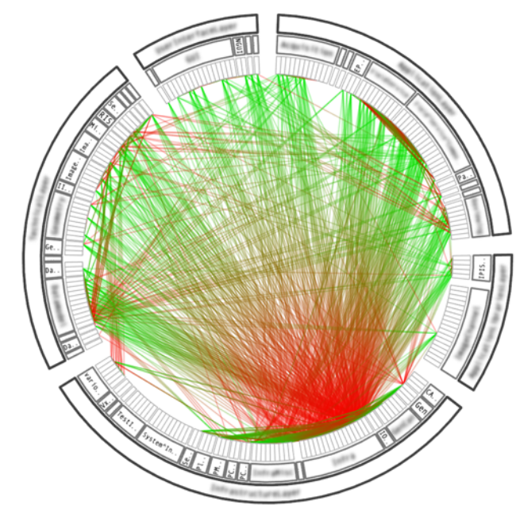
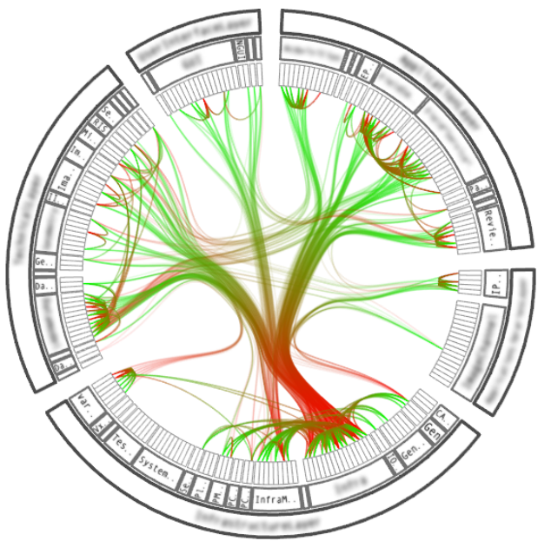

Compound graphs: Edge bundling
How to show a large graph that links elements of a hierarchy?
if we draw links between all elements as straight lines…
…we get a big mess!
straight lines
edge bundles
bundling
^{SolidSX tool}
www.cs.rug.nl/svcg/SoftVis/Dependencies

Slide 37
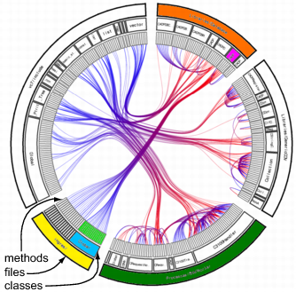
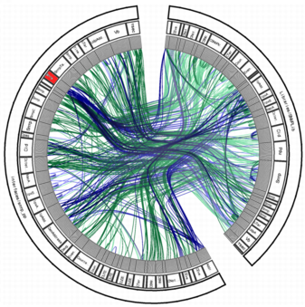

Edge bundling: An use-case
Best existing technique to showing containment and associations
application: modularity / coupling assessment
  hard to quantify in a metric…
  …but extremely easy to see!
Modular system
Monolithic system
Decoupled system
blue = caller, red = called
all functions in the yellow file
call the purple class
green file has many self-calls
blue = virtual, green = static functions
red class has many virtual calls
(possible interface class)
many intra-module calls
few inter-module calls
typical for library software
^{SolidSX tool}
www.cs.rug.nl/svcg/SoftVis/Dependencies

Slide 38

Edge bundling variations
Bundling strength
vary `spline tightness’ factor
continuous scale from
  straight lines (full detail, but cluttered view)
  tight+compact bundles (no clutter, but high simplification)

Slide 39
Edge bundling variations
if associations are correlated with structure, HEBs shows this clearly!
images are intuitive for most users
edge overlaps instead of edge crossings!
  overlaps communicate information
  easy to visually follow a bundle
  built-in scalability (bundling = free aggregation)
Structure and associations of C# system
Enhancements
node and edge color coding
edge alpha blending
  saturated = high density = many edges
  transparent = low density = few edges
aggregation and navigation
  collapse and expand nodes
  replace multiple edges by single one
  (like in NodeTrix, see lecture 1)
shaded cushions
  emphasize structure (hierarchy)
Image generated with SolidSX tool

Slide 40


Edge bundling variations
Layout variations
HEBs work for any other graph layouts besides radial plots
however, the trees used for edge routing are easiest/best mapped on radial plots
squarified treemap
bubble layout

Slide 41




Edge bundling vs chord diagrams
Somewhat similar, but really not the same thing!
Chord diagrams
Graph bundling
Circos (circos.ca)
Gephi (gephi.org)
SolidSX (solidsourceit.com)
Tulip (tulip.labri.fr)
data: general graph (w/o hierarchy)
method: draw circle arcs between nodes
result: somehow see grouping of edges
connecting same nodes
result: no real grouping of edges relating
nodes in same container (hierarchy)
implementation: very simple
data: compound graph (with hierarchy)
method: draw curves based on hierarchy
result: clearly see how edges relating
nodes in same hierarchies relate to each
other
implementation: slightly more complex

Slide 42

Edge bundling application
How bad are clones (code duplicates) in a system?
extract a clone graph
  nodes = files (weight = % code duplicated within file)
  edges = files sharing code (weight = % code shared between files)
most clones occur within same folder
select file to see with whom it shares code
Image generated with SolidSDD tool

Slide 43
Comparison of techniques
Charts
good to show data tables having few dimensions (up to 10)
Table lenses
good to explore tables having many rows (tens of thousands), compare individual columns
Parallel coordinate plots
much like a summary/aggregation of table lenses (when we don’t care about row order)
Projections
good to find clusters of similar table rows, scale very well to table #rows and #columns
Scatterplot matrices
good to correlate individual columns for tables of 10-20 columns
Node-link layouts
good to show tree/graph structures up to 500-1000 nodes/edges, but suffer from clutter
Treemaps
good to show very large attributed trees (10-40K elements)
Matrix plots
good to show small graphs in detail with no clutter (100-400 nodes), but kind of abstract

Slide 44
Part 2:
Software Evolution Visualization

Slide 45
Evolution at line level
take one file in a repository
visualize its changes through its lifetime at line level
Idea
extend the dense pixel map method used for source code [Eick et al ’92]
Line colour encoding
L. Voinea, A. Telea, J. J. van Wijk, CVSscan: Visualization of source code evolution, ACM SOFTVIS, 2005

Slide 46

Evolution at line level
File-based layout
line y position is determined by each version separately
compact line blocks are compact in each version
Discrete time (versions)
Inserted
lines
local
line position

Slide 47

Evolution at line level
Line-based layout
line y position is determined so that the same line stays on the same y over its lifetime
compact line blocks appear now horizontally
Discrete time (versions)
Inserted
lines
local
line position
global
line position

Slide 48

Evolution at line level
Version-centric layout
select one version v
line y position is file-based for v and smoothly changes to line-based for other versions
Discrete time (versions)
Inserted
lines
Local
line position
Global
line position
Interpolated
position
Empty space size decrease
Left bound
Focus
Right bound
empty space
version
empty space

Slide 49


Evolution at line level
CVSscan tool
code metric bar: code size
change per separate line
time metric bar: code size
change in time
detailed code view
around mouse cursor
move mouse in code view: show code that
will be inserted / was removed from current location

Slide 50

Evolution at line level – several files
extend idea to a few (1..4) files
stack several line-level views, one per file
line color = construct type
helps doing cross-file analysis
large size jumps = code refactoring
less wavy patterns = stable code
horizontal patterns = unchanged code
file
lines
comments
function bodies
time
(version)
strings
function headers

Slide 51

Evolution at file level
use 2D dense pixel layouts (similar to table lens idea)
x = time, y = files; one file = one horizontal band; one version = one band segment
time (version)
project
activity
files sorted
by order
in folders
number of
commits
color = version author ID

Slide 52
Evolution at file level
Which are the most changed files, and who worked in those?
sort files on activity, color on author ID
most
active
files
files sorted
by activity

Slide 53

Evolution at file level
What type of code appeared when in the project’s lifetime?
sort files on age, color on file type
oldest
files
activity ~
age…
files sorted
by age
.tcl, .py
.h
.cxx
.in
.pdf

Slide 54

Evolution at file level
How do bug reports correlate with bug fixes?
color on presence of keywords “bug” and “fix” in commit logs
files sorted
by age
no hits
“bug”
“fix”
“bug” and “fix”

Slide 55
Evolution at file level
Which files evolved similarly?
consider similarity of change moments
cluster all files using this metric
visualize cluster tree and user-selected ‘cut’ in the tree
cluster tree: icicle plot; color = cluster cohesion
visualization of
selected cut: one
cushion per cluster

Slide 56



Evolution at file level
What is the risk of releasing the software now?
show bug-reports density using texture splatting
group files by change similarity
color by directory name to correlate file similarity with file location
What we see
largest debugging activity localized in a single folder
changes in that folder do not propagate outside (change-similar files are in 1 cluster)
hence, system is well-structured for localized maintenance!

Slide 57

Evolution at project level
upper-level decision makers do not have time to look at the evolution at each file
visualize aggregated evolution metrics at project level
Team risk analysis
software projects are done by developer teams over years
find if team composition is risky for the project’s maintenance
extract project evolution from software repositories
compute impact of each developer over each file / function / ….
visualize impact evolution in an aggregated manner

Slide 58

Project level visualization
aggregate impact (#files modified by each developer) over time
visualize resulting time series using the theme river metaphor [Havre et al ‘02]
Project A (open-source)
software grows in time
impact is balanced over most developers
Project B (commercial)
software grows in time at about the same rate
but one developer owns most of the code
what if this person leaves the team?!
S. Havre, E. Hetzler, P. Whitney, L. Nowell, ThemeRiver: Visualizing thematic changes in large document collections, IEEE TVCG 8(1), 2002

Slide 59




Evolution at syntax level
How do two revisions of a source-code project differ?
find correspondences between their two syntax trees
matching function can consider name (easy) ... full syntax tree (complex)
color-code nodes (red = unmatched, green = selected for showing details)
show two versions with icicle plots, correspondences with bundled edges
Azureus v2.2
(2283 leafs)
Azureus v2.3
(3179 leafs)
overview
selected detail

Slide 60

Evolution at syntax level: More revisions
C++ code bases (6K LOC/version, 6 versions of interest)

Slide 61
Evolution at syntax level: More revisions
code shrinks
with ~10%

Slide 62
Evolution at syntax level: More revisions
a method f
gets split
a small
fragment
drifts to end

Slide 63
Evolution at syntax level: More revisions
a method f
gets split
surviving code of f

Slide 64
Evolution at syntax level
f undergoes now many changes
a method f
gets split
surviving code of f
…but stays constant from now on

Slide 65

Evolution at syntax level: More revision
two fragments
get swapped

Slide 66
Evolution at syntax level: More revisions
…and the get
swapped once
more

Slide 67
Evolution at syntax level: More revisions
…and there is a third swap (if you look carefully)

Slide 68

Evolution at clone level
How does code duplication vary over time?
extract code clone graphs for each revision
animate between their bundled versions
color: red = newly introduced clones (bad); green = removed clones (good)
time (revision number)
Wicket code base: 14 revisions, 8799 clones, 92810 clone relations

Slide 69
Part 3:
Real-World Applications

Slide 70
Post-Mortem Assessment
Situation
client: established embedded software producer
product: 8 years evolution (2002-2008)
  3.5 MLOC of code in C166 dialect (1881 ﬁles)
  1 MLOC of headers (2454 ﬁles)
  15 releases
  3 teams = ~60 people (2 x EU, 1 x India)
product failed to meet requests, at end...
Questions
what happened right/wrong?
how to prevent such errors in the future?
A. Telea, L. Voinea, Case Study: Visual Analytics in Software Product Assessments, IEEE Vissoft, 2009

Slide 71
Our context
Constraints
data: source code repository only
time: answers needed in max. 1 week
we were unfamiliar with the application
Questions
how to get the most insight & best address questions with these constraints?

Slide 72




Methodology
Raw data
Data enrichment
Enriched data
Visualization
call graphs
dependency graphs
static metrics
code duplication
static analysis
repository
charts
treemaps
modification requests (MRs)
authors
changes / type document
evolution analysis
graphs
timelines
refine
present
stakeholders
ask
observations
& questions
interpret
perfect instance of a visual analytics process:
  multiple data types, multiple tools
  tight combination of data extraction, processing, visualization
  incremental hypothesis refinement
final conclusions

Slide 73


Requirements: MR Duration
files
time
MR related check-in
R1.3 - start
little increase in the file curve – most activity in old files
suggests too long maintenance & closure of requirements

Slide 74


Requirements: MR Duration
time
graph: # commits referring to MRs within a given id range
in mid 2008, activity related to MRs from 2006 still takes place
MR ids (1 bar=100 MRs)

Slide 75




Team: Code Ownership
file
module
package
#developers
#modification requests (MRs)
1
>8
1
>30
MR closure (days)
team A
team B
team C
1
>90
large part of software affected by long open-standing MRs
Most of these are assigned to team A (largest team)…
…and this team was reported to have communication problems!

Slide 76


Code: Dependencies
package
module
file
package
module
file
package
module
file
uses
= call, type, variable, macro, …
is used
iface
Most dependencies occur via the iface, basicfunctions and platform packages
Filter out these allowed dependencies…
…to discover unwanted dependencies
These are accesses that bypass established interfaces

Slide 77


Code: Call graph
High coupling at package level
This image does not tell us very much
Select only modules which are mutually call dependent…
…to discover layering violations
Not a strict layering in the system (as it should be)

Slide 78




Code: Quality Metrics
Moderate code + dependency growth
does not explain product’s problems
Average complexity/function > 20
Total complexity: up 20% in R1.3
testing can be hard!
possible cause of product’s problems

Slide 79

Code: Duplication
External duplication
links: modules that contain similar code
blocks of >25 LOC
Internal duplication
color: # duplicated blocks within a file
Little external/internal duplication
Arguably not a problem for testing
# duplicated blocks
1
60

Slide 80

Documentation
delay
time
30% of files are documentation
updated regularly
grow in sync with rest of code base
1688 other files
854 doc + html
time
40% of docs frequently updated
rest seem to be ‘stale’
Docs (sorted on activity)
Code is arguably well documented…
…so refactoring is likely to be doable
Start from up-to-date docs

Slide 81
Conclusion
delay
Code size: Quite stable (not a problem)
Code quality: Complexity is a problem
Architecture: Clean in general
Documentation: Well maintained
Progress slow due to code complexity & team set-up
TODO’s:
1. Code is good to continue with, but reduce complexity
2. Task-to-team reassignment needed
Customer did this and was happy with the decision
time
30% of files are documentation
updated regularly
grow in sync with rest of code base
1688 other files
854 doc + html
time
40% of docs frequently updated
rest seem to be ‘stale’
Docs (sorted on activity)
Code is arguably well documented…
…so refactoring is likely to be doable
Start from up-to-date docs

Slide 82
Part 4:
Visualization Tools

Slide 83
Getting the Tools
SolidSX
visualize structure, associations, and attributes of source code
.NET, Java, C/C++
SolidSDD
visualize clones of source code
C/C++, C#, Java
SolidSTA
visualize evolution of source code (including metrics)
SVN, Git, TFS (metrics for C/C++/C#)
http://www.staff.science.uu.nl/~telea001/Software

Slide 84

Overall Tool Architecture

Slide 85


SolidSX: Software eXplorer
Code view
Tree browser
Treemap
Table lens
HEB view

Slide 86
SolidSX: Software eXplorer
reads .NET, Java, C/C++
extracts hierarchy (physical/scope), relations (calls, uses, implements, ...)
computes several standard quality metrics (size, complexity, fan-in, ...)
visualizes all above

Slide 87


SolidSX Usage
1. Locate & start the tool
2. Load a sample dataset
(File|Open dataset)
C:\SolidSource\SolidSX2.15\bin\
SolidSX2.exe
C:\SolidSource\SolidSX2.15\examples\
NumberPuzzle.exe.db

Slide 88

SolidSX Usage
Node list view
you get to see this by default after loading a dataset
Contains all entities (nodes) in the loaded dataset, and their attributes
Example: MemoForm(String)
is a public constructor having a call fan-in of 1 and fan-out of 16

Slide 89

SolidSX Usage
Radial view
open by View|Radial View
shows the entire compound attributed graph in the loaded dataset
has tons of customizations (we’ll discuss some next)
Mid pane: radial view
Bundles: relations
Left pane:
Tree view
on hierarchy
Right pane:
Configuration
options
Rings: hierarchy

Slide 90



SolidSX Usage
Radial view: Navigation
expand or collapse any subsystem of interest (right-mouse click on subsystem)
relations get automatically aggregated (collapse) or shown (expansion)
select root, expand
all recursively
select Number Puzzle.exe,
expand it recursively
Shows all data
(maybe too much)
Abstracts system
libraries

Slide 91

SolidSX Usage
Linked views
select any item in any view
add it to user selection (right-shift click menu)
Item gets highlighted in all views
select printCurrentPuzzleRadioButtom
in the Node List view…
…the same item gets highlighted in the Radial view

Slide 92

SolidSX Usage
Customizing the views
increase non leaf height (radial view settings) to better see non-leaf node names
non-leaf rings become thicker, so it’s easier to read their names

Slide 93


SolidSX Usage
Customizing the views
play with the linearization value to see why edge bundling is useful ☺
strongly bundled:
we clearly see how
things depend on each other
no bundling:
classical straight-line view;
pretty useless!

Slide 94


SolidSX Usage
Customizing the views
select only specific edges (settings: right-click on edge selection filter)
you can define many kinds of filters on any edge attributes
…we get to see the call graph!
Example: select only edges of type “call”…

Slide 95

SolidSX Usage
Customizing the views
select only edges connected to a subsystem (shift-click on desired node)
Example: shift-click PrintForm shows all calls from PrintForm to anywhere else

Slide 96

SolidSX Usage
Customizing the views
show other data attributes
example: show code complexity
use a continuous colormap
(green-yellow-red)
color nodes by complexity attribute
aggregate children values to compute parent value

Slide 97



SolidSX Usage
Table view
show all attributes available for all nodes (or edges)
sort/zoom options following table lens metaphor
sort on complexity
zoom out to see full-dataset correlations

Slide 98


SolidSX Usage
Table view and radial view
select most complex item (method) in table view (right-click, add to user selection)
see where that method is in the radial view
the method is defined here!
select most complex item (top of table)

Slide 99


SolidSX Usage
Treemap view
shows software hierarchy; can use color, size, annotation to show 3 any attributes
Set area to show codesize
Set color to show fan-in
(don’t forget to choose aggregation and a continuous colormap)
Fan-in: system libs (right) contain
most call targets
Fan-out: user code (left) emits most calls

Slide 100

SolidSX: How to get data
From .NET compiled code
File | .NET importer
then select any .NET project (.exe’s, .dll’s)
specify where the extracted data is to be saved (SQLite .db file)

Slide 101



SolidSX: How to get data
From Java source code
File | Java source importer
then select the root folder of a Java source code base
specify the java.exe tool and optional classpath
May get some errors (unresolved symbols)
Can typically ignore them.

Slide 102


SolidSX: How to get data
From Visual C++ (older version)
File | BSC importer
then select a Visual C++ BSC file (created when compiling with browse info on)
example: C:\SolidSource\SolidSX1.31_SDD\datasets\AFMM.bsc
Select which folders (from the BSC) contain user code

Slide 103
SolidSDD: Clone analysis
reads source code (C/C++, Java, C#)
extracts clones (code duplicates) and duplication metrics
visualizes clones in detail and at system-wide level

Slide 104


SolidDD Usage
1. Locate & start the tool
2. Create a new project
(File|New...)
C:\SolidSource\SolidSDD\bin\
SolidSDD.exe

Slide 105

SolidDD: Create new project
Where the source code is
Which file types I care to analyze
What language is the code in
Precision of clone detection
How many gaps do I tolerate
How spread can the gaps be
How small is the smallest clone

Slide 106

SolidSDD: Definition of a clone

Slide 107
SolidSDD: Getting the data
Either create your own project
see the previous slides
Or use an already-created project
go to
http://www.staff.science.uu.nl/~telea001/uploads/Software/SolidSDD/
download any of the three datasets:
JCanny_SDD.zip, GameOfLife_SDD.zip, VTKCommon_SDD.zip
unzip the files in
D:\Users\summer2019\Documents
Note
You can unzip elsewhere, but then you should edit the *.prj file to point to the
  path where the source code is
  path where the extracted clones (*.prj parent folder) are

Slide 108

SolidSDD: Small Example
JCanny: Java implementation of Canny image edge detector
code at: https://github.com/rstreet85/JCanny
6 files, 950 LOC
File view
shows file-level clone statistics
Each clone appears max twice
The max duplication is in Sobel.java (18% of that file)
We have 5 files…
Each has between 0 and 4 clones…

Slide 109

SolidSDD: Small Example
File view
shows file-level clone statistics
1. Select file of interest (Sobel.java)
2. Select 2nd file with which 1st file has clones
(we select again Sobel.java)
Examine 1st file
Examine 2nd file
Yellow: clones from 1st file to elsewhere than 2nd file
Green: other clones from 1st to 2nd file
Blue: selected clone

Slide 110
SolidSDD: Small Example
File view (continued)
this is cloned by another
file than the one shown
to the right
clone
clone

Slide 111

SolidSDD: Small Example
File view (continued)
Click on left clone to show the file where it’s cloned (in the right pane)
The right pane shows now ImageUtils.java, where the clicked fragment is cloned
clone
this is cloned by another file than the one shown to the right (Sobel.java, recall)

Slide 112

SolidSDD: Small Example
Clone view
shows all clones (recall, a clone = a code fragment copied in >=2 places)
1. Select largest clone (8 statements)
2. We find it in Sobel.java and ImageUtils.java
…and we can examine its code

Slide 113


SolidSDD: Small Example
Relation view
shows distribution of clones across project structure
2. …and SolidSX shows all clone relations
1. Click the ‘wheel’ button here…
nodes = files & folders
edges = clone relations
color = %code cloned

Slide 114

SolidSDD: Large Example
Visualization Toolkit:
large-scale C++ codebase (4717 C++ files, ~2M LOC)
code: http://www.kitware.org
we’ll only analyze the Common (core) subsystem, for speed reasons
we search for large clones (35+ lines)
Question 1: Which are the most clone-affected files?
File view: sort by %cloned
vtkDataSetAlgorithm.cxx: 89% cloned w.r.t. vtkPointSetAlgorithm.cxx;
58% cloned w.r.t. vtkPassInputTypeAlgorithm.cxx

Slide 115

SolidSDD: Large Example
Question 2: What kind of stuff is cloned?
Click on clones in vtkDataSetAlgorithm.cxx to get some insights:
vtkDataSetAlgorithm.cxx
vtkPointSetAlgorithm.cxx
Code is literally the same! Just name of class is different.
This suggests implementation
inheritance should have been used
Overview shows that, indeed, most of the code is cloned (except first ~10%)

Slide 116

SolidSDD: Large Example
Question 3: What is the largest clone?
Clone view: sort by length
This big clone (413 lines) affects only 2 files
…and we see it’s basically the implem of a template class!

Slide 117

SolidSDD: Large Example
Question 4: What is the most frequent clone?
Clone view: sort by #instances
This clone affects 7 files

Slide 118






SolidSDD: Large Example
Question 4: What is the most frequent clone?
All these files look basically the same (except the 7 different class names)! Again, a case for implementation inheritance.

Slide 119

SolidSDD: Large Example
Question 5: How badly are clones spread over the entire system?
Most clone relations are intra-module, not
inter-module
This is a good sign!
Yet, better quality can
be gotten by refactoring
intra-module clones
(see previous slides)

Slide 120

SolidSDD: Large Example
Question 5: How badly are clones spread over the entire system?
Shift-select ExecutionModel module
to see all its clones
There’s a single inter-module clone here!

Slide 121
SolidSTA: Software Evolution
reads data from various repository types (SVN, Git, TFS)
extracts various metrics (source-code-level, commit-level, text search, ...)
visualizes evolution/correlation of metrics with time and/or items (e.g. files)

Slide 122


SolidSTA: Getting started
1. Locate & start the tool
2. Create a new project
(File|New...)
C:\SolidSource\SolidSTA1.4_TFS\
SolidSTA.exe

Slide 123

SolidSTA: Create new project
Your own name for the project (e.g. “MyProject”)
Type of repository (SVN, Git, TFS, CVS)
Access protocol (e.g. http, https, svn)
URL of repository (e.g. github.org/myrepo)
User name (if repository requires it)

Slide 124

SolidSTA: Load existing project
Choose existing example: FileZilla project
Here you can see how the project was set up

Slide 125

SolidSTA: Repository mining stages
3. Get file contents: Right click on files of interest to get all their revisions (very slow!)
Needed for computing software metrics.
1. Get file list: populates the file tree above
2. Get file history: get all commit moments & logs. Populates main area above

Slide 126
SolidSTA: Main interface elements
Preset: allows interactively mapping different metrics to color
Metrics: shows all available per-revision attributes
Main view: shows evolution of metrics per files over time
Selections: allows selecting arbitrary sets of files for further analysis
files
File tree: allows selecting subset of interest
time

Slide 127

SolidSTA: Simple analyses
Question 1: How is the code base growing over time?
Right-click main view, sort files on creation time
What are these jumps?
files sorted on creation time

Slide 128
SolidSTA: Simple analyses
Question 1: How is the code base growing over time?
Lots of files added at the same time
files sorted on creation time

Slide 129
SolidSTA: Simple analyses
Question 1: How is the code base growing over time?
Red vertical lines: Intense activity moments
files sorted on creation time

Slide 130
SolidSTA: Simple analyses
Question 1: How is the code base growing over time?
Envelope: Overall project size vs time
Flat areas: Relatively stable periods
files sorted on creation time

Slide 131

SolidSTA: Simple analyses
Question 2: Who worked when?
Select all authors, right-click Show revisions…
…then right-click Show evolution…
…to see activity per developer over time

Slide 132

SolidSTA: Simple analyses
Question 3: Which files were most changed?
Select the File type metric
Optionally fine-tune colors (similar types=same color)
Right-click to sort by activity

Slide 133
SolidSTA: Simple analyses
Question 3: Which file types were most changed?
Most active files (also oldest!) are source code
Least active (and newest, and most numerous): images

Slide 134

SolidSTA: Simple analyses
Question 4: Which files were affected by bugs & fixes?
Interestingly, bugs come very late on…
Search for keywords “bug” and “fix” in commit logs
Select the Find text metric
We see a lot of fixes early on in the project…

Slide 135
Visualization Tool Design Guidelines
1. Integration
End users need easy-to-use, end-to-end frameworks that seamlessly combine
parsing, fact extraction
metric computation
visual exploration
2. Specificity
Good tools offer simple ways to achieve concrete, problem-related, goals
solve relevant problems by push of a few buttons
offer complex/frequent operations as presets
end users do not want/know how to code complex stuff from basic primitives!
3. Scalability / robustness
Good tools handle today’s, not yesterday’s (or classroom’s) software systems
MLOC analysis
multi-language
error tolerant (analysis of incorrect/incomplete code!)
D. Reniers, L. Voinea, O. Ersoy, A. Telea (2014) The Solid* Toolset for Software Visual Analytics of Program Structure
and Metrics Comprehension: From Research Prototype to Science of Computer Programming, vol. 79, pp. 224-240, Elsevier

Slide 136


Visualization Tool Design Guidelines
4. Forget about 3D
There’s no single 3D softvis system proven to be really successful
3D pro’s
one extra dimension to show data with
some 3D layouts are intuitive (code city)
3D wow factor
3D con’s
perspective deformation
occlusion
loss of orientation
complex interaction
developers familiar with 2D tools
B
A
which is taller? A or B?
there’s perspective foreshortening
how do you describe this
view to your colleague?
can you tell what is inside?
can you follow an edge?
RA. Teyseyre, M. Campo, An Overview of 3D Software Visualization, IEEE TVCG 15(1), 2009

Slide 137

Thank you for your interest!
Alex Telea a.c.telea@uu.nl
Papers, demos, tools
http://www.staff.science.uu.nl/~telea001

Slide 138
Tool References
Type of data / problem
Tool
Source code / bugs
Source code / C++ syntax, queries
Source code / testing, bugs
Package & library interfaces
Code evolution / file level
Code evolution / syntax level
Generic graphs & software architectures (1)
Software architectures (2)
Generic graphs and trees
Compound digraphs
UML diagrams
UML diagrams and metrics
Dynamic memory allocation logs
Program traces and structure
Software behavior (execution)
Code clones
Software structure and metrics in 3D
SeeSoft
CSV (see VCN)
Tarantula, Gammatella
DreamCode
SolidSTA
CodeFlows
SoftVision (see VCN), ArgoUML
Rigi, aiSee/aiCall/VCG, Creole
GraphViz, Tulip
SolidSX
SugiBib
MetricView
MemoView
ExtraVis
Jinsight, Jumpstart
SolidSDD
CodeCity

Slide 139
Tool References
Tool
URL
CSV (see VCN)
Tarantula
DreamCode, CodeFlows
SolidSTA, SolidSX
SoftVision (see VCN)
Rigi
Creole
GraphViz
Tulip
ArgoUML
SugiBib
ExtraVis
MetricView, MemoView
aiSee/aiCall/VCG
Code clones
Treemaps
www.cs.rug.nl/svcg/SoftVis
www.cc.gatech.edu/aristotle/Tools/tarantula
www.cs.rug.nl/svcg/SoftVis
www.solidsourceit.com
www.cs.rug.nl/SolidSX
www.rigi.csc.uvic.ca
www.thechiselgroup.org
www.graphviz.org
www.labri.fr/tulip
www.argouml.org
www.sugibib.de
www.win.tue.nl/~dholten/extravis
www.cs.rug.nl/SoftVis
rw4.cs.uni-sb.de/~sander
www.solidsourceit.com
www.cs.umd.edu/hcil/treemap-history

